Slide 1
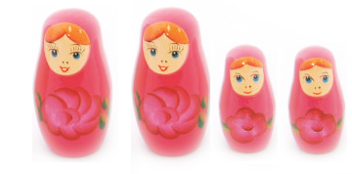
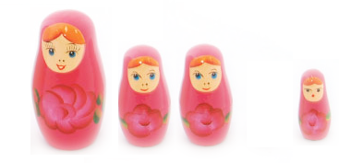
Go with the Winners: Finding solutions to the multimodal problem
Clone most probable states
Kill off least probable states
Recalculate probabilities using biased random walk
http://www.toyemporium.com.au/shop/medium/WT3017R%20Russian%20Doll%20Red.jpg
Aldous, Vazirani (1994) “Go with the winners” Proc. 35th IEEE Sympos. on Foundations of CS
Grassberger, Nadler (2000) “Go with the winners”
Notes:
Unlike GA, there is no recombination to get new solutions.

