Slide 1
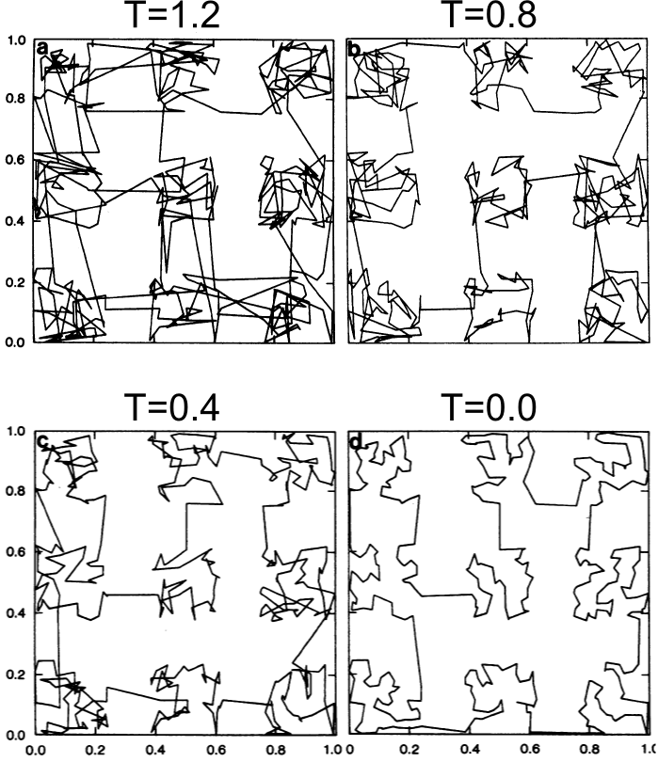

Simulated Annealing: Controlled Cooling
"Optimization by Simulated Annealing" S. Kirkpatrick, C. D. Gelatt, Jr., and M. P. Vecchi, Science 13 May 1983: 220 (4598), 671-680.

