Slide 1
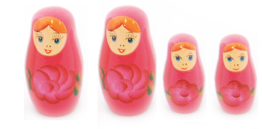
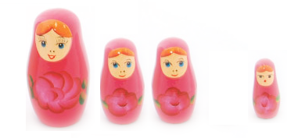
Go with the Winners:
Clone most probable state
Kill off low probable states
Recalculate probabilities w/ SA
http://www.toyemporium.com.au/shop/medium/WT3017R%20Russian%20Doll%20Red.jpg
Aldous, Vazirani (1994) “Go with the winners” Proc. 35th IEEE Sympos. on Foundations of CS
Grassberger, Nadler (2000) “Go with the winners”
Notes:
Unlike GA, there is no recombination to get new solutions.

