Slide 1
Travelling Salesman Problem: Convergence Properties of Optimization Algorithms
Group 2
Zachary Estrada
Chandini Jain
Jonathan Lai

Slide 2
Introduction
B
F
A
C
E
D
Travelling Salesman Problem
Surface Reconstruction
Marcus Peinado and Thomas Lengauer. `go with the winners' generators with applications to molecular modeling. RANDOM, pages 135{149, 1997.

Slide 3
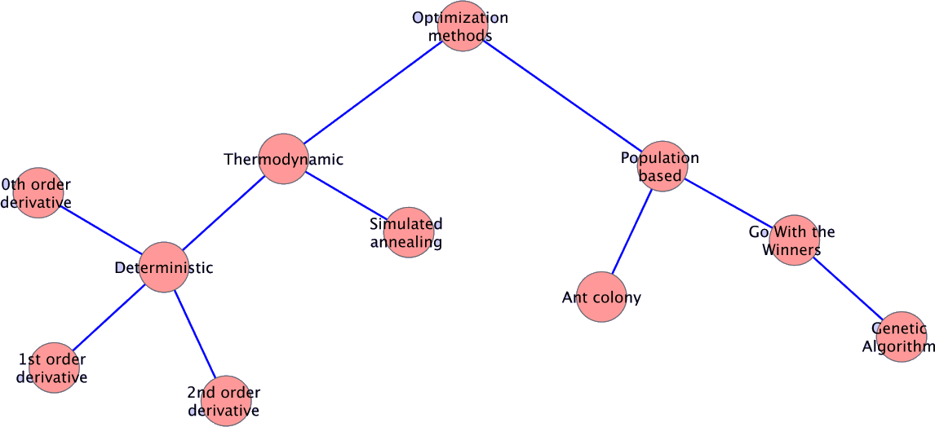
Hierarchy of Optimization Methods

Slide 4
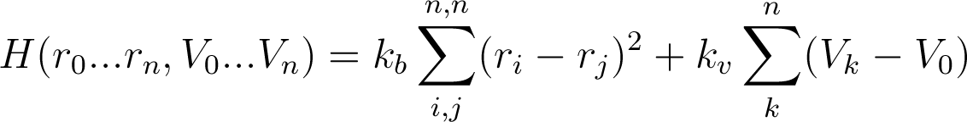
Hamiltonian Description
ri is the position of beadi
Vk is the number of vertices for beadk
V0 is the actual number of vertices beadk should make.
Kb = 1, kv = 1024 are force constants

Slide 5
Hierarchy of Optimization Methods

Slide 6
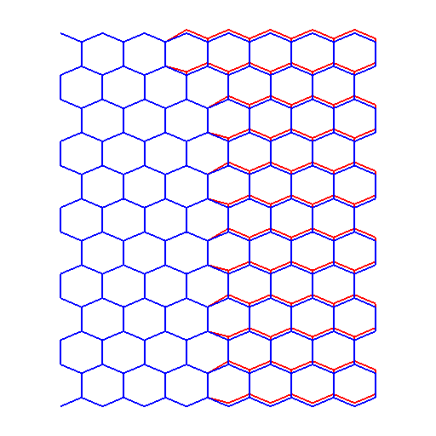
Test Systems

Slide 7
Code Implementation
Java – Heavylifting
Software Java 1.6
Python – Analysis
Tcl – Analysis

Slide 8
Simulated Annealing
Couple of Slides

Slide 9
Ant Colony
Couple of Slides

Slide 10
Genetic Algorithms: Survival of the Fittest
Generate an initial random population
1 | 1 | 0 | 1 | 1
1 | 0 | 0 | 0 | 1
0 | 1 | 0 | 0 | 1
0 | 1 | 1 | 1 | 0
Evaluate fitness of individuals
Select parents for crossover based on fitness
Introduce children into the population and replace individuals with least fitness
1 | 1 | 0 | 1 | 1
1 | 0 | 0 | 0 | 1
Perform crossover to produce children
1 | 1 | 0 | 0 | 1
1 | 0 | 0 | 1 | 1
1 | 0 | 1 | 1 | 1
Mutate randomly selected children
“A genetic algorithm tutorial”, Darrell Whitley , Statistics and Computing, Volume 4, Number 2, 65-85, DOI: 10.1007/BF00175354

Slide 11
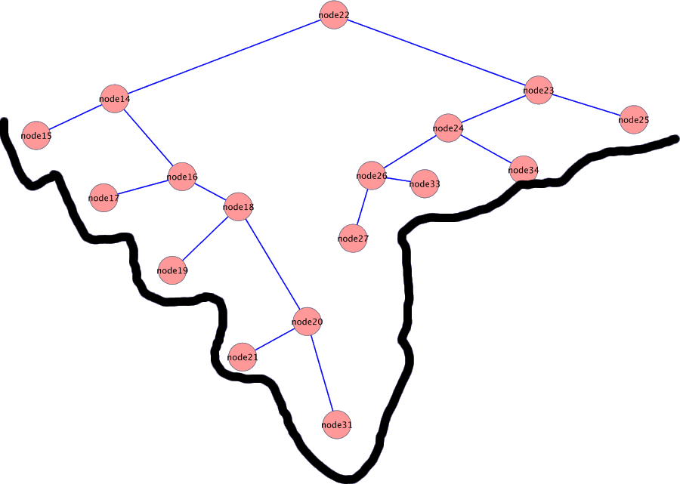
Go With The Winners
Couple of Slides

Slide 12
Simulated Annealing Reconstruction
Hexagonal lattice
Sheared hexagonal lattice

Slide 13
Comparison
Runtime/Number of iterations
Avg Final Energy
Standard Deviation

Slide 14
Conclusion

