Slide 1
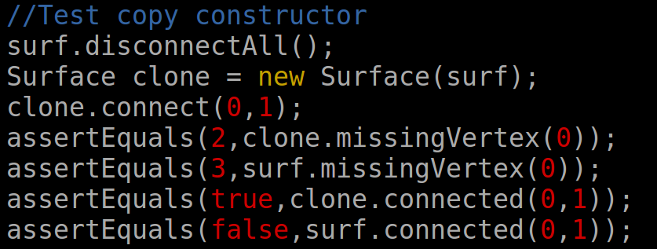
Code Implementation
Java – Heavylifting
Cross-Platform
Abstraction
TDD - JUnit
Threads
Python – Analysis
Tcl (VMD) – Analysis
Awk – Input File

Slide 2
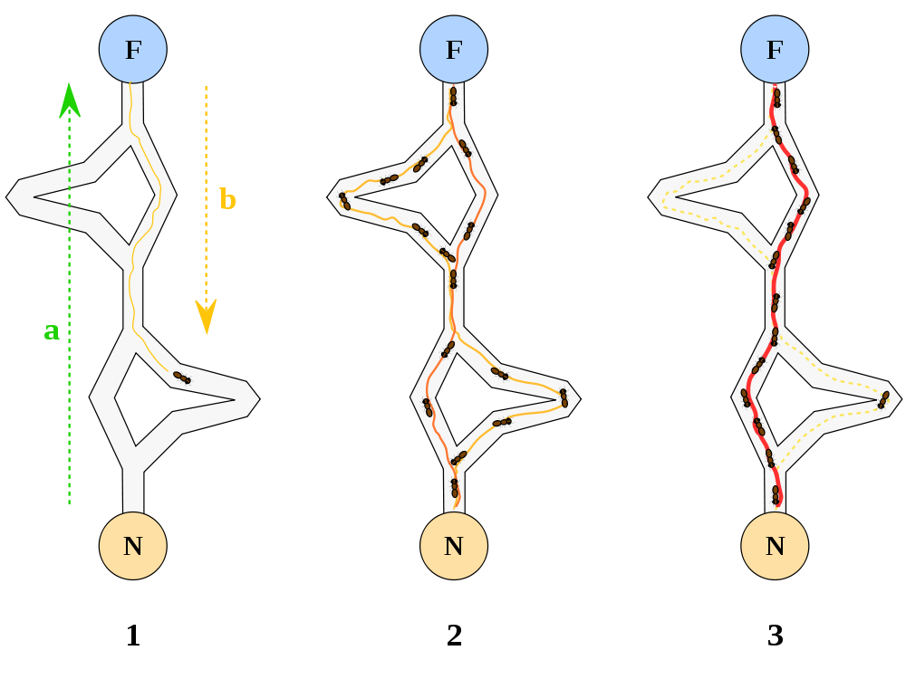
Ant Colony
http://en.wikipedia.org/wiki/File:Aco_branches.svg

Slide 3
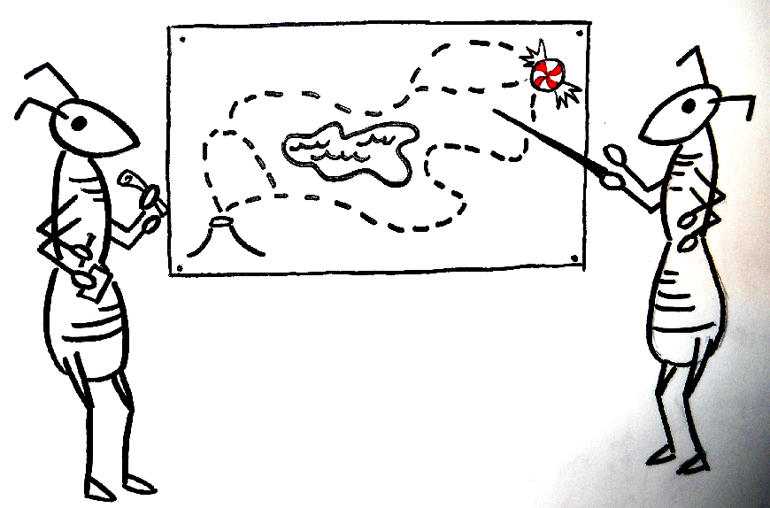
Ant Colony - Implementation
Pheromone Matrix
Each Ant Constructs a Solution
Update Pheromone Matrix

Slide 4
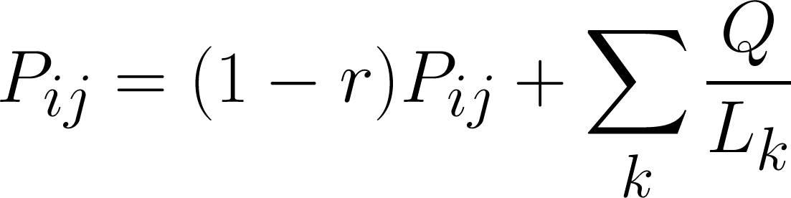
Ant Colony – Implementation (cont.)
Update pheromones based on energy

Slide 5
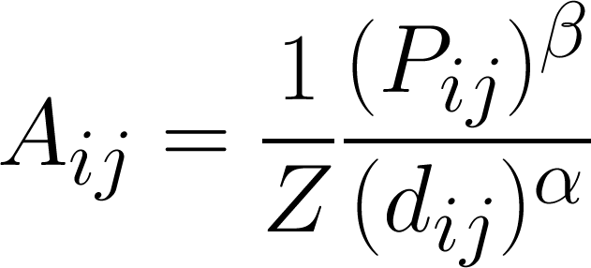
Ant Colony – Implementation (cont.)
Update pheromones based on energy:
Accept moves during walk with probability:

Slide 6
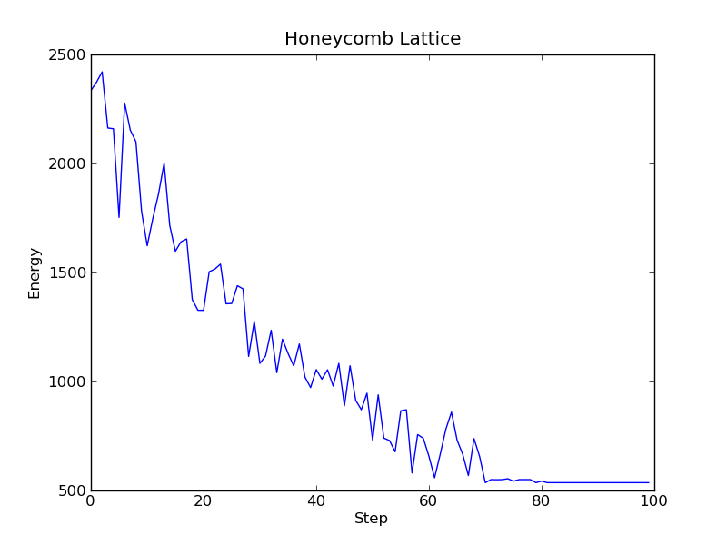
Ant Colony - Discussion

Slide 7
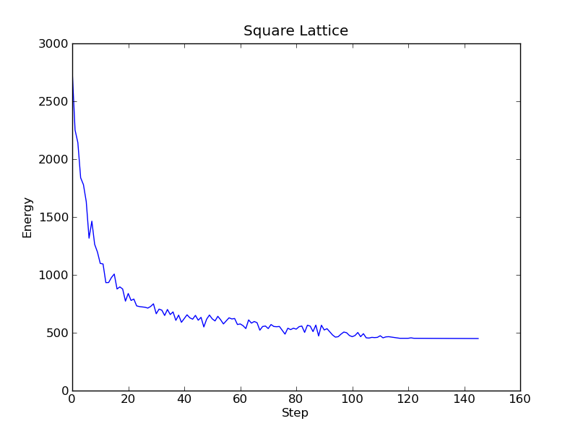
Ant Colony - Discussion

Slide 8
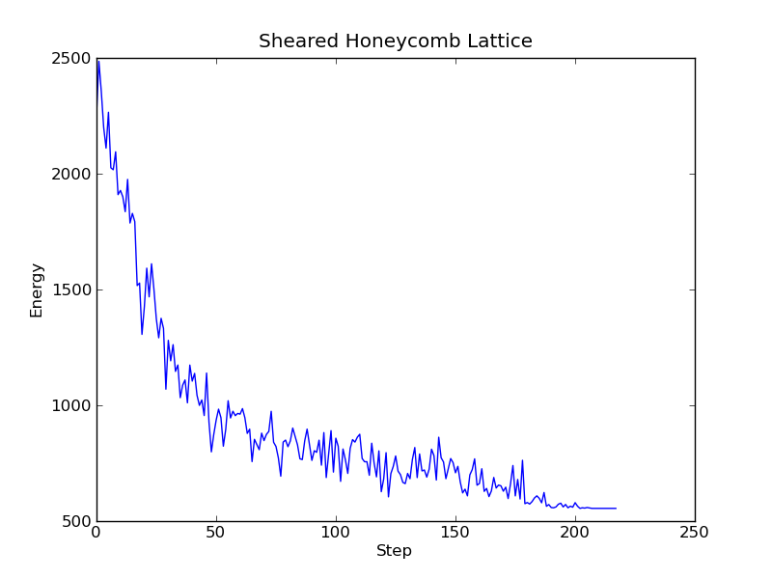
Ant Colony - Discussion

Slide 9
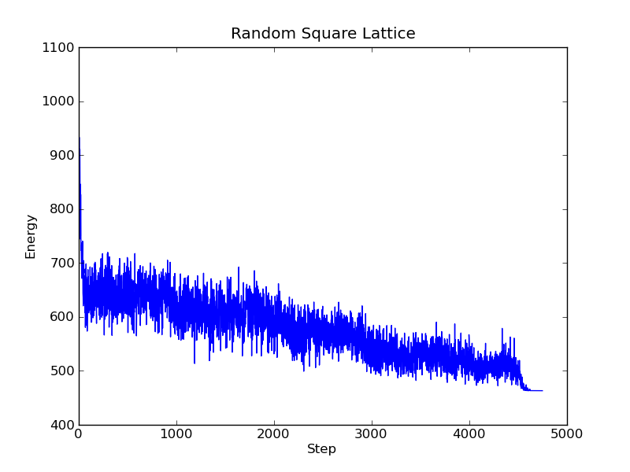
Ant Colony - Discussion

