Slide 1
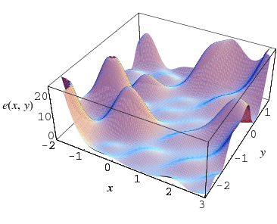
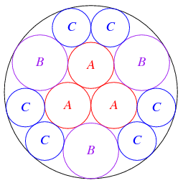
Analysis
http://mathworld.wolfram.com/GlobalOptimization.html
http://mathworld.wolfram.com/CirclePacking.html
Notes:
Plot3D[Abs[x*y*Cos[10*x]*Sin[10*y]]/10-15*Exp[-Abs[Sqrt[x*x+y*y]]]-7*Exp[-Abs[Sqrt[(x-3)^2+(y-3)^2]]]-7*Exp[-Abs[Sqrt[(x+3)^2+(y+3)^2]]]-7*Exp[-Abs[Sqrt[(x+3)^2+(y-3)^2]]]-7*Exp[-Abs[Sqrt[(x-3)^2+(y +3 )^2]]],{x,-5,5},{y,-5,5},PlotRange->All]

