Slide 1
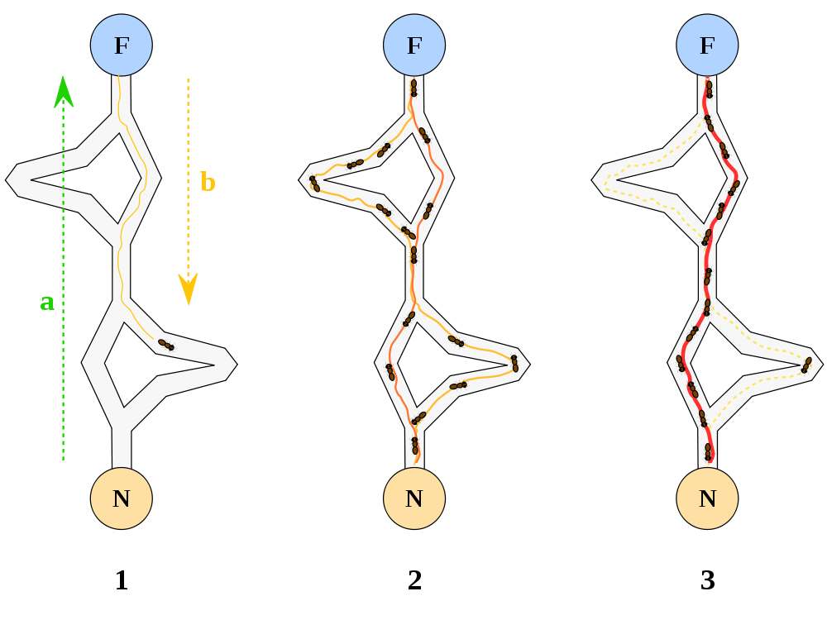
Ant Colony Optimization: Follow the Pheromones
http://en.wikipedia.org/wiki/File:Aco_branches.svg

