Slide 1
Optimization
Group 2:
Zak Estrada, Chandini Jain, Jonathan Lai

Slide 2
Problem

Slide 3
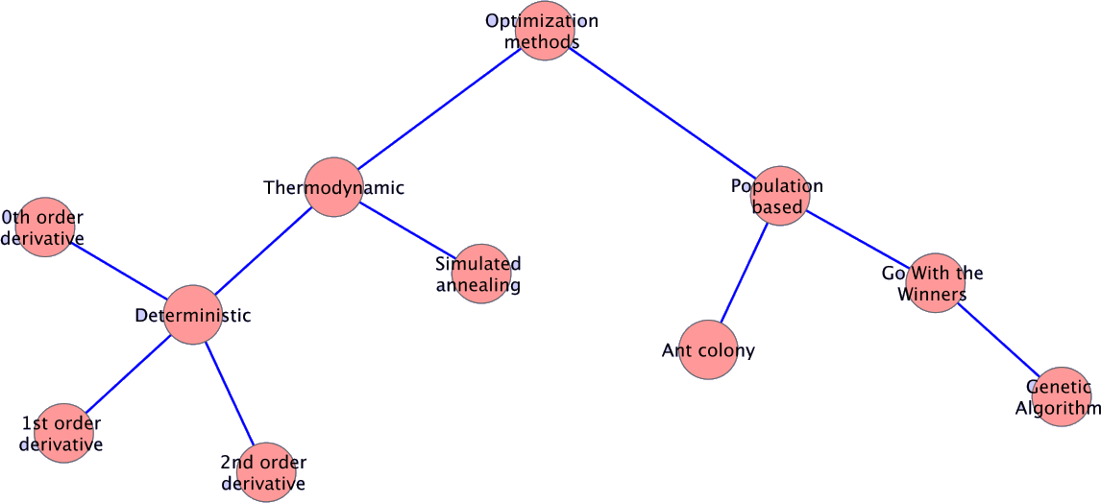
Hierarchy of optimization methods

Slide 4
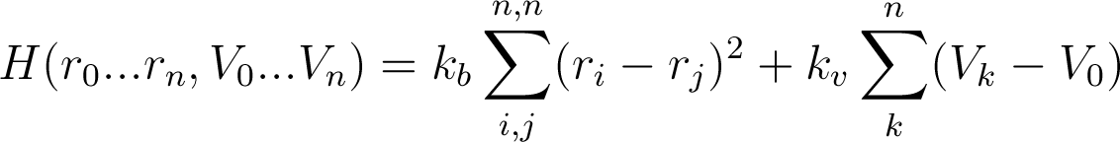
Our Hamiltonian
r_{i} is the position of bead_{i}
V_{k} is the number of vertices for bead_{k}
V₀ is the actual number of vertices bead_{k} should make.
K_{b} = 1, k_{v} = 1024 are force constants

Slide 5
Our systems (Replace with pictures)
HCP
Sheared HCP
HCP with bottom half shifted by δx +0.2
HCP with lower triangular half shifted by δx +0.2 δy +0.2
Square lattice
Random lattice

Slide 6
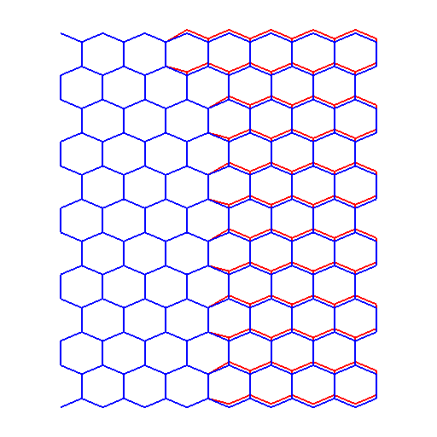
Hexagonal lattice vs sheared hexagonal lattice

Slide 7
Code implementation
Java – Heavylifting
Software Java 1.6
Python – Analysis
Tcl – Analysis

Slide 8
Simulated Annealing
A couple of slides explaining the method

Slide 9
Ant Colony
A couple of slides explaining the method

Slide 10
Genetic Algorithm
A couple of slides explaining the method

Slide 11
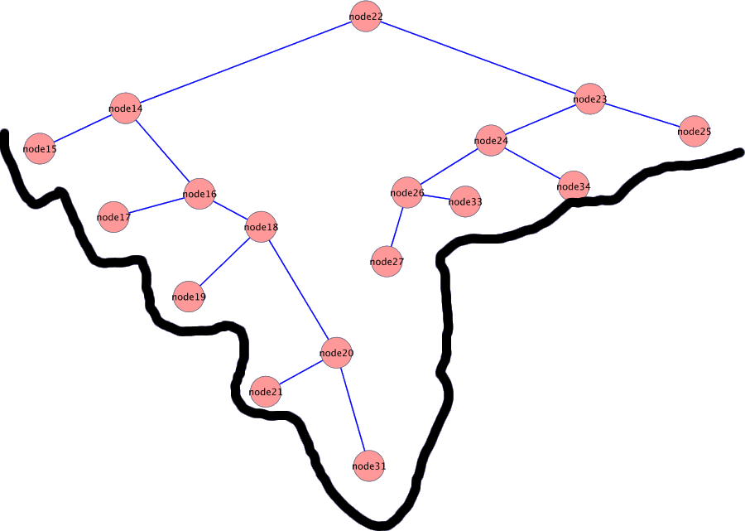
Go With The Winners

Slide 12
Simulated Annealing Reconstruction
Hexagonal lattice
Sheared hexagonal lattice

Slide 13
Comparison
Runtime/Number of iterations
Avg Final Energy
Standard Deviation

Slide 14
Different solutions

Slide 15
Conclusion

