Slide 1


Slide 2
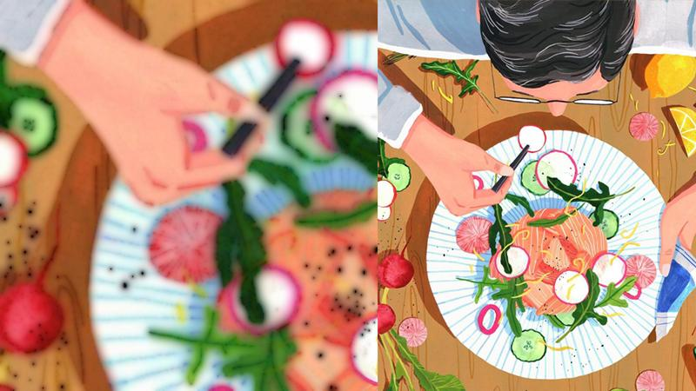
About project

Slide 3

Problem solved
makes it easier for people with specific food preferences to find the right product
you do not have to leave the house to buy the goods
a user-friendly interface will make the purchase process much more enjoyable

Slide 4

Type of client:
-Anonymous -Admin -Client

Slide 5


Slide 6
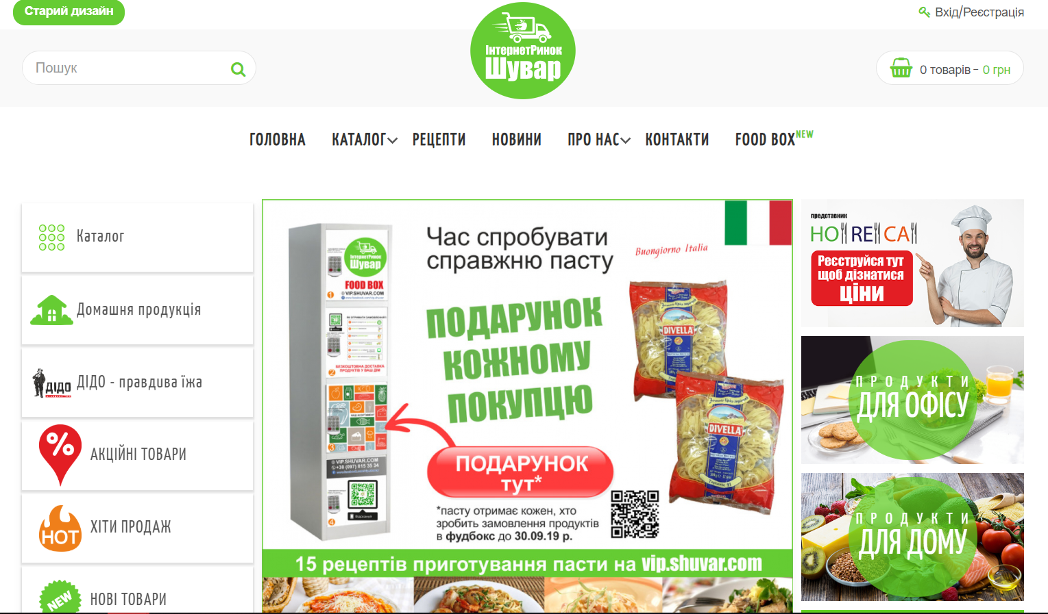
Подібні сайти

Slide 7
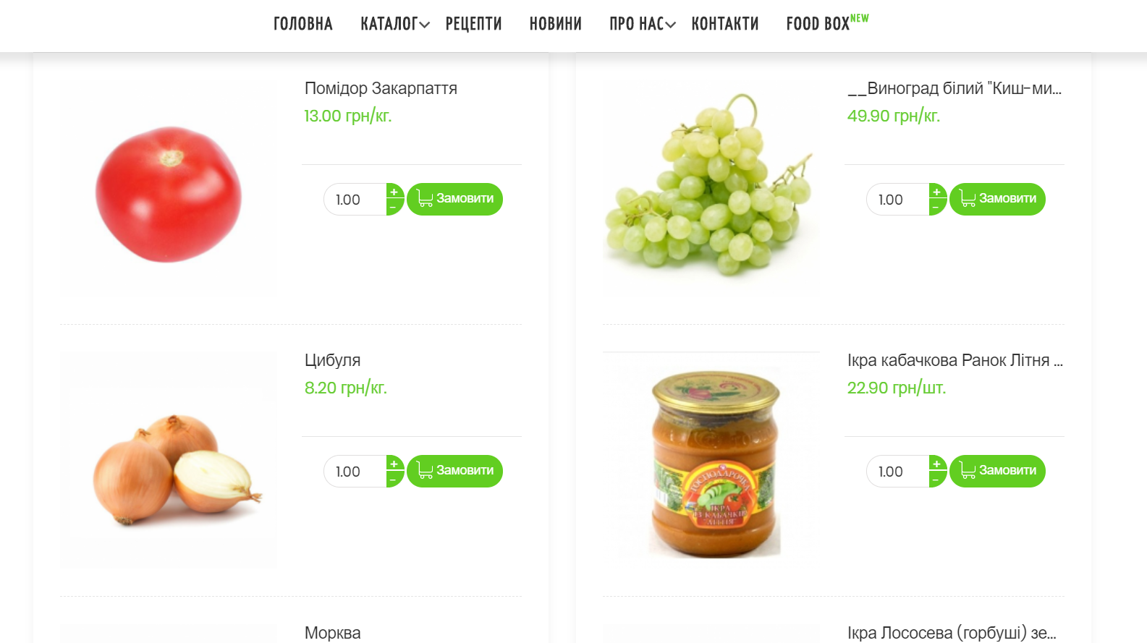

Slide 8
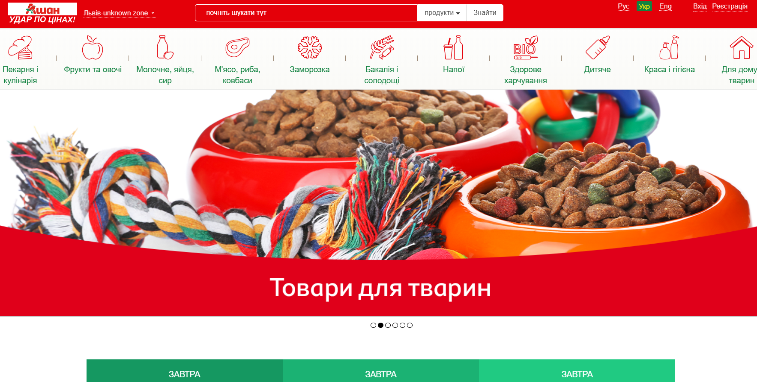

Slide 9
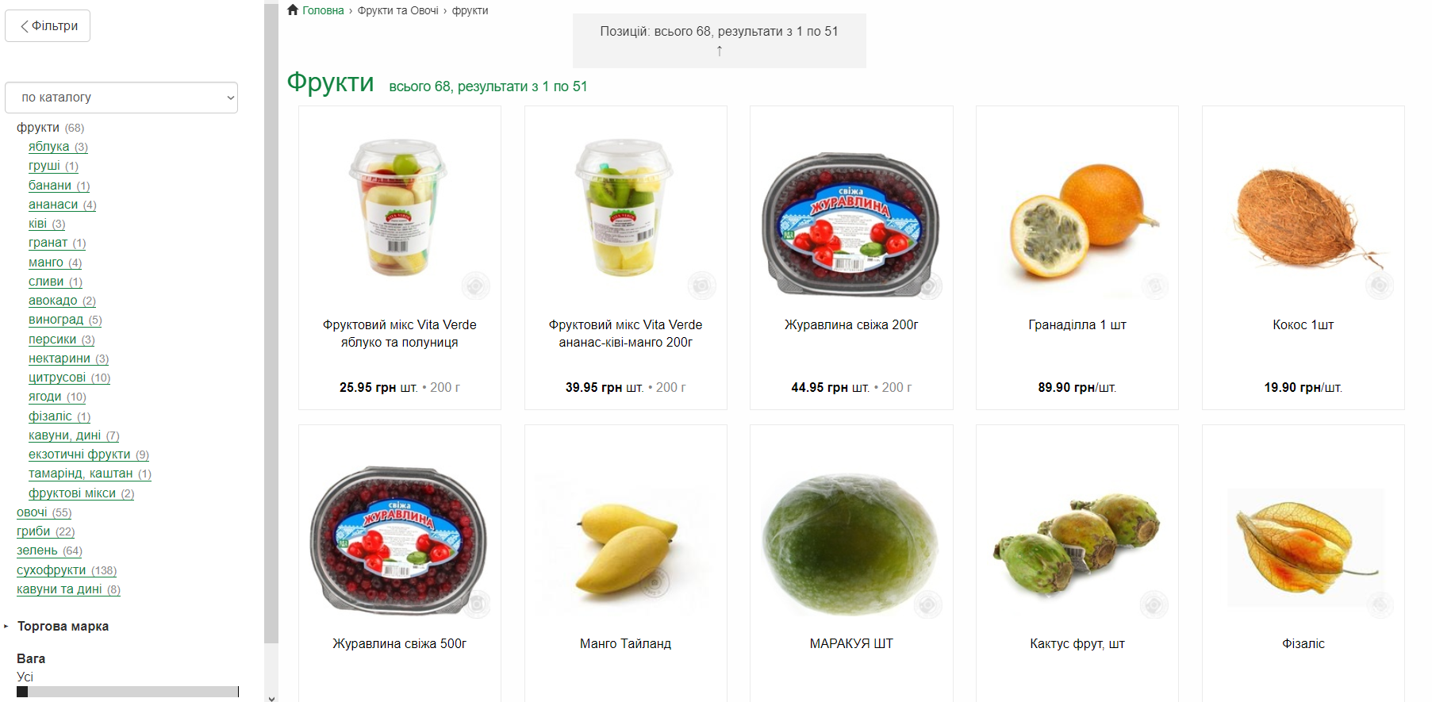

Slide 10

Thank you for your attention!

