Slide 1
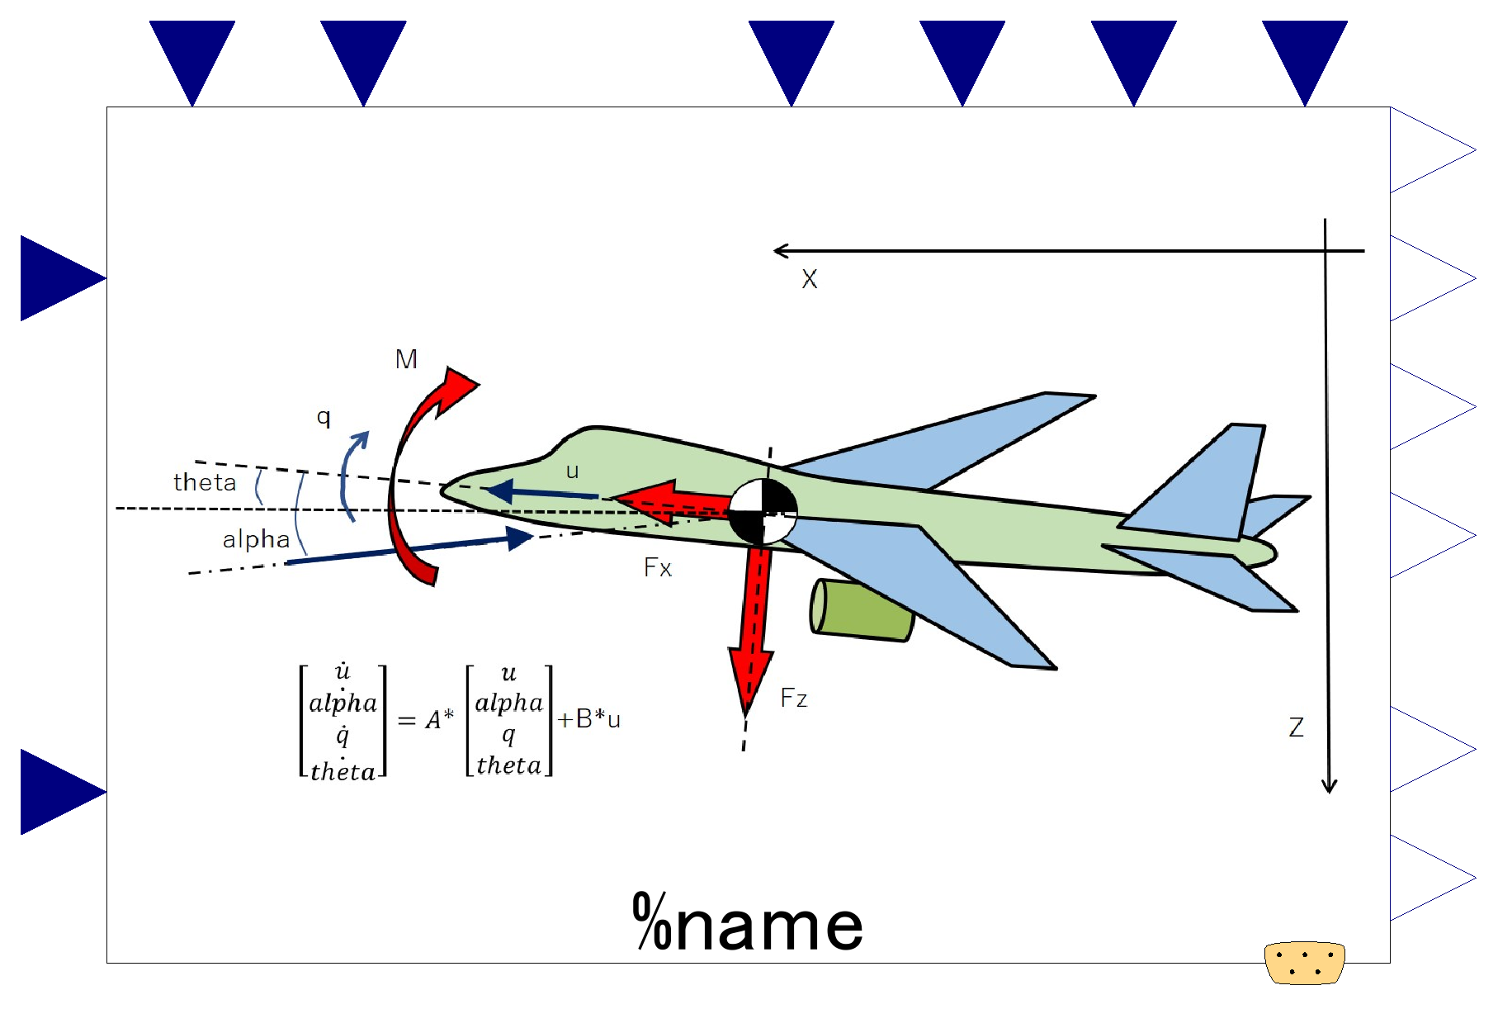

Slide 2
Aircraft characteristics; input
*optional, valid only if use_u_***==true
-. Representative (wing) area
-. Representative length (mean aero. chord)
-. Aircraft mass
-. Moment of inertia about y-axis
Steady state flight condition; input
*optional, valid only if use_u_***==true
-. Flight velocity
-. Dynamic pressure
Dynamic states; output.
-. Velocity along body-x-axis
-. Angle of attack
-. Pitch angular velocity
-. Pitch angle.
Change in elevator angle; input
Change in Thrust; input
Translational Accelerations; output
-. Acceleration in direction of body-z-axis.
-. Acceleration in direction of body-x-axis.
Expandable connector prepared for communication with internal variables which cannot be accessed by other ports,
input&output (use “connect” operator)

Slide 3
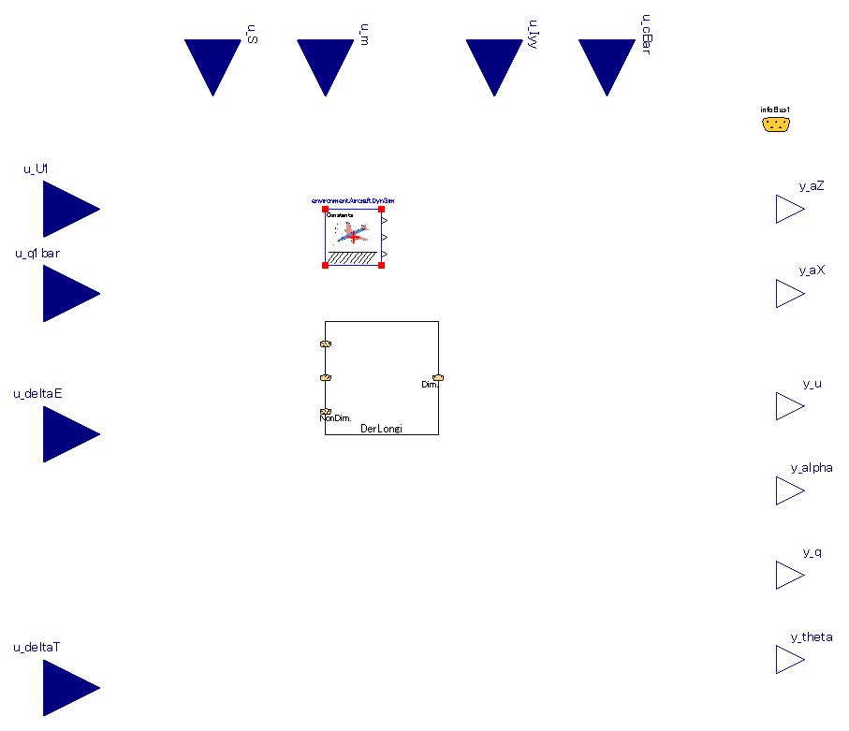
Inner-outer component necessary for simulation.
Same component (with same instance name) must be instantiated outside this component.
Refer to “system” in fluid library of MSL.
Component of calculation between non-dimensional derivatives <-> dimensional derivatives.
This internal component is discrete and calculation is executed only at the initial of simulation.

Slide 4
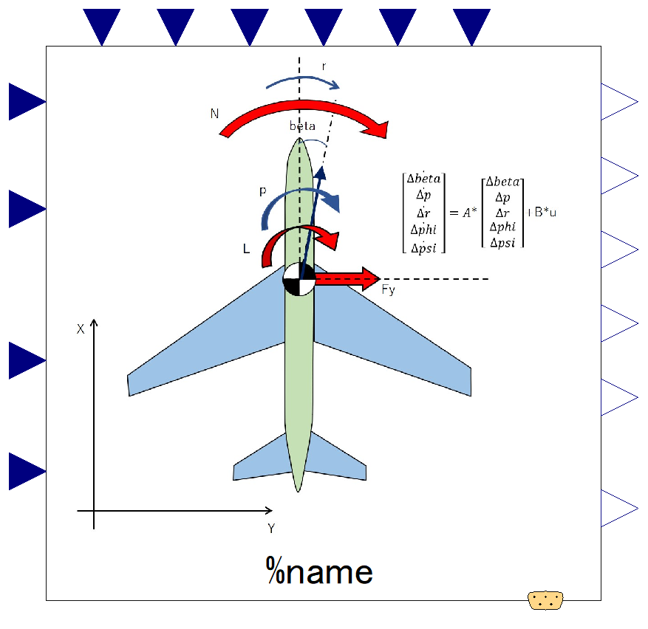

Slide 5
Aircraft characteristics; input
*optional, valid only if use_u_***==true
-. Representative (wing) area
-. Aircraft mass
-. Moment of inertia; Ixx, Izz, Ixz
-. Representative length (wing span)
Steady state flight condition; input
*optional, valid only if use_u_***==true
-. Flight velocity
-. Dynamic pressure
Dynamic states; output.
-. Side slip angle.
-. Roll angular velocity.
-. Yaw angular velocity.
-. Roll (bank) angle.
-. Yaw angle (heading).
Change in aileron angle; input
Change in rudder angle; input
Translational Accelerations; output
-. Acceleration in direction of body-y-axis.
Expandable connector prepared for communication with internal variables which cannot be accessed by other connectors,
input&output (use “connect” operator)

Slide 6
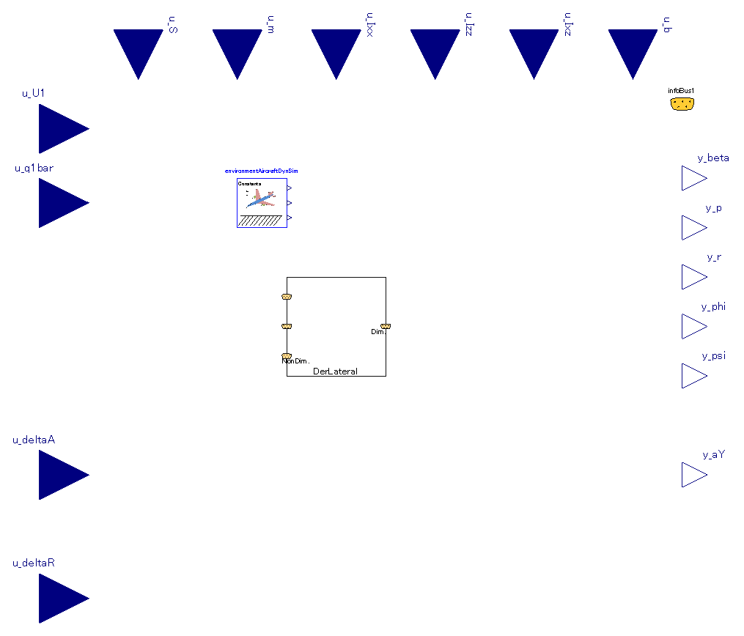
Inner-outer component necessary for simulation.
Same component (with same instance name) must be instantiated outside this component.
Refer to “system” in fluid library of MSL.
Component of calculation between non-dimensional derivatives <-> dimensional derivatives.
This internal component is discrete and calculation is executed only at the initial of simulation.

Slide 7
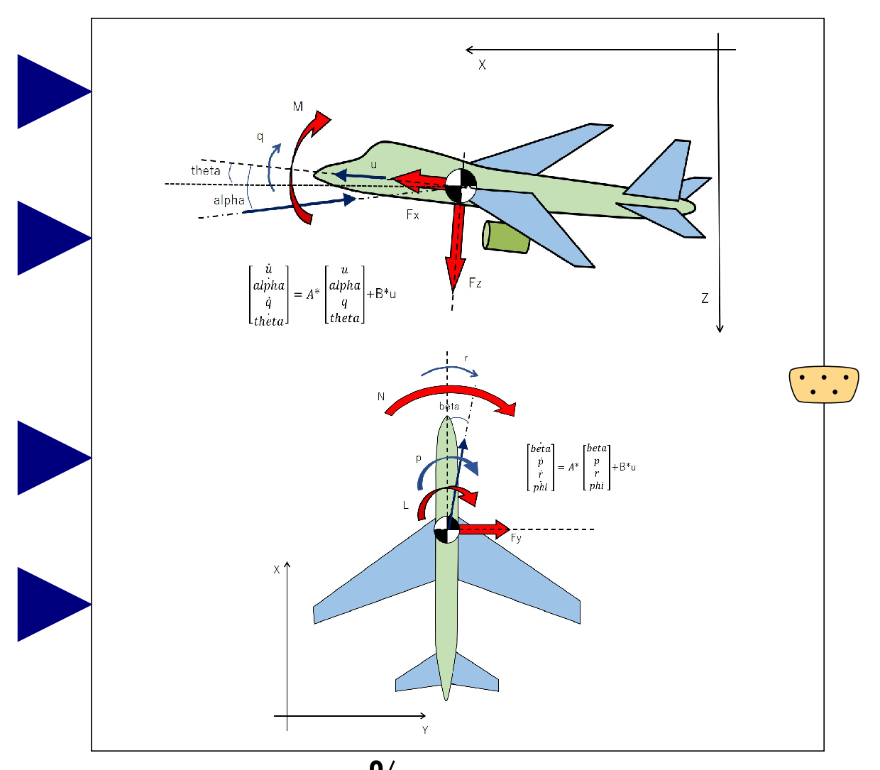

Slide 8
Change in elevator angle;
input (use “connect” operator),
Change in thrust;
input (use “connect” operator),
Expandable connector prepared for communication with internal variables which cannot be accessed by other ports,
input&output (use “connect” operator)
Change in aileron angle;
input (use “connect” operator),
Change in rudder angle;
input (use “connect” operator),

Slide 9
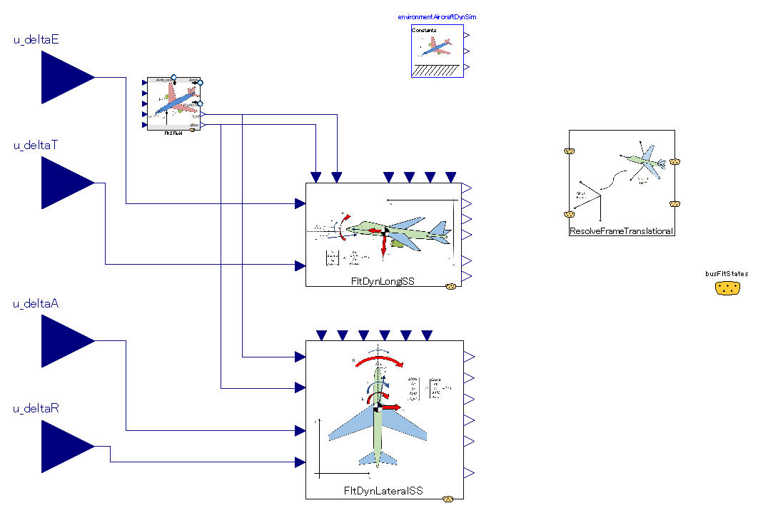
nner-outer component necessary for simulation.
Same component (with same instance name) must be instantiated outside this component.
Refer to “system” in fluid library of MSL.
nner-outer component necessary for simulation.
Same component (with same instance name) must be instantiated outside this component.
Refer to “system” in fluid library of MSL.
Calculates airspeed and dynamic pressure from flight condition.
Resolve-frame calculation of translational motion.
Global position is calculated from attitude angles and body-frame velocities.
Longitudinal dynamics. Linear-Time-Invariant model.
Lateral-directional dynamics. Linear-Time-Invariant model.

