Slide 1
Cl
Cd
AoA

Slide 2
Pamb
Tamb
MN
Alt
AoA

Slide 3
L
D
AoA

Slide 5
CL
CD
Cl
AoA
Cd
AoA

Slide 7
D

Slide 8
D

Slide 9
M
Fy
Fx
L
Fz
N

Slide 10
D

Slide 12
Fy
Fx
Fz

Slide 13
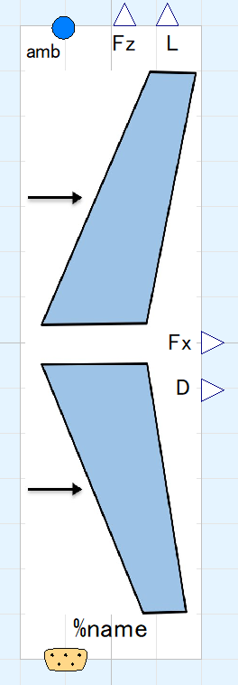
State of ambient air, input&output (use “connect” operator)
Sdes: wing area
rambdaDes: taper ratio
(no effect on calculatoin)
Aerodynamic forces, output
sweepDes: sweep angle
effOsDes: Oswald’s efficiency factor, mainly determined by taper ratio. Directly given by user.
ChRootDes: chord length of wing root
ARdes: aspect ratio
States of flight, input&output (use “connect” operator)

Slide 14
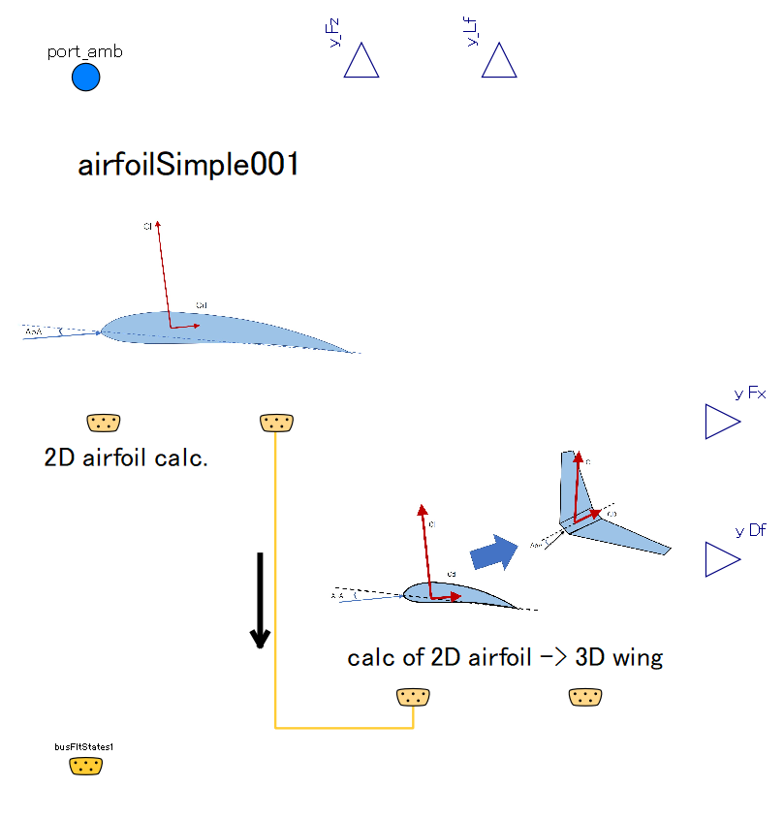
sub-component:
calculates 2D Cl and Cd with 2d airfoil characteristics
Aerodynamic forces are calculated in this component, rather than by sub-components.
sub-component:
calculates 3D Cl and Cd with 2D Cl, Cd, and wing planform
connection:causal,
pass 2D Cl and Cd

Slide 15
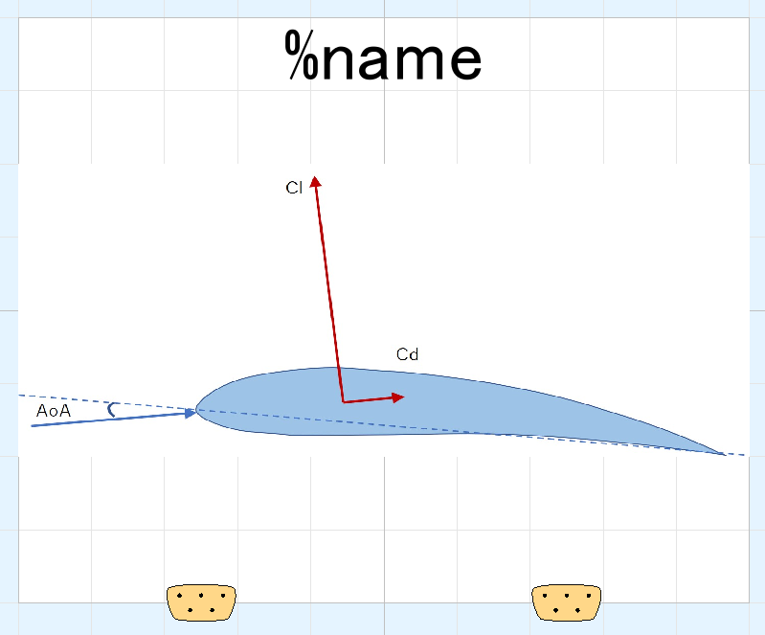
2d aerodynamic coefficients, outut (use “connect” operator)
Angle of attack; input (use “connect” operator)

Slide 16
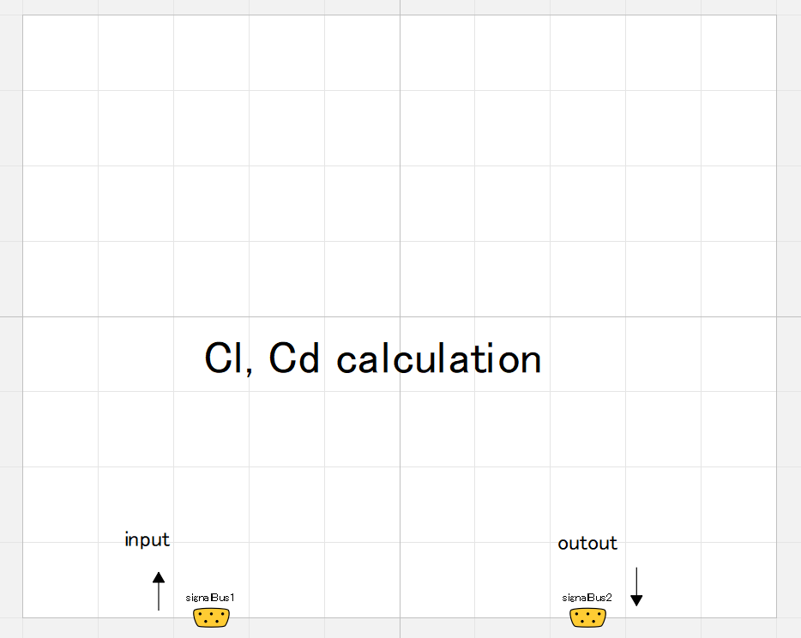
2d lift and drag coefficients are calculated in this component.
Cl [nond]
ClmaxDes: maximum or stall Cl
alpha4Cl0des: angle of attack where Cl is zero
angle of attack [deg]
alpha4ClmaxDes: angle of attack which causes maximum Cl
alpha4ClminDes: angle of attack which causes minimum or negative-stall Cl

Slide 17
Cd [nond]
Power and coefficient of Cdp curve can be differ in out of stall region.
(by user setting)
alpha4ClminDes: angle of attack which causes minimum or negative-stall Cl
alpha4ClmaxDes: angle of attack which causes maximum Cl
angle of attack [deg]
Cdf: Cd by friction. Constant value in this component.
alpha_CdpMinDes: angle of attack where Cdp is minimum (zero)

Slide 18
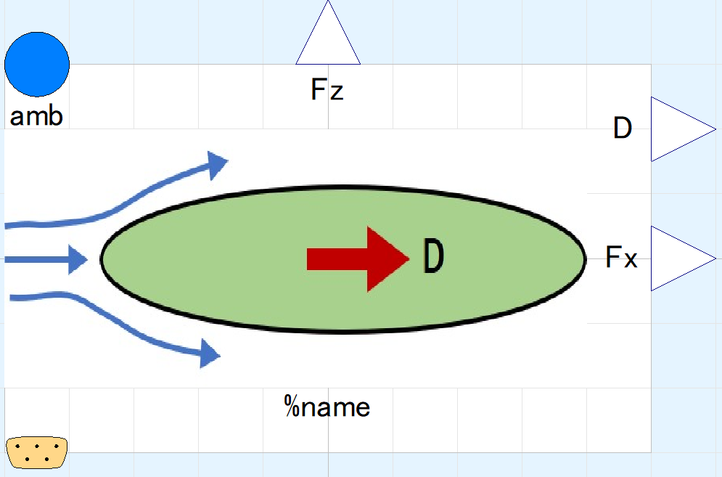
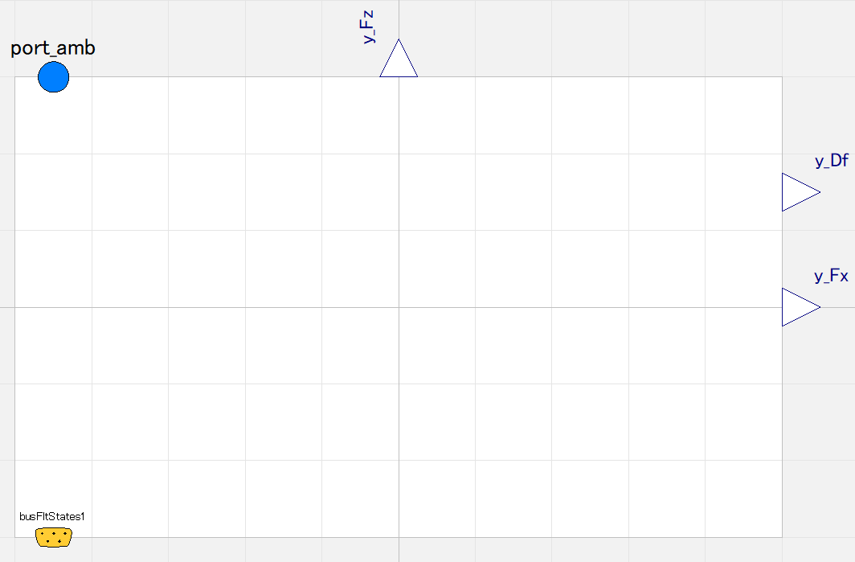
Aerodynamic forces are calculated.

Slide 19
State of ambient air, input&output (use “connect” operator)
Aerodynamic forces, output
States of flight, input&output (use “connect” operator)

Slide 20
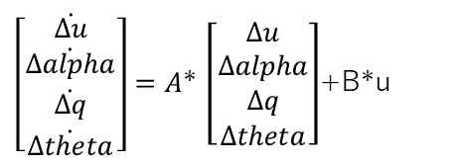
X
M
q
theta
u
alpha
Fx
$\left[\begin{matrix}\dot{Δu} \\ \dot{Δalpha} \\ \dot{Δq} \\ \dot{Δtheta}\end{matrix}\right]=A$* $\left[\begin{matrix}Δu \\ Δalpha \\ Δq \\ Δtheta\end{matrix}\right]$+B*u
Fz
Z

Slide 21
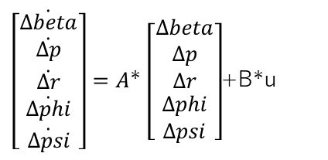
r
N
beta
$\left[\begin{matrix}\dot{Δbeta} \\ \dot{Δp} \\ \dot{Δr} \\ \begin{aligned}\dot{Δphi} \\ \dot{Δpsi}\end{aligned}\end{matrix}\right]=A$* $\left[\begin{matrix}Δbeta \\ Δp \\ Δr \\ \begin{aligned}Δphi \\ Δpsi\end{aligned}\end{matrix}\right]$+B*u
p
L
Fy
X
Y

Slide 22
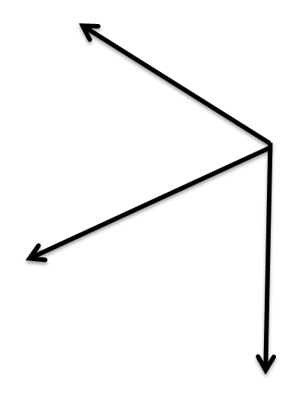
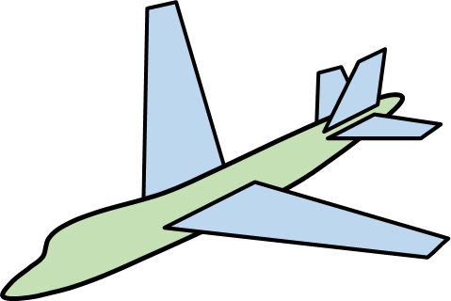
Aircraft
Frame
Global
Frame

Slide 23
Aircraft
Frame
Global
Frame

Slide 24
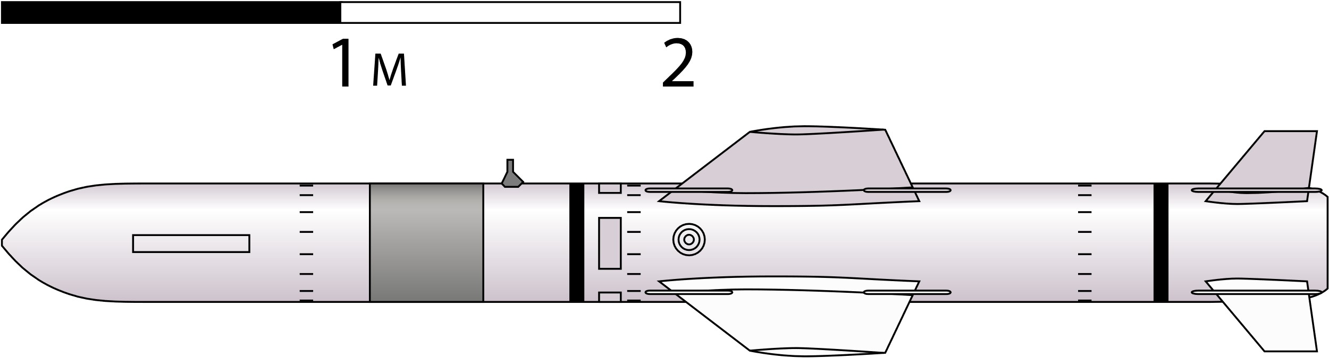
3.41 on fig.
8.46 on fig.
1 / 8.46 = 0.4030733 / 3.41
6.45 on fig.
*Figure on Wikimedia Commons
https://commons.wikimedia.org/wiki/File:Harpoon_missile_sketch.svg
1 / 8.46 = 0.7624113 / 6.45

