Slide 1
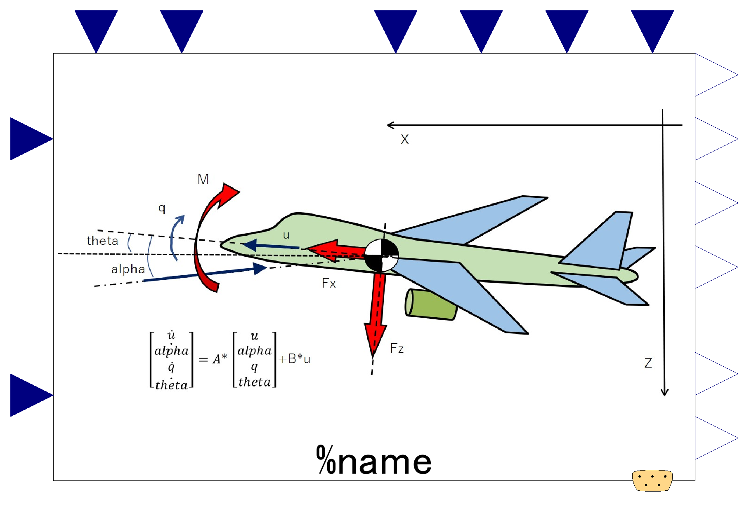

Slide 2
Aircraft characteristics; input
*optional, valid only if use_u_***==true
-. Representative (wing) area
-. Representative length (mean aero. chord)
-. Aircraft mass
-. Moment of inertia about y-axis
Steady state flight condition; input
*optional, valid only if use_u_***==true
-. Flight velocity
-. Dynamic pressure
Dynamic states; output.
-. Velocity along body-x-axis
-. Angle of attack
-. Pitch angular velocity
-. Pitch angle.
Change in elevator angle; input
Change in Thrust; input
Translational Accelerations; output
-. Acceleration in direction of body-z-axis.
-. Acceleration in direction of body-x-axis.
Expandable connector prepared for communication with internal variables which cannot be accessed by other ports,
input&output (use “connect” operator)

Slide 3
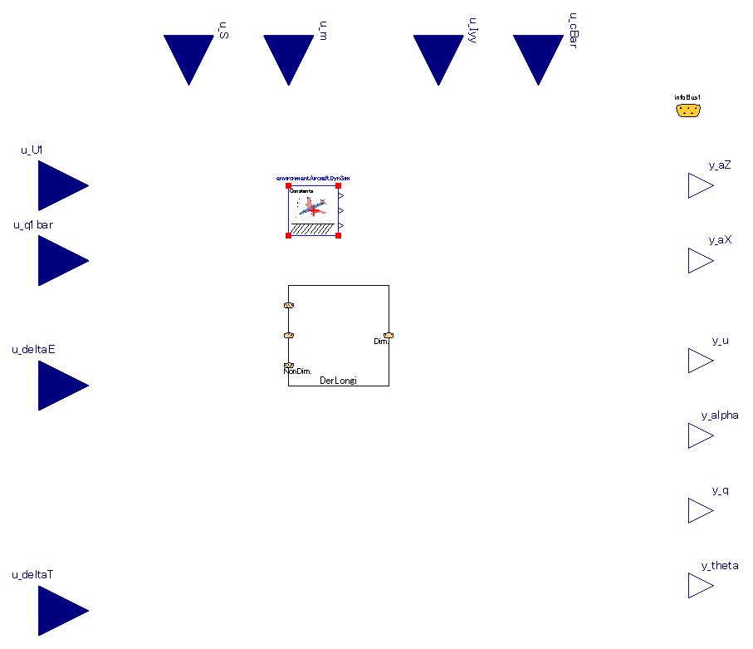
Inner-outer component necessary for simulation.
Same component (with same instance name) must be instantiated outside this component.
Refer to “system” in fluid library of MSL.
Component of calculation between non-dimensional derivatives <-> dimensional derivatives.
This internal component is discrete and calculation is executed only at the initial of simulation.

Slide 4
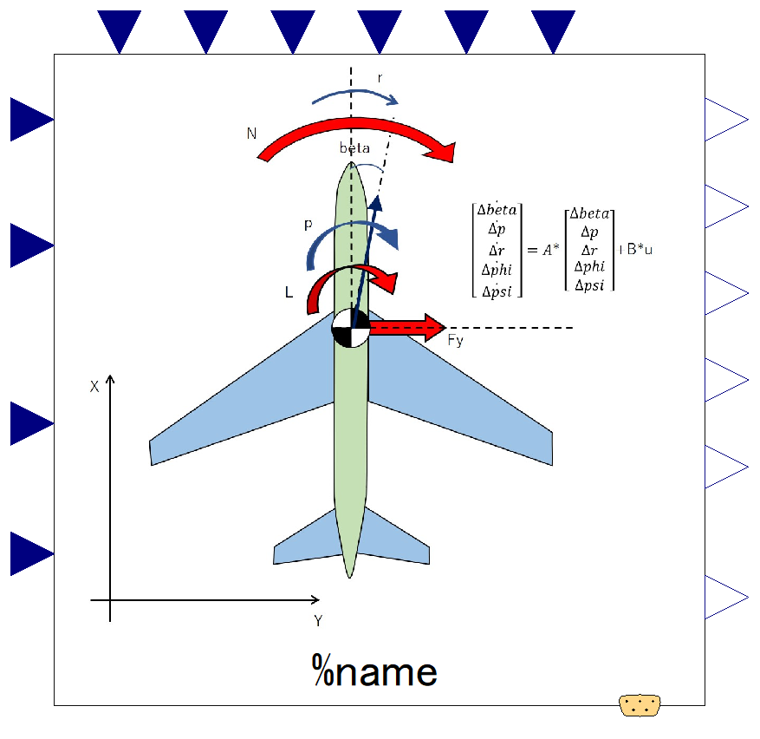

Slide 5
Aircraft characteristics; input
*optional, valid only if use_u_***==true
-. Representative (wing) area
-. Aircraft mass
-. Moment of inertia; Ixx, Izz, Ixz
-. Representative length (wing span)
Steady state flight condition; input
*optional, valid only if use_u_***==true
-. Flight velocity
-. Dynamic pressure
Dynamic states; output.
-. Side slip angle.
-. Roll angular velocity.
-. Yaw angular velocity.
-. Roll (bank) angle.
-. Yaw angle (heading).
Change in aileron angle; input
Change in rudder angle; input
Translational Accelerations; output
-. Acceleration in direction of body-y-axis.
Expandable connector prepared for communication with internal variables which cannot be accessed by other connectors,
input&output (use “connect” operator)

Slide 6
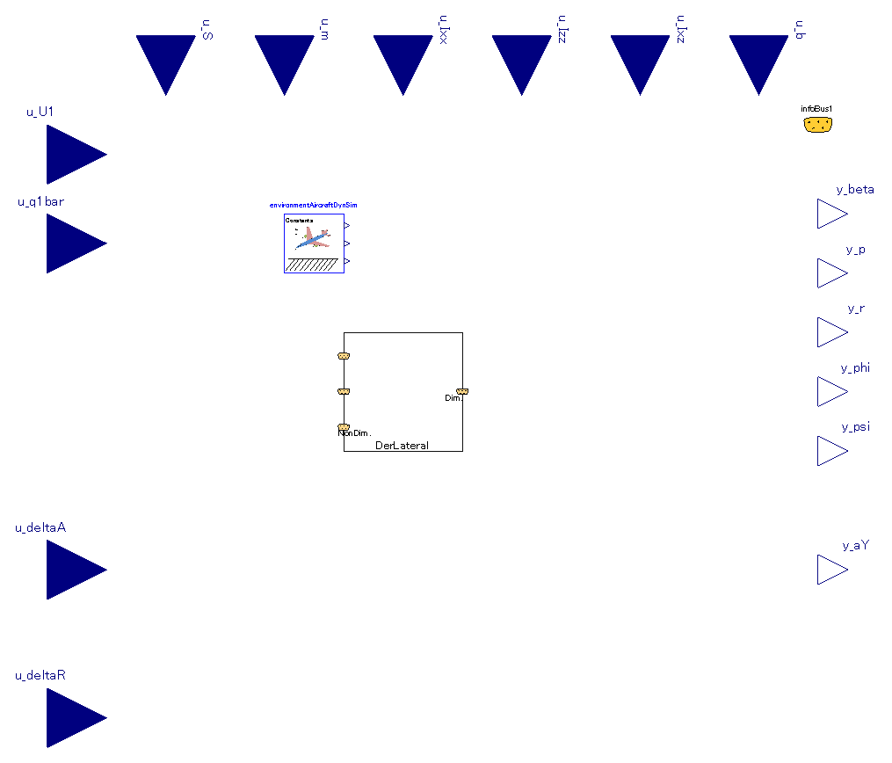
Inner-outer component necessary for simulation.
Same component (with same instance name) must be instantiated outside this component.
Refer to “system” in fluid library of MSL.
Component of calculation between non-dimensional derivatives <-> dimensional derivatives.
This internal component is discrete and calculation is executed only at the initial of simulation.

Slide 7
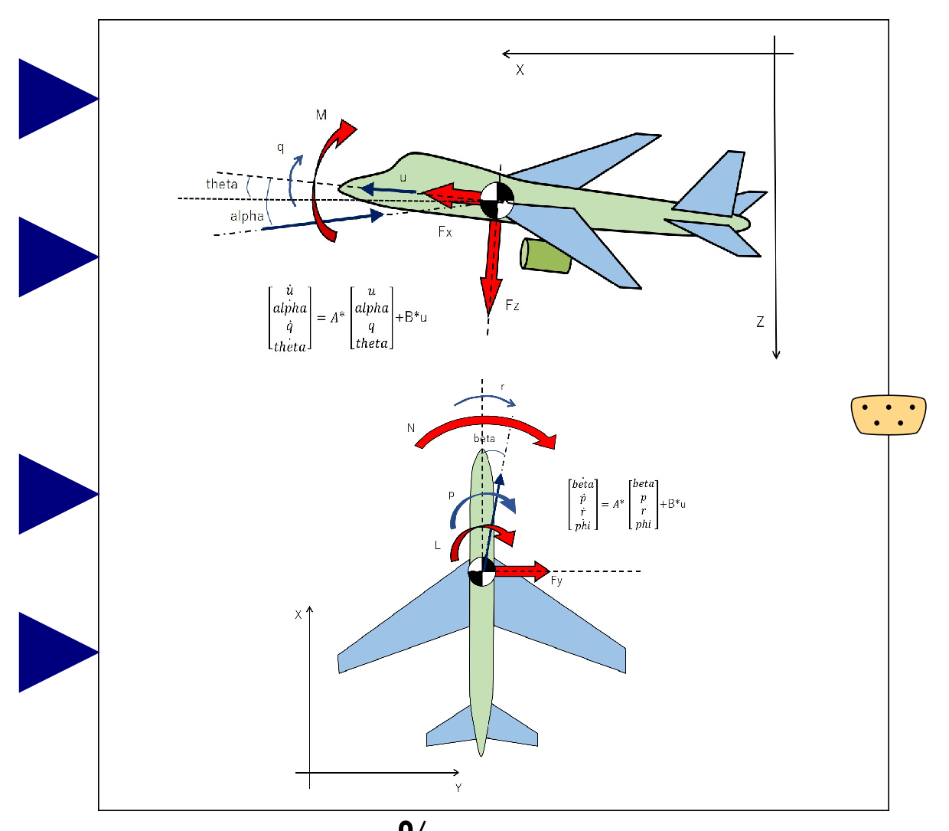

Slide 9
