Slide 1
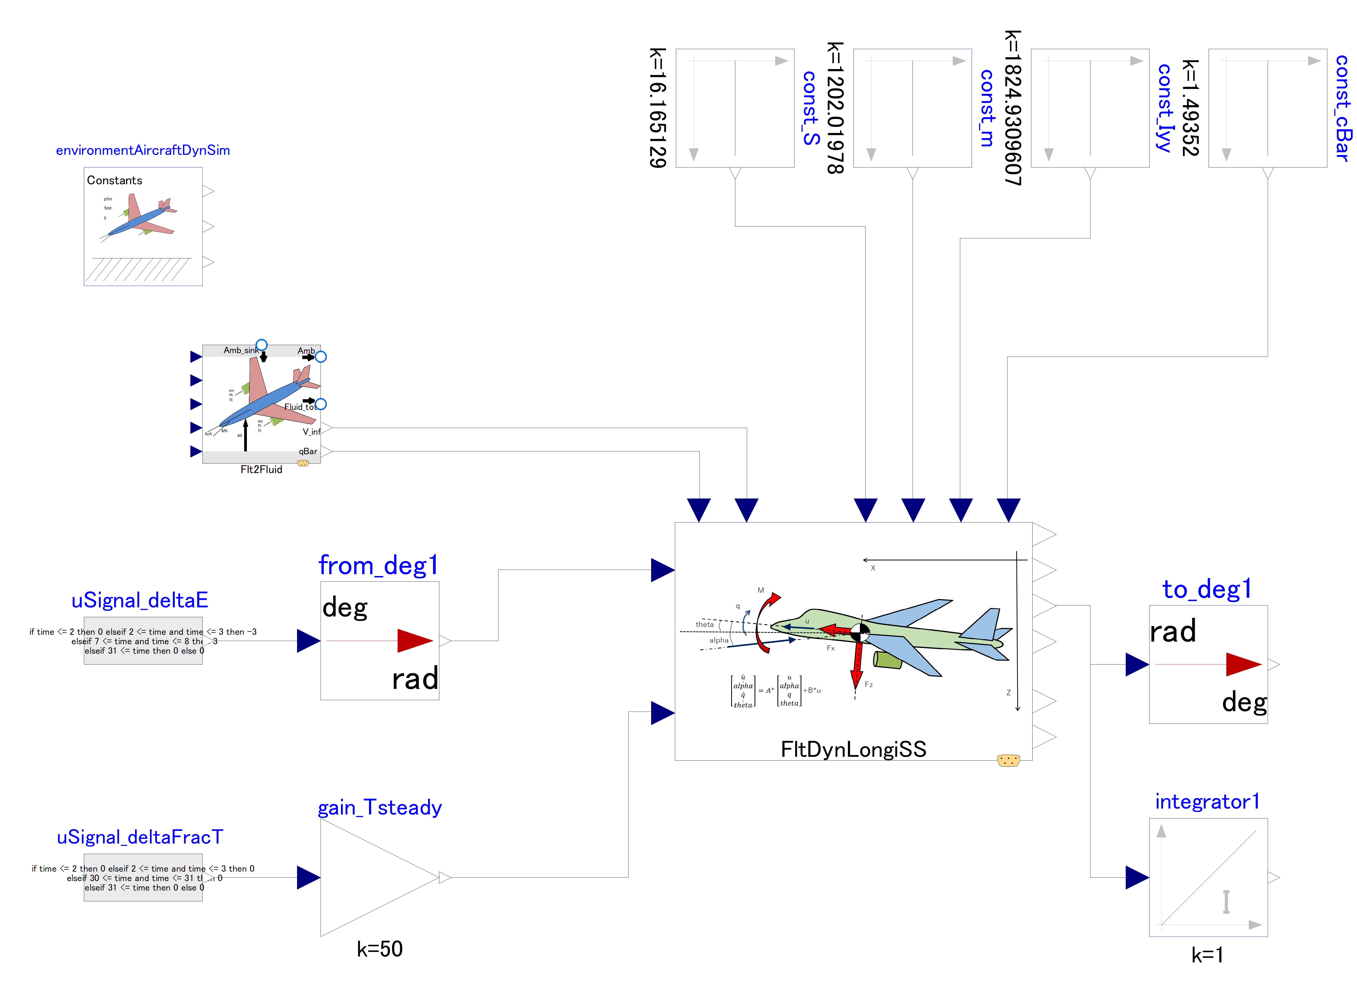

Slide 2
This outer component provides global constants, such as “g” value, to dynamics component
Variables (inputs) related to steady state (center of linearization) flight condition
Variables (inputs) related to aircraft properties.
Flight control inputs:
Change in elevator angle
Change in thrust

Slide 3
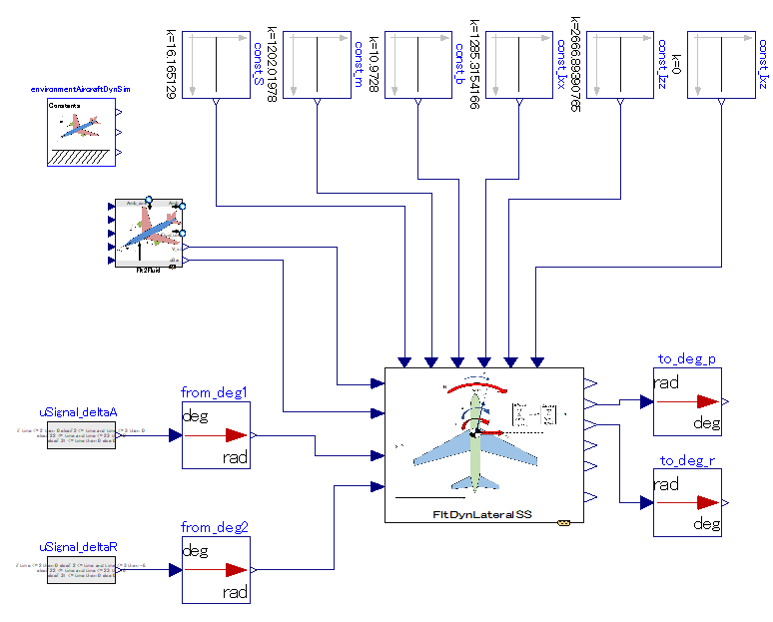

Slide 4
This outer component provides global constants, such as “g” value, to dynamics component
Variables (inputs) related to aircraft properties.
Variables (inputs) related to steady state (center of linearization) flight condition
Flight control inputs:
Change in elevator angle
Change in thrust

Slide 5
