Slide 1
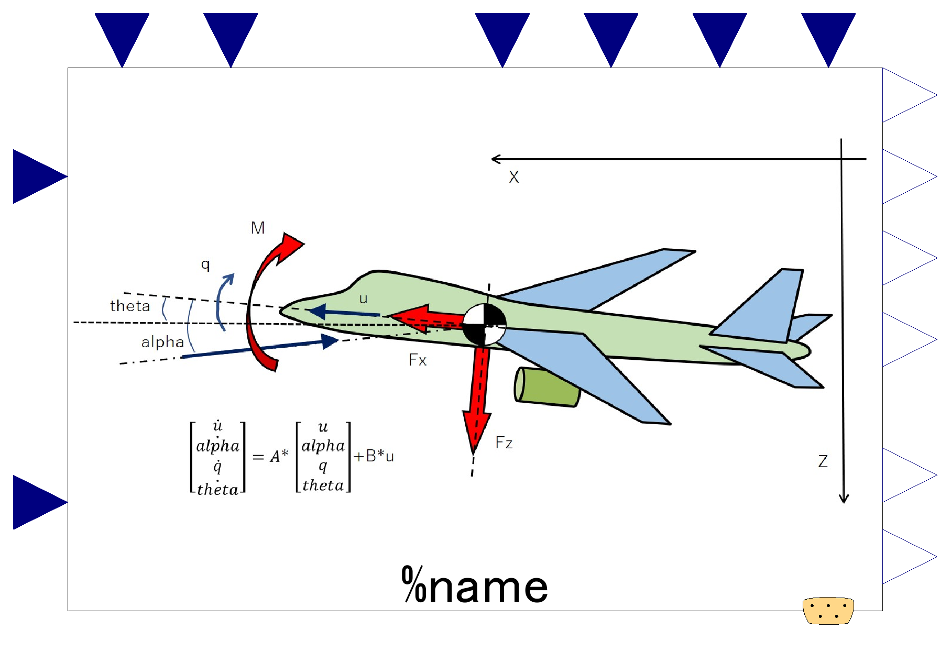

Slide 2
Lower Heating Value of Fuel;
input (use “connect” operator),
valid only when use_u_LHV_fuel==true
Fuel inlet port, input&output (use “connect” operator)
Fuel flow, output

Slide 3
