Slide 1
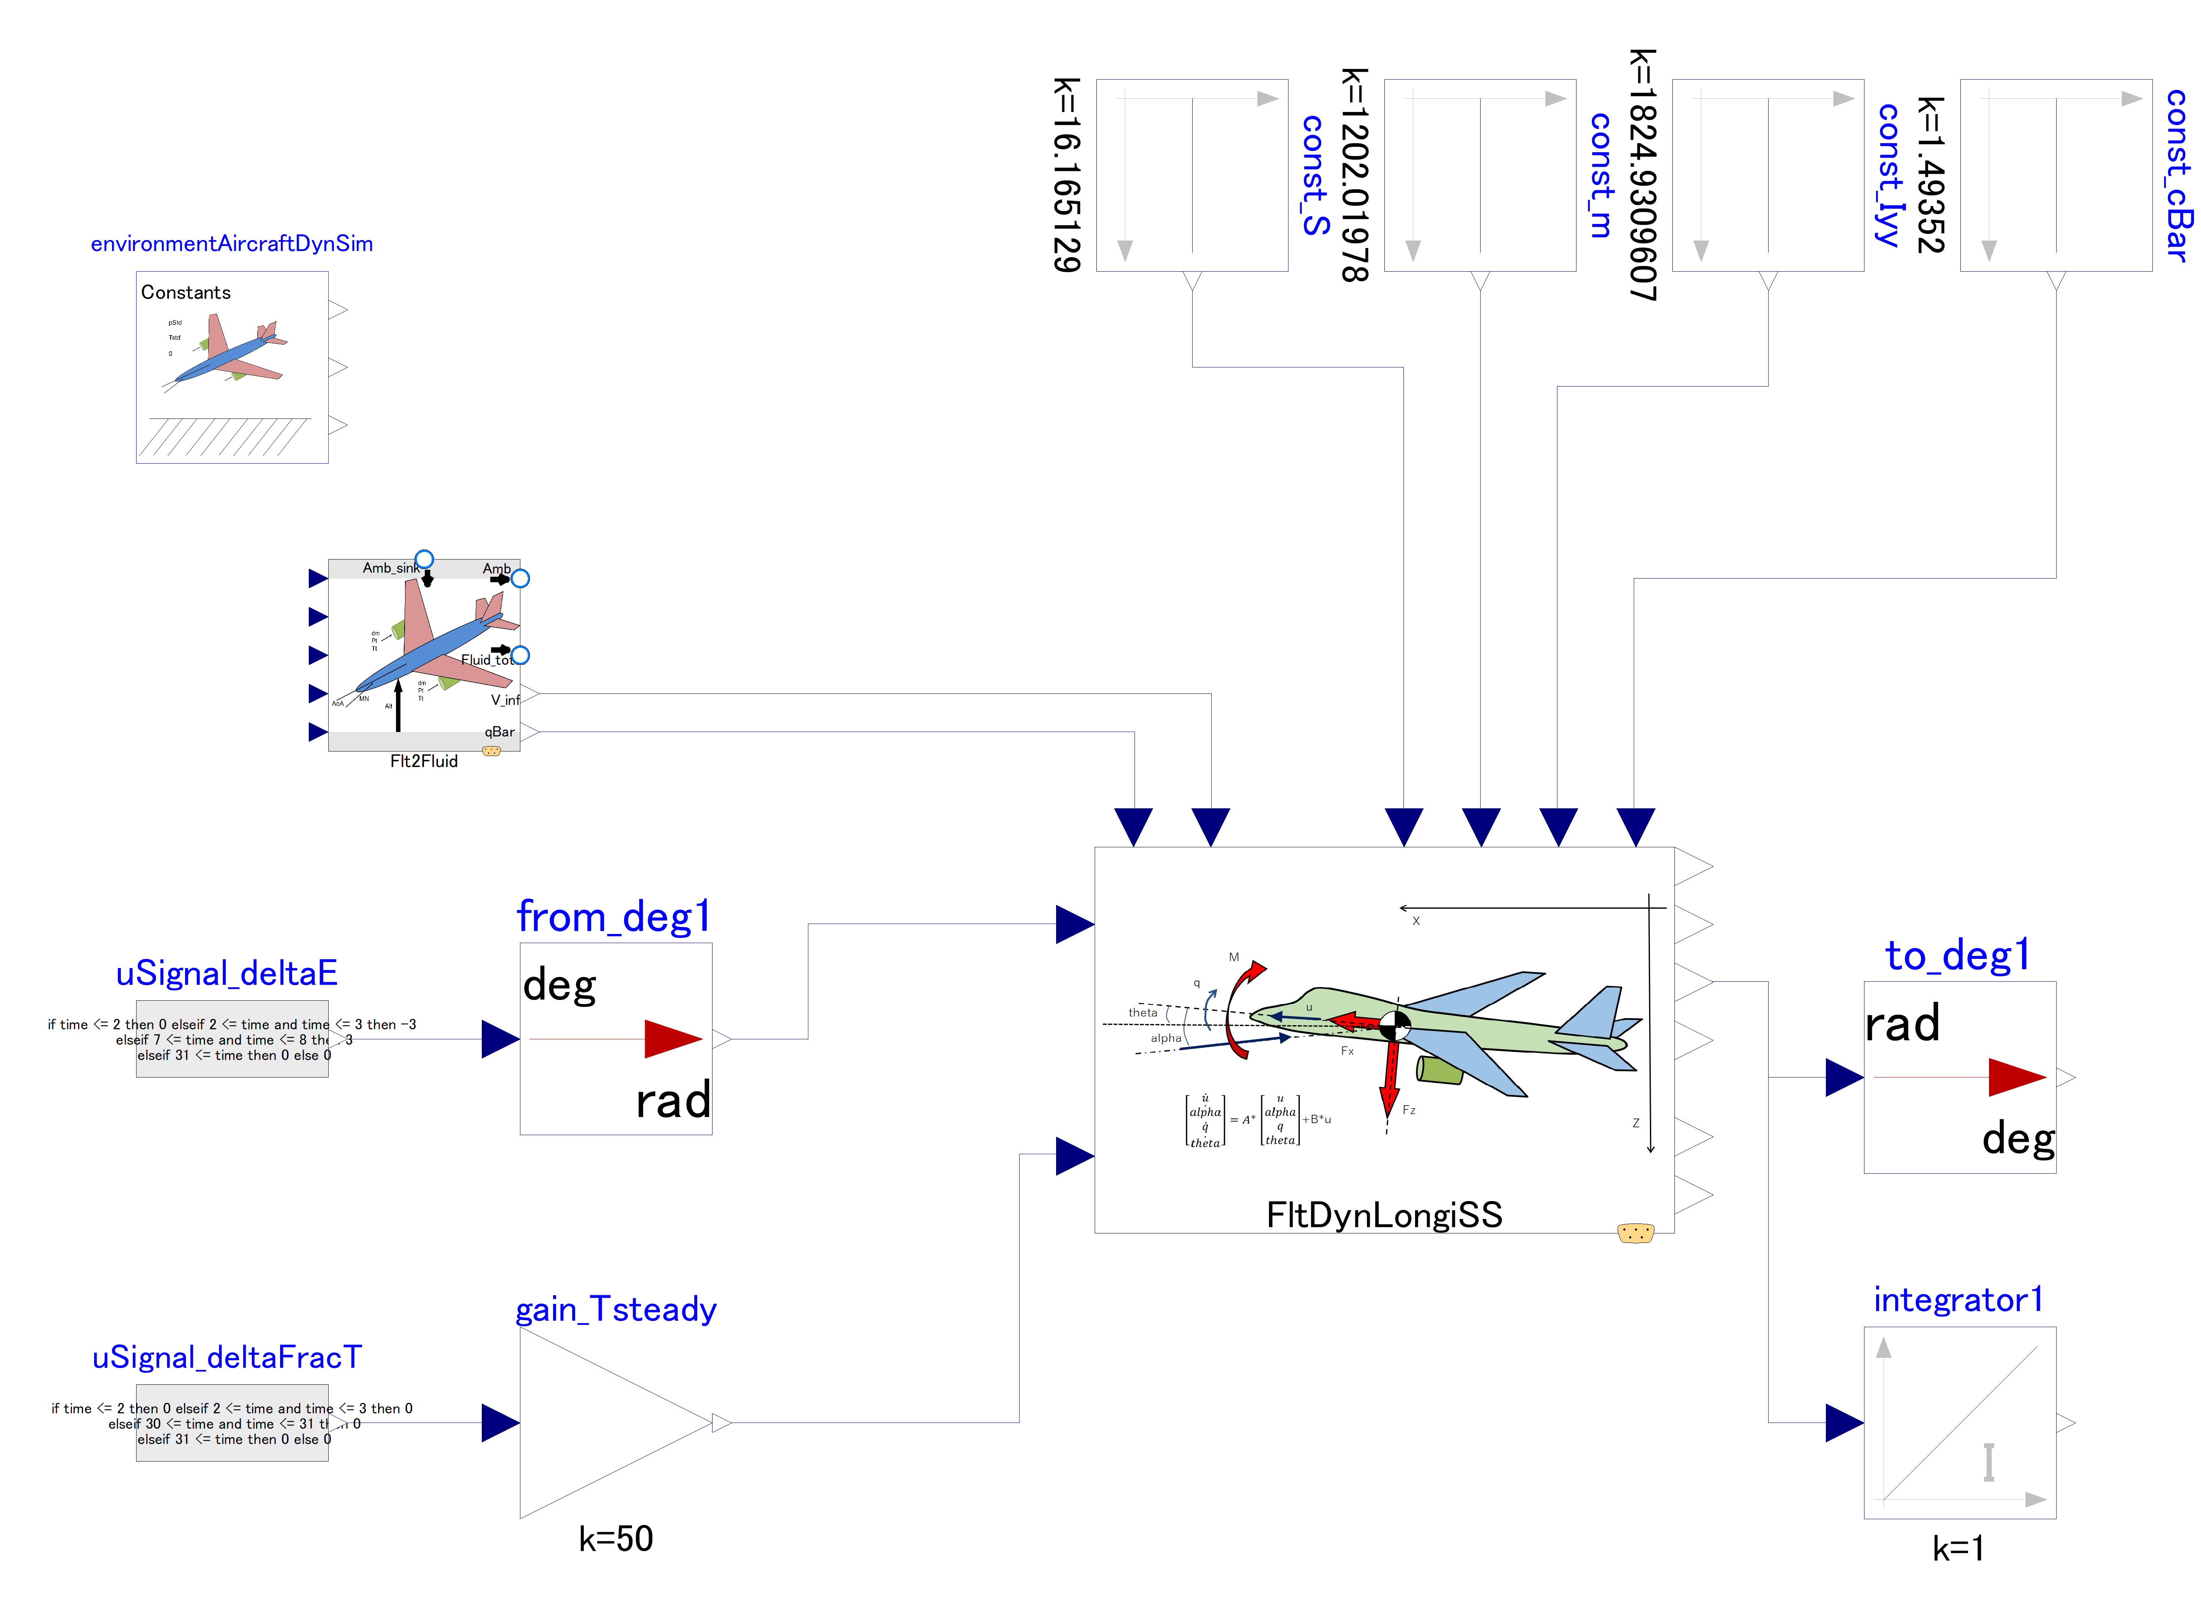

Slide 2
This outer component provides “g” value to dynamics component
Variables (inputs) related to steady state (center of linearization) flight condition
Variables (inputs) related to aircraft properties.
Control inputs:
Change in elevator angle
Change in thrust

