Slide 1
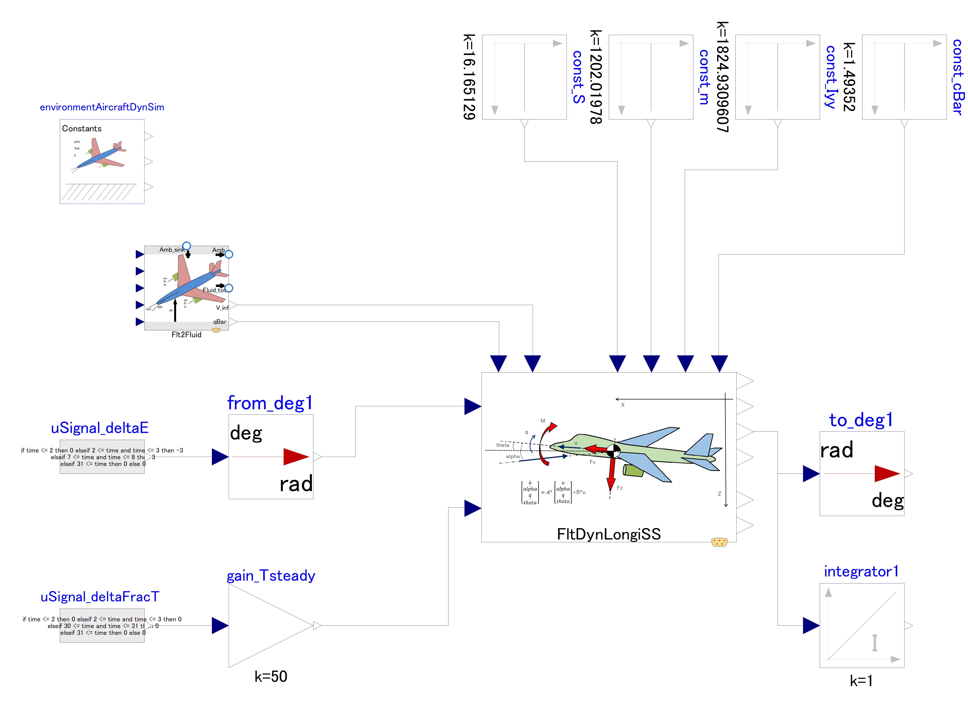

Slide 2
This outer component provides global constants, such as “g” value, to dynamics component
Variables (inputs) related to steady state (center of linearization) flight condition
Variables (inputs) related to aircraft properties.
Flight control inputs:
Change in elevator angle
Change in thrust

Slide 3
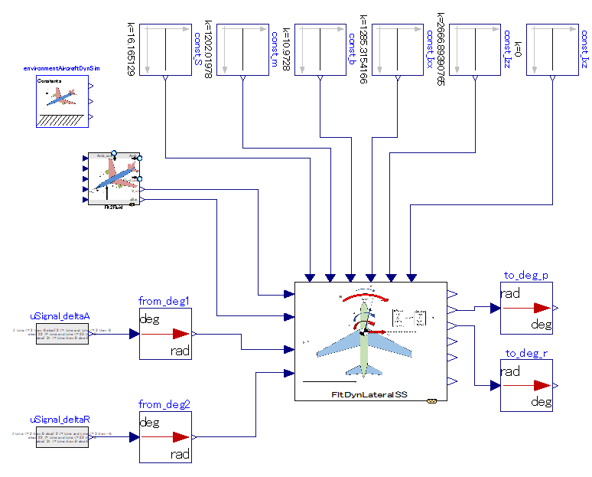

Slide 4
This outer component provides global constants, such as “g” value, to dynamics component
Variables (inputs) related to aircraft properties.
Variables (inputs) related to steady state (center of linearization) flight condition
Flight control inputs:
Change in elevator angle
Change in thrust

Slide 5
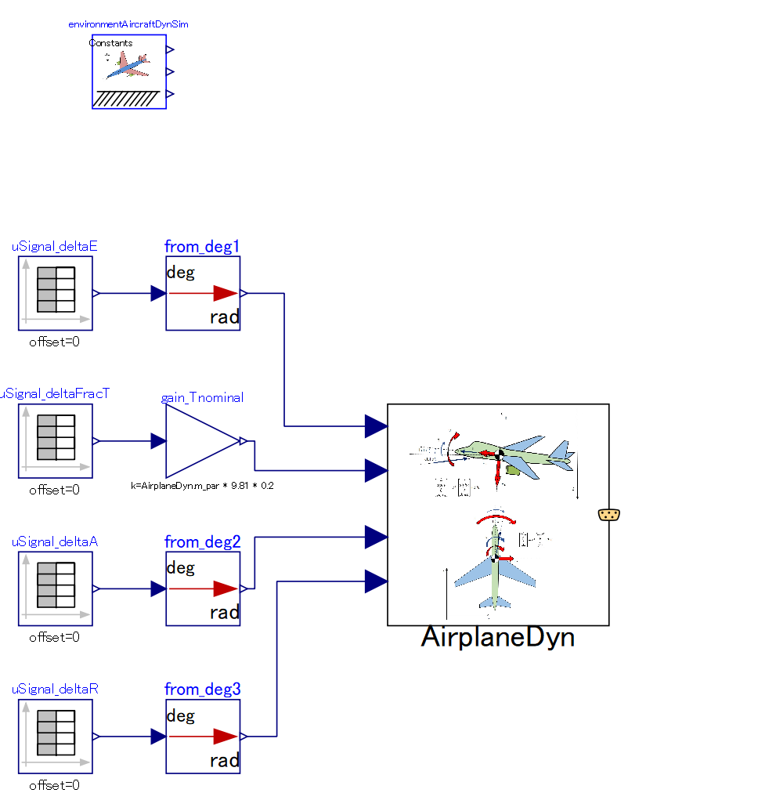

Slide 6
This outer component provides global constants, such as “g” value, to dynamics component
All flight dynamic calculation is executed in this single component.
Input: Flight control
-. Change in Elevator
-. Change in thrust
-. Change in Aileron
-. Change in Rudder

