Slide 1
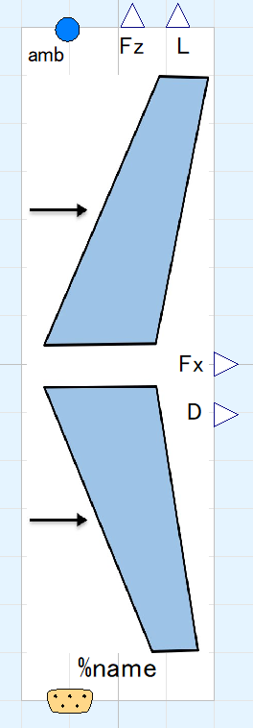
State of ambient air, input&output (use “connect” operator)
Aerodynamic forces, output
States of flight, input&output (use “connect” operator)

