Slide 1
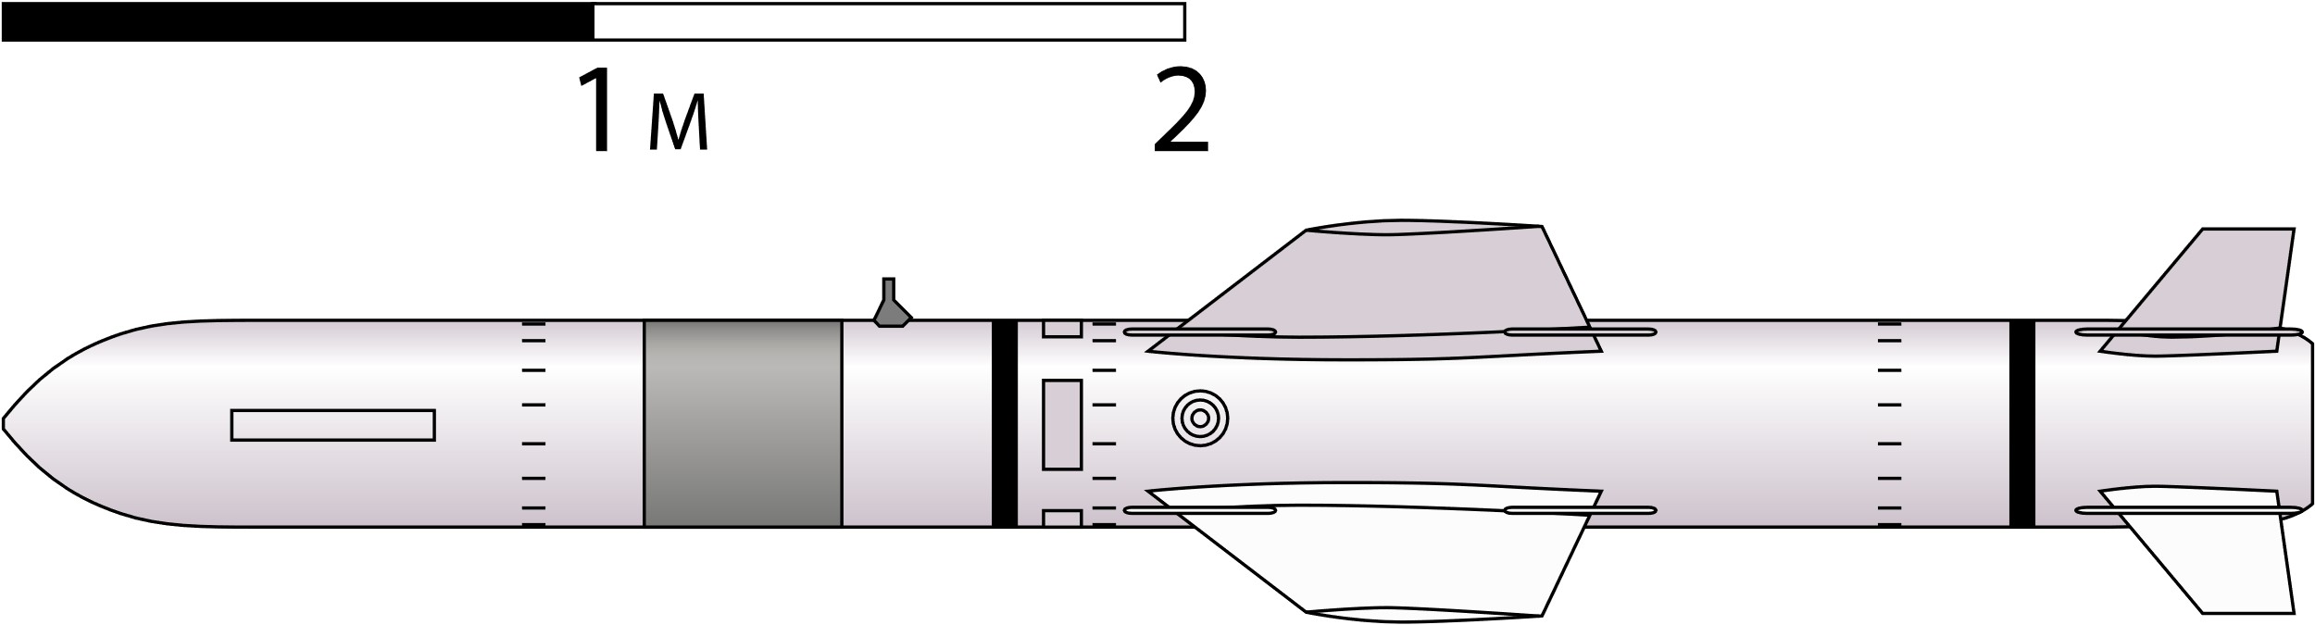
3.41 on fig.
8.46 on fig.
1 / 8.46 = 0.4030733 / 3.41
wing tip chord: 0.4031 [m]
6.45 on fig.
*Figure on Wikimedia Commons
https://commons.wikimedia.org/wiki/File:Harpoon_missile_sketch.svg
1 / 8.46 = 0.7624113 / 6.45
Wing root chord: 0.7624 [m]

Slide 2
Span-wise length;
Wing geometry;
0.7624 [m]
0.287 [m]
0.287 [m]
0.4031 [m]
Wing area:
S = 4*{1/2*(0.4031+0.7624)*0.287} [m2]
Aspect ratio:
AR = {(0.287*2)^2}/(S) [m2]
0.34 [m]
*from Wikipedia
0.914 [m]
*from Wikipedia

Slide 3
Lift of wing and force on aircraft body frame;
Lift of wing
Fz of aircraft body frame
= Lift*cos(45deg)
45 deg
z
y
Aircraft bod frame

Slide 4
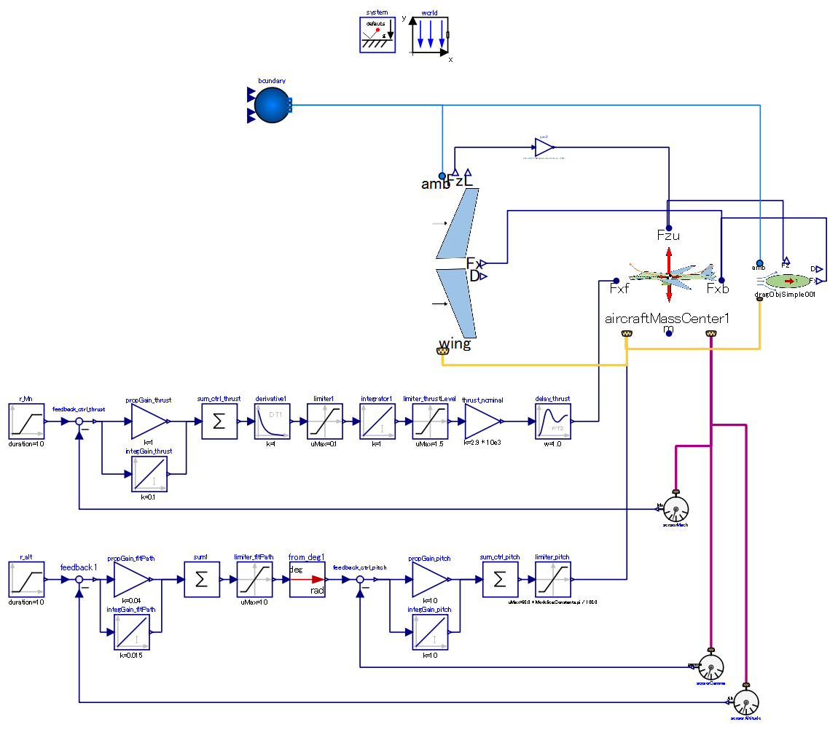

Slide 5
Ambient:
provides ambient air properties (p, T) for calculation of wing and fuselage
Multiply force along z-axis of body by cos(45 deg) to take mount angle of wings into account.
Aircraft mass center:
flight dynamics is calculated in this component.
Wing:
generate lift, and drag (as side effect)
Control law of tangential force (thrust)
-. Target: flight Mach number
-. Actuated: tangential force
Fuselage:
generates drag.
Control law of pitch
-. Target: altitude
-. Actuated: pitch angle

