Slide 1
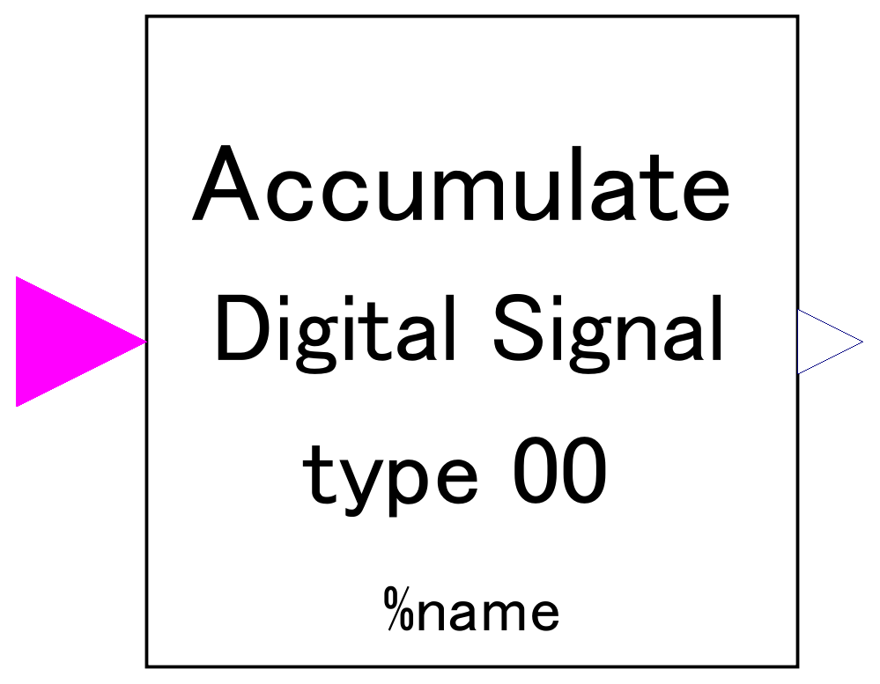
-. accumulate digital signal received and output.
-. Increase of output signal is determined by how many times true signal is received, NOT by how long true signal is maintained.
-. Output signal can be scaled by parameter setting for control of large values.
-. Output signal can be start with desired value set via parameter.
Receive Boolean signal of digital input.

Slide 2
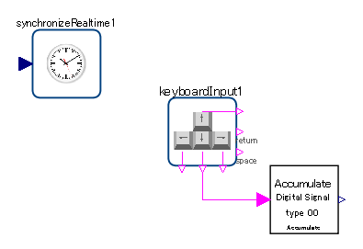
It is assumed to be deployed together with keyboardInput component of Modelica_DeviceDrivers library.

Slide 3
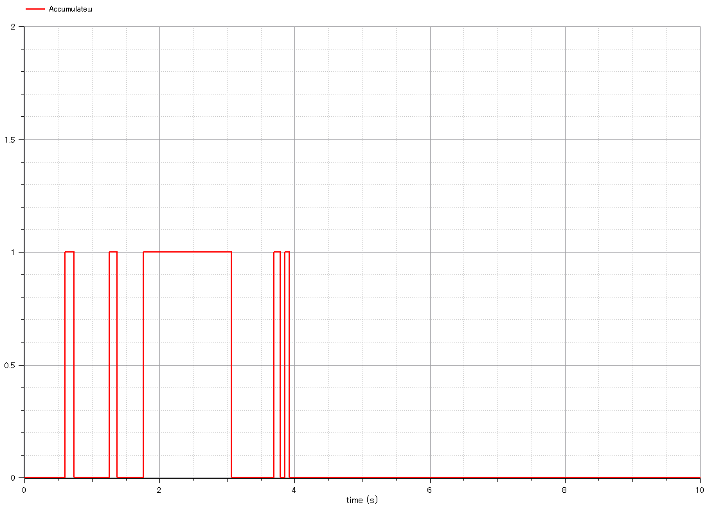
Input:
-. Boolean signal which represent keyboard input.
-.”1” represents “pressed”.

Slide 4
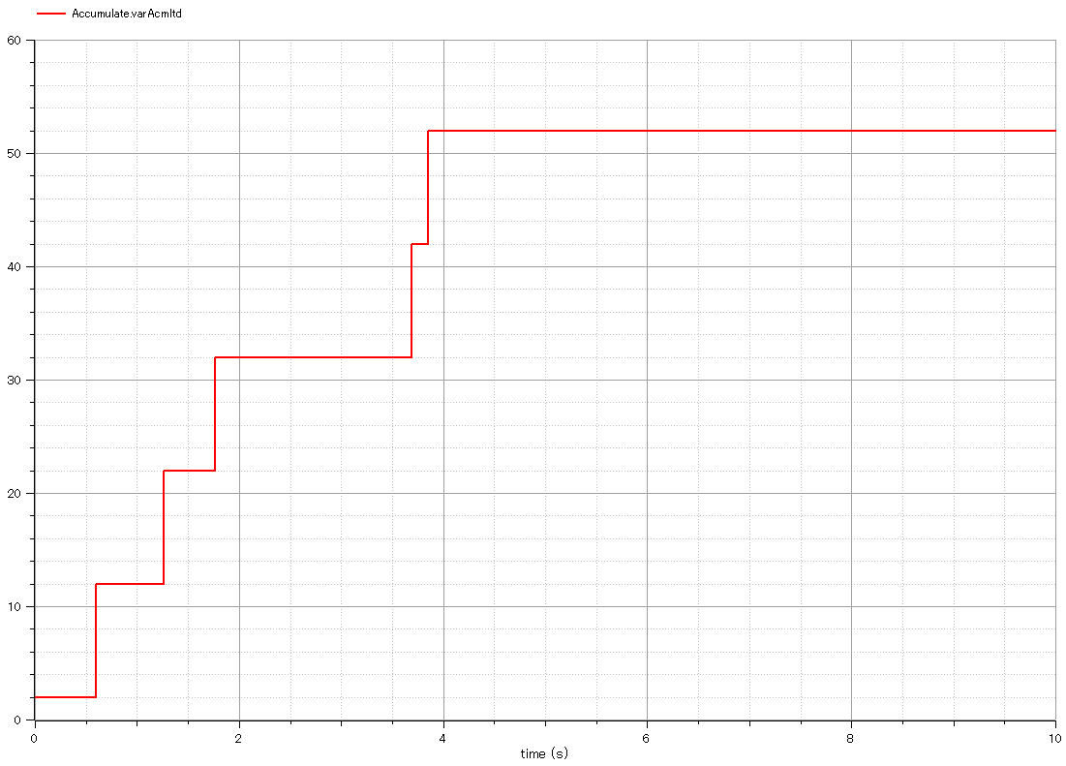
Output:
-. accumulated signal.
-. Output signal increases as keyboard is pressed.
-. How long the key is pressed does NOT affect on output signal.
-. Output signal value began with 2 as set via parameter.
-. Increments of output signal is 10 because scale factor is set 10.

Slide 5
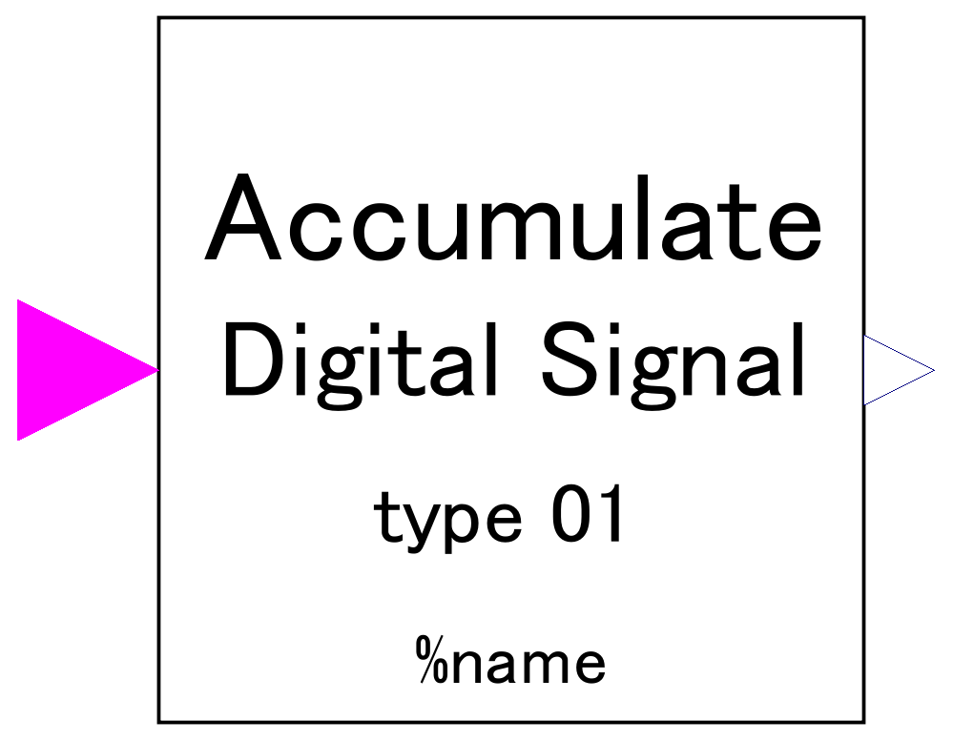
-. accumulate digital signal received and output.
-. Increase of output signal is determined by how many times true signal is received, NOT by how long true signal is maintained.
-. Output signal can be scaled by parameter setting for control of large values.
-. Output signal can be start with desired value set via parameter.
Receive Boolean signal of digital input.

Slide 6
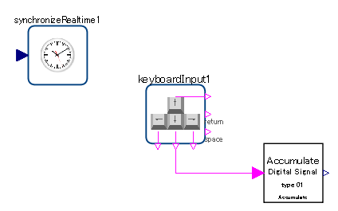
It is assumed to be deployed together with keyboardInput component of Modelica_DeviceDrivers library.

Slide 7
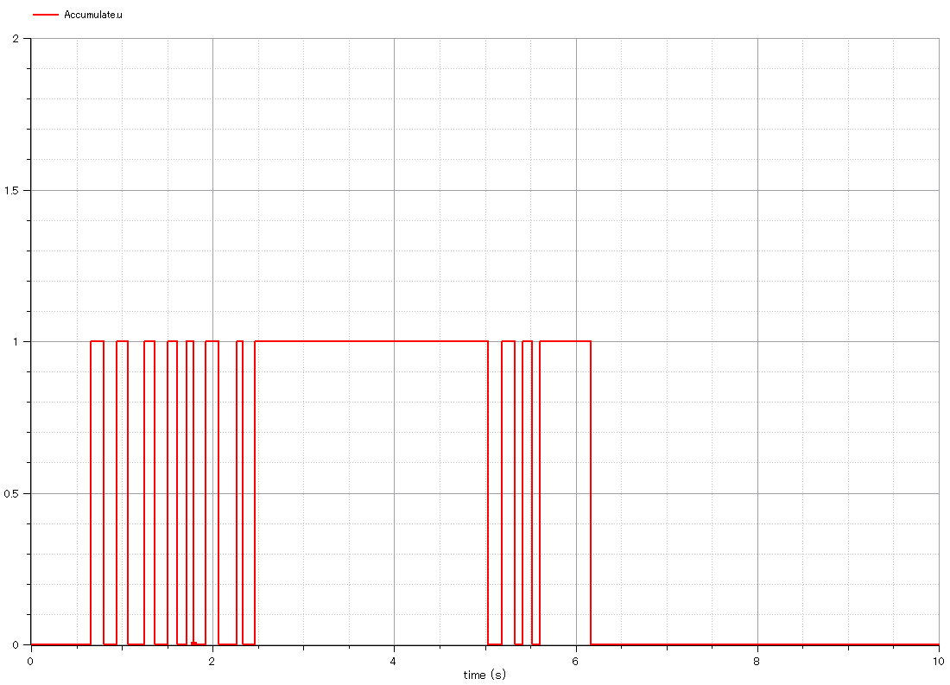
Input:
-. Boolean signal which represent keyboard input.
-.”1” represents “pressed”.

Slide 8
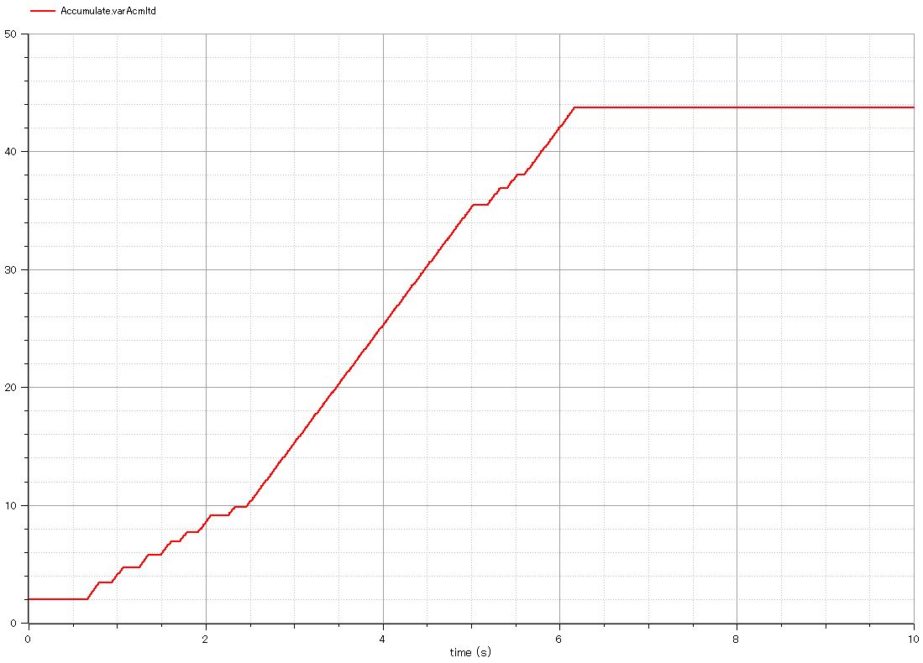
Output:
-. accumulated signal.
-. Output signal increases as keyboard is pressed.
-. How long the key is pressed determines how output signal increases.
-. Output signal value began with 2 as set via parameter.

Slide 9
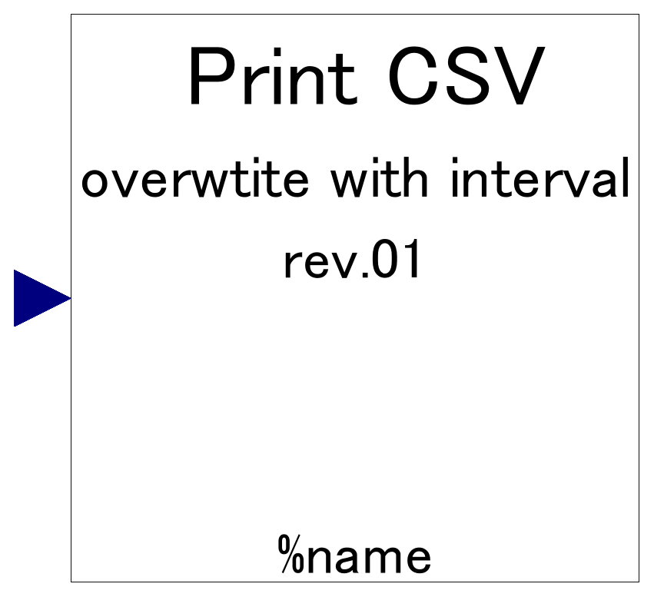

Slide 10
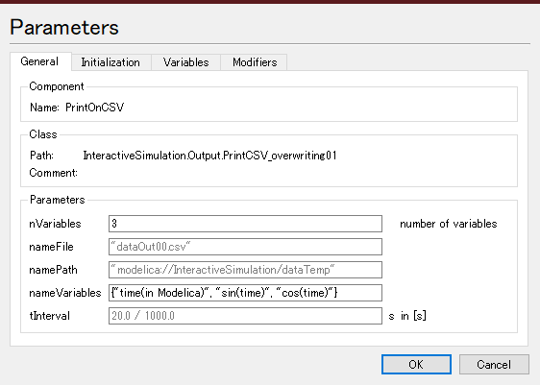

Slide 11
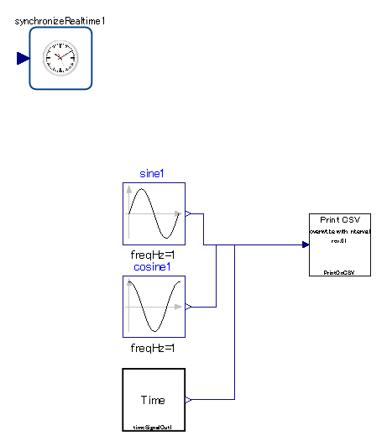

Slide 12
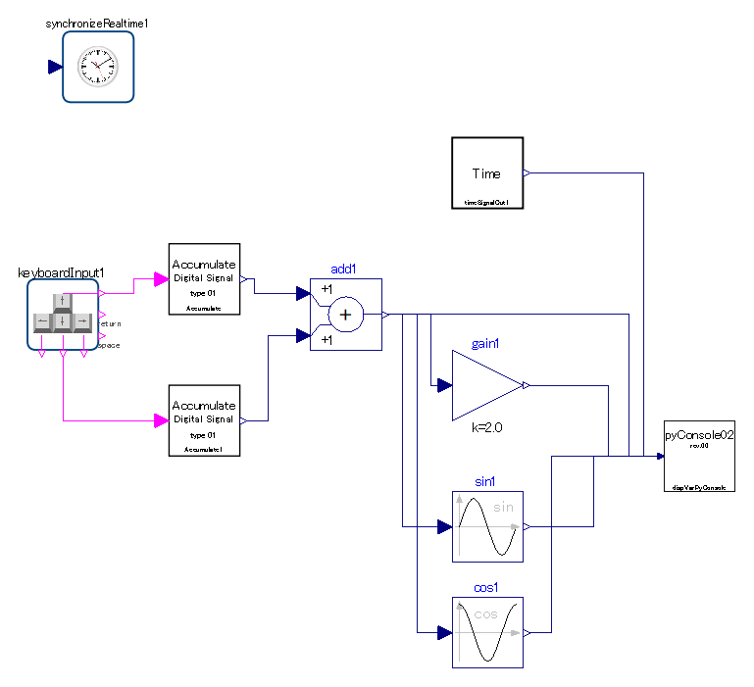

Slide 13
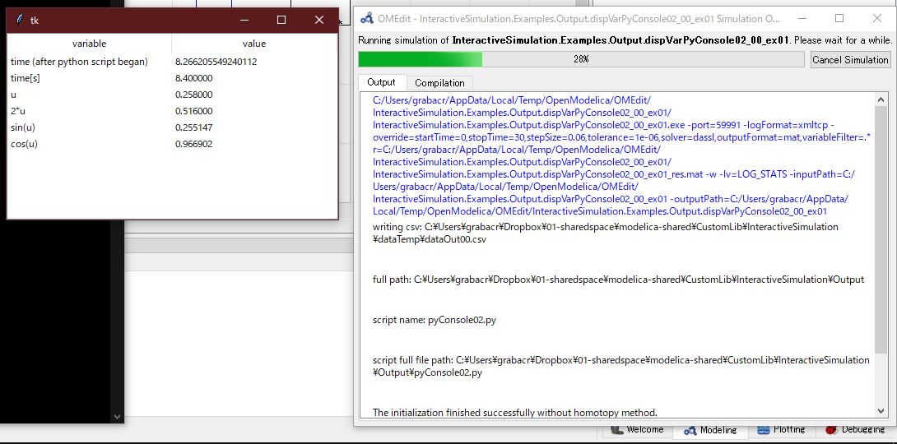

Slide 14
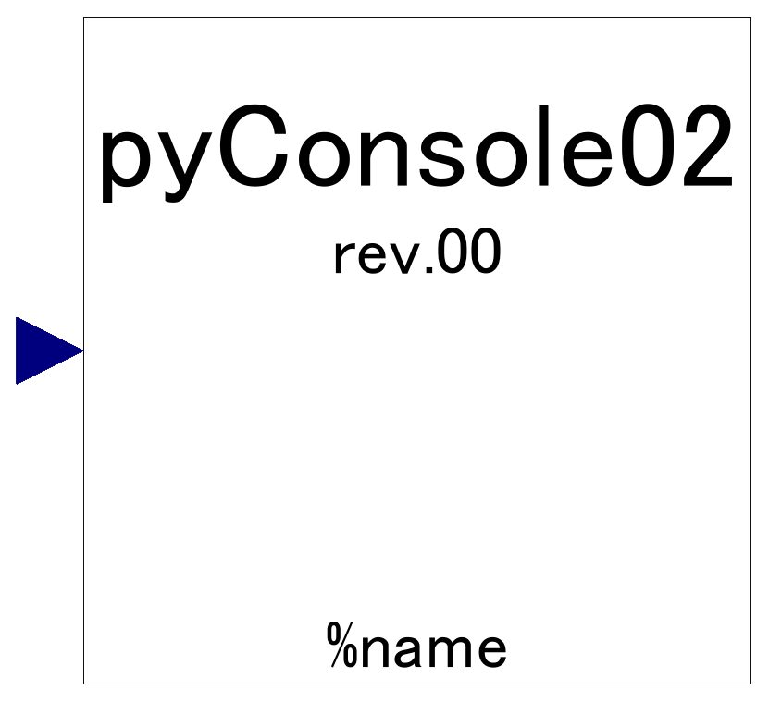

Slide 15
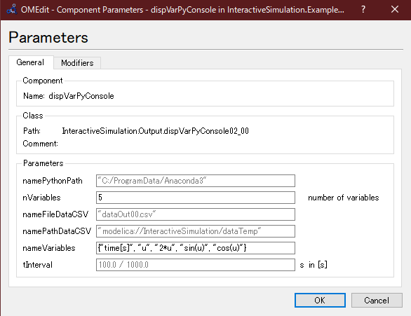
If you install Anaconda3 to Windows10 with default setting, leave default.
Can be left default unless needed.

