Slide 1
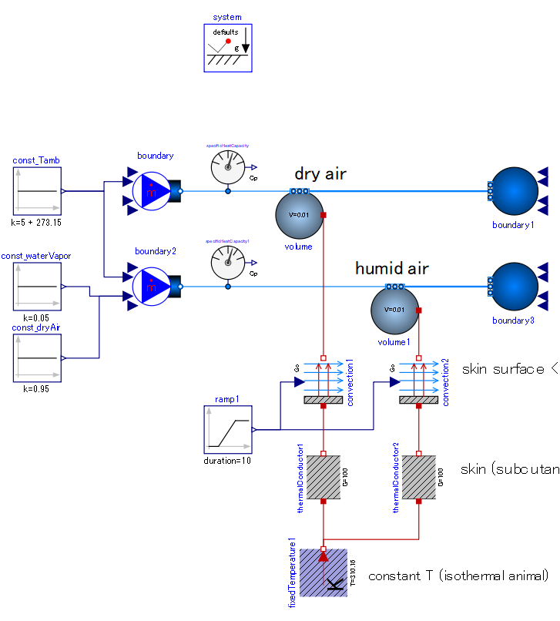

Slide 2
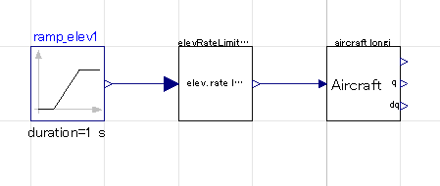
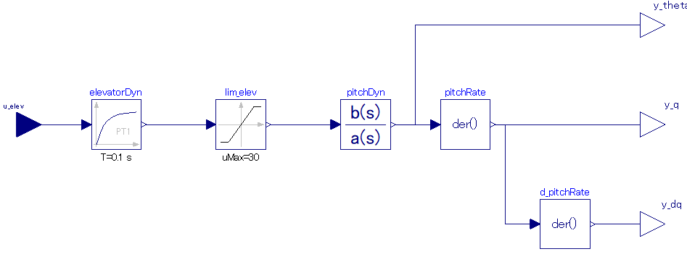
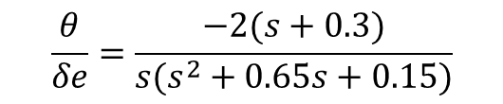
Elevator angle command
aircraft dynamics
Elevator change rate limitter
Elevator dynamics：
1st order lag
Elevator angle limit：
±30 [deg]
Output: pitch angle
Output: pitch rate
Aircraft longitudinal dynamics model：Transfer function, pitch angle in response of elevator angle
$$\frac{θ}{δe}=\frac{−2(s+0.3)}{s(s^{2}+0.65s+0.15)}$$
Output: pitch acceleration

Slide 3
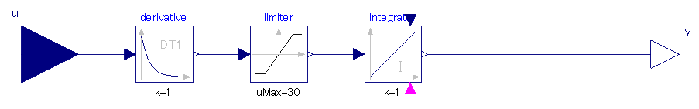
Elevator angle command
aircraft dynamics
Elevator change rate limitter
Signal limitter：
±30 [deg/s]
Differentiate:
Signal of pitch angle -> pitch rate
Integrate:
Pitch rate -> pitch angle signal

Slide 4
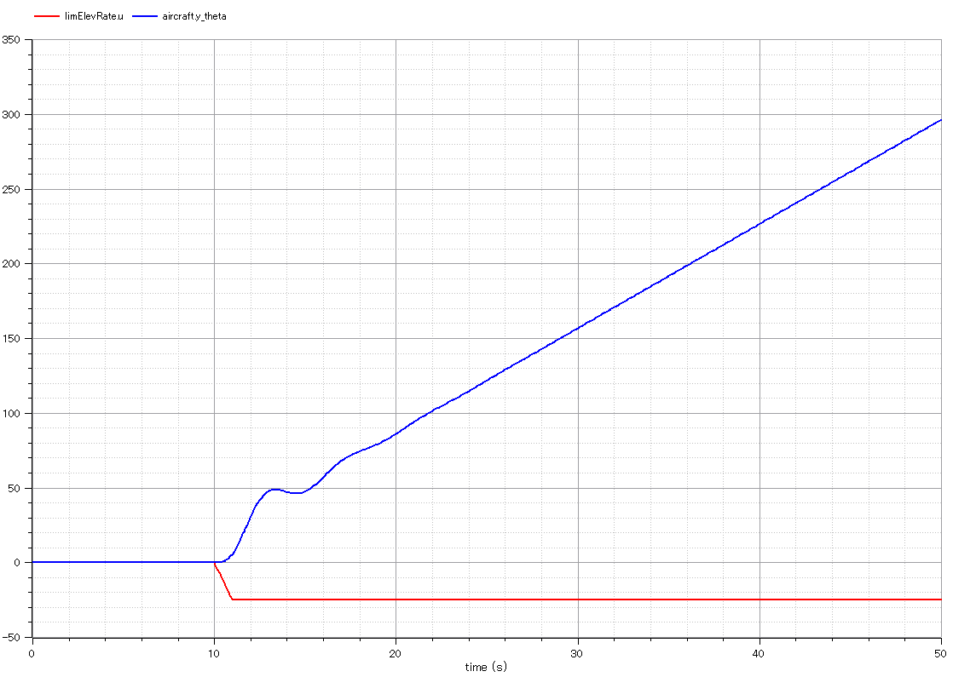
pitch angle
elevator command
(negative == pull-up)

Slide 5
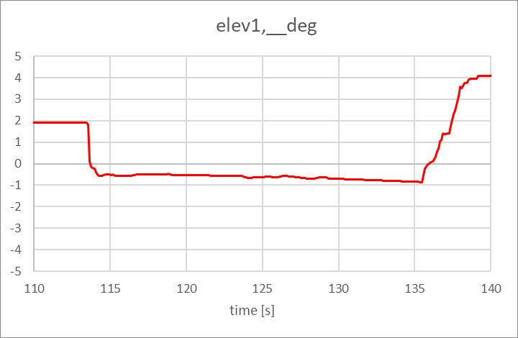
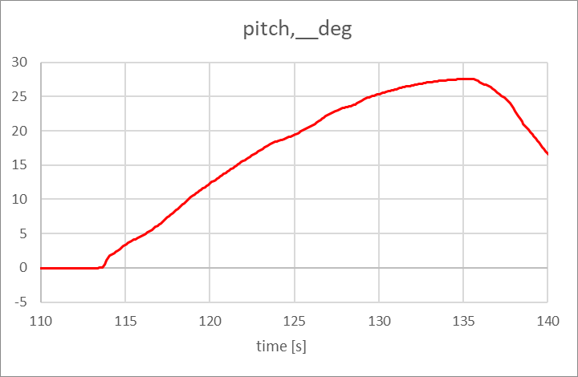
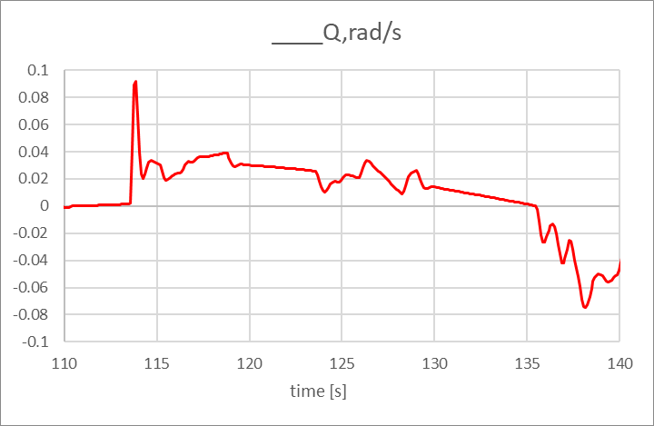
X-plane 10, Cessna Citation-X

Slide 6
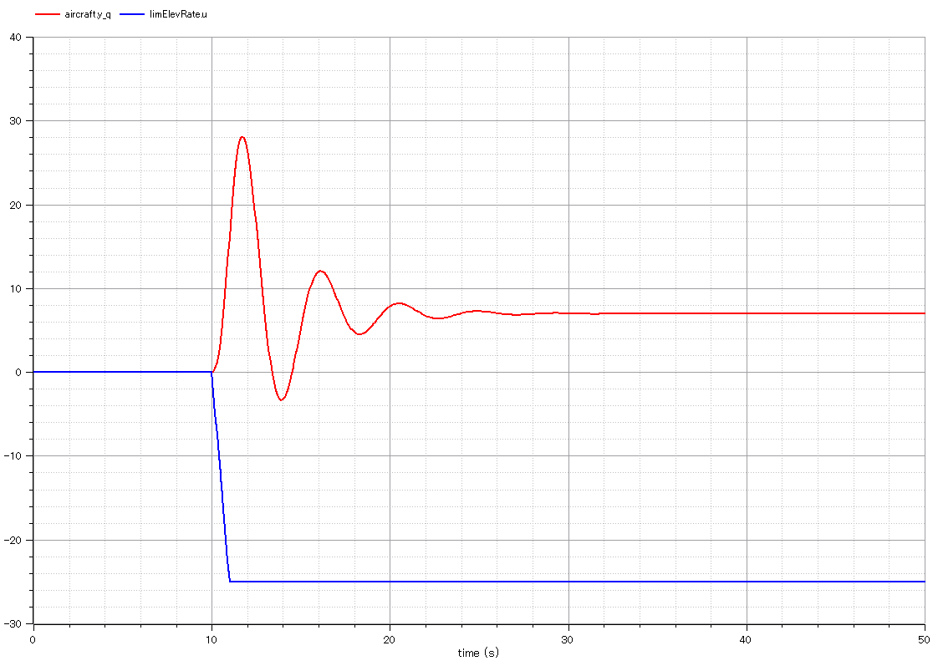
pitch rate
elevator command

Slide 7
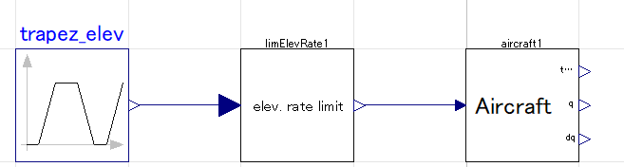
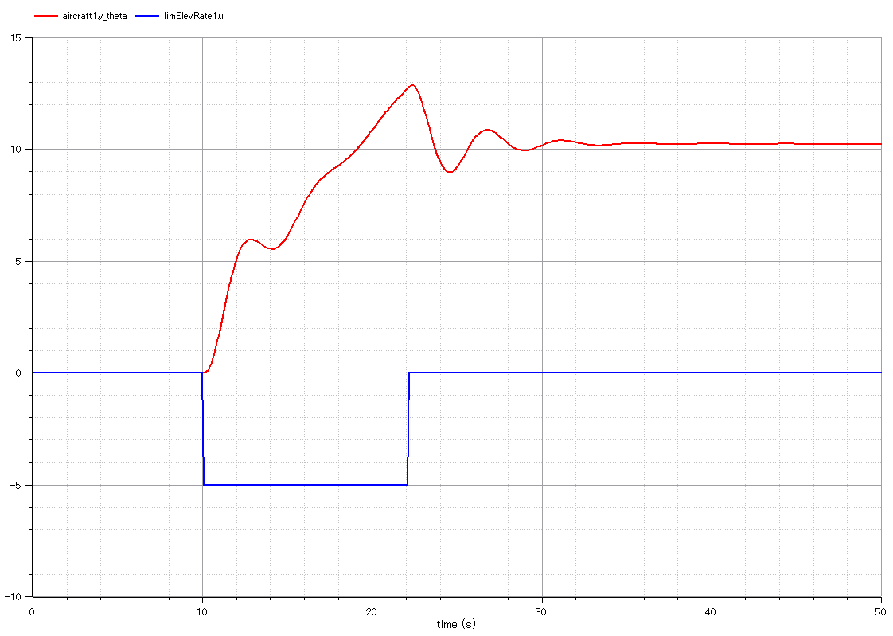
Elevator command with pulse shape
pitch angle
elevator command

Slide 8
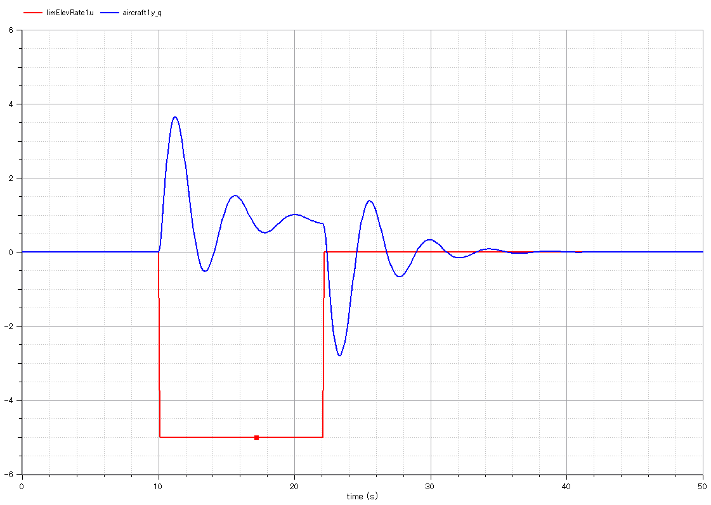
Elevator command with pulse shape
pitch rate
elevator command

Slide 9
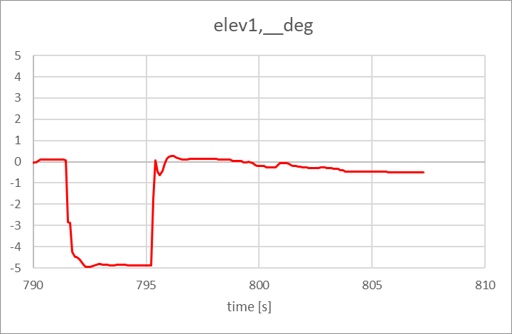
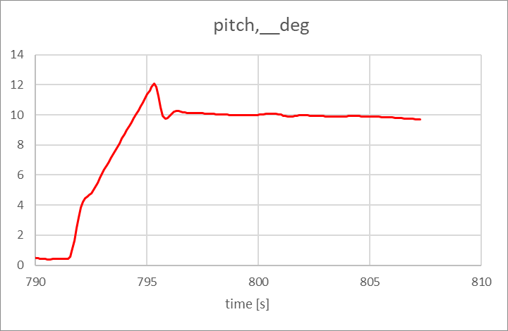
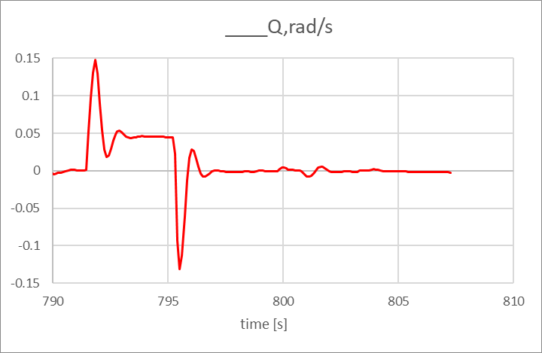
X-plane 10, Cessna Citation-X

Slide 10
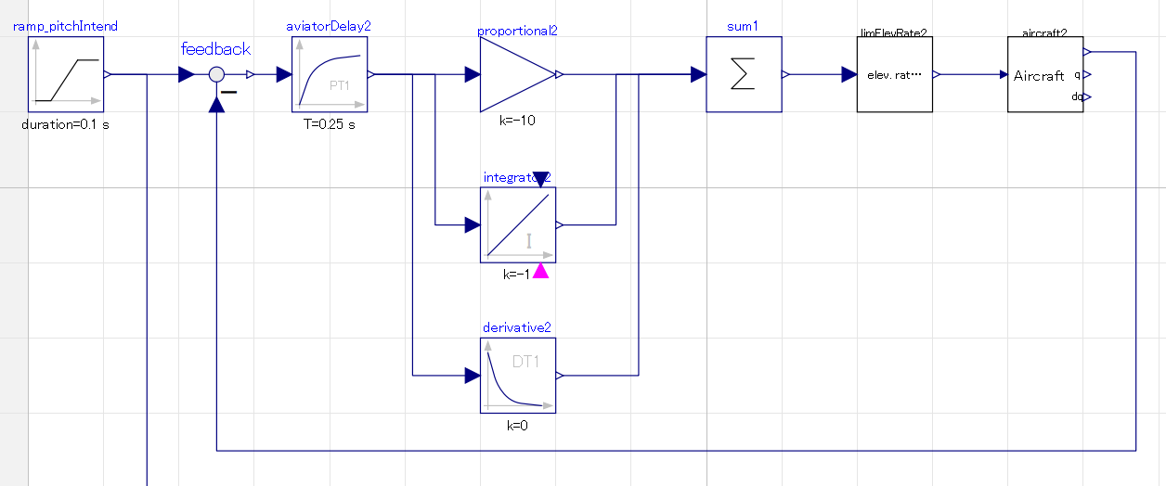
Aviator decides elevator angle command
= Feedback control system
Target of pitch angle
Delay of human response
Set gains by try&error

Slide 11
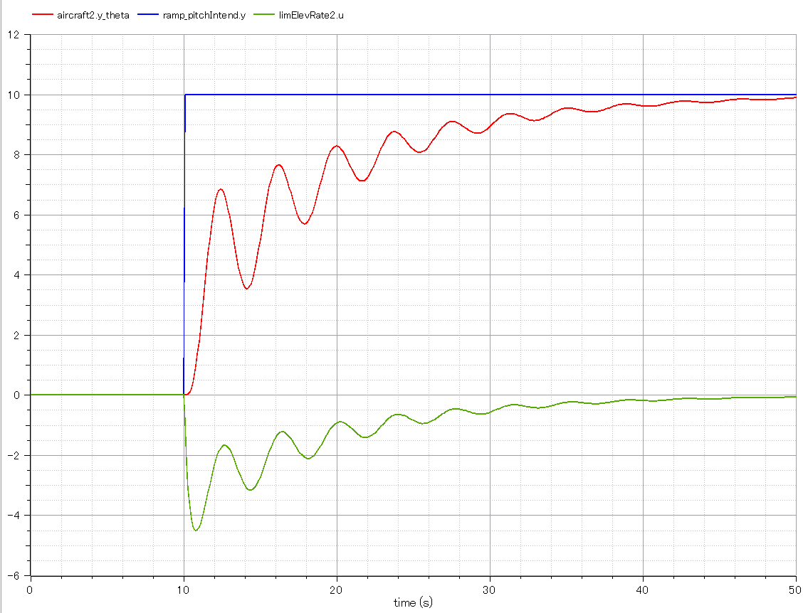
P gain：-0.5
I gain：0
D gain ：0
* gains are negative because pitch increases with input of negative elevator angle
pitch angle
target pitch angle
elevator command

Slide 12
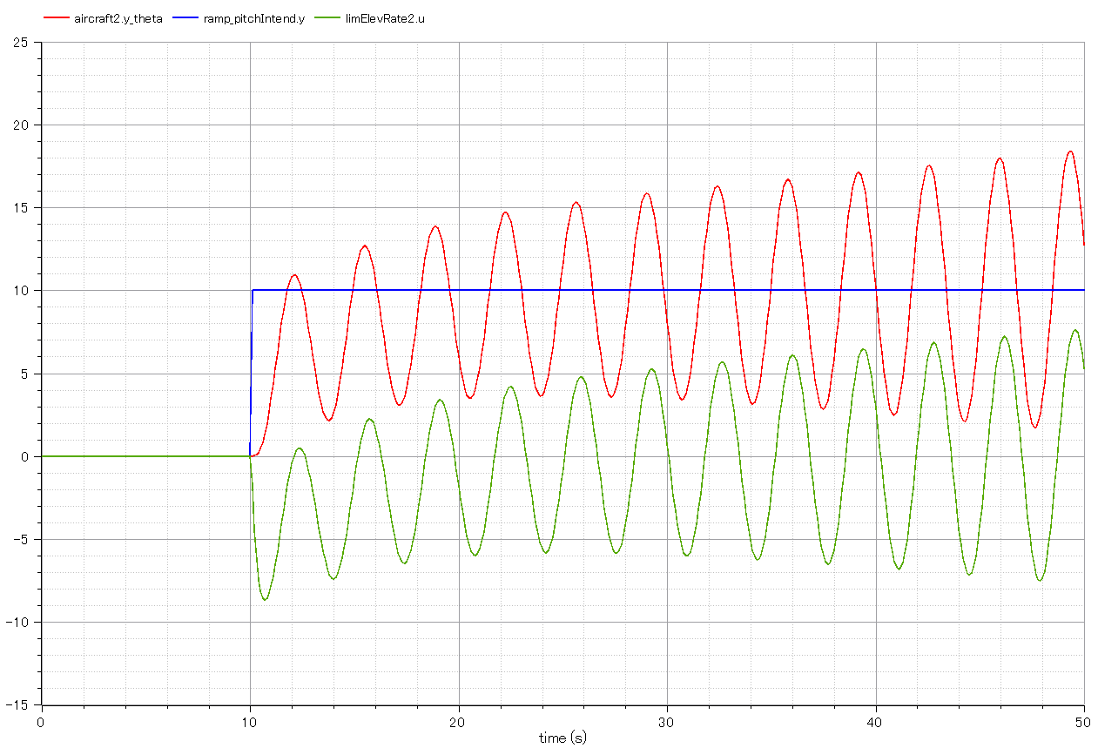
P gain：-1
I gain：0
D gain：0
* gains are negative because pitch increases with input of negative elevator angle
pitch angle
target pitch angle
elevator command

Slide 13
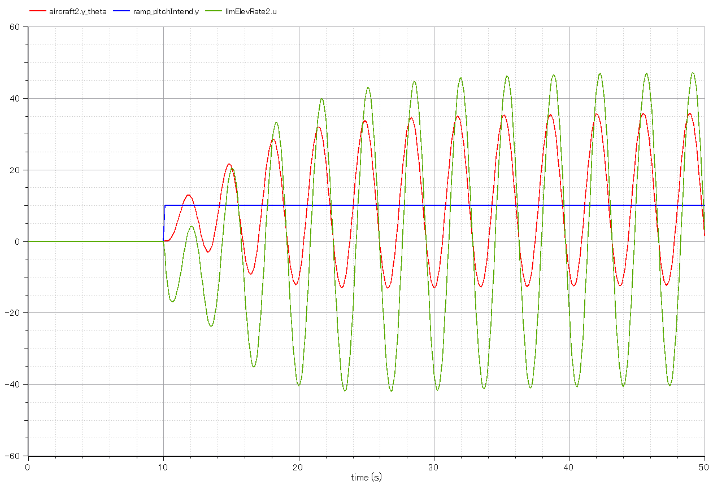
P gain：-2
I gain：0
D gain：0
* gains are negative because pitch increases with input of negative elevator angle
pitch angle
target pitch angle
elevator command

Slide 14
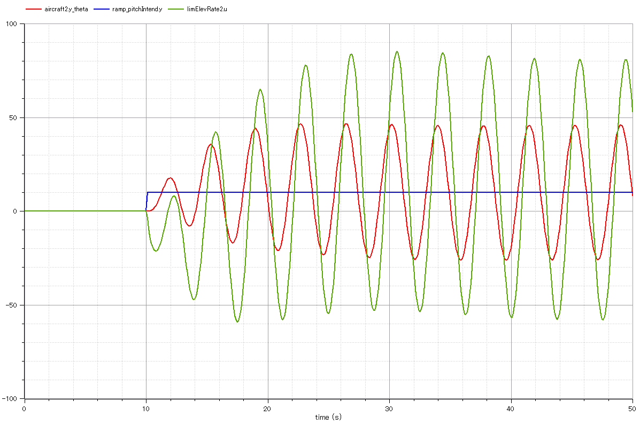
P gain：-2
I gain：-1
D gain：0
* gains are negative because pitch increases with input of negative elevator angle
target pitch angle
pitch angle
elevator command

Slide 15
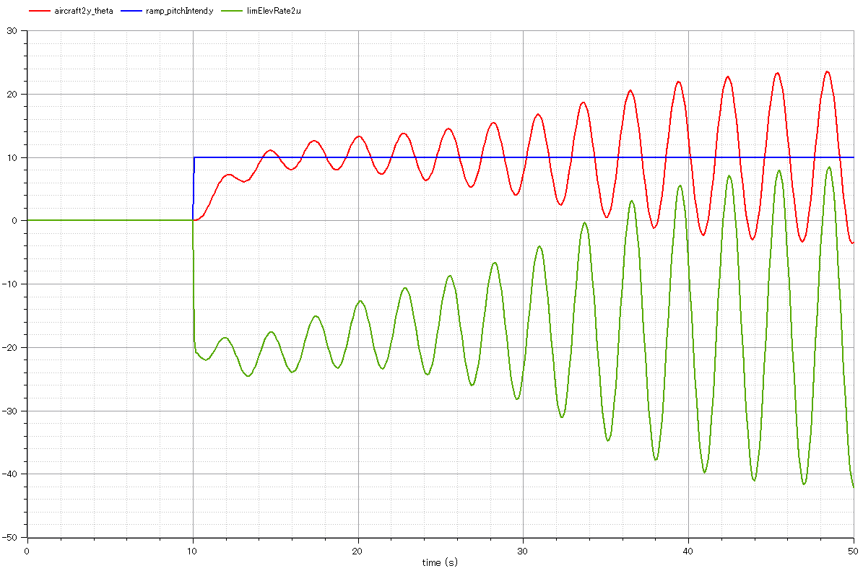
P gain：-2
I gain：-1
D gain：-0.5
* gains are negative because pitch increases with input of negative elevator angle
pitch angle
target pitch angle
elevator command

Slide 16
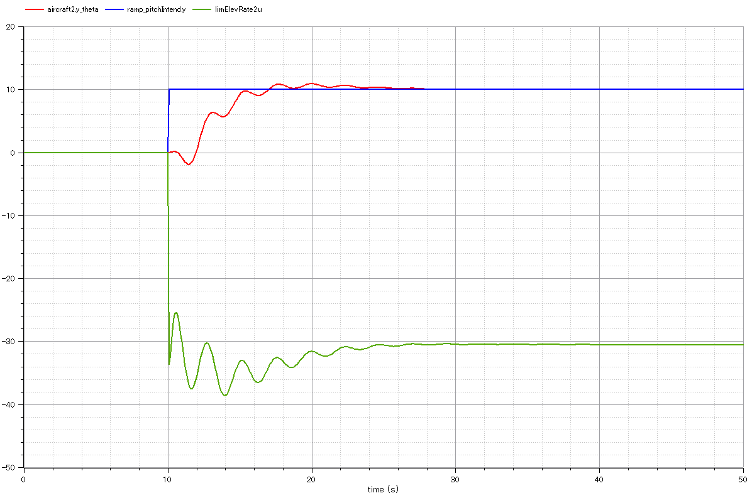
P gain：-2
I gain：-1
D gain：-1
* gains are negative because pitch increases with input of negative elevator angle
target pitch angle
pitch angle
elevator command

Slide 17
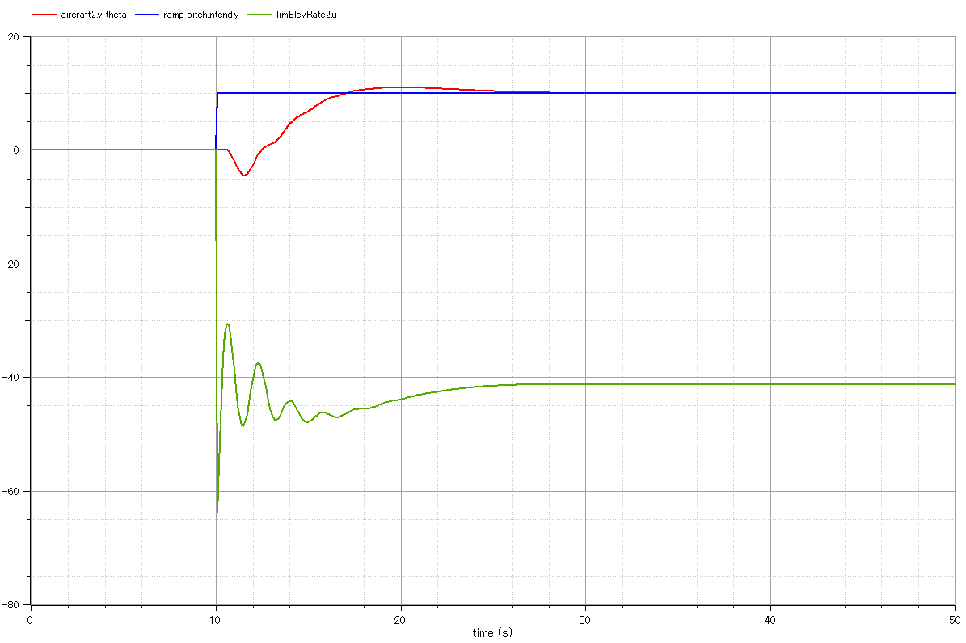
P gain：-2
I gain：-1
D gain：-2
* gains are negative because pitch increases with input of negative elevator angle
target pitch angle
pitch angle
elevator command

Slide 18
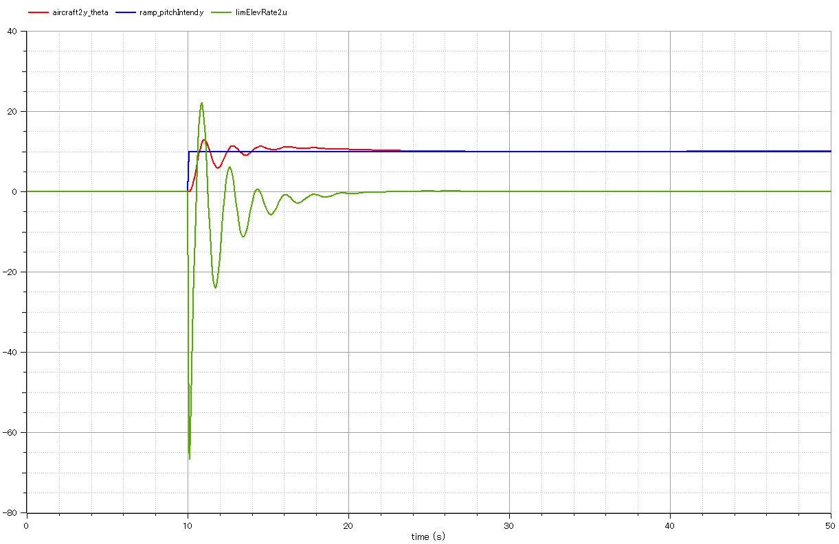
P gain：-2
I gain：-1
D gain：-2
* gains are negative because pitch increases with input of negative elevator angle
pitch rate limit:±10000 (extremely large)
target pitch angle
pitch angle
elevator command

Slide 19
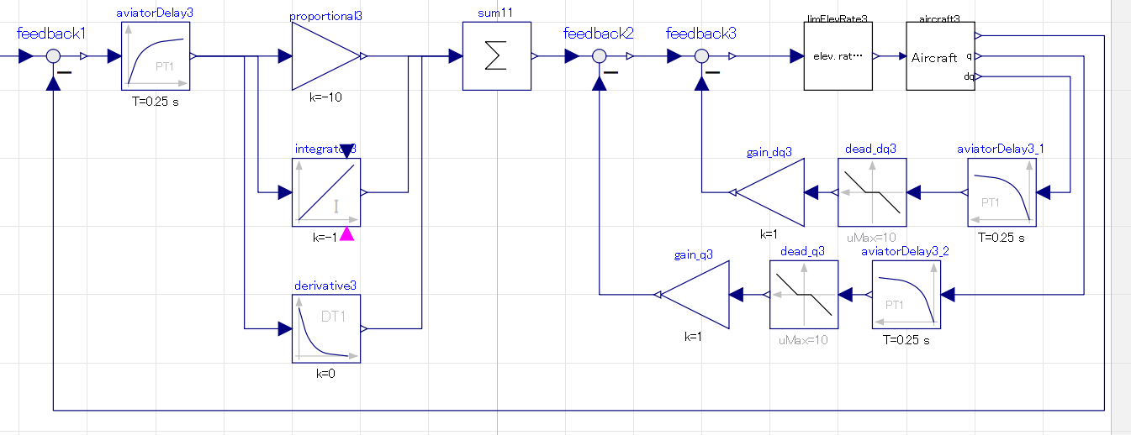
Feedback by pitch acceleration：
Attempt to suppress pitch acceleration
Feedback by pitch rate：
Atttempt to suppress pitch rate
Ignore when smaller than certain value

Slide 20
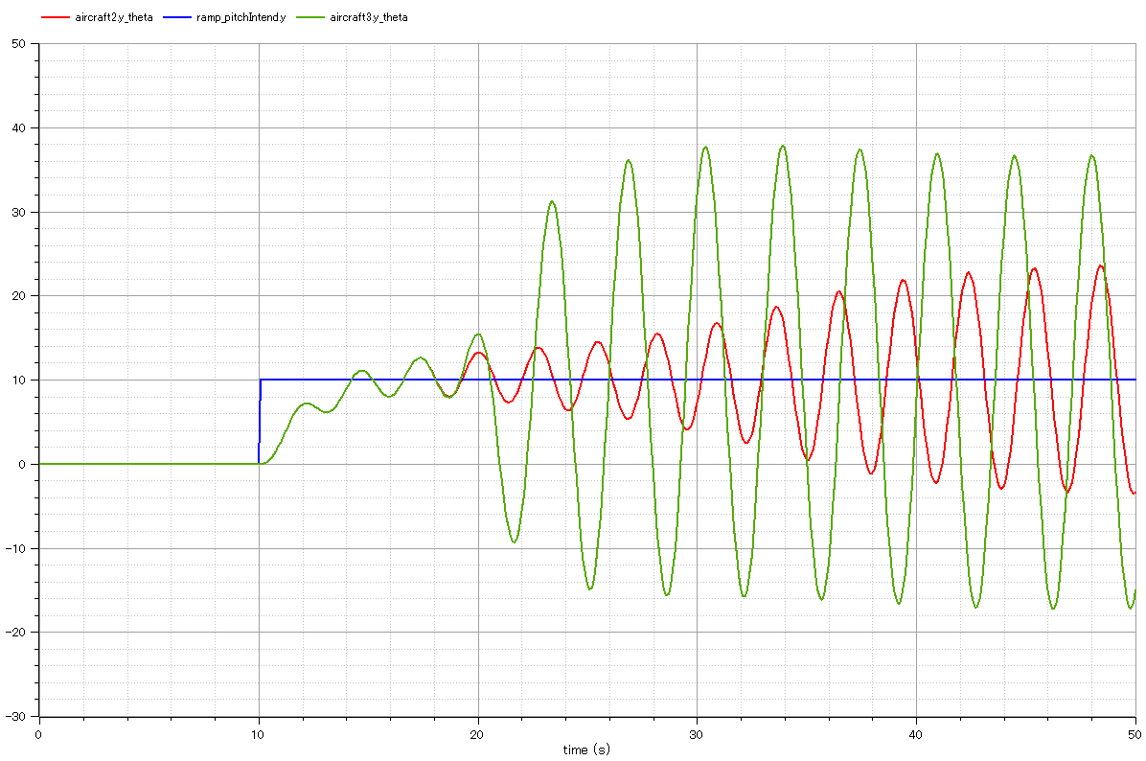
P gain：-2
I gain：-1
D gain：-0.5
* gains are negative because pitch increases with input of negative elevator angle
pitch angle without rate & acceleration feedback
target pitch angle
Pitch angle with rate & acceleration feedback

Slide 23
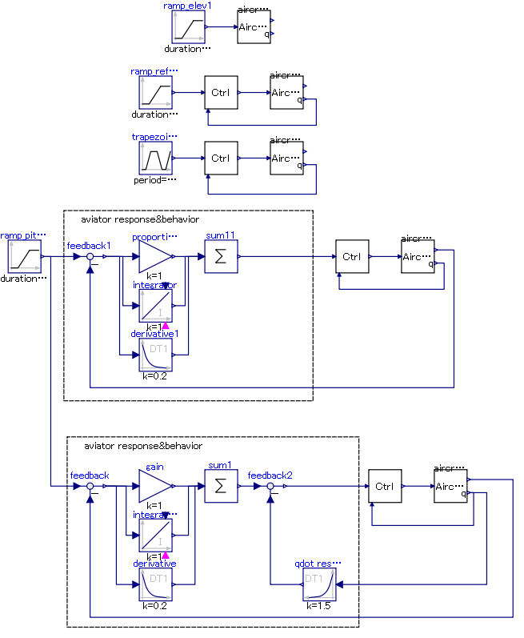
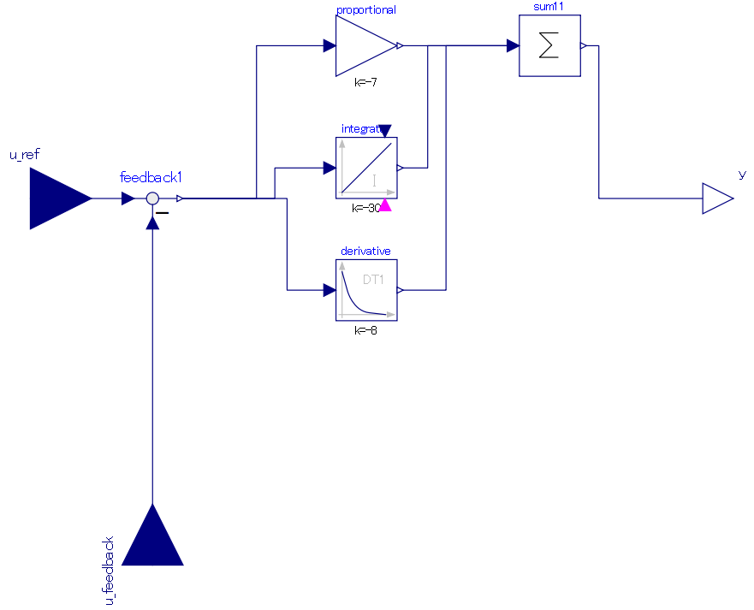
input信号のみ異なる
PIDによるpitch角速度制御
pitch角速度指令信号input
pitch角速度フィードバック信号input

