Slide 1
Treasury Efficiency
A study of current interest rates and recession probabilities

Slide 2

Executive Summary
Swift Panda RS LLC was presented with a problem:
Investment Inc. is consumed with research for potential investment strategies. The process is highly time-consuming; the client is overwhelmed with the amount of data available on the web, which often leads to losing track of valuable metrics. Moreover, Investment Inc. must spend a significant amount of monthly capital on maintaining multiple data gathering services subscriptions.
The client desires to improve the efficiency of the research process and significantly decrease the time spent, have advanced filtering of proper metrics, reduce spending for subscription services, improve investment strategies, and generate more capital long term.
Swift Panda RS presented the solution of an investment tool to improve the stock picking strategy and portfolio creation with the implementation of the API to access financial data to perform analysis. The solution is presented with Python, Pandas, and PyViz technologies.
We interpret data in presentable ways for clients to further make appropriate investment decisions.

Slide 3
Concept
Treasury Efficiency is a way to collect data from multiple companies to further display key components and metrics to perform efficient decision-making for investment strategies.
The motivation for the development of Treasury Efficiency is to significantly improve the monthly or quarterly research process efficiency for investment companies by up to 90%.
User story - perform manual updates as well as import static CSV files from multiple sources.

Slide 4
Data Techniques
Data source - financialmodelingprep.com Financial Modeling Prep is a new concept that user to access API for SEC data and market information (news, currencies, and stock prices). Fmp Cloud comprises a team of engineers, financial analysts, accountants, and data analysts to provide data.
The reasoning for data selection - Financial Modeling Prep is a one-stop data source that simplifies the day-to-day process for information and documentation related to stock interest rates, quarterly releases, future recession probabilities, etc.
Data collection is done through a more efficient API method directly from the source, which allows skipping CSV gathering and downloading from multiple sources.
Exploration - research of multiple visualization tools that are easy to reconfigure translates to reusability.
Cleaning process - re-indexed, changed formatting, and dropped unnecessary columns.

Slide 5
Approach
Technology Packages used:
Python
Pandas
PyViz
Plotlib
Plotly
Breakdown of tasks and roles
Cassandra - research, concept development, delivering Pandas data
Michael - research, concept development , delivering visual component using Pandas to reach an API
Yulianna - research, concept development, presentation visualization
Henry - research, concept development, information gathering
Challenges - data preparation for the plot visualization and Pandas data frame
Successes - selection from several graph options to provide accurate visualization

Slide 6
Bullet points
Demonstrate getting interest rates from treasury API without CSV file
Use the financial modeling API to get recession percentages
Create a graph that merges the interest rates and recession percentages

Slide 7
Demo

Slide 8
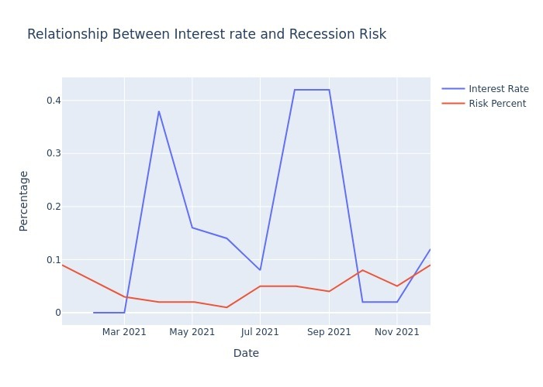
YIELD CURVE and FINANCIAL MODELING PREP

Slide 9
Next Steps
Go after more interest rates and more time frames
See if the initial relationship holds between the recession indicator and interest rates

Slide 10
Links
https://github.com/zeta1178/FinTech-Project1

