Slide 1
QUANT BOOTCAMP PROJECT
BTC FUTURES
5 Years
HEDGING
BTC-USD & Futures Data
Minimum-Variance Hedge Ratio: Naive vs Static vs Dynamic
3 Strategies
Naive · Static · Dynamic
76.8%
Best Variance Reduction
Data: Yahoo Finance | 2021–2025 | 60-day rolling window

Slide 2
WHY HEDGE BTC?
The Problem
Assumptions
Long Spot BTC
Linear exposure — portfolio P&L is spot P&L minus futures P&L
Hold BTC directly — exposed to full price volatility
Hedge ratio fixed within each period
Short Futures
Self-financing — no interim cash flows
Take offsetting futures position to reduce risk
Log returns used for symmetric properties
Goal: Minimize Variance
No transaction costs or margin frictions
Not eliminate P&L, but reduce daily fluctuations

Slide 3
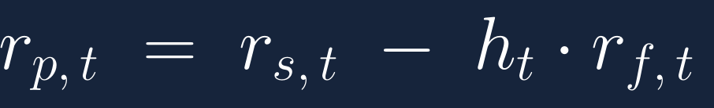
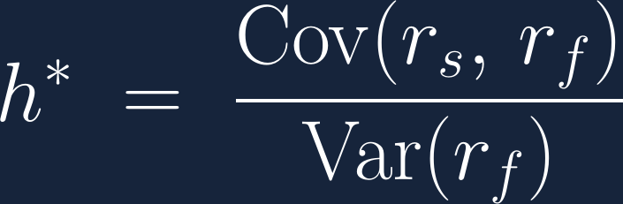
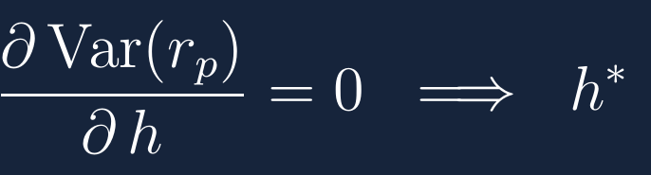
THE MATH
Minimum-Variance Framework
Hedged Portfolio Return
where rₛ = spot return, r_f = futures return, h = hedge ratio
Optimal Hedge Ratio (Minimize Variance)
Intuition
The optimal hedge is essentially the OLS beta of spot returns on futures returns. If spot and futures move 1-to-1, h* = 1. In practice, basis risk means h* < 1. For BTC: h* ≈ 0.85 — hedge ~85% of spot exposure, not 100%.

Slide 4

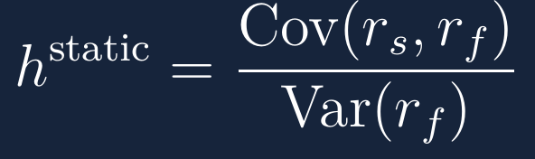
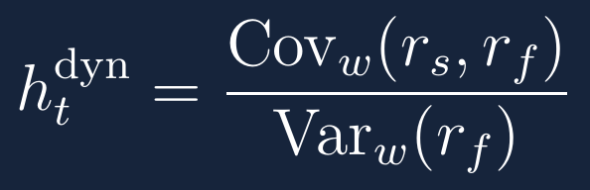
THREE STRATEGIES
Naive Hedge
Static Hedge
Dynamic Hedge
Assumes spot and futures move dollar-for-dollar. Simplest benchmark — no estimation required.
Single OLS estimate over the full 5-year sample. Data-driven but assumes stable relationship.
Rolling 60-day window re-estimates h each day. Lagged to avoid look-ahead bias.
✓ Zero estimation error
✓ Optimal in-sample
✓ Adapts to market changes
✗ Ignores basis risk
✗ Can't adapt to regime shifts
✗ Noisier estimates

Slide 5
DATA & METHODOLOGY
Spot
BTC-USD daily close (Yahoo Finance)
Returns
Log returns: ln(Pₜ / Pₜ₋₁)
Futures
BTC=F — CME Bitcoin Futures
Window
60-day rolling for dynamic hedge
Period
Jan 2021 — Dec 2025 (~1,800 obs)
Lag
hₜ₋₁ applied at time t (no look-ahead)
Pipeline
Download spot & futures → Compute log returns → Estimate h (naive / static / dynamic) → Compute hedged returns → Measure variance reduction (HE)

Slide 6
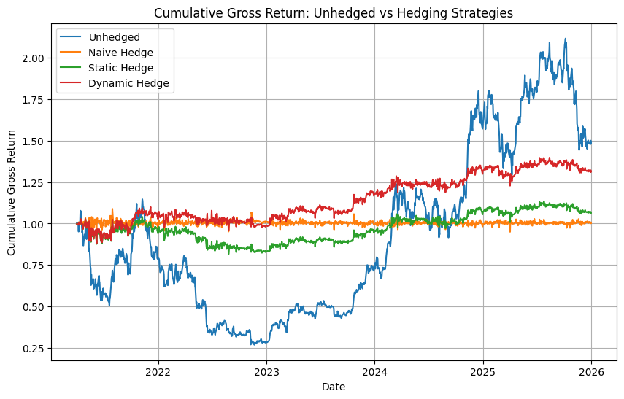
CUMULATIVE GROSS RETURNS
Unhedged vs Hedging Strategies (2021–2025)
Key Observations
Unhedged
Highest return in bull markets, but largest drawdowns. Final: ~1.49
Naive
Nearly flat around 1.0 — almost fully neutralizes BTC exposure.
Static
Reduces volatility while preserving some upside. Final: ~1.06
Dynamic
Best cumulative return among hedged strategies. Final: ~1.31

Slide 7
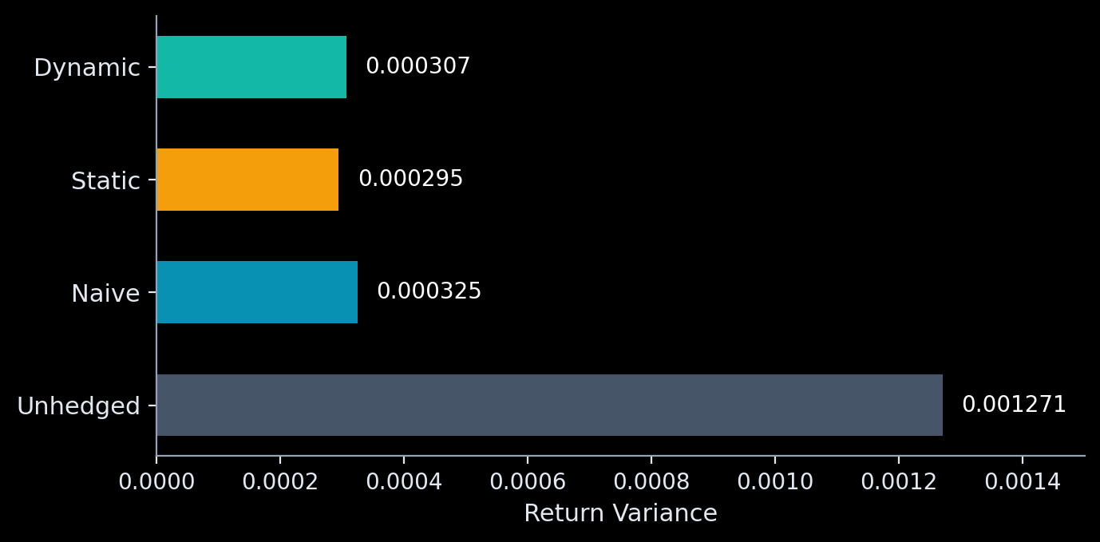
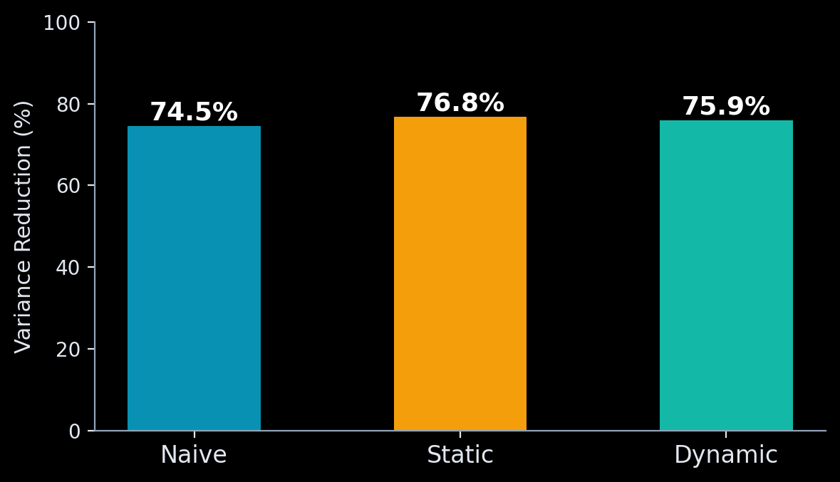
HEDGING EFFECTIVENESS
Variance Reduction Analysis
Summary Statistics
74.5%
76.8%
75.9%
h* = 0.85
Naive HE
Static HE
Dynamic HE
Optimal Ratio

Slide 8
KEY
All strategies cut variance 74–77%
TAKEAWAYS
Static hedge wins in-sample (76.8%)
Hedging ≠ maximizing returns
Preserve wealth → hedge. Reduces volatility & drawdowns. Grow capital → don't hedge. Keep full upside, manage position size instead.
Optimal h* ≈ 0.85, not 1.0
For 1 BTC: short ~0.85 BTC futures for best variance reduction
Naive (h=1) over-hedges · Dynamic (h≈0.82) adapts but adds noise

