Slide 1
Apple Disease Detector
SC/2019/11126 W.A.I.M.Weerasinghe (Leader)
SC/2019/11150 V.M. Sooriyaarchchi
SC/2019/11144 G.D.A.M. Asanka Madhushan
SC/2019/11117 R.P.M.L. Vijayathunga
SC/2019/11132 W.K.D.H. Hashan Piyumal

Slide 2
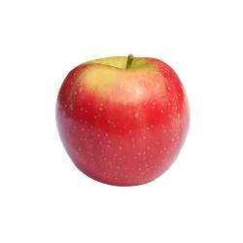
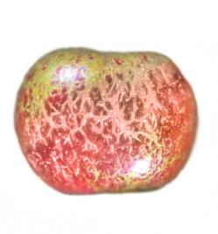
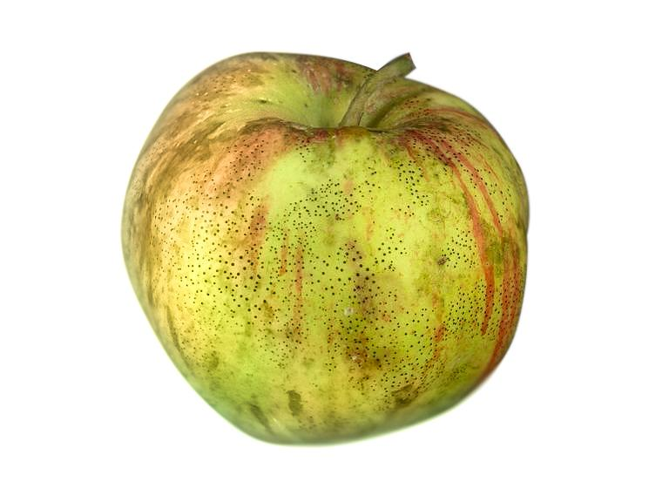
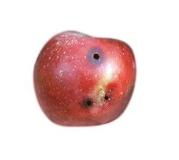
Problem : Diseases on Apples
Common 3 diseases for Apples,
Powdery Mildew disease
Flyspeck disease
Apple Cod disease

Slide 3
Problem (cont..) : Identification
Use image processing techniques, such as,
RGB Channel separation
Grey Level slicing
Edge detection techniques
Binary image Arithmetic (Logical AND)
Image segmentation
To identify between those mentioned diseases.

Slide 4
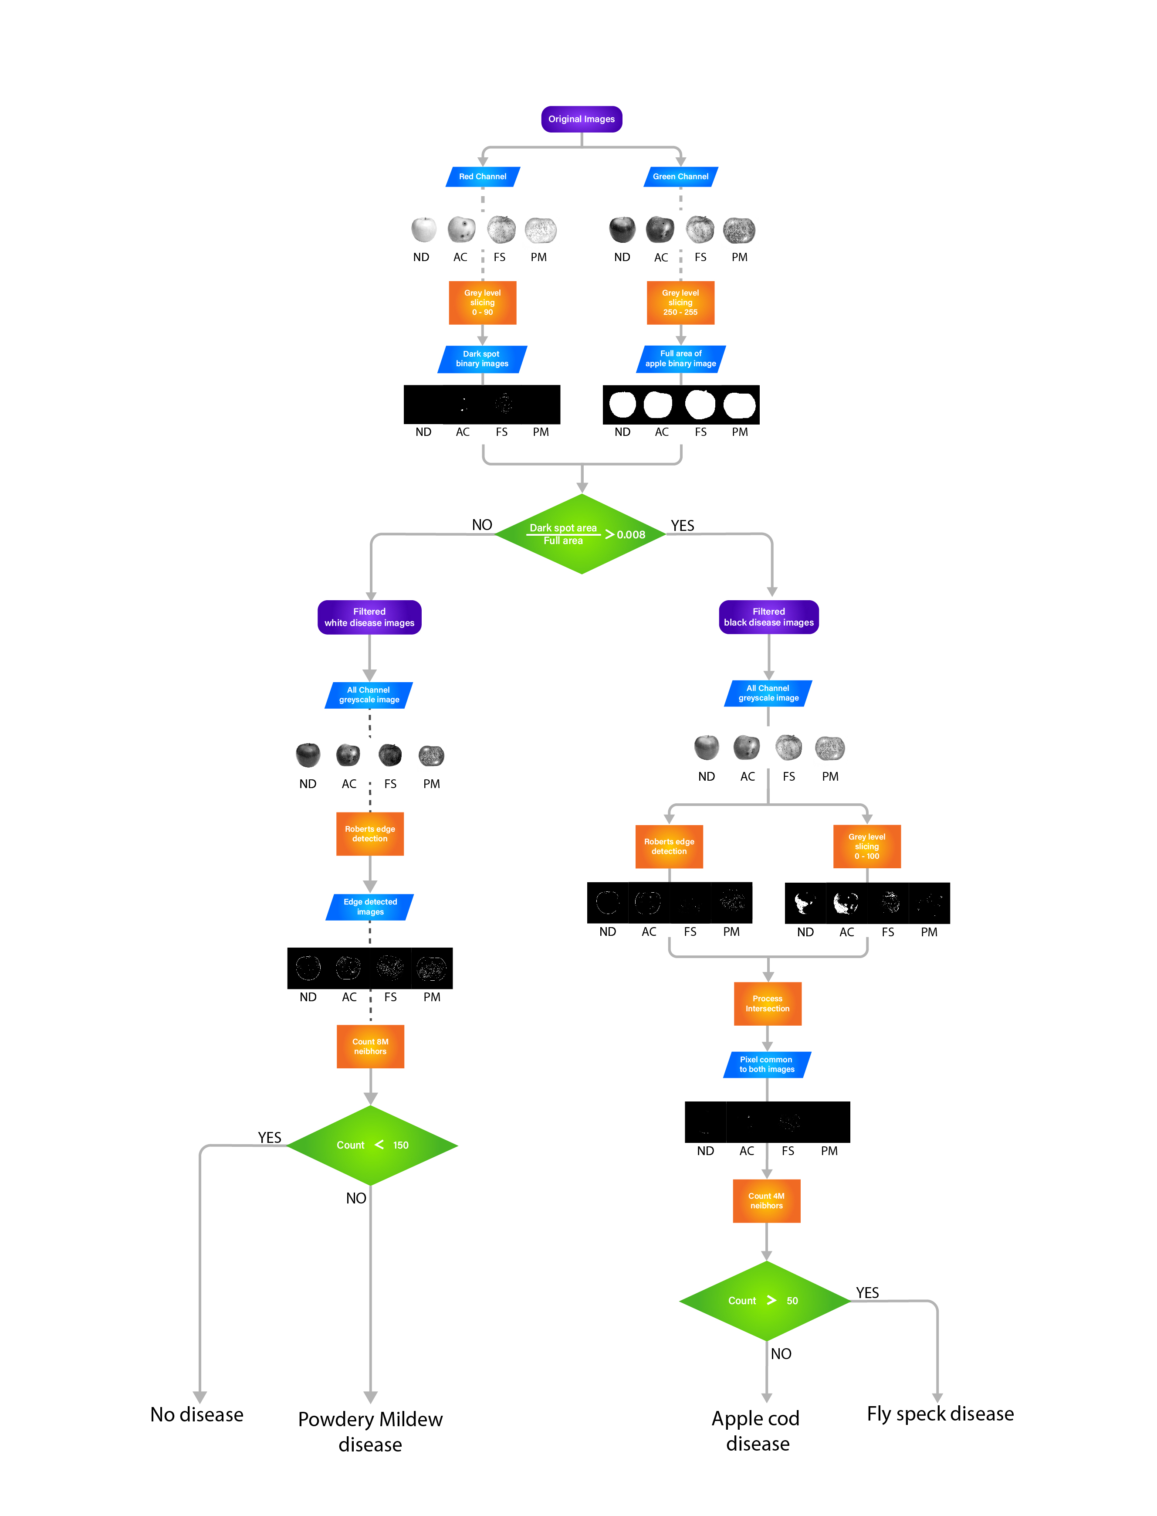
Let's discuss how it is done....

