Slide 1
NANOTECHNOLOGY
PRESENTED BY:
ABION, ERICA B.
CEDENO, DIANA ASHLEY
FABIANO, FAYE DOMINIC

Slide 2
OBJECTIVES
At the end of this section the student should be able to:
1. Discuss the antecedents of Nanotechnology and its importance to society
2. Enumerate the positive and negative impacts of Nanotechnology on the environment and society; and
3. Identify the moral and ethical questions and concerns surrounding Nanotechnology

Slide 3

NANOTECHNOLOGY
*The branch of technology that deals with the manipulation and study of matter at the nanoscale
*It covers all types of research and technologies that deal with the special properties of matter on an atomic molecular and supramolecular scale

Slide 4
APPLICATIONS OF NANOTECHNOLOGY

Slide 5
APPLICATIONS OF NANOTECHNOLOGY
With scientist and engineers continuously finding ways to make materials at the nanoscale, more uses of nanotechnology arise.
Here are the following applications of nanotechnology:
•Medicine
•Water purification system
•Agriculture
•Bionanotechnology

Slide 6
APPLICATIONS OF NANOTECHNOLOGY
•Medicine
In medicine, nanotechnology has numerous applications in the development of more effective drugs.
Assisted by the view of molecules afforded by X-ray lasers, biological mechanisms can be simulated to destroy a cancer cell while it is treated by drug-bearing nanoparticles

Slide 7
APPLICATIONS OF NANOTECHNOLOGY
•Water purification system
Water purification system containing materials and utilizing new membrane technologies containing variable pore-sized filters
Nanoparticles are used to prepare heat resistant and self cleaning surfaces, such as floors and benchtops

Slide 8
APPLICATIONS OF NANOTECHNOLOGY
•Agriculture
In agriculture, novel techniques of nanotechnology applications are applied to breed crops with higher levels of micronutrients to detect pets and to control food processing.

Slide 9
APPLICATIONS OF NANOTECHNOLOGY
•Bionanotechnology
Bionanotechnology can support cleaner production methods and provide alternative and renewable energy sources to enhance the sustainability of factories.

Slide 10
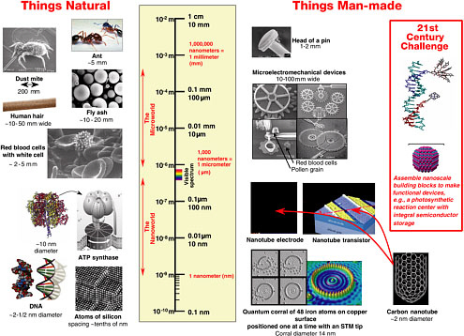
NANOSCALE
A chemical reagents or catalyst are smaller yet they increase the rate of chemical reaction, thus lessening the input of raw materials

Slide 11
Nanotechnology in the Philippines

Slide 12
Nanotechnology in the Philippines
In the Philippines, Nanotechnology can be applied in making source of renewable energy accessible to many, developing medicine that would address serious diseases, improving the state of agriculture and more

Slide 13
Nanotechnology in the Philippines
There are also existing and ongoing research studies funded by the Department of Science and Technology (DOST) on the possible application of technology as well as Nano-Metrology and Education Public Awareness

Slide 14
Challenges of Nanotechnology

Slide 15
Challenges of Nanotechnology
The advantages brought by innovations in nanotechnology come with a price. With rapid developments in nanotechnology, its adverse effects become more visible.

Slide 16
Challenges of Nanotechnology
The environmental effect of mineral-based nanoparticles found in cosmetics, paints, clothing, and other products are questioned as they go through sewerage. treatment plants untreated due to their undetectable size
.

Slide 17
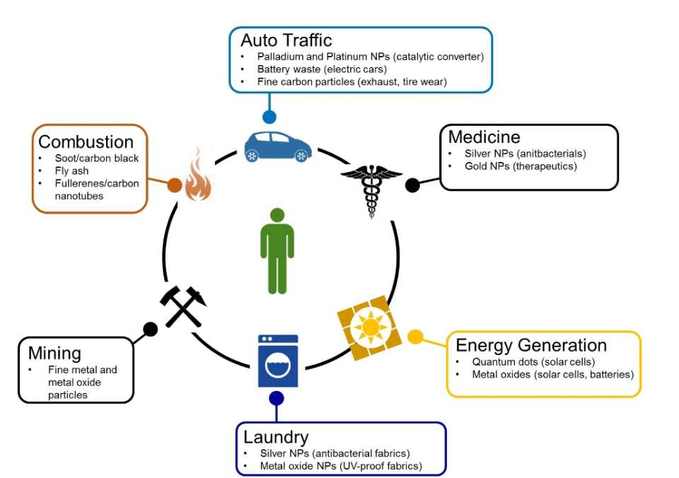
Challenges of Nanotechnology
Carbon nanotubes in manufacture of memory storage, electronics, batteries, etc. were found to have unknown harmful impacts to the human body by inhalation into lungs comparable to asbestos fiber 11.

Slide 18
Challenges of Nanotechnology
Carbon nanotubes in manufacture of memory storage, electronics, batteries, etc. were found to have unknown harmful impacts to the human body by inhalation into lungs comparable to asbestos fiber 11.

Slide 19
Ethical Dilemmas of Nanotechnology

Slide 20
Ethical Dilemmas of Nanotechnology
With the identified potential hazards that nanoparticles can bring to human health and the environment, should people disregard the benefits that nanotechnology provide them?

Slide 21
Ethical Dilemmas of Nanotechnology
Issues raised regarding nanotechnology should be further studied, and nanotechnology methods should be modified.

Slide 22
Thank youu :>

