Slide 1
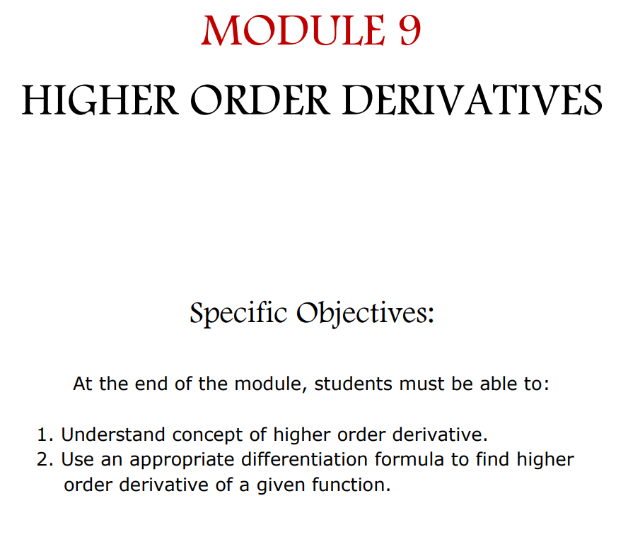

Slide 2
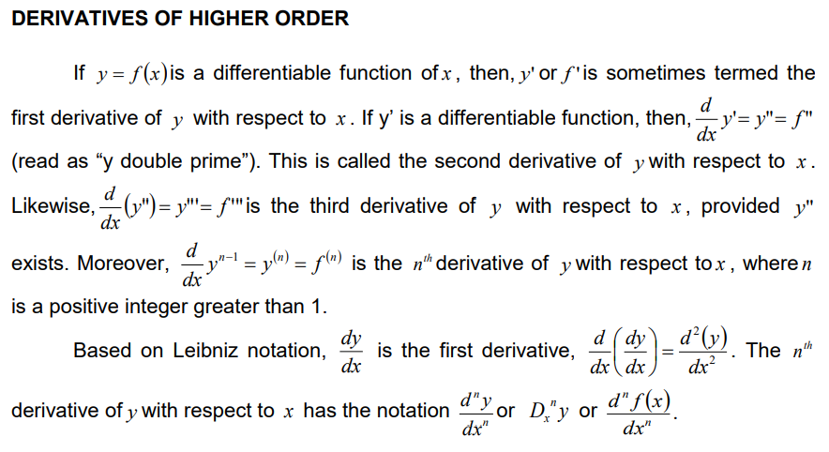

Slide 3


Slide 6


Slide 7
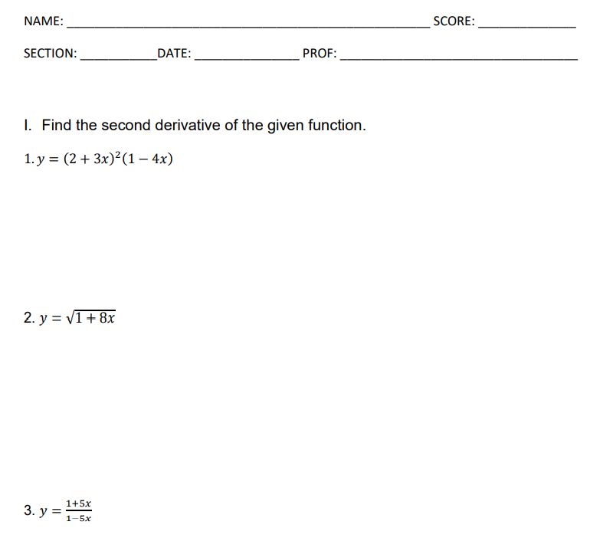
ASSIGNMENT NUMBER 13

Slide 8
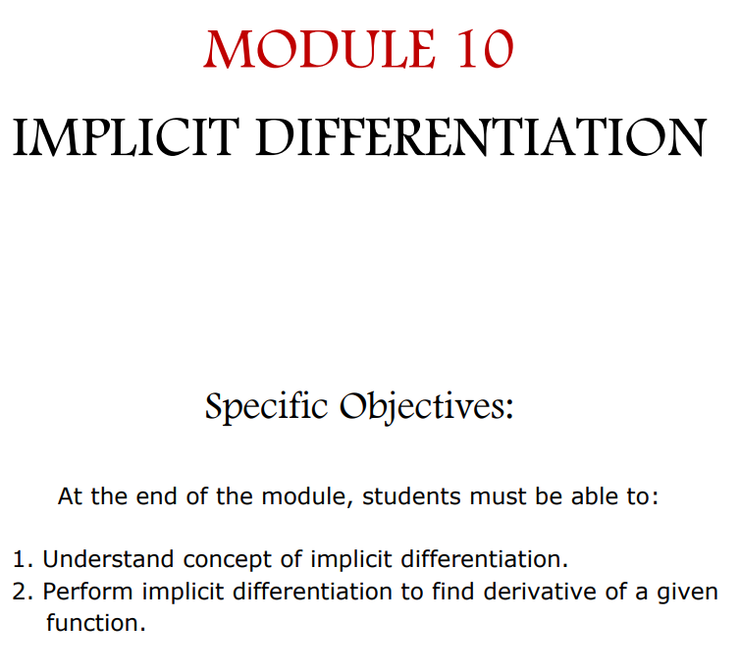

Slide 9
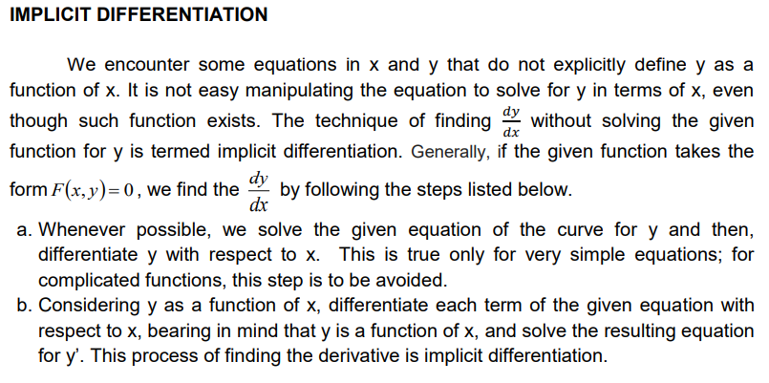

Slide 10


Slide 11


Slide 12


Slide 13


Slide 14


Slide 15
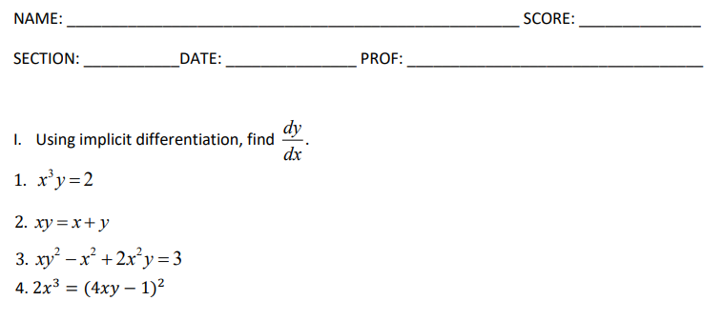
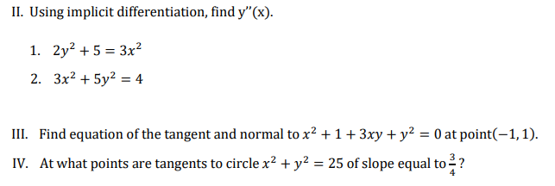
ASSIGNMENT NUMBER 14

Slide 16
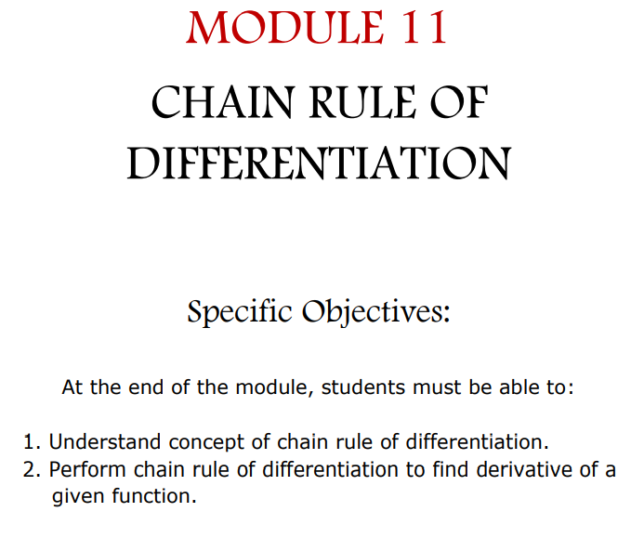

Slide 17
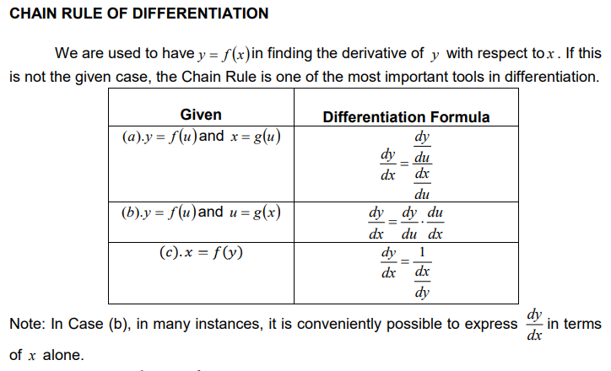

Slide 18


Slide 19


Slide 21
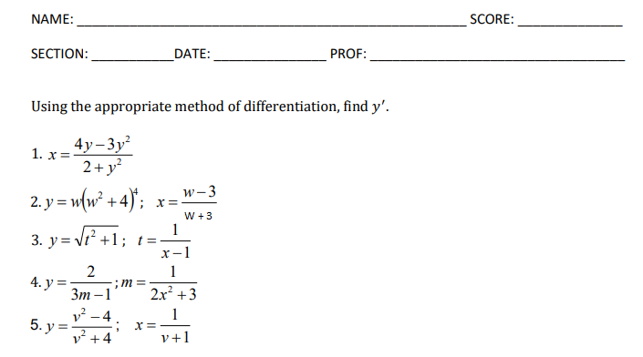
Assignment number 15

