Slide 1
PL/SQL Web Application

Slide 2
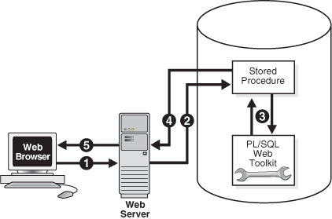
INVOKING PL/SQL WEB APPS

Slide 3
Invoking PL/SQL Apps
The process includes the following steps:
A user visits a Web page, follows a hypertext link, or submits data in a form, which causes the browser to send a HTTP request for a URL to an HTTP server.
The HTTP server invokes a stored procedure on an Oracle database according to the data encoded in the URL. The data in the URL takes the form of parameters to be passed to the stored procedure.
The stored procedure calls subprograms in the PL/SQL Web Toolkit. Typically, subprograms such as HTP.Print generate Web pages dynamically. A generated Web page varies depending on the database contents and the input parameters.
The subprograms pass the dynamically generated page to the Web server.
The Web server delivers the page to the client

Slide 4
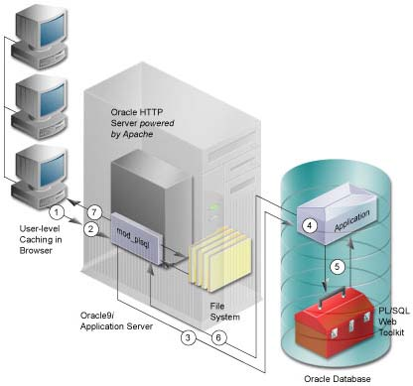
Implementing PL/SQL Web Applications
You can implement a web browser-based application entirely in PL/SQL with these Oracle Database components:
PL/SQL Gateway
PL/SQL Web Toolkit

Slide 5
You can implement a web browser-based application entirely in PL/SQL with these Oracle Database components:
PL/SQL Gateway
PL/SQL Web Toolkit

