Slide 1
Vectors
Lesson 4.3

Slide 2

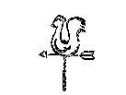
What is a Vector?
A quantity that has both
  Size
  Direction
Examples
  Wind
  Boat or aircraft travel
  Forces in physics
Geometrically
  A directed line segment
Terminal point
Initial point

Slide 3
Vector Notation
Given by
  Angle brackets <a, b> a vector with
    Initial point at (0,0)
    Terminal point at (a, b)
  Ordered pair (a, b)
    As above, initial point at origin, terminal point at the specified ordered pair
(a, b)

Slide 4
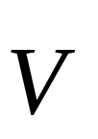
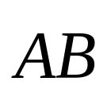
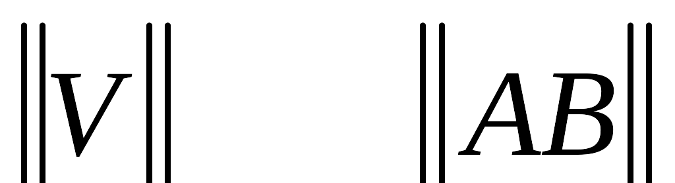
Vector Notation
An arrow over a letter
  or a letter in
  bold face V
An arrow over two letters
  The initial and terminal points
  or both letters in bold face AB
The magnitude (length) of a vector is notated with double vertical lines
V
A
B

Slide 5
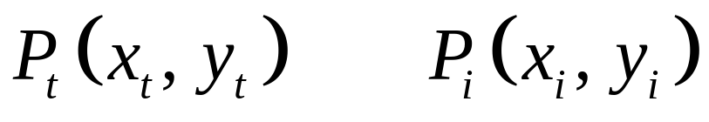
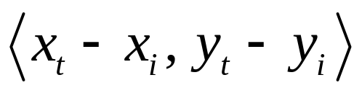
Equivalent Vectors
Have both same direction
and same magnitude
Given points
The components of a vector
  Ordered pair of terminal point with initial point at (0,0)
(a, b)

Slide 6
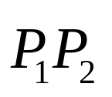
Find the Vector
Given P₁ (0, -3) and P₂ (1, 5)
  Show vector representation in <x, y> format for
  <1 – 0, 5 – (-3)> = <1,8>
Try these
  P₁(4,2) and P₂ (-3, -3)
  P₄(3, -2) and P₂(3, 0)

Slide 7
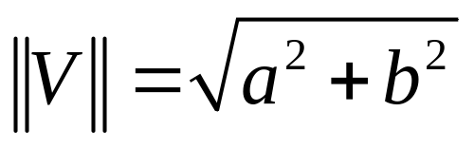
Fundamental Vector Operations
Given vectors V = <a, b>, W = <c, d>
Magnitude
Addition
  V + W = <a + c, b + d>
Scalar multiplication – changes the magnitude, not the direction
  3V = <3a, 3b>

Slide 8
Vector Addition
Sum of two vectors is the single equivalent vector which has same effect as application of the two vectors
A + B
Note that the sum of two vectors is the diagonal of the resulting parallelogram
A
B

Slide 9
Vector Subtraction
The difference of two vectors is the result of adding a negative vector
  A – B = A + (-B)
A
B
A - B
-B

Slide 10
Vector Addition / Subtraction
Add vectors by adding respective components
  <3, 4> + <6, -5> = ?
  <2.4, - 7> - <2, 6.8> = ?
Try these visually,
draw the results
  A + C
  B – A
  C + 2B
A
C
B

Slide 11
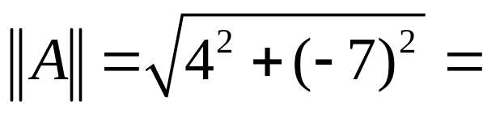
Magnitude of a Vector
Magnitude found using Pythagorean theorem or distance formula
  Given A = <4, -7>
Find the magnitude of these:
  P₁(4,2) and P₂ (-3, -3)
  P₄(3, -2) and P₂(3, 0)

Slide 12
Unit Vectors
Definition:
  A vector whose magnitude is 1
Typically we use the horizontal and vertical unit vectors i and j
  i = <1, 0> j = <0, 1>
  Then use the vector components to express the vector as a sum
  V = <3,5> = 3i + 5j

Slide 13
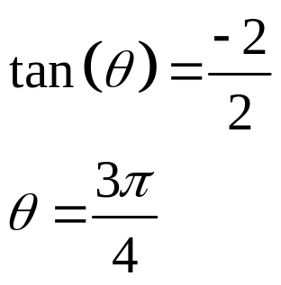
Unit Vectors
Use unit vectors to add vectors
  <4, -2> + <6, 9>
  4i – 2j + 6i + 9j = 10i + 7j
Use to find magnitude
  || -3i + 4j || = ((-3)² + 4²)^{1/2} = 5
Use to find direction
  Direction for -2i + 2j

Slide 14

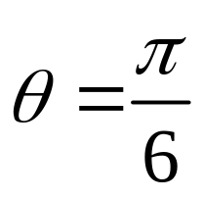
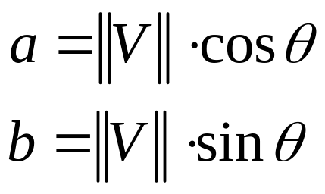
Finding the Components
Given direction θ and magnitude ||V||
V = <a, b>
b
a

Slide 15

Applications of Vectors
Sammy Squirrel is steering his boat at a heading of 327° at 18mph. The current is flowing at 4mph at a heading of 60°. Find Sammy's course
Note info about E6B flight calculator

Slide 16

Application of Vectors
A 120 pound force keeps an 800 pound box from sliding down an inclined ramp. What is the angle of the ramp?
  What we have
  is the force
  the weight
  creates
  parallel to the
  ramp

Slide 17
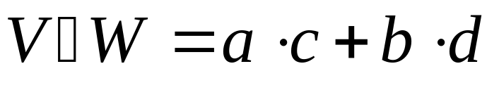
Dot Product
Given vectors V = <a, b>, W = <c, d>
Dot product defined as
Note that the result is a scalar
Also known as
  Inner product or
  Scalar product

Slide 18
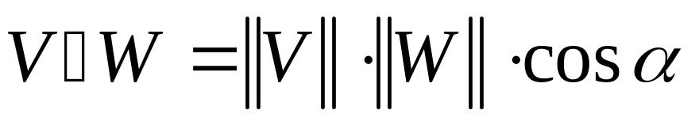
Find the Dot (product)
Given A = 3i + 7j, B = -2i + 4j, and
C = 6i - 5j
Find the following:
  A • B = ?
  B • C = ?
The dot product can also be found with the following formula

Slide 19
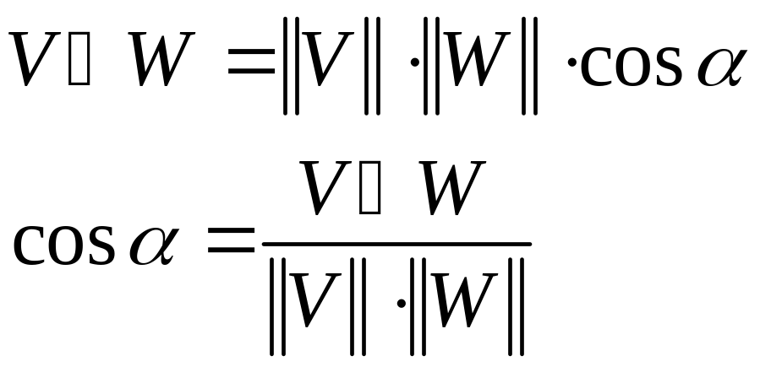
Dot Product Formula
Formula on previous slide may be more useful for finding the angle α

Slide 20
Find the Angle
Given two vectors
  V = <1, -5> and W = <-2, 3>
Find the angle between them
  Calculate dot product
  Then magnitude
  Then apply
  formula
  Take arccos
W
V

Slide 21
Dot Product Properties (pg 321)
Commutative
Distributive over addition
Scalar multiplication same over dot product before or after dot product multiplication
Dot product of vector with itself
Multiplicative property of zero
Dot products of
  i • i =1
  j • j = 1
  i • j = 0

Slide 22
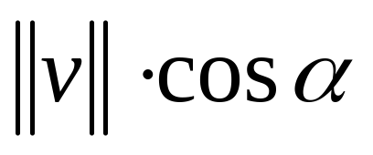
Scalar Projection
Given two vectors v and w
Proj_{w}v =
v
α
w
proj_{w}v
The projection of v on w

Slide 23
Scalar Projection
The other possible configuration for the projection
Formula used is the same but result will be negative because α > 90°
v
α
proj_{w}v
The projection of v on w
w

Slide 24
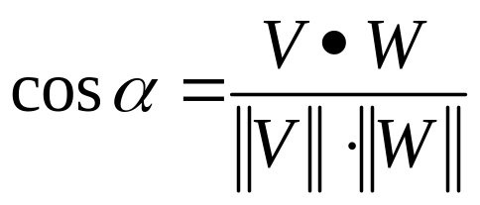
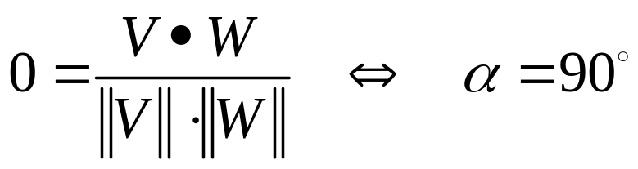
Parallel and Perpendicular Vectors
Recall formula
  What would it mean if this resulted in a value of 0??
  What angle has a cosine of 0?

Slide 25
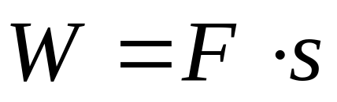

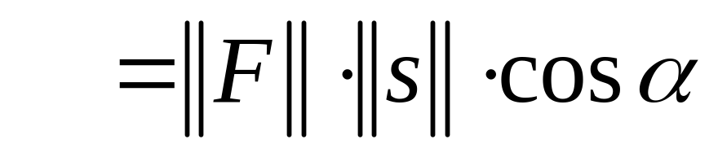
Work: An Application of the Dot Product
The horse pulls for 1000ft with a force of 250 lbs at an angle of 37° with the ground. The amount of work done is force times displacement. This can be given with the dot product
37°

