Slide 1
Reading Real Handwriting
Upgrading the Handwritten Examination Digitizer’s recognition model — Week 8
NLP Course Project 2026 · AI University Platform
Group 1 — J001 · J002 · J004 · J005 · J006

Slide 2
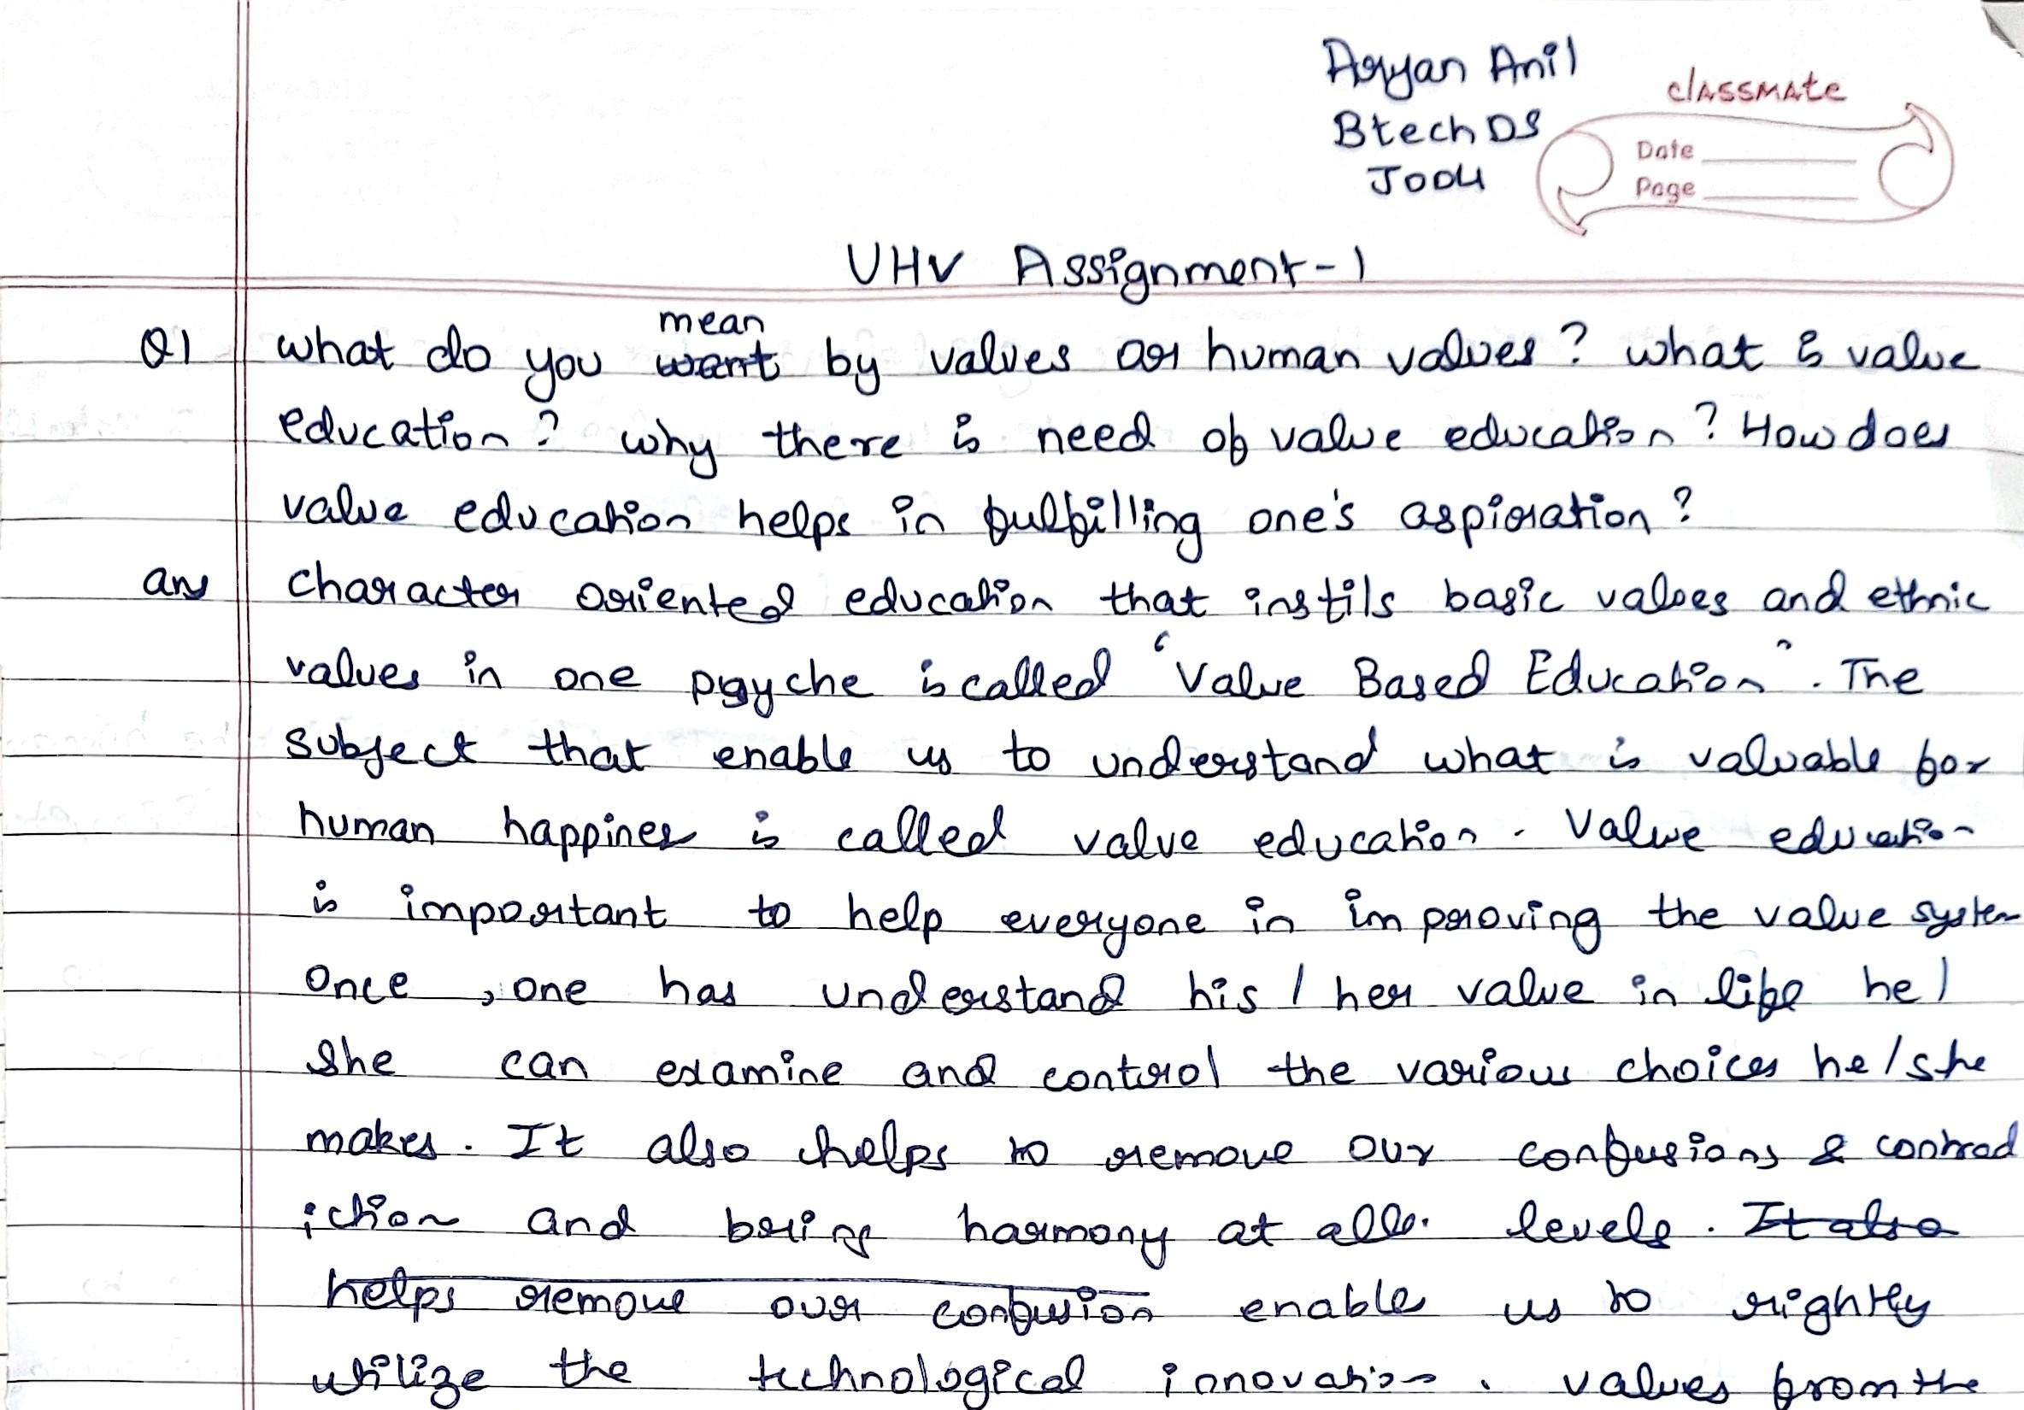
Our digitizer read the benchmark, not the handwriting
Week-7 model (TrOCR-small) on synthetic IAM booklets vs a real handwritten assignment page
4.5%
character errors on our
synthetic test booklets
16.0%
on a real assignment page —
“unusable” is anything over 10%
Worst failure mode: confident wrong words — “psyche is called” → “payche spelled” — which silently cost marks downstream.
The test page: real cursive, ruled paper, cross-outs, an inserted correction (used with the writer’s consent)

Slide 3
How we tested
One page, one ground truth, one metric — every model measured the same way
1
Real input — Top half of page 1 of a genuine handwritten assignment — conditions our synthetic booklets never cover.
2
Hand-made ground truth — Transcribed from the scan; every ambiguous word verified by zooming into the ink — one of our own readings (“Once”) was corrected this way. Crossed-out words excluded.
3
The project’s own metrics — CER = wrong letters per 100 · WER = wrong words, from evaluation/metrics.py. Under 5% CER is “very good”, under 2.5% “excellent”, over 10% unusable.
4
Four model families — Specialized HTR (TrOCR) · specialized OCR (PaddleOCR) · open vision-language models (Qwen3-VL 2B/8B, local) · hosted frontier model (Gemini). Same page, same prompt, same scorer.

Slide 4
Results: smaller errors with every step up
Character error rate (CER, %) on the real page — lower is better
Red specialized OCR · Amber open VLMs, runs on our laptop · Green hosted API · word-error rate fell 35.9% → 4.2%

Slide 5
What the errors actually look like
Same ink, three readers — word-level diffs in testing/model_comparison.html
TrOCR-small — 16.0% CER
Qwen3-VL-8B (local) — 5.9% CER
Gemini + verify — 2.5% CER
• “what do you may values on human valued”
• “payche spelled ‘Value Based Education’”
• “I can’t itfor” (for: & contradiction)
• reads the crossed-out sentence
• drops the last two lines of the page
• “what do you want by values as human values”
• psyche ✓ happiness ✓ contradiction ✓
• bring ✓ rightly ✓ last lines ✓
• still transcribes the crossed-out sentence
• innovation(s) and form/from remain
• every clearly-written word correct, in order
• picks “mean” over the crossed-out “want”
• rejoins contrad/iction across the line break
• left: one ambiguous plural, one form/from,
• three words leaking from struck text
The one thing every model gets wrong: handwritten digits — roll number J004 → “JODU”. Our glyph-CNN + roster check keeps owning student IDs.

Slide 6
What we built in Week 8
The recognition model is now a configuration choice, not an architecture decision
1
Swappable backend factory — make_line_reader(name) picks the recogniser from EXAM_DIGITIZER_HTR; any backend that fails to load warns and falls back to TrOCR — the pipeline never hard-fails.
EXAM_DIGITIZER_HTR =
gemini ← default
Qwen/Qwen3-VL-2B-Instruct
microsoft/trocr-small-…
tesseract
no key / old library?
→ warns, falls back to TrOCR
2
Gemini backend (new default) — Line crops JPEG-batched into one API call per page; key from .env, never logged; self-estimated per-line confidence; retries on network drops.
3
Local VLM backend — Qwen3-VL via transformers ≥ 4.57 or llama.cpp GGUF — fully offline, for pages that must not leave the machine.
4
Layout fix — The last line of a full page (written in the page-number strip) is no longer dropped; narrow printed page numbers still are.
52 tests pass
incl. 11 new Week-8 tests (TDD); suite
runs offline on transformers 4.41 and 5.x

Slide 7
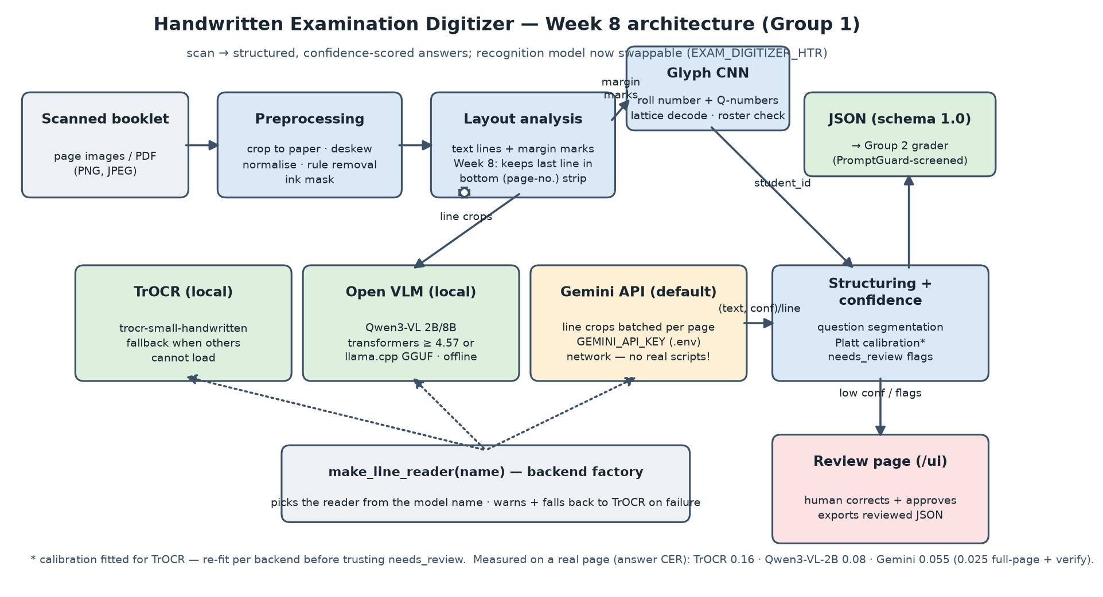
Architecture after Week 8

Slide 8
Demonstration
Everything in the week8/demo folder — reproducible with two commands
Digitize a real page
python -m exam_digitizer.cli digitize sample_real_page.png
JSON answers + confidences via the Gemini backend (set GEMINI_API_KEY)
Same page, fully local
EXAM_DIGITIZER_HTR=Qwen/Qwen3-VL-2B-Instruct … digitize
no network, no key — the privacy-preserving path
Review page
python -m exam_digitizer.cli serve → http://127.0.0.1:8000/ui
human checks boxed lines, corrects, approves, exports JSON
Full-assignment transcript
demo/gemini_full_transcript.md
all 3 pages of the assignment, transcribe + verify pass per page
Word-level comparison
testing/model_comparison.html
every model’s reading vs the ink, mistakes highlighted

Slide 9
Responsible AI
The accuracy win does not change the rules — it sharpens them
1
Privacy boundary — The Gemini backend sends images to Google. Real student scripts never go to it (assignment §8): hosted = synthetic or consented pages only; the local Qwen path exists for everything else. Our test page was a group member’s own assignment, used with consent.
2
Calibration honesty — needs_review thresholds were calibrated for TrOCR. Other backends’ confidences are on different scales (Gemini’s 1.00 ≠ TrOCR’s 1.00) — re-fit before trusting automatic routing.
3
Human in the loop — Unchanged: flagged, unidentified or low-confidence answers are never auto-graded; the review page records who approved what. VLMs misread handwritten digits, so student IDs stay with the glyph CNN + roster.
4
Key hygiene — The API key lives in an untracked .env, read at runtime, never logged or committed.

Slide 10
From unusable to excellent on real handwriting
16.0% → 2.5%
character error rate
35.9% → 4.2%
word error rate
52
tests passing
2
deployment modes: private local / hosted
Next: re-run the frozen 40-booklet benchmark with the new backends · re-fit confidence calibration · OCR-tolerant key-point matching in the grader · anonymised real booklets end-to-end
Group 1 · Handwritten Examination Digitizer · Week 8

