Slide 1

Smart Healthcare Solutions
Application Engineering & Development Project
Ashish Aggarwal | Syed Haroon
001241945 001824956
STARKS

Slide 2
Problem Statement
To impart fluidity and transparency in a city healthcare scenario
The objective of this project is to implement a holistic approach towards a smart healthcare system over the model of a city that will serves its citizen/government.
The idea is to build an application to enhance and smoothen the process flow for various tasks involved in maintaining/running a city to provide its citizens with fundamental services especially those related to healthcare.
The projects will help in easing out complex procedures for government services, and impart transparency regarding funding in different public sectors
Also, to give intelligent recommendations, based on previously recorded data from various patients.

Slide 3
Approach
To build a system that increases efficiency
Real time fund distribution analysis, in healthcare domain
Use reusable, multi-level work request model for efficient functioning
To build a smart system based on historical data of a patient’s medical history and current vitals, a model is developed to predict the chances of a patient being susceptible to a disease
Citizens would be able to view the schedule of remote clinics
Use of graphical tools for analysis and quick interpretation.

Slide 4
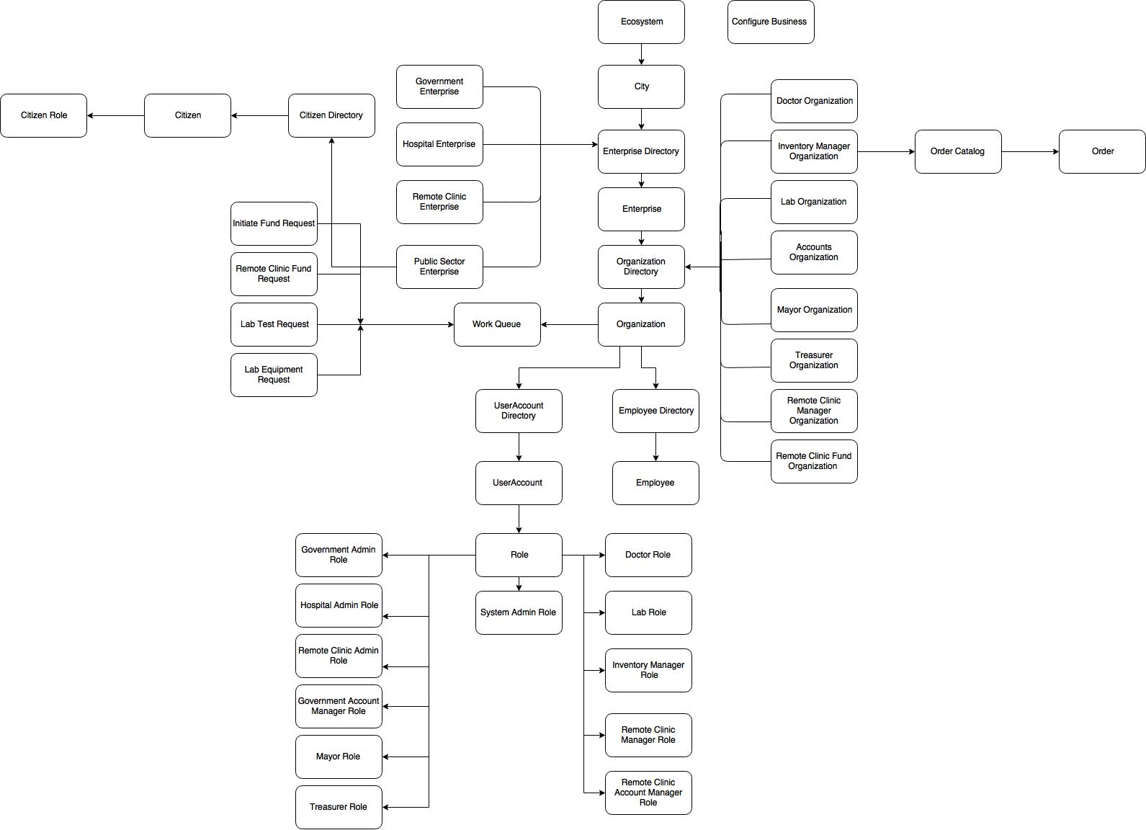
Object Model

Slide 5
Roles
System Admin Role : Creates and Manages Network, Enterprise and Enterprise Admin User Accounts
Admin Role(All Enterprise) : Creates and Manages Organizations, Employee, User Accounts
Account Manager Role : Receives Fund requests from all Enterprises and forwards to Mayor for approval
Mayor Role : Checks and Processes Fund Requests from Account Manager and sends to Treasurer and allocates funds to different enterprises.
Treasurer Role : Receives Fund Approvals from Mayor and Completes Payments to enterprises respective account organisations.
RemoteClinic Manager Role : Can Manage Remote Clininc Schedule and locations and requests funds from RemoteClininc Account Manager

Slide 6
Roles Contd
RemoteClinic Account Manager Role : Receives requests and if funds required forwards to Account Manager
Doctor Role : Registers Patients and process diagnosis . Requests for Lab Tests
Lab Assistant Role : Requests for equipment's from Inventory Manager and completed lab test from doctor
Inventory Manager Role : Add and manage equipment catalog, initiates requests for funds based on order.

Slide 7
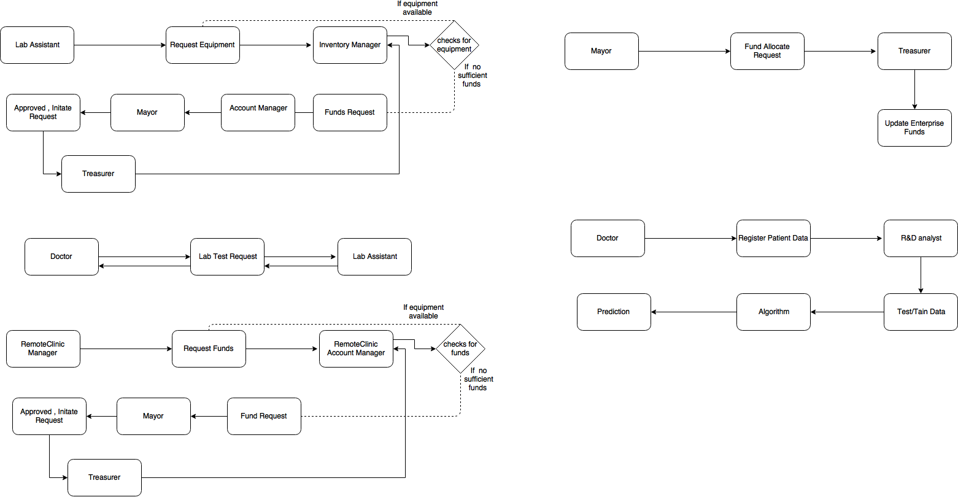
Work Flow

Slide 8
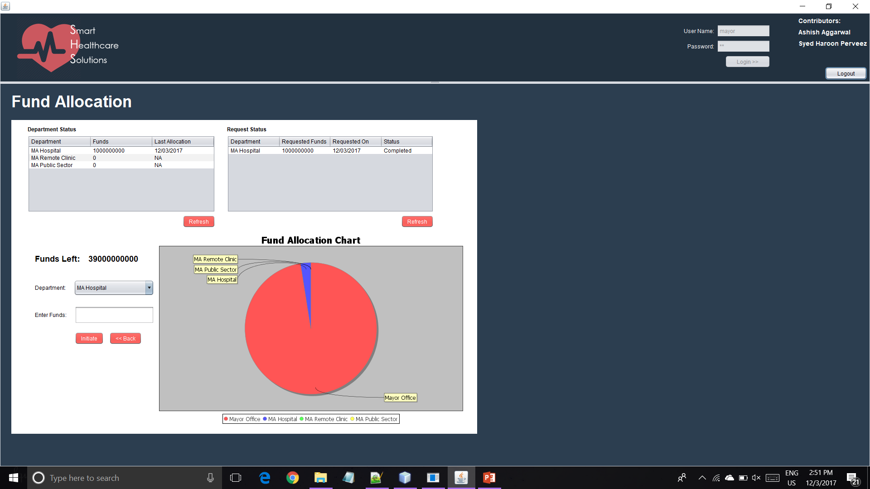
Screenshots

Slide 9
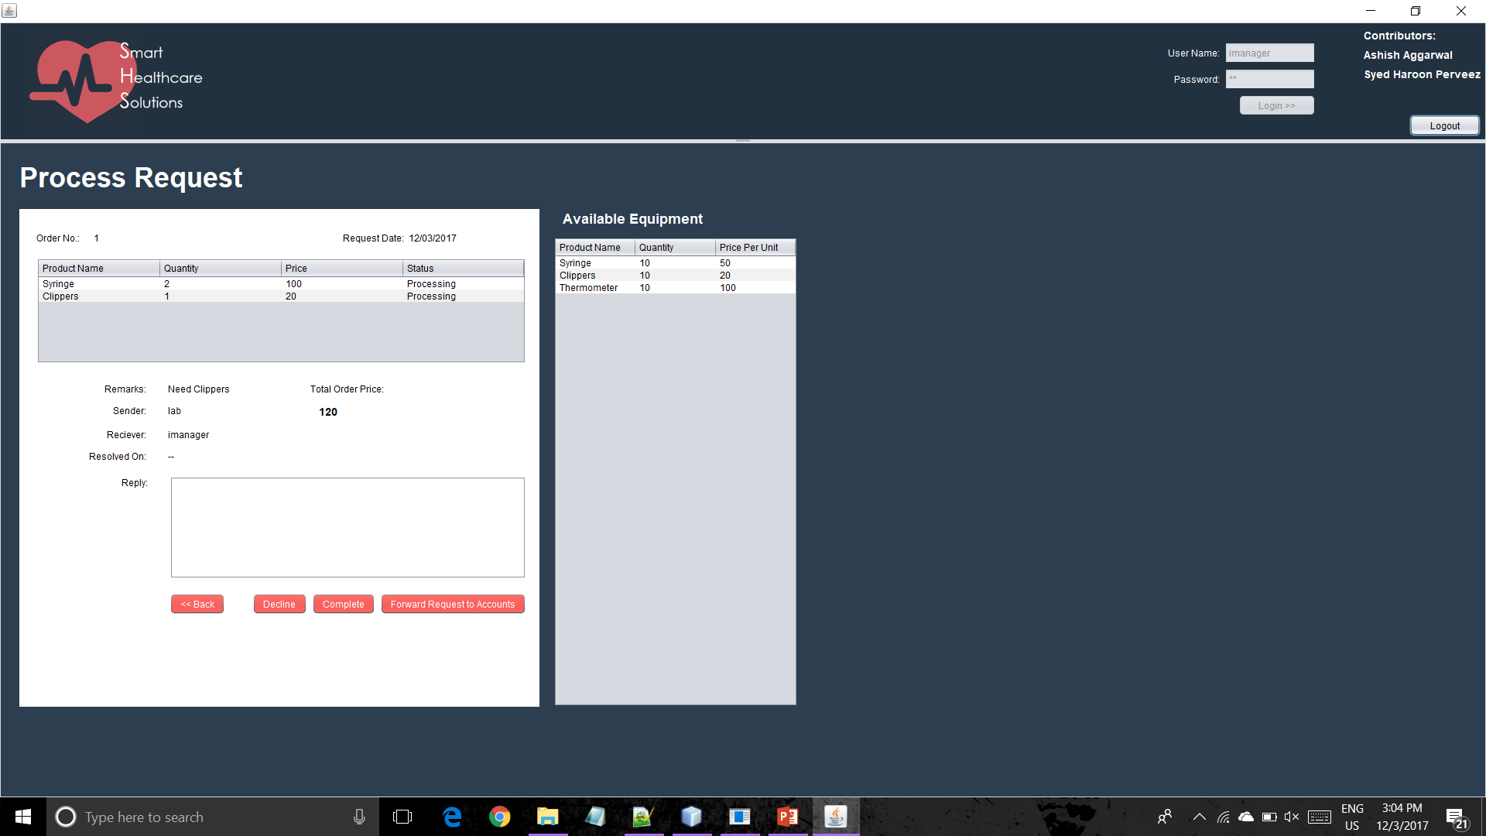

Slide 10
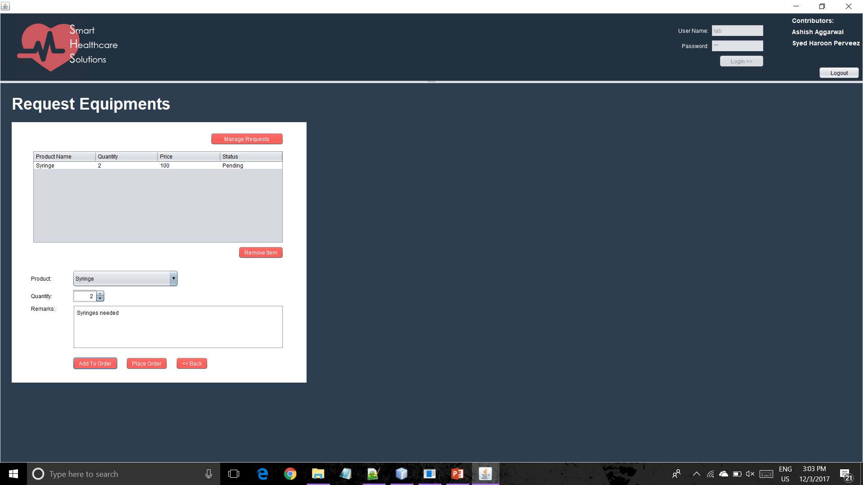

Slide 11
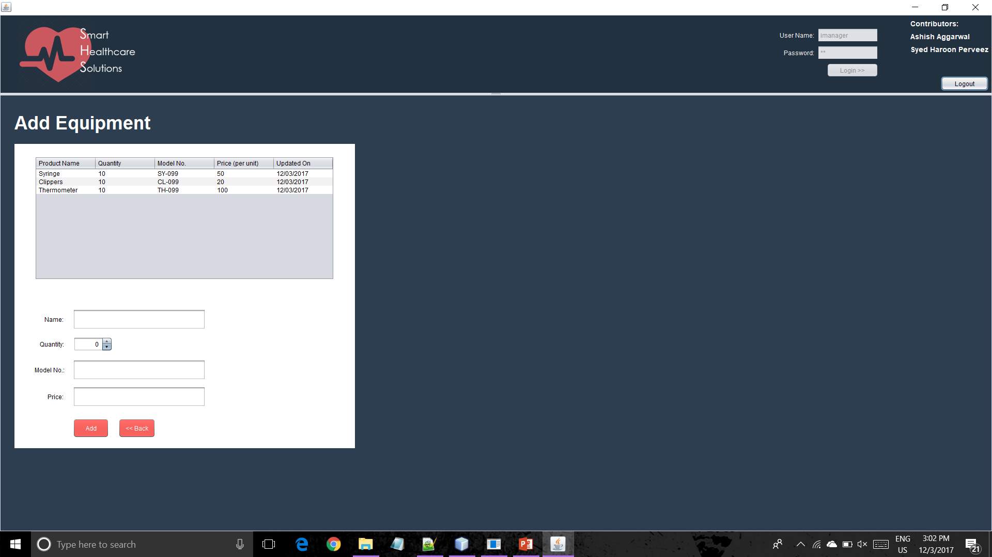

Slide 13
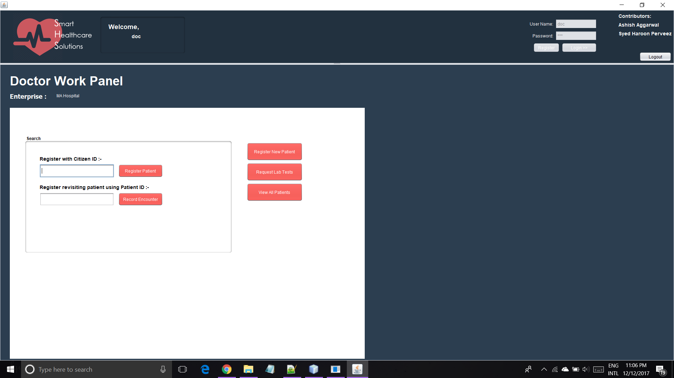

Slide 14
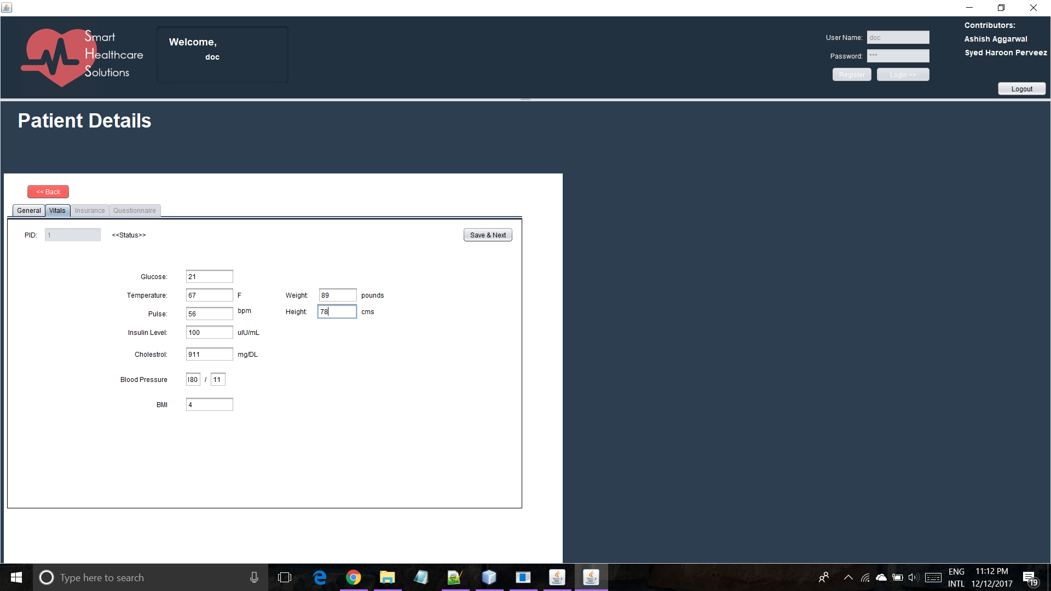

Slide 15
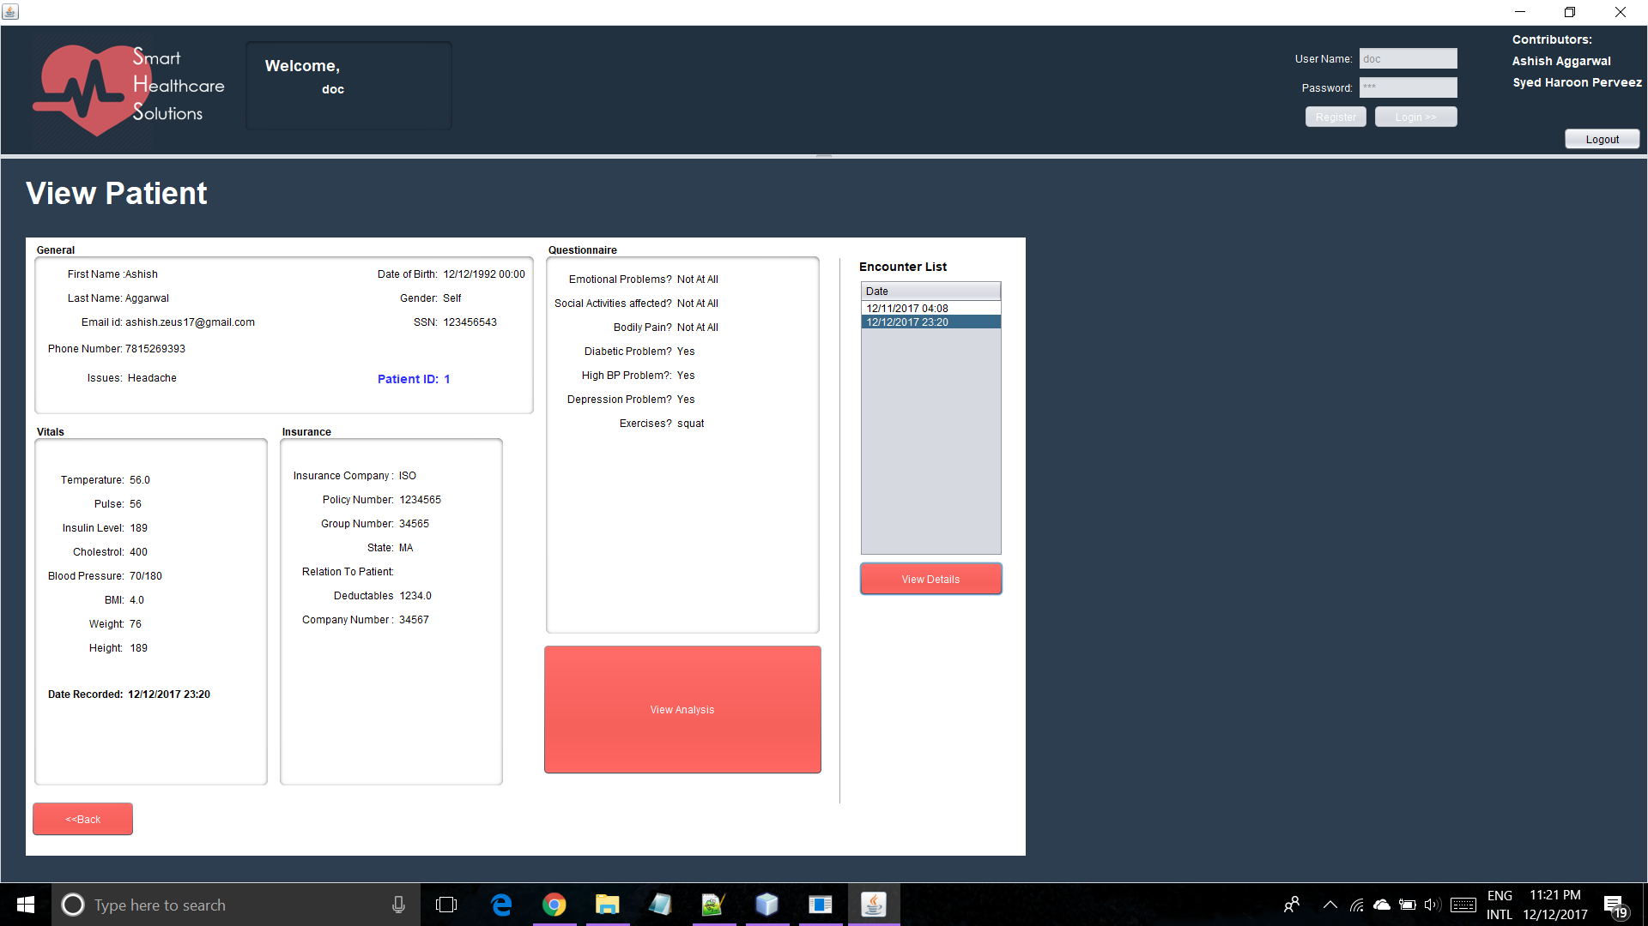

Slide 16
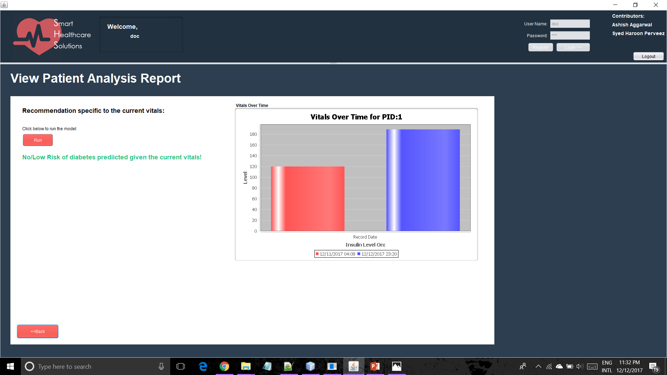

Slide 17
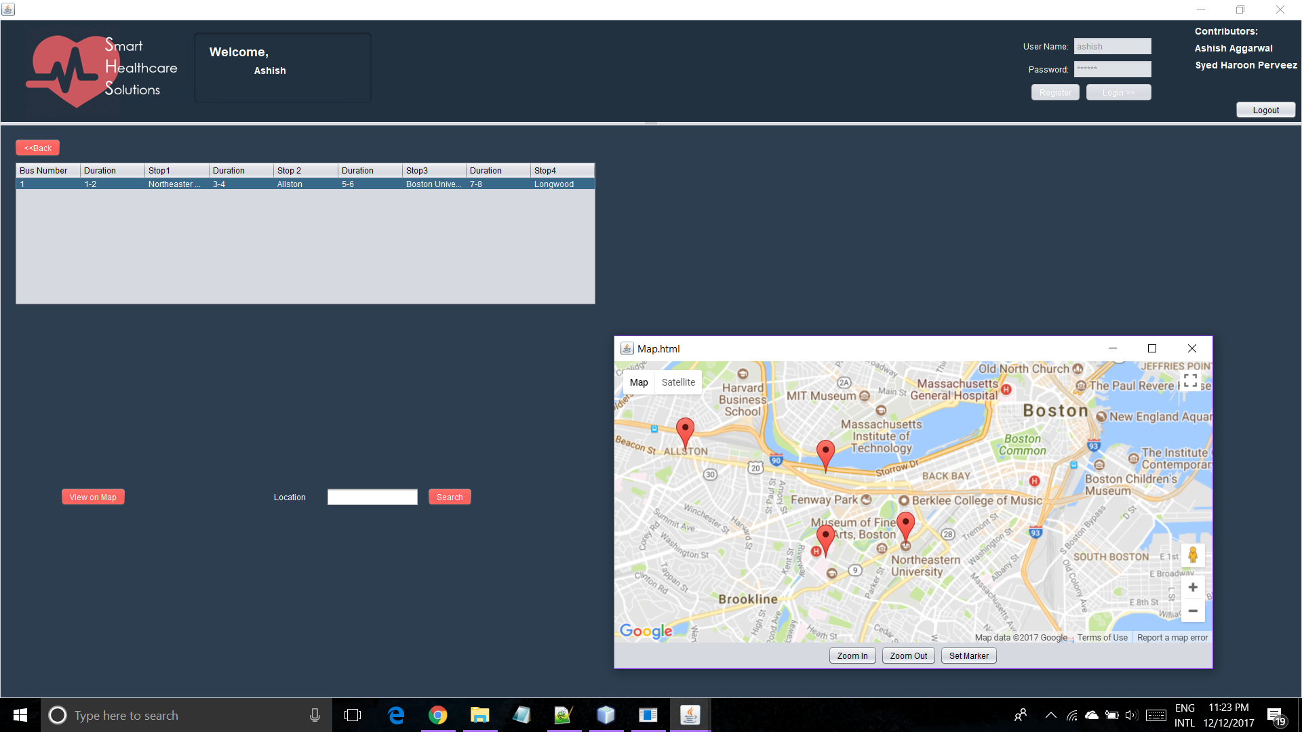

Slide 18
Thank You
Ashish Aggarwal
Syed Haroon
STARKS

