Slide 1


Approximate Similarity Search in Genomic Sequence Databases using
Landmark-Guided Embedding
Ahmet Sacan and I. Hakki Toroslu
email: [ahmet,toroslu]@ceng.metu.edu.tr
Computer Engineering Department,
Middle East Technical University
Ankara, TURKEY
Notes:
The availability of genomic databases has had a great impact on biological and health sciences research. The increasing size of these databases presents a challenge for maintenance and search of sequences.
GenBank, a central database of publicly available DNA sequences has been doubling in size every 15 months. About 700 organisms have been completely sequenced and there are more than 3000 ongoing genome sequencing projects.
In this study, our goal is to efficiently store and retrieve genomic sequences. Instead of looking for exact answers, we allow approximate results. Our study is based on embedding the sequences into a vector space, and perform indexing and retrieval in the vector domain.

Slide 2
Outline
Background
  Sequence Alignment
  Blast
Embedding Subsequences
  Fastmap, LMDS
  Analysis of parameters to achieve stable and accurate mapping
Indexing Subsequences
Notes:
Before going into our methodology, I will be presenting the sequence alignment problem which is used to define the similarity of sequences. I will briefly talk about Blast, which is the popular sequence search tool.
We have examined two embedding methods: Fastmap and LMDS (Landmark MDS=multidimensional scaling). I will present a detailed analysis of the parameters involved to achieve stable and accurate mapping.
Finally, I will present results of indexing the embedded sequences.

Slide 3
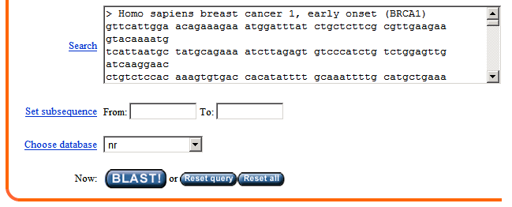
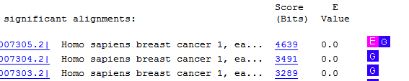

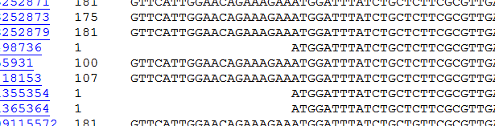
Sequence Similarity Search
Sequence similarity search is at the heart of bioinformatics research
  Similarity information allows: structural, functional, and evolutionary inferences
Notes:
Sequence similarity search can be defined as finding the database subsequences that gives the best alignment score for a given query sequence.
Sequence similarity search is an essential component of bioinformatics research. Finding similar sequences allows us to make structural, functional, and evolutionary inferences. The annotation available for database sequences can be transferred to new sequences whose function is not yet known. Moreover, the similarity of sequences can help us identify conserved residues or functional motifs.
The figure illustrates a typical search process. The user provides a query sequence (left), and obtain hits from the database (right-top). Each of the results are also associated with a statistical significance (E-value). After obtaining the results, the user can also analyze the alignment of these hits (right-bottom) to make biological inferences.

Slide 4
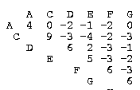
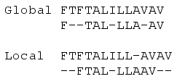
Sequence Alignment
Goal: maximize “alignment score”
Score of aligning two residues:
  Substitution matrix
Optimal solution: Dynamic Programming
  Global: Needleman-Wunsch (1970)
  Local: Smith-Waterman (1981)
Notes:
The similarity is defined in terms of alignment. The alignment score is calculated using a residue substitution matrix which determines how similar two aligned characters are.
The optimal alignment can be found using dynamic programming. Global alignment seeks to align the whole sequence, whereas local alignment tries to identify high scoring local segments.

Slide 5
Blast (Basic Local Alignment Search Tool)
Popular tool for similarity search in sequence databases
Generate “k-tuples” (“k-mers”, “words”) from query
  CDEFG → CDE, DEF, EFG
  CDE → ADE,CDC,CCE, CDE, …
Find (exact) matching k-tuples in the database
For each candidate sequence, extend the k-tuple match in both directions.
Notes:
Sequential scan with Dynamic Programming is not feasible for large databases. So, several heuristic methods have been developed.
Blast is currently the popular tool for sequence search.
The Blast heuristic approach assumes the presence of short exact matches between similar sequences.
Under this assumption, Blast generates all k-tuples from the query sequence. More tuples are generated by including very close neighbors, to allow some inexact matches.
The generated tuples are then searched in the database and each candidate hit is extended in both directions to obtain longer alignments.

Slide 6
Time-accuracy trade-off
Proteins (20³ tuples)
DNA (4¹¹ tuples)
1
2
3
4
…
11
k:
Too many k-tuple hits to process
→Slows down the extension phase
Few/none k-tuple hits
Fast execution
Exact k-tuple matching not sensitive
→Too many false negatives
Challenge:
  Allow flexible matching for larger words at reasonable time
Notes:
The time and accuracy challenges can be best described as a trade-off on the parameter k.
If we use a small k value, then we get too many k-tuple hits to process for the extension phase. If we use a large k value, then the “exact short matches” assumptions does not hold, and we miss the true positives.
The challenge here is to allow flexible (inexact) matching for larger words efficiently.

Slide 7
Raising the bar for k
Map k-tuples to a vector space
  Mapping cannot be perfect, thus “approximate results”
Use Spatial Access Methods (e.g. R-tree, X-tree) to index and retrieve k-tuples
Notes:
Our approach to tackle this challenge is to map the k-tuples to a vector space for efficient retrieval using Spatial Access Methods.
Note that the mapping cannot be perfect, because the original sequence space is not Euclidean. This is why our approach yields approximate results.
In this study, we focus on searching k-tuples. So, from here on, when I say database, I mean the database of k-tuples. The motivation for searching k-tuples is two-fold:
The k-tuple hits can be extended to obtain local sequence alignments, as is done in Blast.
The k-tuple hits themselves can be used to identify conserved motifs.

Slide 8
Mapping k-tuples
Requirements:
  Need to support out of sample extension
  Speed
Candidate methods:
  Fastmap (Faloutsos, 1995)
  Landmark MDS (de Silva, 2003)
Notes:
The mapping method will take the original distance among sequences and generate a vector representation of the sequences.
The mapping method we use needs to support “out-of-sample extension”, because we can’t really afford to rebuild the mapping for each new database entry or new query. Furthermore, the mapping should be fast and able to handle large databases.
Classical multi-dimensional scaling does not provide these. (no out-of-sample extension, and speed:N^2 is not enough).
We have investigated two methods that do provide these features, which I will describe next.

Slide 9
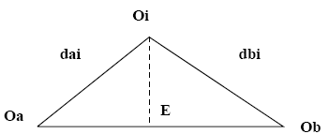

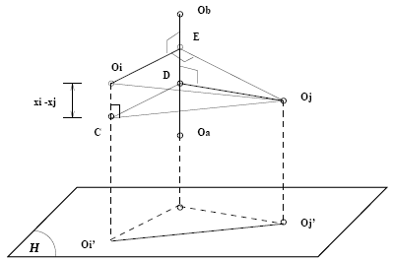

Fastmap
Select two pivots
  Distant pivots heuristic
Obtain projection using
cosine law
Project objects to
new hyperplane
Repeat
Notes:
Fastmap is based an iterative mapping procedure.
Two pivot objects (k-tuples) are selected. Fastmap uses a heuristic that maximizes the distance between the selected pivots (complexity=O(Nk) instead of O(N^2)):
Randomly select a pivot A
Select B, the most distant object to A.
Repeat step2 k times (using the newer object).
The rest of the objects are projected onto the axis defined by the pivots using the cosine law. This projection forms one dimension in the final embedding.
The objects are then projected to hyperplane that is orthogonal to the axis of the pivots. This provides us with new residual distances among objects.
The procedure is repeated for the new distances to calculate more embedding dimensions. We can repeat this as many times as we want the dimensionality of the target space to be.

Slide 10
Fastmap
Fast! O(Nd)
  N: number of data points
  d is the target dimensionality
For query, need only to calculate distances to set of pivots
Unstable (esp. if original space is non-Euclidean)
Notes:
Fastmap has a simple implementation and is quite fast.
For a new query tuple, we only need to calculate the distances to the set of pivots in order to map the new query to the same vector space. (We have two pivots for each dimension.)
However, fastmap is unstable, especially if the original space is not Euclidean.

Slide 11
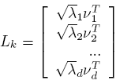

Landmark MDS
Select n landmarks (pivots)
Embed landmarks using classical MDS
For the remaining objects, apply distance-based triangulation based on distances to landmarks
Notes:
On the other hand, Landmark MDS provides better stability of the embedding.
Instead of the iterative embedding used in Fastmap, LMDS uses a flat set of pivots (landmarks).
These landmark objects are mapped to a vector space using classical MDS. (Note that classical MDS on the whole database of k-tuples is not feasible).
The classical MDS computes the d largest positive eigenvalues (\lambda), of the mean-centered inner-product matrix.
Delta_x,n is the vector of squared distances to the n landmark points
L_k# is the pseudoinverse transpose of the landmark embeddings
(3) The remainder of the k-tuples are embedded using distance-based triangulation based on their distances to the landmarks.

Slide 12
Landmark MDS
Provides stable results
Good selection of landmarks is critical.
  LMDS_{random}
  LMDS_{maxmin}
    Add new landmarks that maximizes the minimum distance to already selected landmarks
  LMDS_{fastmap}
    Use the same landmarks as found by Fastmap
Notes:
Landmark MDS provides stable results, however good selection of landmarks is critical for the accuracy of the mapping. We have investigated three mapping strategies.
LMDS_random uses a random set of landmarks
LMDS_maxmin uses tries to maximize the distances among the landmarks by iteratively adding new landmarks such that we maximize the minimum distance to the already selected landmarks
LMDS_fastmap uses the same landmarks as identified by Fastmap

Slide 13
Evaluation
Synthetic datasets
  Randomly generate k-tuples for a given k and alphabet size σ
Real dataset
  Yeast proteins benchmark (σ=20)
  6,341 proteins, 2.9 million residues
  103 query proteins, 38-884 residues
Weighted Hamming distance
CB-EUC substitution matrix (Sacan, 2007)
Notes:
We evaluate the performance of embedding on synthetic and real datasets.
The synthetic dataset is composed of randomly generated k-tuples for a given k length and alphabet size
The real dataset is from the yeast proteins benchmark which has been used to benchmark Blast.
There are more than 6 thousand proteins and close to 3 million residues (amino acids). The yeast dataset also has a separate set of about 100 query proteins ranging from ~40 to ~900 residues.
[[Note2self: Note that the yeast dataset is a protein dataset where each protein is composed of a sequence of 20 types of amino acids (The alphabet size is 20). The methods introduced here can easily be applied to DNA sequences (where alphabet size is 4).]]
To measure the distance between k-tuples, we use weighted hamming distance.
[[Note2self: We use the weighted hamming distance instead of the original alignment score to speed up the evaluation. This is justified for short sequences, because the gap penalty is higher than aligning two different residues]]
As the amino acid substitution matrix, we used a metric substitution matrix that we have developed earlier. We have shown that this matrix gives more accurate alignments than other available metric matrices.

Slide 14
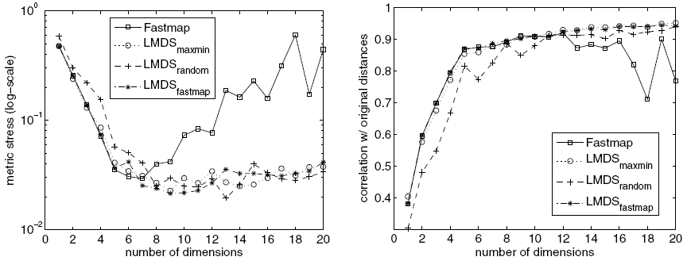

Target dimensionality (d)
k=5, synthetic dataset, identity matrix
Sammon’s metric stress:
Breaking point dimensionality
Notes:
We compare the success of the embedding methods using Sammon’s metric stress measure which shows how well the original distances between the k-tuples are preserved in the embedded vector space.
The figures show the effect of target dimensionality on the metric stress. (We also show the correlation measure on the right).
For fair comparison, 2*d pivots are used in both Fastmap and LMDS.
One would normally expect that when we use more dimensions to represent the data, we should get better accuracy. This is not true for Fastmap, which gives unstable results when embedding non-Euclidean spaces. The LMDS methods give more robust embedding results due to its least-squares scaling and triangulation methods that minimize the embedding error.
In mapping sequences to vector spaces using Fastmap, we observed that Fastmap gave consistent results up to a certain dimensionality, which lead us to define the “breaking poitn dimensionality”
We define the breaking point dimensionality as number of target dimensions after which no significant improvement in embedding performance is obtained. We take the number of dimensions after which Fastmap’s performance degrades (becomes unstable). This gives us an “intrinsic Euclidean dimensionality” of the dataset.

Slide 15
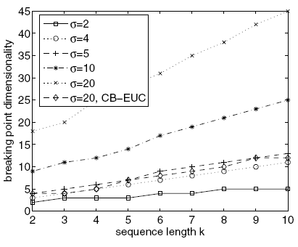

Subsequence length (k) and alphabet size (σ)
Notes:
the breaking point dimensionality of the dataset increases linearly with both the sequence length k and the alphabet size σ. An identity substitution matrix is used in the distance calculation in order to compare the alphabet size σ across datasets.
Note that even though the alphabet size is 20 for proteins, aminoacid substitution matrices impose a clustering on the aminoacid types, which in effect reduces the intrinsic dimensionality of the dataset. The dimensionality of the dataset when the CB-EUC substitution matrix is used ranges between that of the datasets with σ = 4 and σ = 5. In fact, the principal component analysis of the CB-EUC matrix shows that the first 5 principal components account for the 98.2% of the variation in the matrix values.

Slide 16
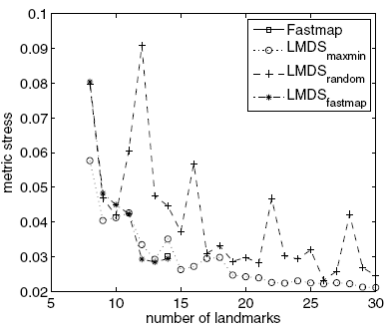
Number of landmarks
k=5, d=7, synthetic dataset, identity matrix
Notes:
For a fixed target dimensionality, Fastmap uses twice as many landmarks (2*d pivots). However, LMDS does not have this restriction, and we can increase the performance of LMDS using more landmarks.
LMDS_maxmin and LMDS_random do converge to an optimal performance, given sufficiently high number of landmarks are used. However, each addition of landmark may not give better embedding accuracy.
On the other hand, LMDS_Fastmap gives monotonically decreasing metric stress. Which shows that Fastmap’s landmark selection strategy is more reliable than the maxmin strategy.

Slide 17
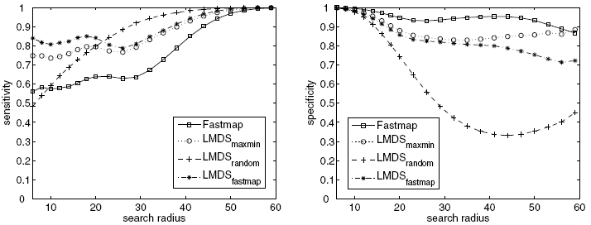
Approximate k-tuple search performance
Find all k-tuples within a specified radius from a query k-tuple
k=6, d=8, real dataset, CB-EUC matrix
Notes:
Metric stress or correlation with the original distances is not the ultimate goal. We really want to improve the “search” accuracy. Here, we show the results of range queries performed in the embedded space.
The k-tuples generated from query proteins are searched against the embedded k-tuples generated from the yeast dataset.
Here we show the sensitivity (true positive rate) and specificity (1 - false positive rate) for varying search radius.
The approximation by Fastmap tends to overestimate the original edit distances, which yields less number of hits in the answer set, and thus higher specifity but lower sensitivity compared to other methods. LMDS_fastmap combines the landmark selection strategy of Fastmap with the stability of LMDS. And it yields the best sensitivity results while having comparable specificity with those of LMDS_maxmin and Fastmap.

Slide 18
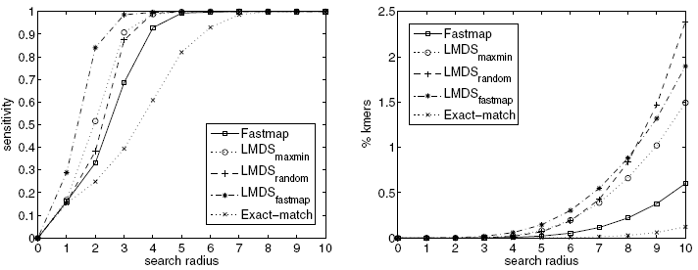
Homology search
k=6, d=8, real dataset, CB-EUC matrix
Notes:
The ultimate goal of searching for k-tuples from the query protein is to identify the proteins (sequences) that are homologous (similar) to the query. Here, for each distance threshold, a search result is considered to be a true hit if at least one kmer of the query protein returns a kmer of the homologous proteins. (The true homologs are already identified by human experts in the benchmark dataset).
The results are compared with “Exact-match” which is based on sequentially searching each k-mer against all the database k-mers and using the original distance value. [[Note2self: this is not to be confused with exact k-mer matching where only identical k-mers are seeked! By exact, I mean that the exact distance value is used rather than the approximated value in the embedded space.]]
The results of the homology search are in accordance with the results of the k-tuple search I showed in the previous slide. Namely, the methods that provide more sensitive k-tuple answer sets also provide more sensitive homology search results.
The homology search procedure is particularly permissive to small errors in the approximation of k-tuples distances, because k-tuples from the homologous proteins missed by some of the query subsequences are compensated by other subsequences that correctly return the ktuples of the homologous proteins. This is why, a smaller search radius is required in the embedding methods than the Exact-match to achieve the same level of sensitivity.
LMDS_fastmap gives the best accuracy for small search radius. Considering that the typical application will only be concerned with small search radius, LMDS_fastmap seems to be the best choice of method.
[[Note2self: Although Fastmap provides best filtering for large search radius, it does not give as accurate results for small radius]].

Slide 19
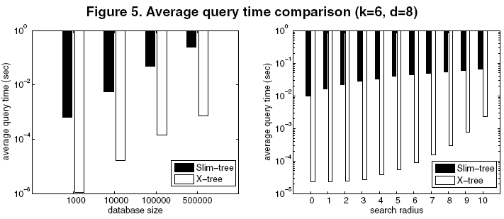
Search time
search radius=7
Database size=100,000
Notes:
In order to demonstrate the speed-up achieved by approximate embedding of sequences, we indexed the embedded vector representation using X-tree and performed range queries.
The search times are compared with that of indexing the original k-tuples using the metric access method Slim-tree.
Using the vector representation, we achieve about 500-fold speed-up compared to metric-indexing the original sequences.

Slide 20
Conclusion
Applied an embedding-based approach to approximate sequence similarity search for the first time
Significant time improvements with negligible degradation in accuracy
Achieved more stable embedding with combined pivot selection strategy
Defined intrinsic Euclidean dimensionality of the dataset

