Slide 1
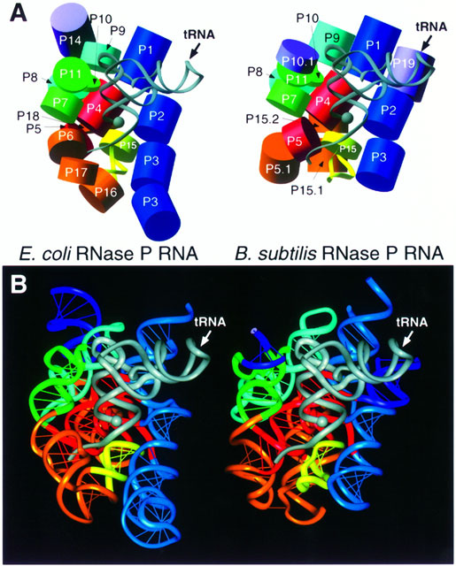
Evolving Models of
Biological Sequence Similarity
Daniel P. Miranker
The University of Texas at Austin
[Chenetal98]

Slide 2
Polymers
Polymer:
a molecule composed of a linear sequence of smaller molecules (monomers).

Slide 3
Biopolymers
Start with monomers
Nucleic acids
    DNA
    RNA
Amino acids
    Proteins
    Peptides
Sugars
    Carbohydrates

Slide 4
Monomers/Polymers
Nucleic acids
    DNAs
    RNAs
Amino acids
    Proteins
    Peptides
Sugars
    Carbohydrates

Slide 5
Describing Polymers
Primary, Secondary and Tertiary Structure
Notes:
Lecture is about two things -
primary structure is very little information
The nature of the questions being asked is changing as rapidly as data is accumulating

Slide 6
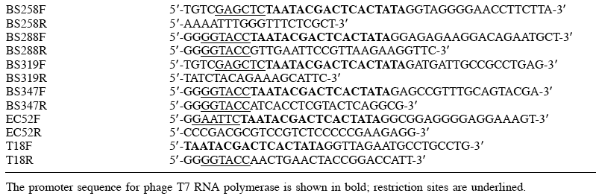
Polymer: Primary Structure Description
Most pictures borrowed from:
  Jiunn-Liang Chen, James M.Nolan, Michael E.Harris and Norman R.Pace,
  Comparative photocross-linking analysis of the tertiary structures of Escherichia coli and Bacillus subtilis RNase P RNAs,
  The EMBO Journal Vol.17 No.5 pp.1515–1525, 1998

Slide 7
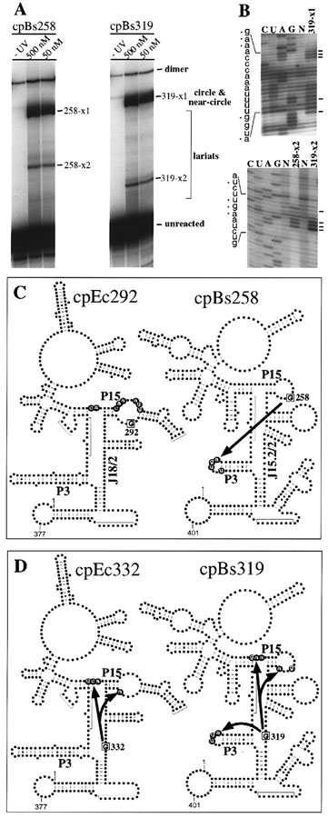
Polymer Secondary Structure
RNA’s fold up on themselves
  Loops
  Helices
Proteins
  Alpha - helix
  Beta - sheet
  … 7 structures and beyond
[Chenetal98]

Slide 8
Polymer
Tertiary
Structure

Slide 9
How to model similarity?
Which features do we pick?
What are the metrics?
Notes:
Lecture is about two things -
primary structure is very little information
The nature of the questions being asked is changing as rapidly as data is accumulating

Slide 10
First, determine the goal
Given a molecule, a biologist will ask:
What is it?
What does it do?
How does it do it?

Slide 11
What about homology?
Definition: Homology
A component of two organisms, (e.g a molecule),
are homologous if they evolved from a common ancestor.

Slide 12
Homology and the Three Questions
Homology is a property on its own.
Homology is a way of defining equivalence classes.
  Classifying a molecule in group gives it identity.
Homologous molecules,
usually, perform the same function.
and
largely, function in the same way.
  The small differences are an opportunity understand the system as a whole

Slide 13
Primary Structure Similarity:
Has answered “What is this?”, based on homology
Important:
  Large-scale production of primary structure definitions.
  $1,000.00 human genome
Can use string algorithms.

Slide 14
Primary Structure Matching
Method | Novelty
Needleman-Wunch[70] | Global Alignment
Sellers [74] | [Metric] Weighting
Waterman, Smith and Beyer [76] | Gaps
Smith-Waterman[81] | Local-alignment
BLAST, [Altshul etal90] | Hot-spot matching

Slide 15
Global-alignment
Needleman-Wunch Alignment new base-case, 0’s for all “$” cells
 | $ | P | I | P | E | R
$ | 0 | 0 | 0 | 0 | 0 | 0
P | 0
E | 0
P | 0
P | 0
E | 0
R | 0
scores the common sequence
no penalty for
  different length sequences
  parts of sequences that don’t align
aka: Longest common subsequence problem (LCS)

Slide 16
Recurrence for Global Alignment
S_{ij} = 0 if i = 0 or j = 0
S_{i-1,j-1} + c(v_{i},w_{j})
S_{i,j} = min S_{i,j-1} + c(_,w_{j})
S_{i-1,j} + c(v_{i}, _)

Slide 17
Local alignment
Smith Waterman alignment
s_{i-1,j-1} + c(v_{i},w_{j})
s_{i,j} = max s_{i,j-1} + c(_,w_{j})
s_{i-1,j} + c(v_{i}, _)
0
No longer a metric
max, not min
cost matrix, penalizes edits with negative scores

Slide 18
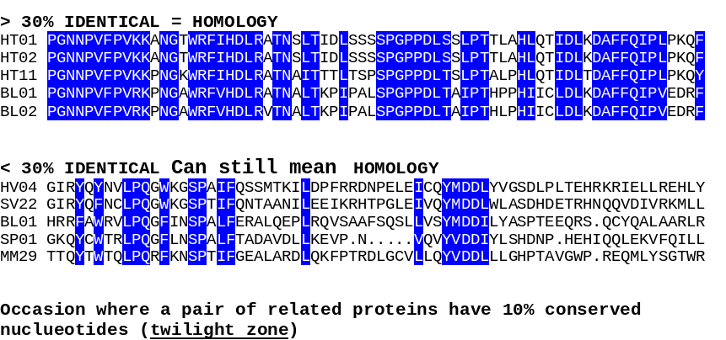
Replacing Edits with “Words”
Local areas of high conservation:
  such retained features form a larger vocabulary of building blocks

Slide 19
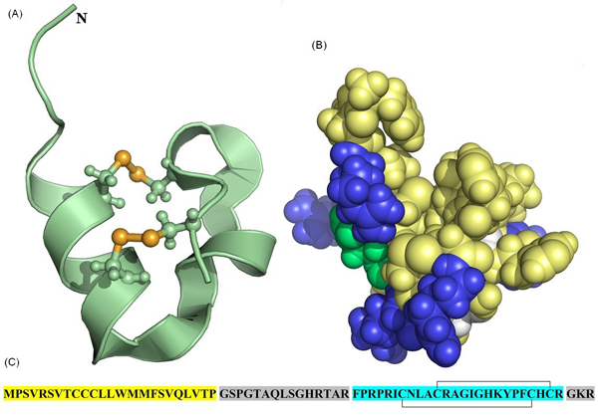
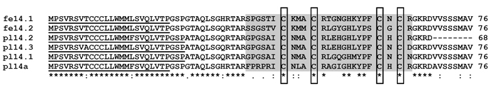
Phylogenetic Footprint
“Key word”
[Mondal etal 2007]

Slide 20
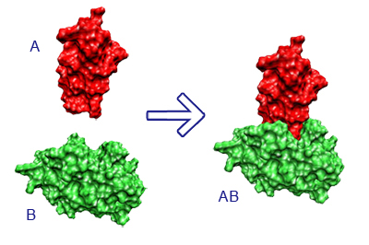
Keywords, a basis of critical function
e.g. active site for
docking
[Biespiel]

Slide 21
Small Differences are Revealing
The basis for stabilizing a fold in a RNA[Chenetal98]

Slide 22
Nature Retains and Rediscovers Useful Structures
Biological goal:
  Determine a larger vocabulary of building blocks.
Molecular data management systems play a key an important role
  Catalog identified building blocks. (e.g. Pfam, SCOP)
  Organize around functional and homologous groups.
Increasingly, identity is being resolved by word-level matches.

Slide 23
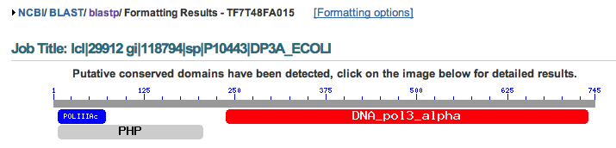
NCBI Protein BLAST Result
Pfam domain matches
If you insist, a second query for sequence matches will be executed.

Slide 24
Sequence-based homology
Is no less important, (biological criteria)
More sequence data -->
  Identification is easier
  For an unknown, all definitions of identity

Slide 25
Where does that leave us?
Models must begin to reflect chemical function.
Bad news: leave a comfort zone.

Slide 26
A common current approach:
Polymers have first, second and tertiary structure
Create a triple
  (Primary structure descriptor,
  Secondary structure descriptor,
  Tertiary structure descriptor)
Good news: lots of degrees of freedom, lots of room for different ideas.

Slide 27
Protein Example
  (W, alpha, (3.32, 1.027, 4.1108))
  Primary Structure: amino acid alphabet
  No change
  Secondary Structure: alpha-helix or beta sheet,
  Symbolic vocabulary of structure
  Open opportunity, SCOP catalog
  Tertiary Structure: location, x, y, z, of a particular carbon atom in the amino acid.
  - Known for some proteins, PDB is the repository

Slide 28

If you have two PDB files:
[wikipedia]
Generally,
  3-d data is unavailable.
  PDB is the basis for gold standards

Slide 29
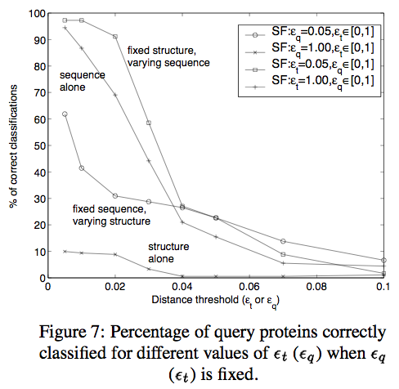
An Observation
Even a little secondary structure information helps a lot.
Despite adding new explicit dimensions,
Implicit dimensionality goes down.
[Bhattahcarya et. al.]

Slide 30
Open Problems:
DBMS: If data is organized by homology group, what are the [query] services?
Database retrieval in biology is almost always a two step, two criteria process.
  Retrieve a solution set based on similarity.
  Assign a statistical significance to each result in the solution set. (e.g. BLAST e-scores)
  Is there a one step process (index), that embodies both?
Other data types in biology, not just individual molecules
  Pathways, sets of proteins may be homologous.
  Mass-spectra

