Slide 1
The many facets of approximate similarity search
Marco Patella and Paolo Ciaccia
DEIS, University of Bologna - Italy

Slide 2
Roadmap
Why?
  motivation for approximate search
How?
  a classification schema
How much?
  optimality in the context of approximate search
How good?
  assessing the quality of results

Slide 3
What is approximate similarity search?
Well, it’s similarity search…
…but with approximation!
We try to speed-up query resolution
by accepting an error in the result
The user is offered a quality/time trade-off

Slide 4



When is approximating a good idea?
The user perception of similarity is different wrt the one implemented by the system
Give me the picture of a bull…

Slide 5


When is approximating a good idea?
In the early stages of an iterative search,
the user may want a quick look at the data
Is there any image of a bull in this collection?

Slide 6

When is approximating a good idea?
The user might be satisfied with a
“good enough” result
I need refueling…
Gimme a gas station
within 3 miles!*
QUICK!
*=800 metros de los taxistas (mt)

Slide 7
What are you talking about?
k-NN queries
cost:
  number of computed distances
  number of accessed nodes
  (for disk-based techniques)
quality (wrt exact result):
  distance to the query object
  same ordering
  more on this later…

Slide 8
A classification schema for approximate techniques
Useful to compare existing (and new) approaches
  a plethora of approximate methods
  have been proposed over the years
  usually, each technique is not put “into context”
  highlights similarities between approaches
  discover limitations in the applicability
  of some technique

Slide 9
The many (4!) facets of approximate similarity search
Independent coordinates
  data type
  approximation type
  quality guarantees
  user interaction

Slide 10
Coord. I: Data type
In increasing order of generality:
  vector spaces, L_{p} (Minkowski) distance
    Manhattan distance
    Euclidean distance
  vector spaces, any distance
    correlation between coordinates is allowed
    e.g., quadratic forms
  metric spaces
    triangular inequality is required

Slide 11
Coord. II: Approximation type
How approximate techniques are able
to reduce costs for similarity searches:
  changing space
      solving the exact problem in an “easier” space
  reducing comparisons
    by aggressive pruning
      avoid visiting regions of the space that are unlikely to
      (but still may) contain qualifying objects
    by early stopping
      stopping the search before correctness of the result
      can be proved

Slide 12
Coord. III: Quality guarantees
Can an approximate technique guarantee
that its errors stay below a given value?
  no guarantee
      heuristic conditions to approximate the search
  deterministic guarantees
      deterministic bounds (from above) on the error
  probabilistic guarantees
    parametric
      the data follow a certain distribution
      only few parameters are unknown and need to be estimated
    non-parametric
      no assumption is made on distribution of objects
      such information has to be estimated and stored
      e.g., distribution of distances in an histogram

Slide 13
Coord. IV: User interaction
Possibility given to the user to specify,
at query time, the parameters for the search:
  static
    the user cannot freely choose the parameters
    for query approximation
    e.g., maximum error
  interactive
    not bound to a specific set of parameters
    can be interactively used by varying parameters
    at query time

Slide 14
Some examples…
Radius shrinking
  Like exact search, but the search radius
  (the distance to the current NN) is reduced
  by a factor ε
  The (relative) error on distance is always ≤ ε
shrunken radius
q
tree
node
Current k-NN

Slide 15
Radius shrinking is:
Data type: VS-L_{p} VS MS
Approx.: CS RC_{AP} RC_{ES}
Quality: NG DG PG_{par} PG_{npar}
Interaction: SA IA

Slide 16
PAC queries
Given parameters δ and ε
  Estimate the distance of the 1-NN
  (using distance distribution)
  Find a search radius r so that the probability
  of finding a 1-NN with distance ≤ r is ≤ δ
  Use radius shrinking with a factor ε
  Stop when an object is found at a distance ≤ r

Slide 17
PAC is:
Data type: VS-L_{p} VS MS
Approx.: CS RC_{AP} RC_{ES}
Quality: NG DG PG_{par} PG_{npar}
Interaction: SA IA

Slide 18
Proximity searching with order permutations
Linear method, similar to LAESA
p pivots are chosen off-line
Only a fraction f of objects is visited
For each object, pivots are sorted
from closest to farthest
The same ordering is done for the query
The order according to which points
are visited is obtained by comparing
how pivots are sorted
  Similarity between sorted lists (Spearman coeff.)

Slide 19
Proximity searching with order permutations is:
Data type: VS-L_{p} VS MS
Approx.: CS RC_{AP} RC_{ES}
Quality: NG DG DG_{par} DG_{npar}
Interaction: SA IA

Slide 20
Optimality of approximate search
We focus here on RC_{ES} algorithms
  The only difference with exact search
  is early stopping
This can be viewed as an on-line process
  The quality improves over time
  The exact result can be reached
  if enough time is allocated

Slide 21
A typical k-NN search
The quality increases quickly in the first steps
distance
The correct result is found, but we still have to prove it!
early stopping: distance threshold
early stopping: cost threshold
We proved the result correct
(the quality has not increased)
cost

Slide 22
What does optimality mean?
Minimum distance after a given cost
has been paid (distance-optimality)
Least cost for reaching a given distance
(cost-optimality)
The scenario we consider is:
  recursive conservative partitioning of the space (tree)
  a compact representation of each tree node is available
Which is the best way of ordering tree nodes (schedule) so as to obtain optimality?

Slide 23
Optimality of exact search
The schedule based on MinDist
is optimal for exact search
  minimizes cost for producing the correct result
  does not necessarily provide better results earlier
distance
MinDist schedule
non-optimal schedule
cost

Slide 24
Optimality of approximate search
distance
cost
An optimal schedule is better (no worse)
than any other over all distances and costs
The two notions of optimality coincide

Slide 25
Optimality: an impossible task
Which is the best way of ordering nodes?
q
NN

Slide 26
Optimality: an impossible task
Which is the best way of ordering nodes?
q
NN

Slide 27
Optimality: an impossible task
The problem lies in the incomplete knowledge of the nodes’ content
Note that this also holds for exact search
  Our notion of optimality is slightly different
  As said, MinDist does not necessarily provide
  better results earlier…
We shift our aim toward optimal-on-the-average schedules
  Optimal when a random query is considered

Slide 28
Optimal-on-the-average schedules
Cost-optimality
  Given a distance threshold θ, minimize avg. cost
Distance-optimality
  Given a cost threshold c, minimize avg. distance
We use the distance distribution G_{i}(r)
of the 1-NN of a random query in node N_{i}
G_{i}(r) = probability to find in N_{i} (at least)
a point with distance ≤ r

Slide 29
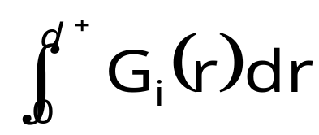
Optimal-on-the-average schedules
Cost-optimality
  Given a distance threshold θ, minimize avg. cost
  Choose, at each step, the node maximizing G_{i}(θ)
  Intuitively, we maximize the probability to stop
Distance-optimality
  Given a cost threshold c, minimize avg. distance
  Choose, at each step, the node maximizing
  Intuitively, we choose the node having
  the minimum avg. 1-NN distance

Slide 30
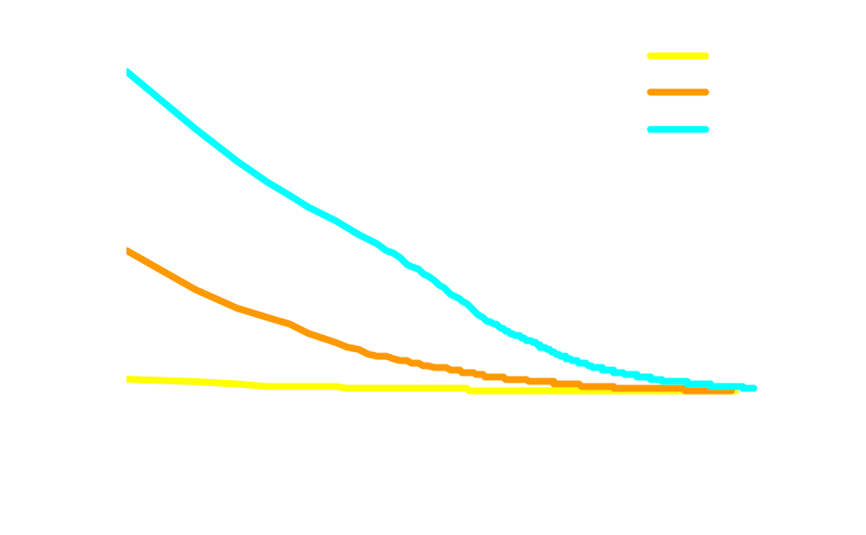
Comparing schedules
Corel dataset
  68000+ 32-d vectors
  4000 nodes
  682 queries

Slide 31
Quality of results
How the quality of attained results
is assessed?
Commonly obtained by comparing the results of approximate and exact algorithms
Virtually every technique in literature proposes its own definition of result quality
  lack of a common framework
  difficult to compare results from different papers

Slide 32
An example (k=5)
Exact result (ID, distance):
(A, 1) (B, 2) (C, 3) (D, 4) (E, 5)
Approximate result:
(A, 1) (C, 3) (D, 4) (F, 5) (G, 5)
How do we evaluate the quality
of the approximate result?

Slide 33
Two families of quality measures
ranking-based
  compare the ranking (position) of objects between approximate and exact results
    may require a (costly) full ranking of the objects
    e.g., in the previous example we should know
    the position of objects F and G in the exact result
    inaccurate in case of ties
distance-based
  compare the distance to the query
  of approximate and exact results
    no additional information is required

Slide 34
Some examples…
ranking-based
  precision (fraction of exact results
  in the approximate result)
  error on position (average difference
  between position of objects in the two results)
distance-based
  effective error (relative error on distance)
  total distance ratio (ratio of sum of distances between exact and approximate results)

Slide 35
An example (k=5) (cont.)
Exact result (ID, distance):
(A, 1) (B, 2) (C, 3) (D, 4) (E, 5)
Approximate result:
(A, 1) (C, 3) (D, 4) (F, 5) (G, 5)
  precision = 3/5
  error on position = 1+1+2+2/5*7 = 6/35
  relative error = (0 + 1/2 + 1/3 + 1/4 + 0)/5 = 13/60
  total distance ratio = (1+2+3+4+5)/(1+3+4+5+5) = 15/18

Slide 36
Which measure is best?
Both are needed!
distance of the 1st NN = 1
distance of approx. NN rank of approx. NN
query 1: 2 2
query 2: 2 100
query 3: 100 2
query 4: 100 100
Which query attains the best result?
Application requirements might favor
a quality measure over the others
  e.g., distance-based for the gas station example

Slide 37
What’s next?
Use the classification schema
for new techniques
  The paper contains the classification of
  25 existing approaches
Two underestimated facets
of approximate search
  Optimality of scheduling policies
  Quality assessment

