Slide 1



Dynamic P2P Indexing and Search based on Compact Clustering
Mauricio Marin Veronica Gil-Costa Cecilia Hernandez
Yahoo! Research
Latin America
UNSL, Argentina
Universidad de Chile

Slide 2
Outline
Introduction
Data Structure Index
P2P Networks
SimPeer
P2P Bottom-up
Experiments
Conclusions and Future Work

Slide 3
Introduction
Similarity search over a collection of metric-space database objects distributed on a large and dynamic set of small computers forming a Peer-to-Peer (P2P) network has been widely studied in recent years.
Currently there are efficient solutions for structured networks like those based on the general purpose CAN and Chord protocols.

Slide 4
Introduction
Super-peer systems are believed to represent a good tradeoff between centralized and distributed architectures. They are also considered a reasonable tradeoff between unstructured and structured P2P networks.
In this case the network is seen as a collection of stable peers called super-peers to which normal peers can connect and initiate queries.

Slide 5
Previous Work
KM (SimPeers) is the state of the arte strategy
for peers and super-peers.
Its main drawback is that it employs local indexing
in a bottom-up fashion.
This work (LC) employs global indexing in a top-down
fashion.

Slide 6



List of Cluster (LC)
I₃
c₃
r₁
c₁
r₃
I₁
I₂
r₂
c₂
Clusters of fixed size
E₁
E₂
(c₁, r₁, I₁)
(c₂, r₂, I₂)
(c₃, r₃, I₃)

Slide 7




List of Cluster (LC)
q
r
c
q
d(c,q)
d(c,q)
r
r
r
c
q
r
d(c,q)
c
r

Slide 8
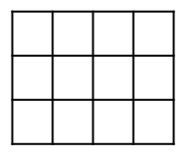
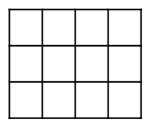
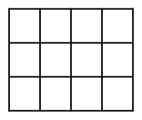
LC-SSS
(c₁, r₁, I₁)
(c₁, r₁, I₁)
(c₁, r₁, I₁)
Sparse Spatial Selection Algorithm

Slide 9


P2P
Hierarchical system of peers and super-peers
Super-peer
peers

Slide 10





Bottom-up
_{1… M}
N_{p}
_{1 … M}
semi-global
centers
_{1… M}
_{M*Np}
_{1… M}
(c_{i},r_{i})
N_{p}
_{1 … M}
N_{p}
LC-SSS
LC-SSS

Slide 11
Bottom-up
semi-global
centers
N_{p}
(i,c_{sp},sp,r’_{m},r’_{x})*
(i,c_{sp},sp,r’_{m},r’_{x})*
(i,p,r_{m},r_{x})
…
(i,p,r_{m},r_{x})
(i,p,r_{m},r_{x})
_{1 … M}
<c_{i},r_{m},r_{x},b_{i}>
…
<c_{j},r_{m},r_{x},b_{j}>
N_{p}
_{1 … M}
N_{p}
LC-SSS
LC-SSS

Slide 12
Searching
(i,c_{sp},sp,r’_{m},r’_{x})*
(i,c_{sp},sp,r’_{m},r’_{x})*
(i,p,r_{m},r_{x})
…
(i,p,r_{m},r_{x})
(i,p,r_{m},r_{x})
<c_{i},r_{m},r_{x},b_{i}>
ts
q
r
…
<c_{j},r_{m},r_{x},b_{j}>
tp
N_{p}
q
q
r_{x}
r_{m}
d(q,c)-r ≤ r_{x}
d(q,c)+r ≥r_{m}

Slide 13


Updates
Overflow area
New centers
Intersection
degree
requerimiento
Sends M semi-global centers
(c_{i},r_{i})
M
Overflow area

Slide 14








Updates: Intersection Degree
If (d(c₁, c₂) ≤ r₁ + r₂)
S_{1,2} = 1
Else
S_{1,2} = 0
r₂
c₂
c₁
r₁
c₂
c₂
c₁
c₂
c₁
c₁
S_{1,2} = 1+r₂/r₁
S_{1,2} = (r₁/r₂) ·S_{1,2}
S_{1,2} = (|r₁ − r₂|/d(c₁, c₂) ) · S_{1,2}
All centers k for which S_{k,1} is 0 are considered candidates to become new global centers (c_{k}, r_{k})

Slide 15
Experimental Results
Metric Spaces Library SISAP (http://www.sisap.org/Home.html)
  Uniform 3.000.000
  Gauss 3.000.000
  NASA 3.000.000
  30 super-peers and 1.000 peers
  M = 10 centers

Slide 16
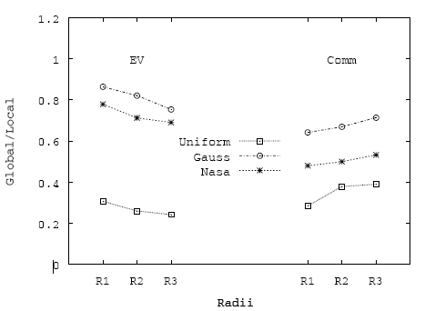
Constant Number of Peers
Total number of distance evaluations and messages for global and local indexing by using the LC strategy.

Slide 17
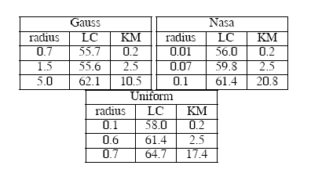
PERCENTAGE OF EFFECTIVENESS:
Percentage of objects that are compared with the query and become part of the query answer.

Slide 18
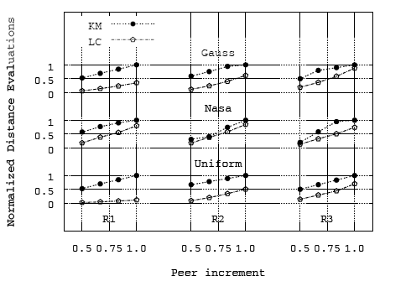
Increasing the Number of Peers
As new peers join to the network the algorithms require more distance evaluations to processes queries,
Further experiments in the paper

Slide 19
Conclusions
The paper has shown that by approximating global but resumed information about the indexed data in each peer, the average amount of computation and communication performed to solve range queries can be significantly reduced.

Slide 20
Future Work
Currently we are studying different cache techniques to optimize similar searches and reduce queries response time.

Slide 21
Contact Information
Mauricio Marin mmarin@yahoo-inc.com
Veronica Gil-Costa gvcosta@unsl.edu.ar
Cecilia Hernandez chernand@inf.udec.cl

