Slide 1
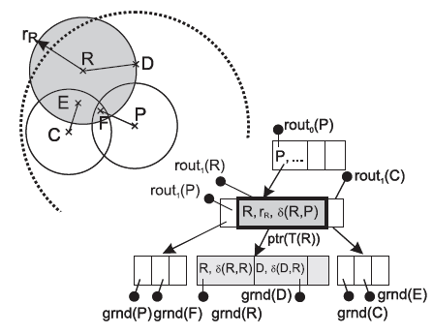
Parallel dynamic batch loading in the M-tree
Jakub Lokoč
Department of Software Engineering
Charles University in Prague, FMP

Slide 2
Presentation outline
M-tree
  The original structure
  Simple parallel construction
  Concurrent parallel construction
Parallel batch loading
Experimental results

Slide 3
Motivation
The trend in CPU development is oriented on multi core architectures - we need scalable algorithms, e.g., index construction
Faster indexing - applications
  User wants to upload a lot of new objects
  More sophisticated indexing methods
  Re-indexing
Scientists can perform much more tests

Slide 4
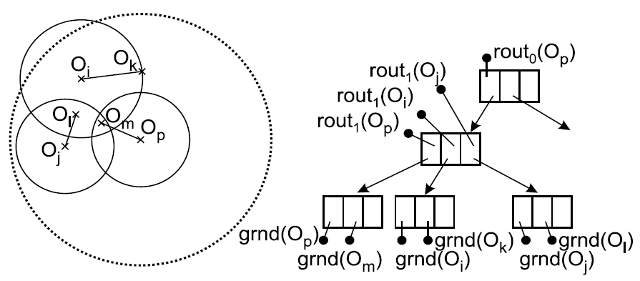
M-tree (metric tree)
dynamic, balanced, and paged tree structure (like e.g. B⁺-tree, R-tree)
the leaves are clusters of indexed objects O_{j} (ground objects)
routing entries in the inner nodes represent hyper-spherical metric regions (O_{i} , r_{Oi}), recursively bounding the object clusters in leaves
the triangle inequality allows to discard irrelevant M-tree branches (metric regions resp.) during query evaluation
Q
range query
(euclidean 2D space)

Slide 5
Parallel M-tree construction
Reading disk pages in parallel (I/O)
  Prediction – just one branch can be selected
  Using cache vs. data declustering
  SSD disks – solution of the problem?
Parallel distance computation (CPU)
  Processing objects in a node (limited by capacity)
  Node splitting
  Concurrent processing of multiple new objects

Slide 6






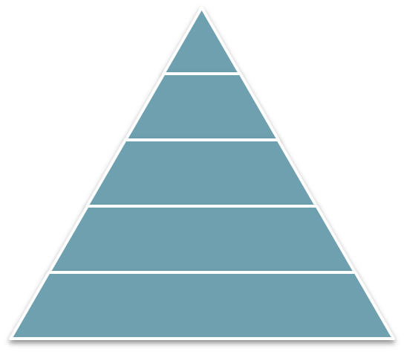




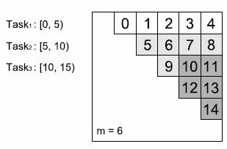

Simple parallel construction
new object
Inserting starts in the root node
Some routing item is selected using a heuristic
(limited number of distances is evaluated in parallel)
0.2 0.3 0.4 0.2
m
3) The radius of the routing item can be updated
4) Object is delegated to the child node
(nodes are processed sequentially)
5) If the actual node is leaf then insert new object else step 2
6) If the leaf node is overfull then split the node
a) Compute distance matrix
b) Promote new routing items
c) Redistribute objects and set links
h
The number of distance evaluations during one insertion is bounded by h x m
Using m (and more) cores - we still have to wait until h distances are evaluated
More than m cores can be exploited just for splitting (up to m x (m - 1) / 2)
Acceptable for one object, but we usually need to insert a lot of objects – n x h !!!

Slide 7


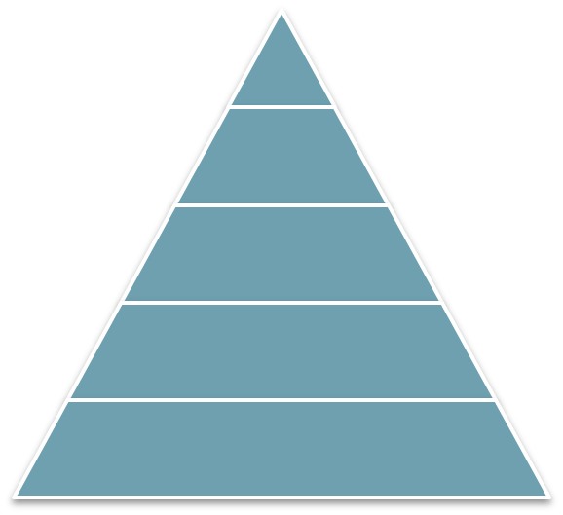















Concurrent inserting
One insertion is atomic operation – less parallel overhead
Inserted objects have shared access to inner nodes – no blocking
Parallelism is not limited by the node capacity
Complexity of insertions is almost the same
(small differences depend on node utilization)
Ideal task for parallelism
Simple definition of the problem
Simple work distribution between tasks
However, traditional inserting has to be improved by synchronization

Slide 8


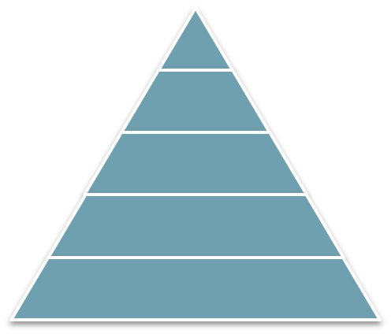












Synchronisation problems
Objects can’t be inserted just in parallel
Routing items have to be updated (radius)
  One routing item can be changed by two threads
  Easy to solve using locks
Updated leaf nodes must be locked
  Similar as for routing items
Splitting
  Split may change tree hierarchy significantly
  It is complicated to synchronize more concurrent splits
  Locking during splitting may decrease speed up of concurrent inserting
  Is it necessary to perform concurrent splits??? Splitting can be postponed!

Slide 9
Postponed reinserting
To avoid the split the most distant object is removed from the overfull node and its radius is decreased
M-tree hierarchy is improved
Used to avoid synchronization problems
Removed object is inserted later

Slide 10


Parallel dynamic batch loading
1. Aggregation
2. Parallel batch loading
Not all objects are inserted during
the second step. Moreover, some
objects are removed from the tree
and stored. Some of them are inserted
in traditional way to perform several splits.
3. Traditional inserting
Not inserted objects
“Split generating” – will be inserted in traditional way (exploiting limited parallelism)
Postponed – will be inserted during the next batch
To find scalability bottlenecks we measured
Parallel batch loading time – PI
Traditional inserts causing split time – ICS
Traditional inserts not causing split time – INCS

Slide 11
Parallel dynamic batch loading
Which objects insert in the traditional way?
  a) Randomly select several objects
  b) Postpone the “furthest” objects
Not inserted objects
“Split generating” – will be inserted in traditional way (exploiting limited parallelism)
Postponed – will be inserted during the next batch
Objects assigned to the same
leaf node (same routing item)
during concurrent inserting

Slide 12
Experimental results
Two datasets
CoPhIR (MPEG7 image features)
  1.000.000 feature vectors
  76 dimension (12 color layout + 64 color structure)
  L_{5.123456} distance
Polygons
  250,000 2D polygons
  5-15 vertices
  Hausdorff distance

Slide 13
Experimental results (win)
 | Polygons |  | CoPhIR
 | 4 096 | 6 144 | 8 192 | 12 288
CLASSIC 1 | 83.4 | 111.6 | 648.7 | 837.5
CLASSIC 2 | 54.2 | 70.2 | 374.8 | 476.4
CLASSIC 4 | 35.6 | 43.1 | 246.6 | 302.8
Batch 1 | 88.1 | 110.9 | 703.3 | 877.8
Batch 2 | 49.2 | 61.5 | 377.1 | 474.9
Batch 4 | 29.8 | 36.1 | 225.0 | 263.6
Construction time

Slide 14
Experimental results (win)
DC by range queries
 | Polygons |  | CoPhIR
 | 4 096 | 6 144 | 8 192 | 12 288
CLASSIC | 2 013 | 2 035 | 314 074 | 293 110
Batch 1 | 1 900 | 1 869 | 303 833 | 275 848
Batch 2 | 1 958 | 1 819 | 297 074 | 285 677
Batch 4 | 1 935 | 1 837 | 303 490 | 276 090

Slide 15
Experimental results (linux)
Method | Cores | Time (s) | Utilization (%)
M-tree | 1 | 938 | 54
M-tree | 16 | (5.2 x) 179 | 54
Batch | 1 | 1013 | 59
Batch | 2 | 594 | 59
Batch | 4 | 304 | 59
Batch | 8 | 157 | 59
Batch | 16 | (9.7 x) 104 | 59
CoPhIR 1.000.000
Dimension 76 (12 + 64)
L_{5.123456} distance
24 / 25 inner/leaf node size
512MB cache size
Method | PB time (s) | ICS time (s) | INCS time (s)
Batch 1 | 675 | 284 | 46
Batch 2 | 383 | 174 | 29
Batch 4 | 186 | 93 | 17
Batch 8 | 91 | 48 | 11
Batch 16 | (14 x !!!) 48 | 39 | 10

Slide 16
Thank for your attention!
References:
P. Ciaccia, M. Patella, and P. Zezula
M-tree: An efficient Access Method for Similarity Search in Metric Spaces
In VLDB'97, pages 426-435, 1997.
J. Lokoc and T. Skopal
On reinsertions in m-tree
In SISAP '08: Proceedings of the First International Workshop on Similarity Search and Applications (sisap 2008), pages 121{128, Washington, DC, USA, 2008. IEEE Computer Society.
P. Zezula, P. Savino, F. Rabitti, G. Amato, and P. Ciaccia
Processing m-tree with parallel resources
In Proceedings of the 6th EDBT International Conference, 1998.

