Slide 1
A dynamic pivot selection technique for similarity search
Benjamín Bustos
Center for Web Research, University of Chile (Chile)
Oscar Pedreira, Nieves Brisaboa
Databases Laboratory, University of A Coruña (Spain)
SISAP 2008
First International Workshop on Similarity Search and Applications
Cancún, México, 12 April 2008

Slide 2
Outline
Motivation
Previous work
Our method
  Sparse Spatial Selection (SSS)
  Non-Redundant Sparse Spatial Selection (NR-SSS)
Experimental results
Conclusions

Slide 3
Motivation
Pivot-based indexing algorithms
Possible classification of indexing methods for similarity search:
  Pivot-based indexes
  Clustering-based indexes
Pivot-based indexes:
  Indexes are built from a set of reference points called pivots
  The distances from the objects in the database to the pivots are computed and stored in an appropriate data structure
Some well-known examples…
  BKT, FQT, FQA, AESA, LAESA, etc.

Slide 4
Motivation
Why pivot selection techniques?
The specific set of pivots affects the search performance
  Which ones? Some algorithms select pivots at random, others with complex computations.
  How can we find the optimal number of pivots? → Usually done by trial and error on the complete database, which makes the index static

Slide 5
Outline
Motivation
Previous work
Our method
  Sparse Spatial Selection (SSS)
  Non-Redundant Sparse Spatial Selection (NR-SSS)
Experimental results
Conclusions

Slide 6
Previous work
First heuristics for pivot selection (I)
First works addressing the problem of pivot selection proposed heuristics that tried to select pivots far away from each other:
  [Micó, Oncina, Vidal, 1994] proposes to choose pivots that maximize the sum of distances between pivots previously chosen.
  [Yianilos, 1993] proposes a heuristic based on the second moment of the distance distribution, which selects objects far away from each other.
  [Brin, 1995] proposes a greedy strategy that also selects objects far away from each other (though designed to select split points).

Slide 7
Previous work
[Bustos, Navarro & Chávez, 2003] (I)
[Bustos, … 2003] addressed the problem of pivot selection in a formal way
They defined an estimator of the efficiency of a set of pivots based on a formalization of the problem
Using this estimator they proposed three techniques

Slide 8
Previous work
[Bustos, Navarro & Chávez, 2003] (II)
Selection
  N sets of random pivots are selected. The final set of pivots is the one maximizing the efficiency criterion.
Incremental
  The set of pivots is built incrementally, by adding to it the object maximizing the efficiency criterion.
Local Optimum
  The set of pivots is iteratively improved by replacing the worst pivot for a better one.

Slide 9
Previous work
Problems of the previous techniques for pivot selection
In previous techniques the optimal number of pivots has to be obtained by trial and error using the complete database
Insertions, updates and deletions of objects can reduce the index performance
This makes the index static

Slide 10
Outline
Motivation
Previous work
Our method
  Sparse Spatial Selection (SSS)
  Non-Redundant Sparse Spatial Selection (NR-SSS)
Experimental results
Conclusions

Slide 11
Our method
Sparse Spatial Selection [Brisaboa & Pedreira, 2007] (I)
Sparse Spatial Selection [Brisaboa, et. al 2006] dynamically selects a set of pivots adapted to the intrinsic complexity of the space
More efficient than previous techniques
Dynamic and adaptive

Slide 12

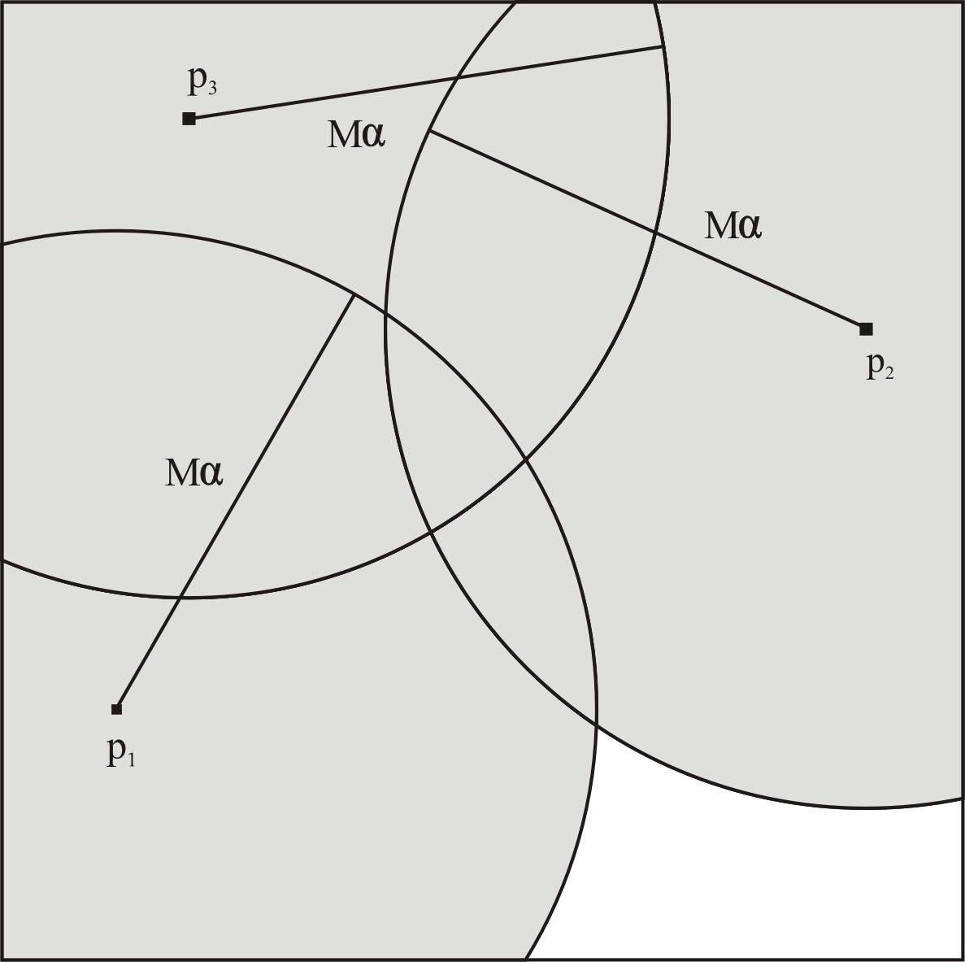
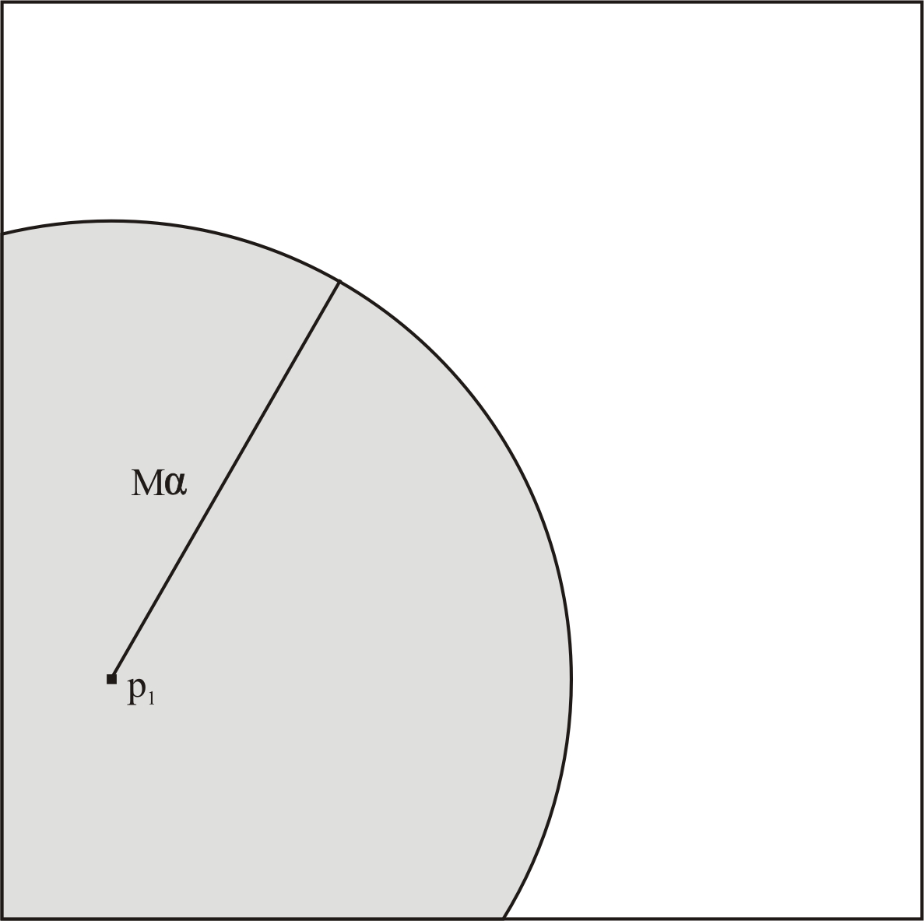
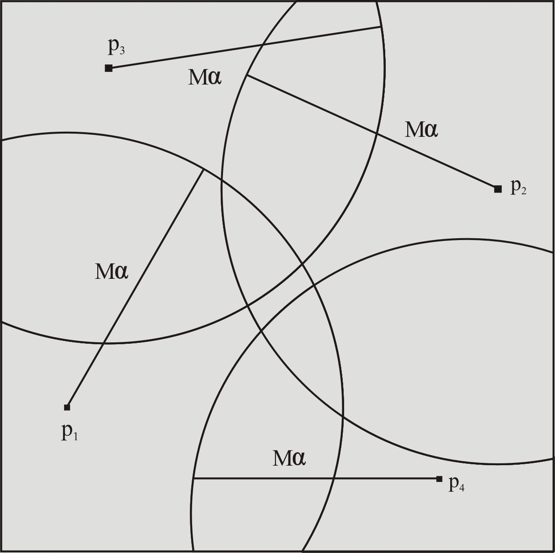
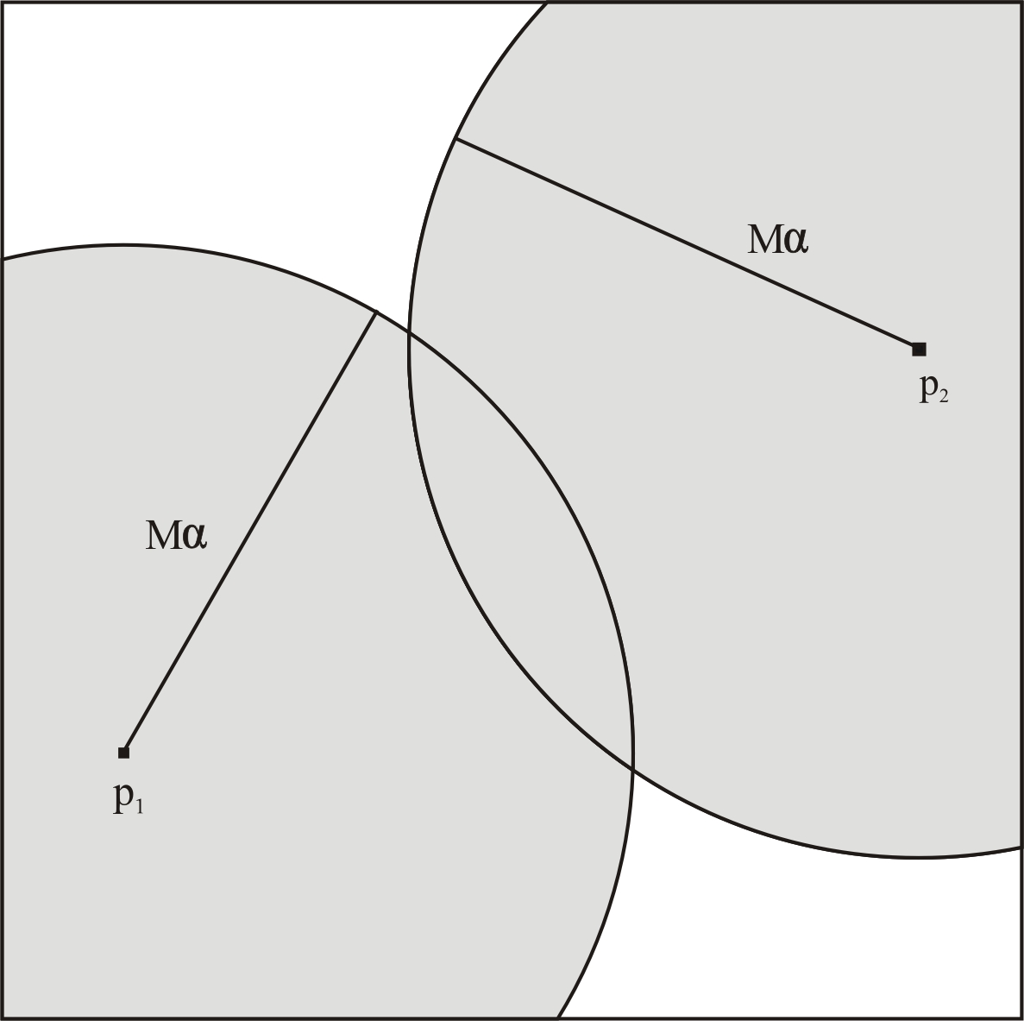

Our method
Sparse Spatial Selection [Brisaboa & Pedreira, 2007] (II)
When an object is inserted, it is selected as a new pivot if it is far away enough from the current pivots
The object is considered “far-away” if its distance to the current pivots if greater than Mα
M maximum distance
0 < α < 1
x₆
x₅
x₃
α = 0.5
M
x₄
x₂
x₁

Slide 13
Our method
Sparse Spatial Selection [Brisaboa & Pedreira, 2007] (III)
Database
p₁ p₂ p₃ p_{k-2} p_{k-1} p_{k}
x₁
1.3542 | 1.5362 | 2.4473 | … | 0.3834 | 3.2938 | 1.2532
2.3645 | 3.8472 | 2.7364 | … | 2.7363 | 3.8756 | 1.2837
. . . | . . . | . . . | … | . . . | . . . | . . .
2.7463 | 1.2937 | 2.9384 | … | 2.8374 | 2.8464 | 1.9876
{x₁, x₂, …, x_{n}}
x₂
Pivots
x_{n}
{p₁, p₂, …, p_{k}}

Slide 14
Our method
Sparse Spatial Selection [Brisaboa & Pedreira, 2007]
SSS was experimentally validated, showing that
  The number of pivots does not depend on the collection’s size, but on the space’s intrinsic dimensionality. (Then, the number of pivots selected should become stable in some moment.)
  The optimal values of α are stable
  SSS outperforms state-of-art strategies.

Slide 15
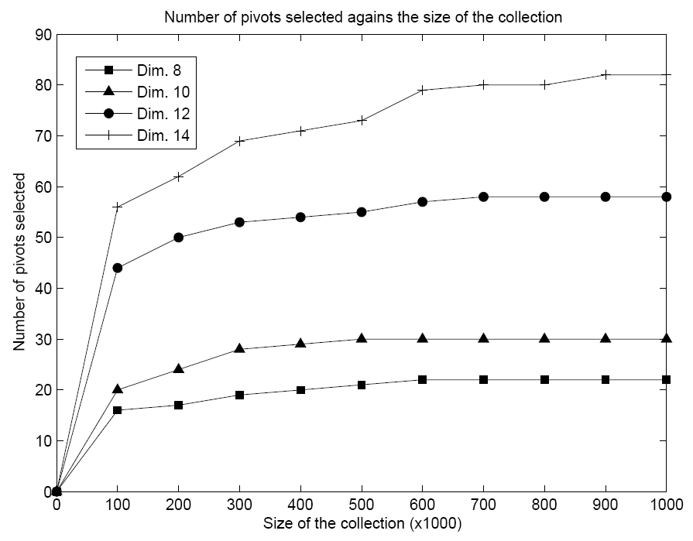
Our method
Sparse Spatial Selection [Brisaboa & Pedreira, 2007] (IV)

Slide 16
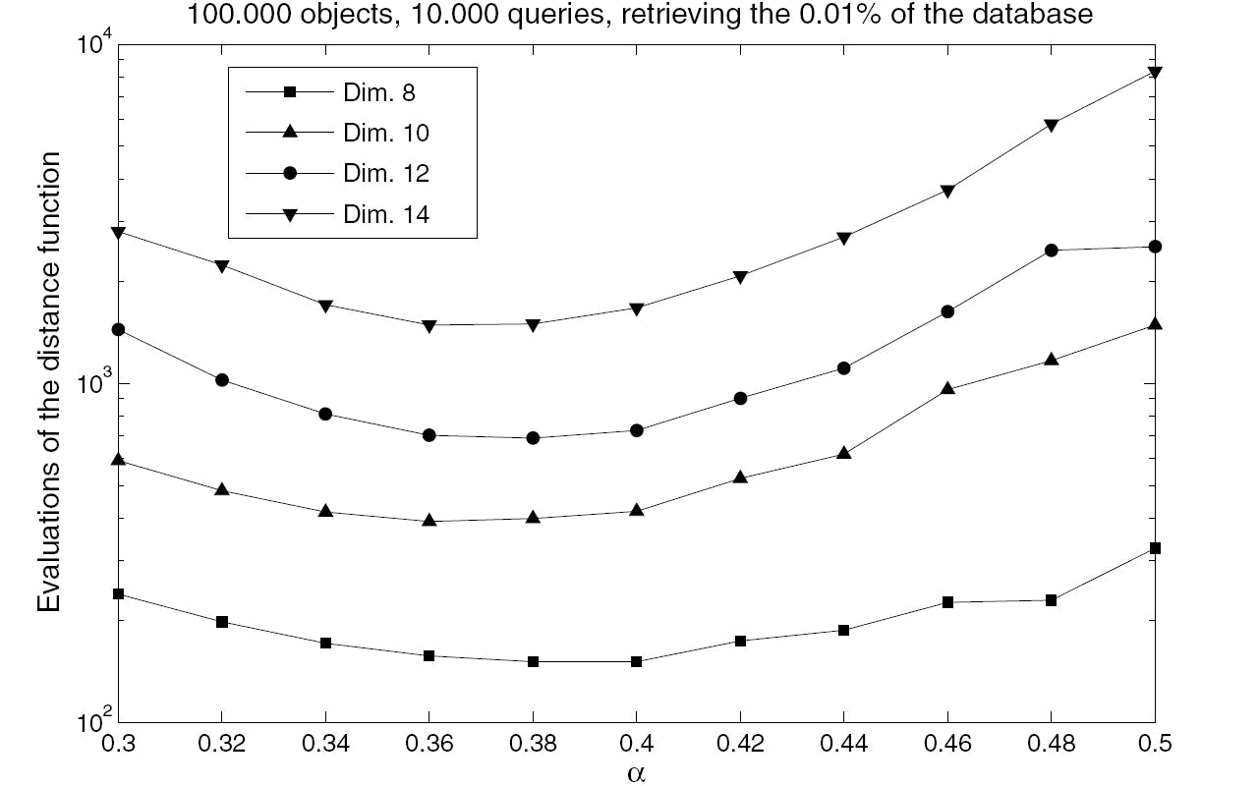
Our method
Sparse Spatial Selection [Brisaboa & Pedreira, 2007] (V)

Slide 17
Our method
Sparse Spatial Selection [Brisaboa & Pedreira, 2007] (VI)
DB | µ | σ² | Int. dimens. | α | pivots | α | pivots
English | 8.239141 | 5.277638 | 6.085550 | 0.5 | 108 | 0.44 | 205
Spanish | 8.272277 | 6.014831 | 5.688486 | 0.5 | 64 | 0.44 | 124
K = 8 | 1.043901 | 0.125227 | 4.351026 | 0.5 | 18 | 0.38 | 68
K = 10 | 1.208123 | 0.146074 | 4.995954 | 0.5 | 25 | 0.38 | 126
K = 12 | 1.333767 | 0.175158 | 5.078096 | 0.5 | 43 | 0.38 | 258

Slide 18
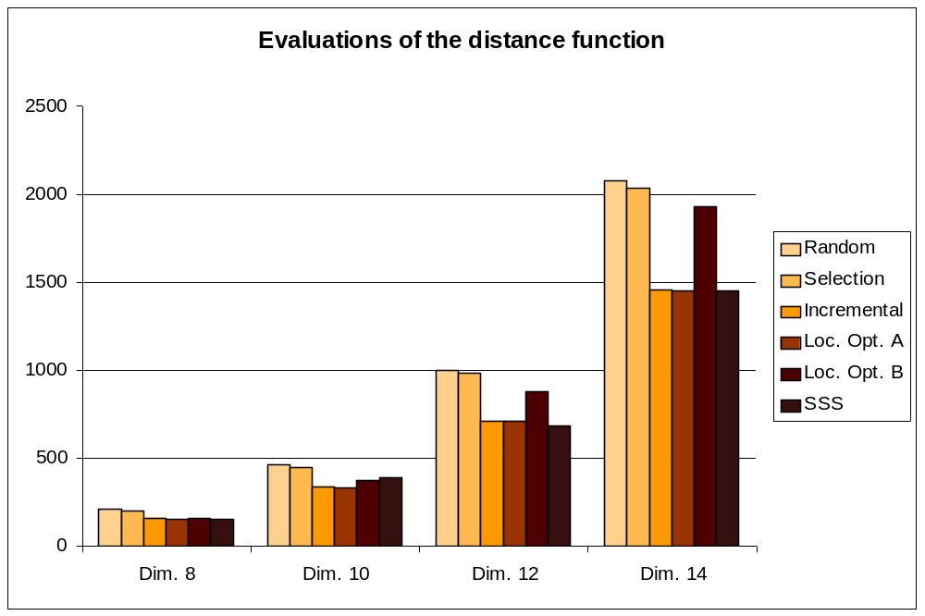
Our method
Sparse Spatial Selection [Brisaboa & Pedreira, 2007] (VII)

Slide 19
Our method
Sparse Spatial Selection [Brisaboa & Pedreira, 2007] (VIII)
SSS presents important properties for the index…
  Dynamic
    The database can be initially empty. Pivots are selected in a incremental way as the database grows.
    The algorithm sets itself the number of pivots that will be used.
  Adaptive
    Pivots are selected when they are needed to cover the space.
    The set of pivots adapts itself to the intrinsic dimensionality of the metric space.
  Efficient
    Experimental results show that this method is in most situations more efficient than previous proposals.

Slide 20
Our method
Non-Redundant Sparse Spatial Selection (NR-SSS)
Non-Redundant Sparse Spatial Selection (NR-SSS)
  Goal: To remove from the set of pivots selected by SSS the less efficient ones → The set of pivots conserves the good properties of SSS but works better
  The pivots are well distributed, efficient, and dynamically selected
The smaller the set of pivots, the smaller the internal complexity

Slide 21
Our method
Non-Redundant Sparse Spatial Selection (NR-SSS)
Non-Redundant Sparse Spatial Selection (NR-SSS)
  When Sparse Spatial Selection (SSS) identifies a new object in the DB as a pivot, we add it to the set of pivots.
  We also check its contribution to this set of pivots. If its contribution to the set of pivots is 0, it is redundant, and thus immediately discarded.
  If the new pivot contributes more than the worst already selected pivot, we remove the worst, since it is no longer useful.
But… How can we compute the contribution of each pivot?

Slide 22
Our method
Contribution of a pivot
p₁ | p₂ | … | p_{n}
(x₁,y₁)
(x₂,y₂)
(x_{A},y_{A})
1.34 | 0 |  | 0
0 | 2.57 |  | 0
0 | 0 |  | 1.00
Contribution of each pivot for each pair of objects
A pair of objects selected at random
∑
1.34 | 2.57 |  | 1.00
Total contribution
Notes:
La puntuación de un pivote

Slide 23
Outline
Motivation
Previous work
Our method
  Sparse Spatial Selection (SSS)
  Non-Redundant Sparse Spatial Selection (NR-SSS)
Experimental results
Conclusions

Slide 24
Experimental results
Test environment
All the collections used for experimental evaluation can be found at SISAP Metric Spaces Library
  NASA: 40,150 images from NASA image and video archives, represented by feature vectors of dimension 20. Euclidean distance.
  COLOR: 112,862 color images, each of them represented by a feature vector of 112 components. Euclidean distance.
  SPANISH: 81,061 words taken from the Spanish dictionary. Edit distance.

Slide 25
Experimental results
Hypothesis
The set of pivots selected by Dynamic is smaller than the selected by Sparse Spatial Selection
The smaller the value of alpha, the higher the number of pivots replaced by Dynamic
The index built with Dynamic is more efficient than the one built with Sparse Spatial Selection in the search operation

Slide 26
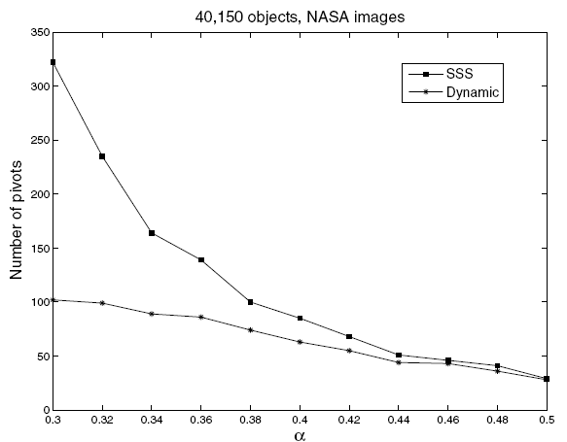
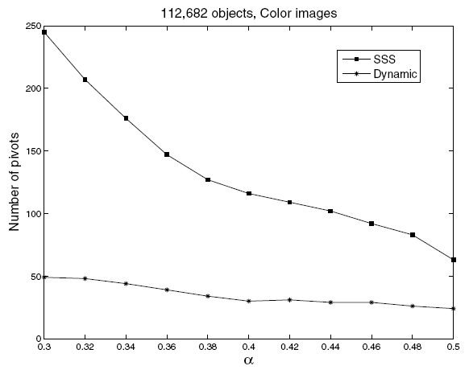
Experimental results
Number of pivots selected by Dynamic and SSS
NASA Images
COLOR Images

Slide 27
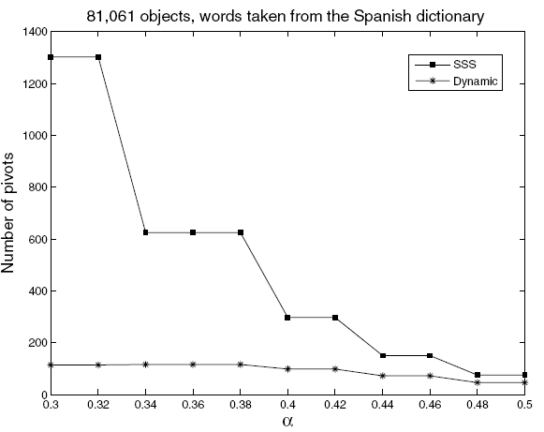
Experimental results
Number of pivots selected by Dynamic and SSS
Words from the Spanish dictionary

Slide 28
Experimental results
Hypothesis
The set of pivots selected by Dynamic is smaller than the selected by Sparse Spatial Selection
The smaller the value of alpha, the higher the number of pivots replaced by Dynamic
The index built with Dynamic is more efficient than the one built with Sparse Spatial Selection in the search operation
√

Slide 29
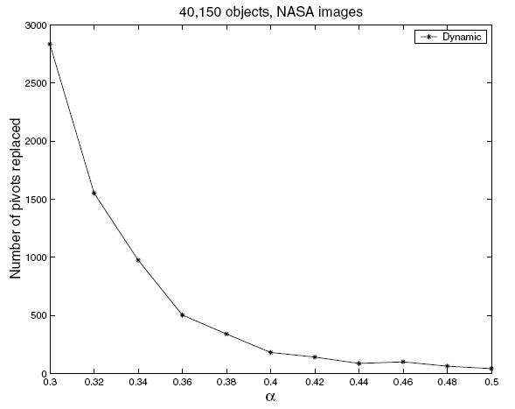
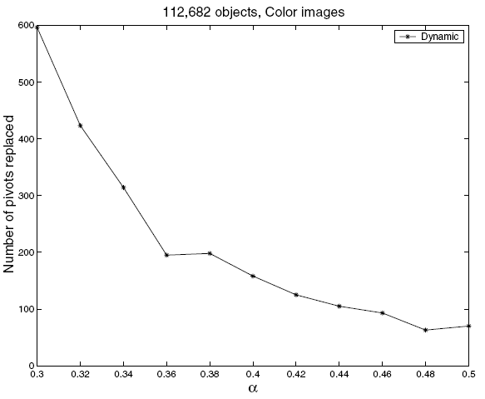
Experimental results
Pivots replaced in terms of α by Dynamic and SSS
NASA Images
COLOR Images

Slide 30
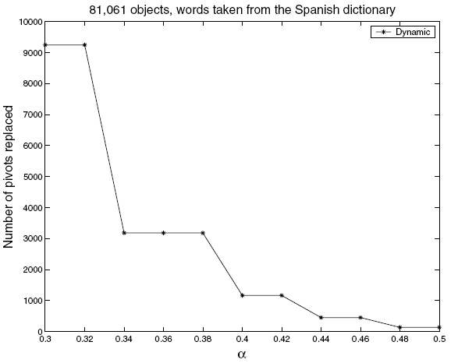
Experimental results
Pivots replaced in terms of α by Dynamic and SSS
Words from the Spanish dictionary

Slide 31
Experimental results
Hypothesis
The set of pivots selected by Dynamic is smaller than the selected by Sparse Spatial Selection
The smaller the value of alpha, the higher the number of pivots replaced by Dynamic
The index built with Dynamic is more efficient than the one built with Sparse Spatial Selection in the search operation
√
√

Slide 32
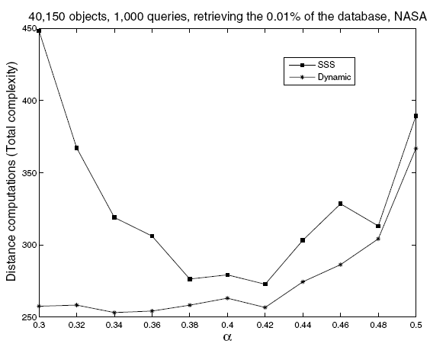
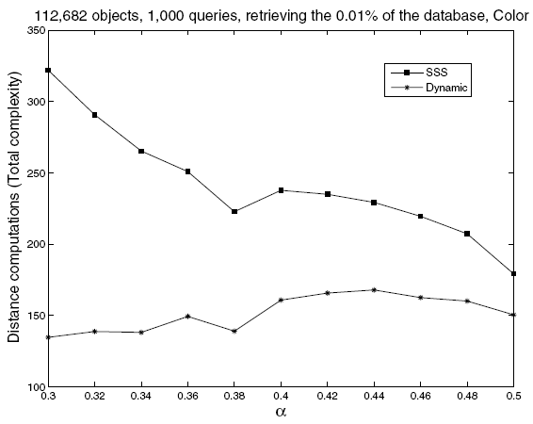
Experimental results
Search efficiency in Dynamic and SSS
NASA Images
COLOR Images

Slide 33
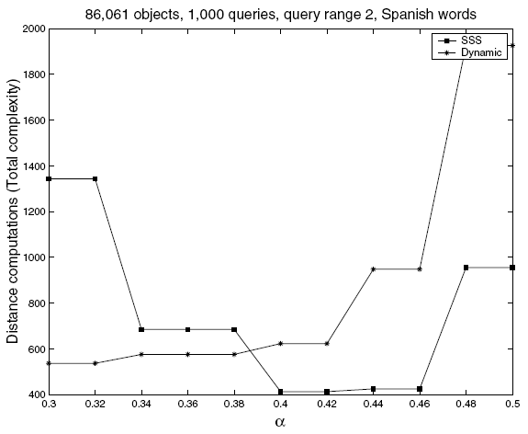
Experimental results
Search efficiency in Dynamic and SSS
Words from the Spanish dictionary

Slide 34
Experimental results
Hypothesis
The set of pivots selected by Dynamic is smaller than the selected by Sparse Spatial Selection
The smaller the value of alpha, the higher the number of pivots replaced by Dynamic
The index built with Dynamic is more efficient than the one built with Sparse Spatial Selection in the search operation
√
√
√

Slide 35
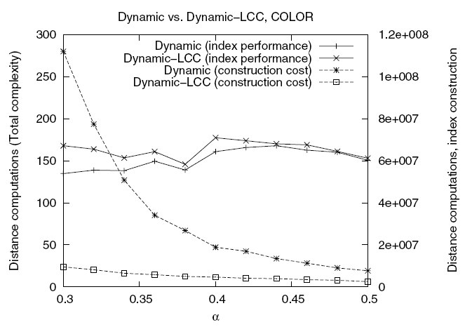
Experimental results
Dynamic-LCC → Low Construction Cost

Slide 36
Outline
Motivation
Previous work
Our method
  Sparse Spatial Selection (SSS)
  Non-Redundant Sparse Spatial Selection (NR-SSS)
Experimental results
Conclusions

Slide 37
Conclusions
The paper proposes a new pivot selection technique called Non-Redundant Sparse Spatial Selection (NR-SSS): efficient, dynamic and that adapts itself to the space complexity.
The pivots selected by Sparse Spatial Selection are filtered by NR-SSS, removing the useless ones
The set of pivots is smaller → internal complexity is reduced
Experimental results show the new technique outperforms state-of-art strategies

Slide 38
And …
Thanks for your attention!
Questions?

