Slide 1
On Reinsertions in M-tree
Jakub Lokoč Tomáš Skopal
Charles University in Prague
Department of Software Engineering
Czech Republic

Slide 2
Presentation Outline
M-tree
  the original structure
Forced reinserting (in M-tree)
  motivation
  algorithm outline
Experimental Results

Slide 3
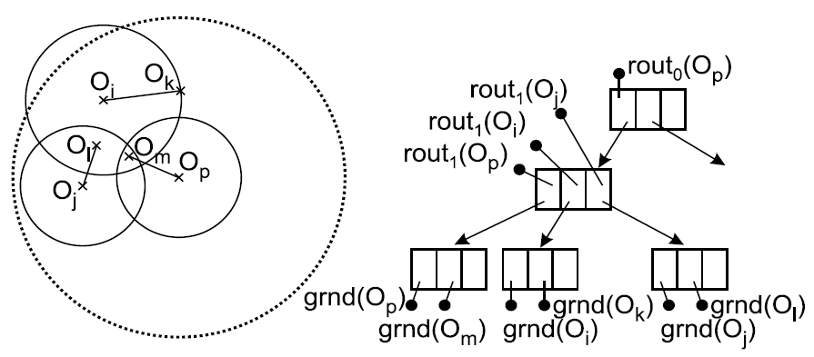
M-tree (metric tree)
dynamic, balanced, and paged tree structure (like e.g. B⁺-tree, R-tree)
the leaves are clusters of indexed objects O_{j} (ground objects)
routing entries in the inner nodes represent hyper-spherical
metric regions (O_{i} , r_{Oi}), recursively bounding the object clusters in leaves
the triangle inequality allows to discard irrelevant M-tree branches (metric
regions resp.) during query evaluation
Q
range query
(euclidean 2D space)

Slide 4
Motivation
the compactness of metric regions’ hierarchy in M-tree heavily depends on the order of new objects’ insertions
→ newly created regions may be more suitable for previously inserted objects (but these reside in the old ones)
→ unnecessarily big “volumes” and overlaps between regions
→ higher probability of intersection with query region
→ less efficient search
reduction of metric region “volume” should lead to more effective discarding
of irrelevant subtrees
how to rearrange objects to get a more compact M-tree hierarchy?

Slide 5
Reinsertions in general
Batch construction/rearrangements
  bulk loading algorithms
    static
  post-processing, like slim-down algorithm
    very expensive
Dynamic insertion
  non-deterministic (sublinear) leaf determination
    looking for the best leaf
  deterministic (logarithmic) leaf determination
    looking for a suboptimal leaf, only one path in the M-tree is traversed
Our goal
  to perform local rearrangements/hierarchy optimization during dynamic insertion
  keeping the costs low
    i.e., sublinear in case of non-deterministic leaf determination and logarithmic in the deterministic case
  the way: forced reinsertions
    redistribution of some objects in a leaf that is about to split (avoiding the split)

Slide 6
Forced reinsertions in M-tree
Modified splitting of an M-tree leaf:
Remove the most distant objects (4 strategies)
(i.e., remove objects close to the region’s border, reducing the radius)
Save them temporarily in a global memory stack.
Insert objects from the stack to M-tree (one by one).
(regular dynamic insertion, possibly leading to other split attempts)
If new split appears, repeat the process.
When reached a user-defined limit of reinsertions (recursion depth), insert the rest objects in the stack in a usual way (w/o reinsertions).

Slide 7
Reinserting example
Insert new object O₁₁
Remove O₈, O₆ and insert them into the stack
Decrease region’s radius (to O₁₁)
Insert O₆ from the stack
Remove O₂ and insert in the stack
Decrease region’s radius (to O₆)
Insert O₂ from the stack
Insert O₈ from the stack
O₄
O₆
O₁
O₃
O₁₁
O₁₁
O₅
O₂
O₇
STACK
O₈
O₉
O₁
O₅
O₉
O₁₀
O₁
O₃
O₄
O₂
O₅
O₇
O₈
O₆
O₉
O₁₀

Slide 8
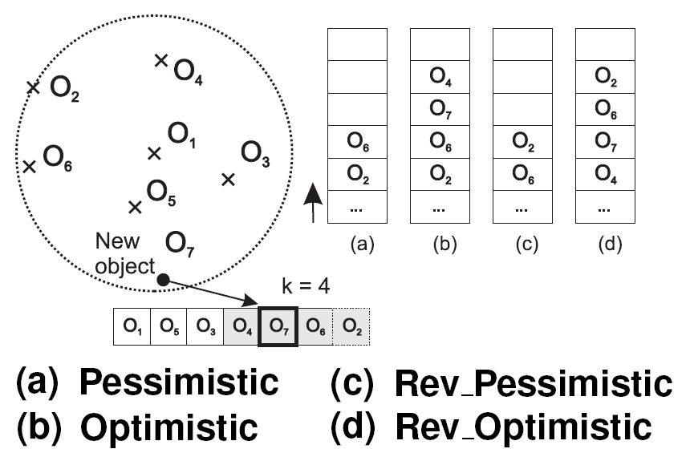
Removing strategies
(moving objects to the stack)
When reinserting, the k most distant objects in leaf are removed
(and pushed to the stack). We distinguish 4 strategies of removing:
(a) Pessimistic
- removing in descending order from the most distant object
- the removing early stops if the new (last inserted) object is reached
(b) Optimistic
- removing in descending order from the most distant object
(c) Reverse Pessimistic
- removing in ascending order from the
(at most) k-th most distant object
- if the new object is within the
k most distant, the removing
consideres just the further ones
(d) Reverse Optimistic
- removing in ascending order from the k-th most distant object
stack (top)

Slide 9
Open questions
How many entries remove from the node?
How to select the recursion depth?
Generally – greater recursion depth and/or the number of removed entries = better query costs, but higher construction costs (while the querying is improved much less than the construction is more expensive).
Empirically, we set the number of removed entries to k=5 and the recursion depth to 10, which gives the best construction vs. query costs trade-off.

Slide 10
Experimental results
2 datasets
  Corel features
    68,000 32-dimensional vectors (color histograms)
    L2 distance
  Polygons (synthetic)
    250,000 2D polygons, each ranging from 10 to 15 vertices
    Hausdorff distance
Several M-tree building methods
  CLASSIC – deterministic with O(m^2) splitting
  SAMPLING – deterministic with O(km) splitting
  MW – non-deterministic with O(m^2) splitting
  GSD – generalized slimdown algorithm (post-processing after CLASSIC)

Slide 11
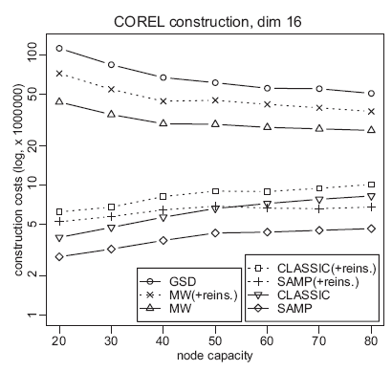
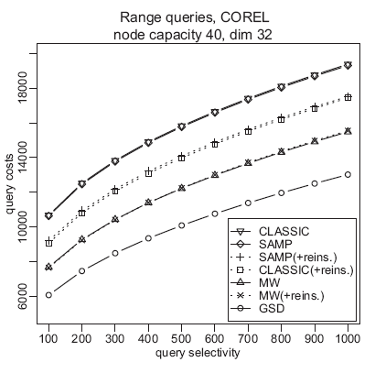
Experimental results

Slide 12
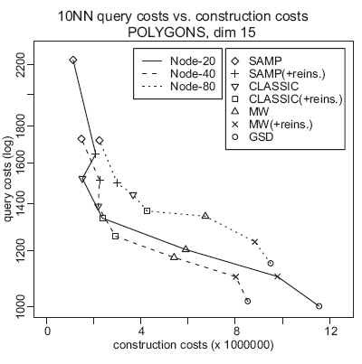
Experimental results

Slide 13
Thank for your attention!
References:
[1] Paolo Ciaccia, Marco Patella, Pavel Zezula:
M-tree: An Efficient Access Method for Similarity Search in Metric Spaces
VLDB 1997
[2] Tomas Skopal, Jaroslav Pokorný, Michal Krátký, Vaclav Snášel:
Revisiting M-tree Building Principles
ADBIS 2003
[3] Caetano Traina Jr., Agma Traina, Bernhard Seeger, Christos Faloutsos:
Slim-trees: High Performance Metric Trees Minimizing Overlap Between NodesMetric
EDBT 2000

