Slide 1

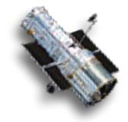
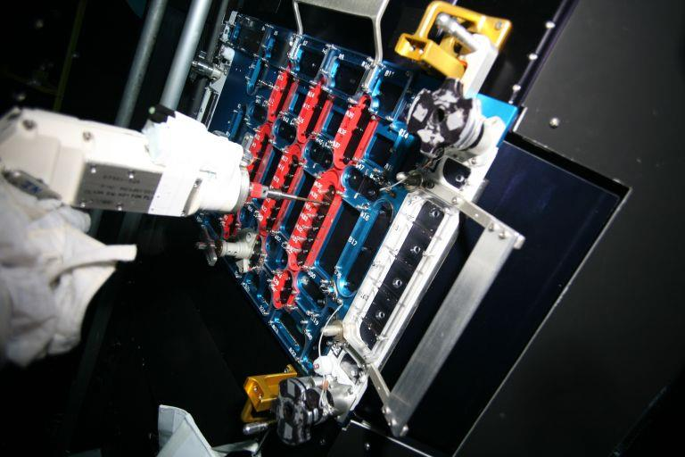
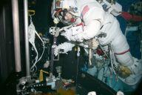
STIS Repair Concept Still Being Perfected
Goddard Space Flight Center
HST System engineers are working with the crew to define the correct
Tools
Procedures
Nominal
Contingency
Timelines
Remember the role of the system engineer is incredibly diverse
Fastener removal in NBL
Fastener removal in NBL

