Slide 1
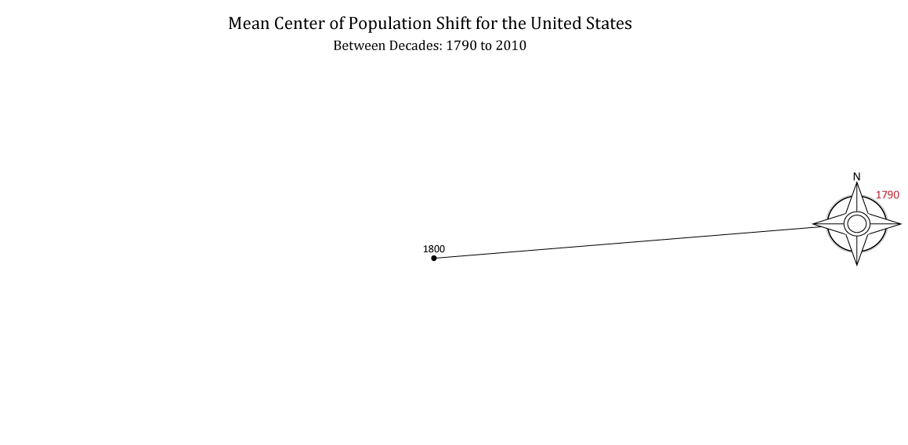

Notes:
Pauses for explanation. Click to advance.

Slide 2
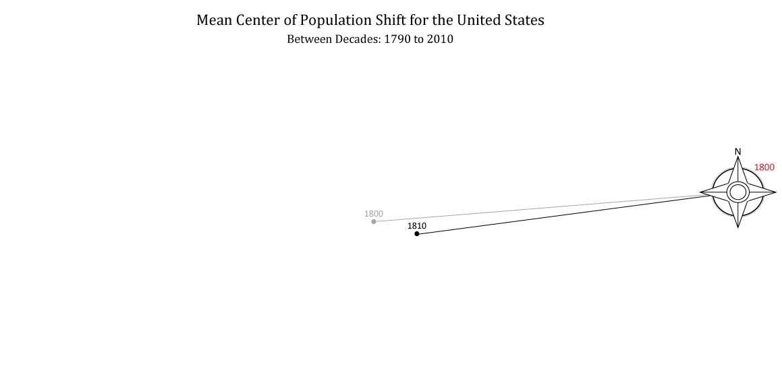
Notes:
Automatically advances after 1 second, click to go faster

Slide 3

Notes:
Automatically advances after 1 second

Slide 4
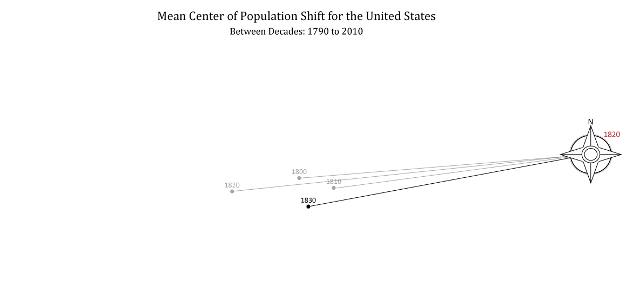
Notes:
Automatically advances after 1 second

Slide 5

Notes:
Automatically advances after 1 second

Slide 6

Notes:
Automatically advances after 1 second

Slide 7

Notes:
Automatically advances after 1 second

Slide 8

Notes:
Automatically advances after 1 second

Slide 9

Notes:
Automatically advances after 1 second

Slide 10

Notes:
Automatically advances after 1 second

Slide 11

Notes:
Automatically advances after 1 second

Slide 12

Notes:
Automatically advances after 1 second

Slide 13

Notes:
Automatically advances after 1 second

Slide 14

Notes:
Automatically advances after 1 second

Slide 15

Notes:
Automatically advances after 1 second

Slide 16

Notes:
Automatically advances after 1 second

Slide 17

Notes:
Automatically advances after 1 second

Slide 18

Notes:
Automatically advances after 1 second

Slide 19

Notes:
Automatically advances after 1 second

Slide 20
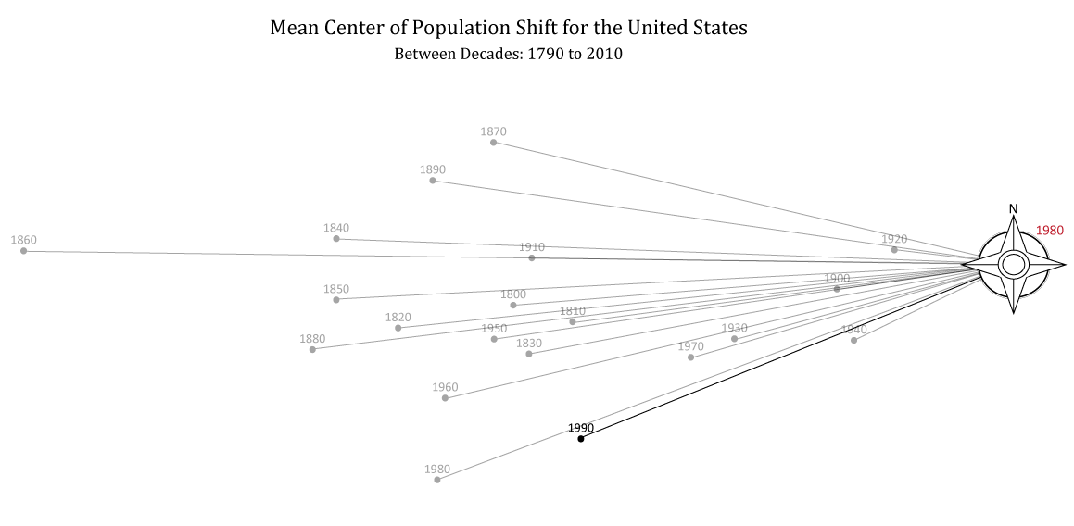
Notes:
Automatically advances after 1 second

Slide 21

Notes:
Automatically advances after 1 second

Slide 22

Notes:
Automatically advances after 1 second

Slide 23
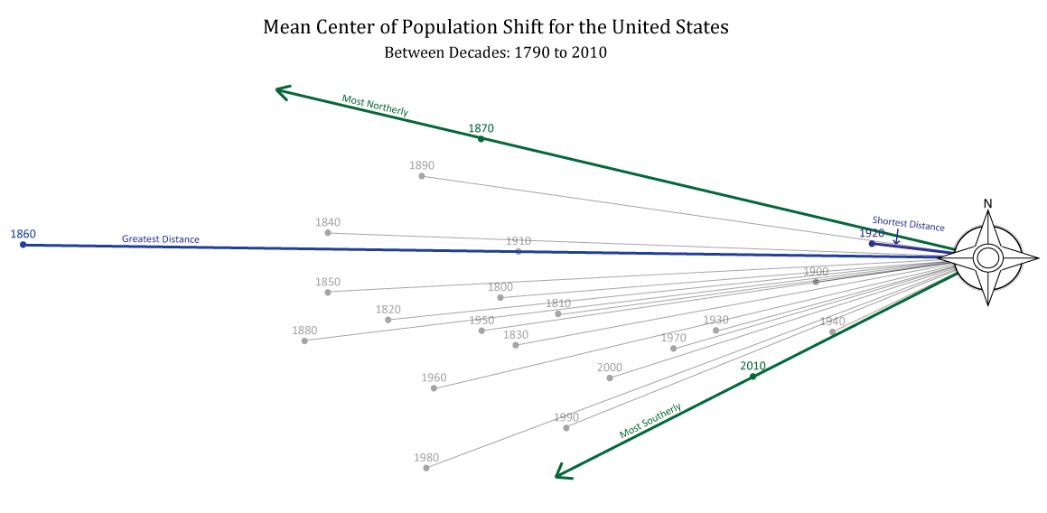
Notes:
Pauses for explanation. Click to advance.

