Slide 1
College of Arts and Sciences

Slide 2


Tale' Aaron
Bachelor of Arts

Slide 3
O. Akogun
Bachelor of Arts

Slide 4
Isaac Allen
Bachelor of Arts

Slide 5
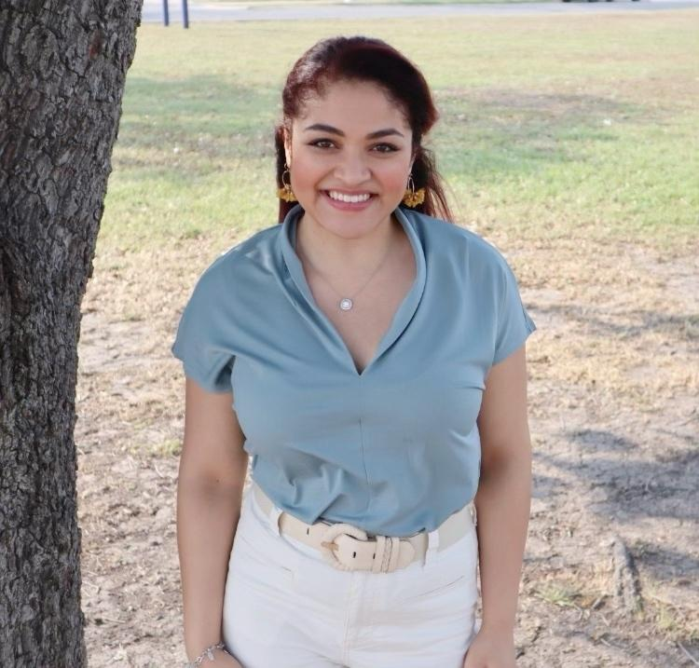
J. Allred
Bachelor of Arts

Slide 6
L. Andersen
Bachelor of Arts
Cum Laude

Slide 7
Nicole Behrle
Bachelor of Arts
Summa Cum Laude

Slide 8
Nicole Berryhill
Bachelor of Arts
Magna Cum Laude

Slide 9
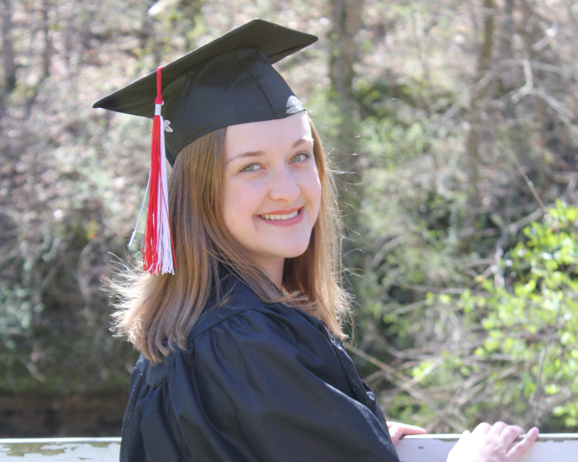
Christine Rysanek
Bachelor of Science and Bachelor of Science
Magna Cum Laude

Slide 10
College of Health Professions

Slide 11
M. Sallee
Bachelor of Arts
Magna Cum Laude

Slide 12
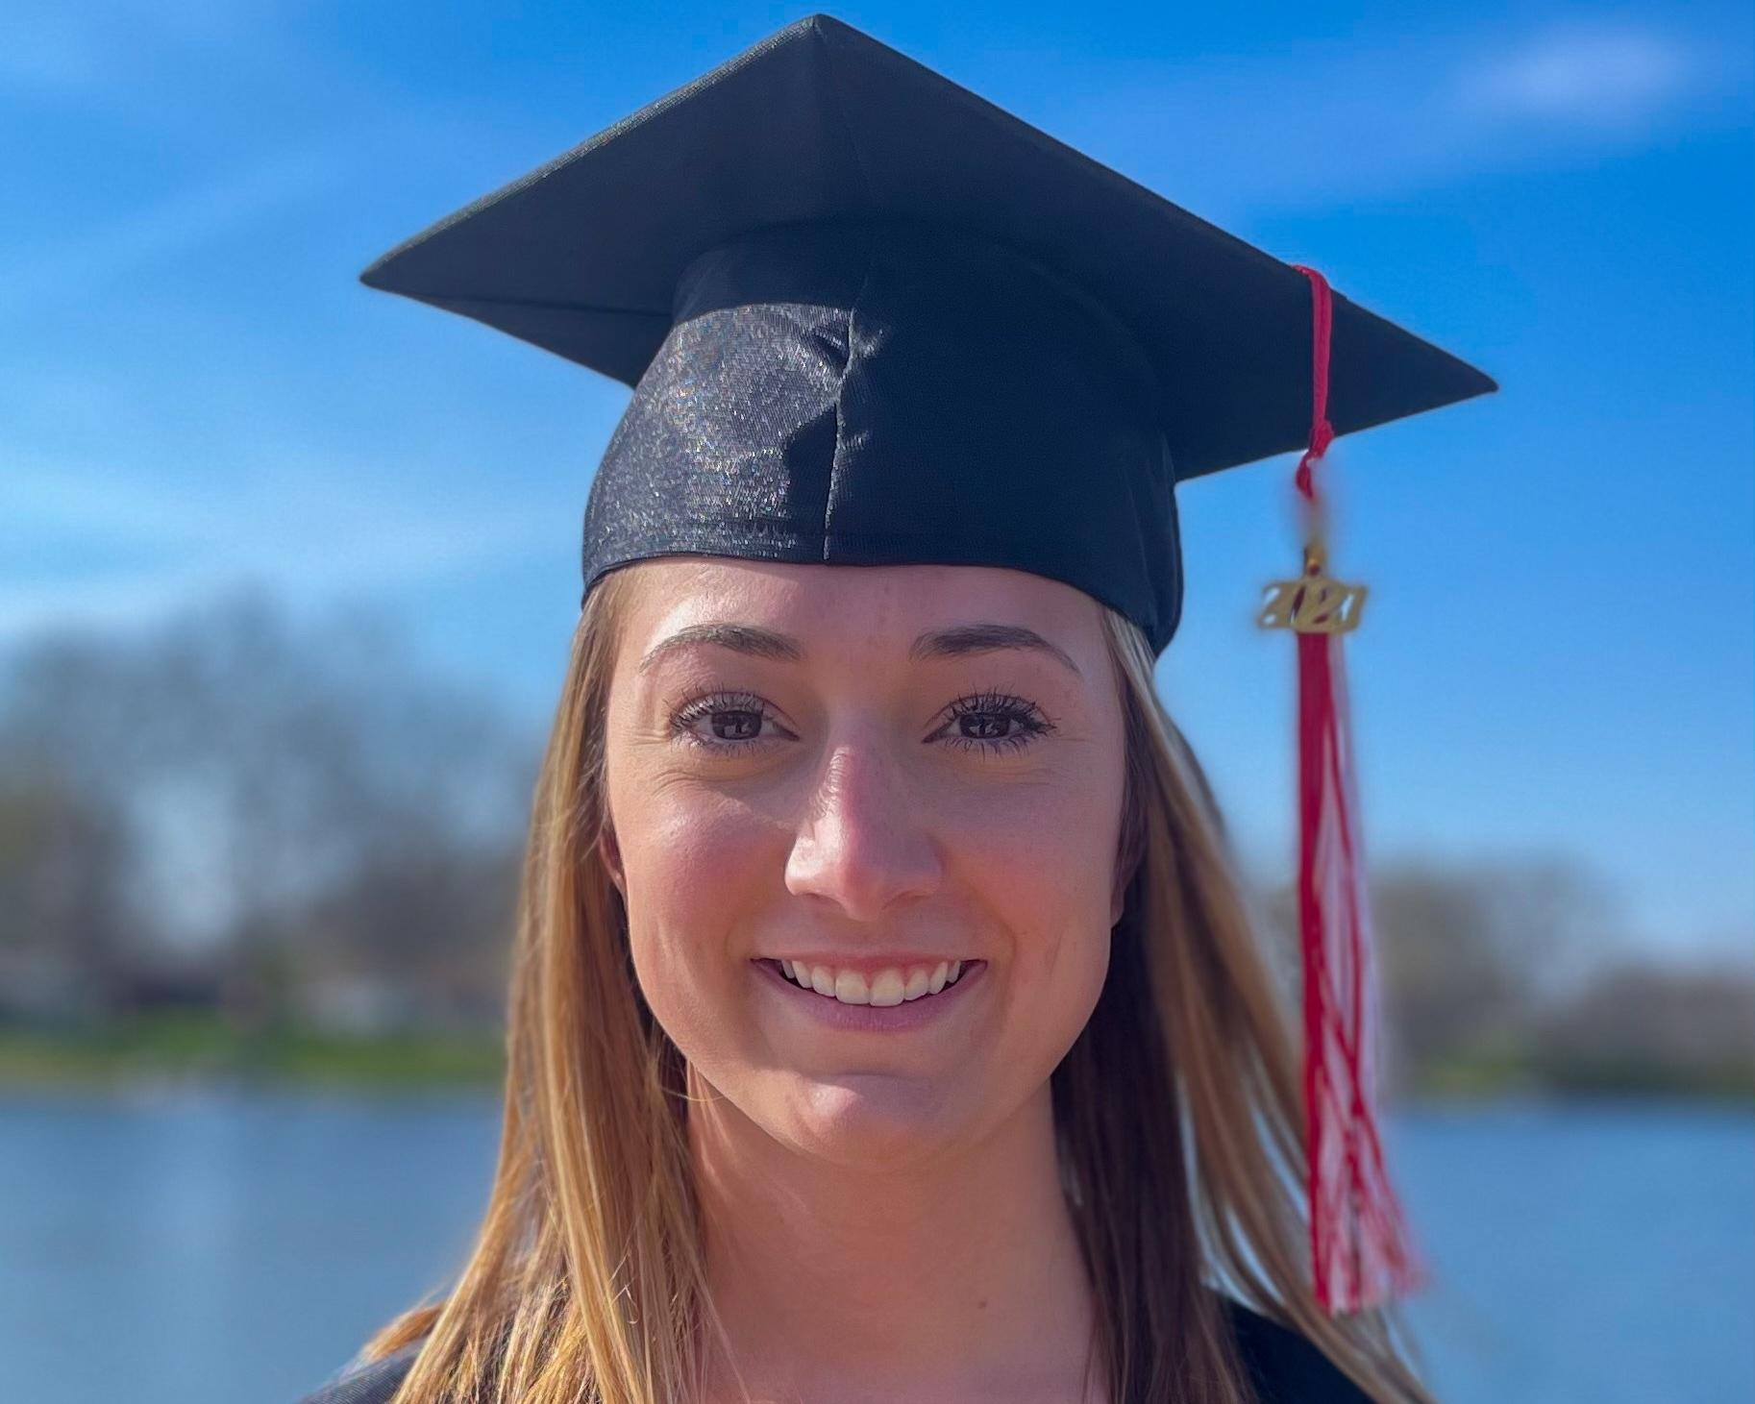
Elizabeth Ackerman
Bachelor of Science
Cum Laude

Slide 13
School of Business

Slide 14
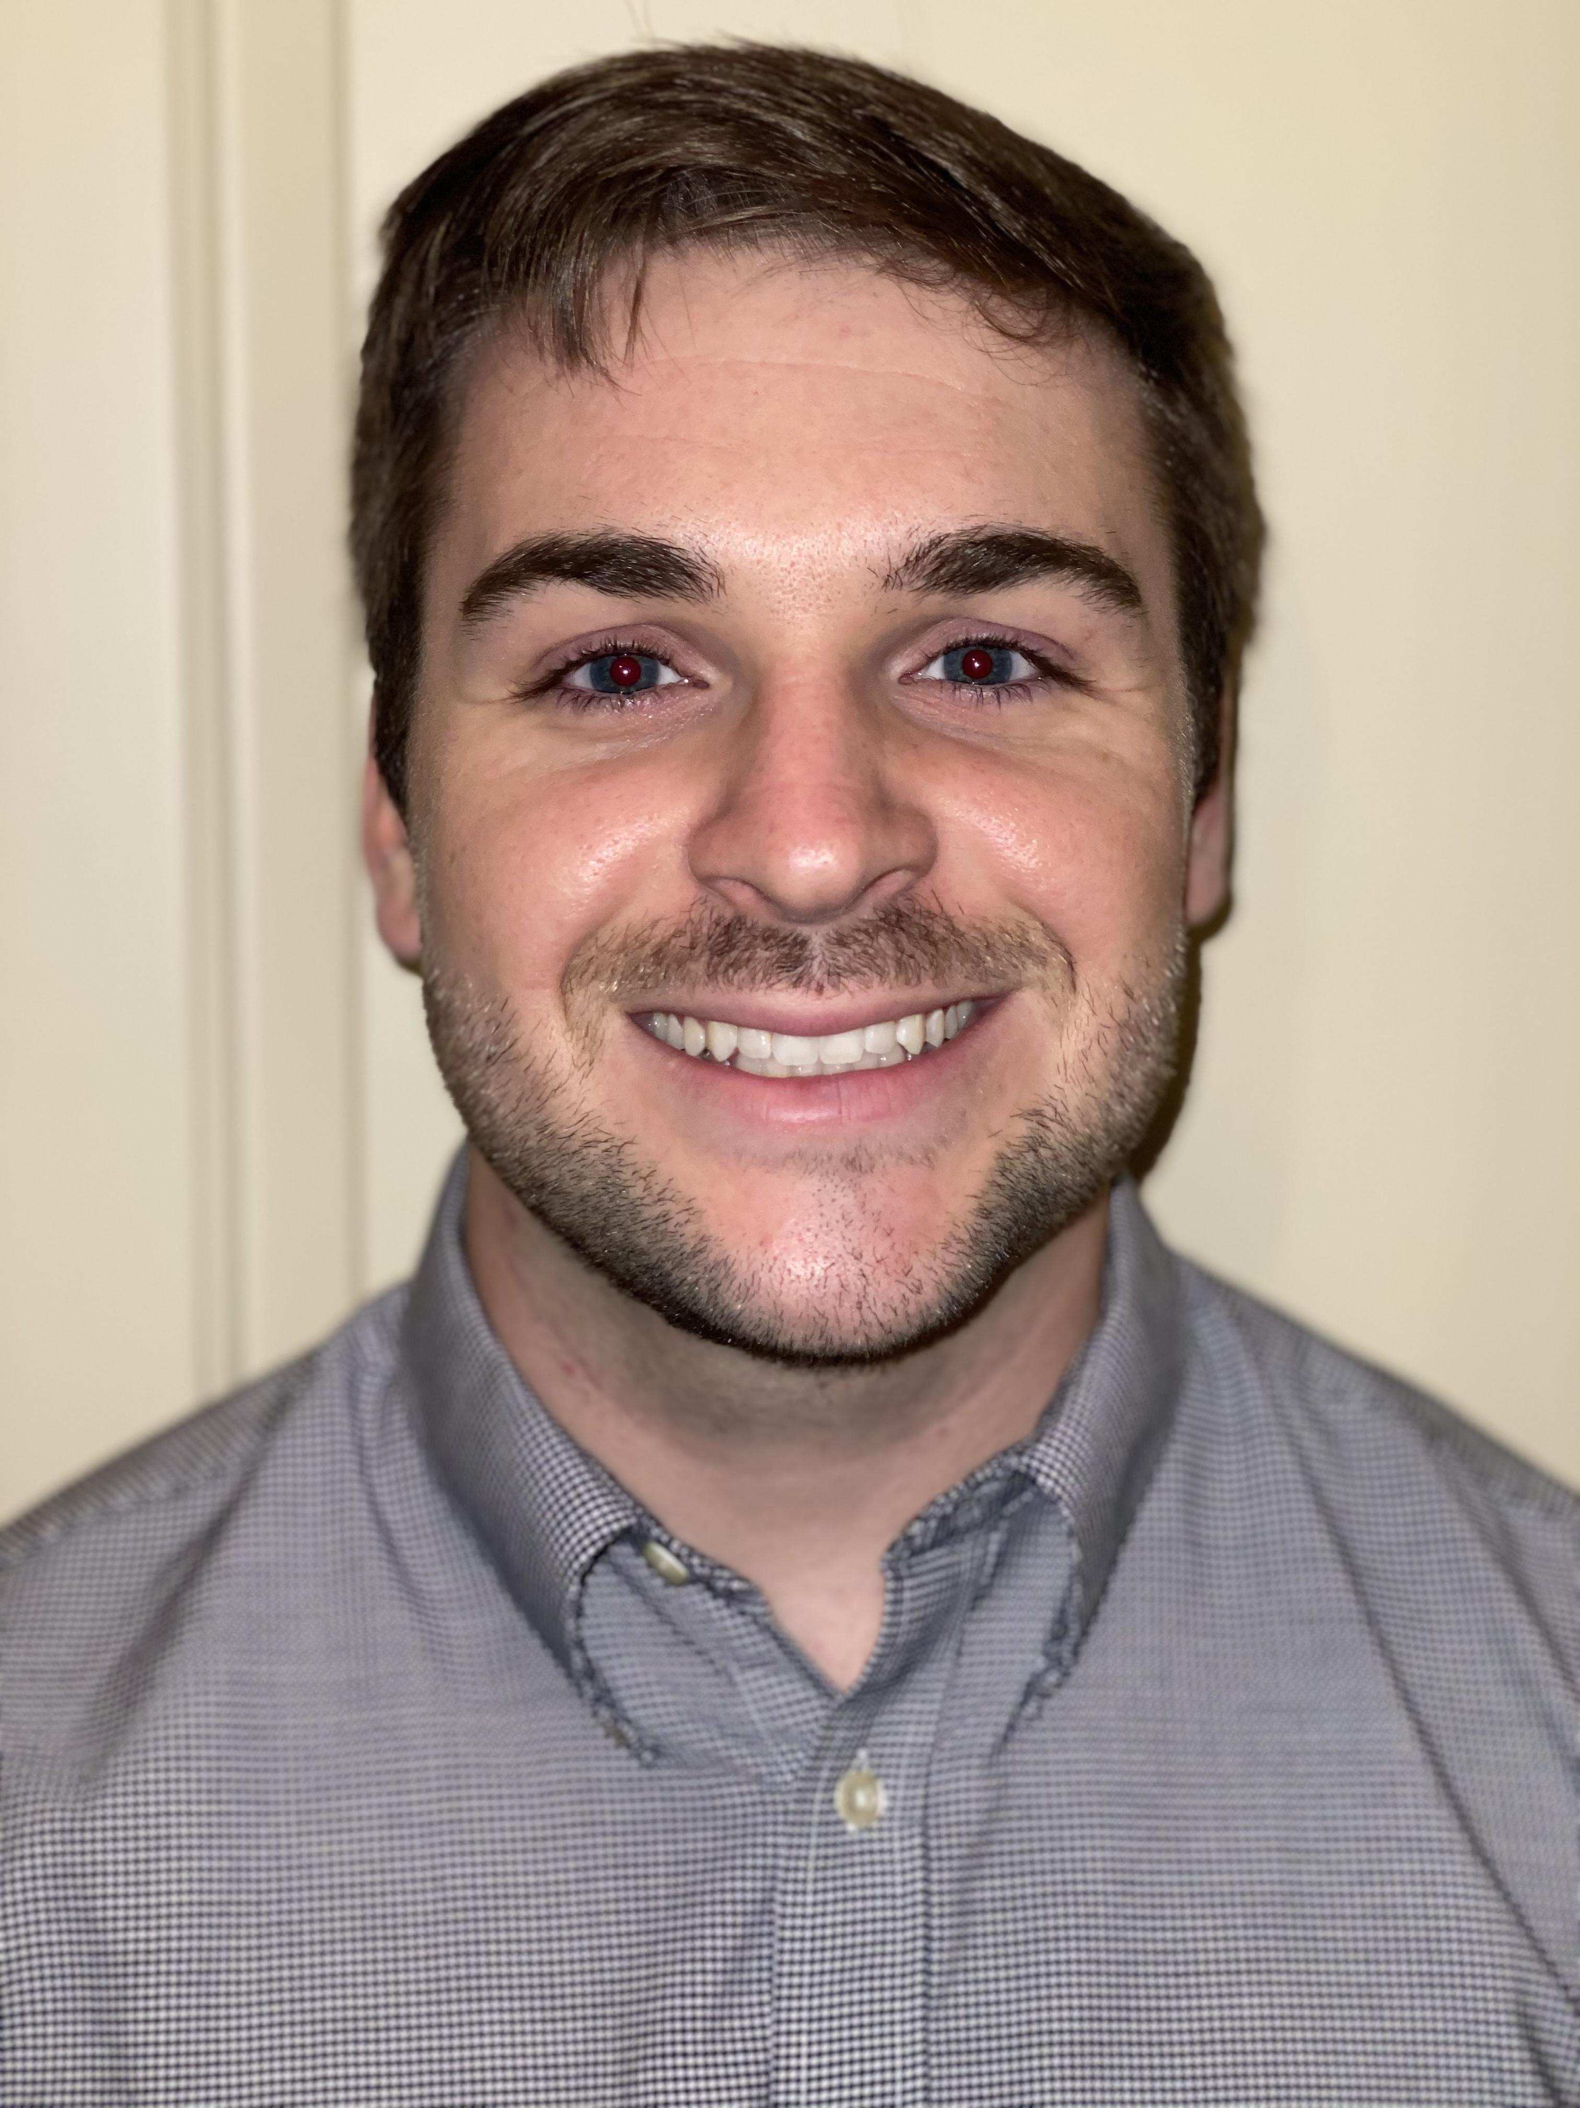
Hayden Anderson
Bachelor of Science
Summa Cum Laude

Slide 15
Xavier Andrade Cazar
Bachelor of Science
Magna Cum Laude

Slide 16
Joseph Anselm
Bachelor of Science
Cum Laude

Slide 17
Anderson Bachman
Bachelor of Science
Cum Laude

