Slide 1
Analysis of Heart Disease
William Borenstein​

Slide 2
AGENDA
Client description​
Background of data
Visuals
​Results​

Slide 3
Introduction
My stake holder is a healthcare system that are endeavoring to develop tools to assist in screening patients for heart disease. People who are at higher risk can be identified for further testing and appropriate interventions.

Slide 4
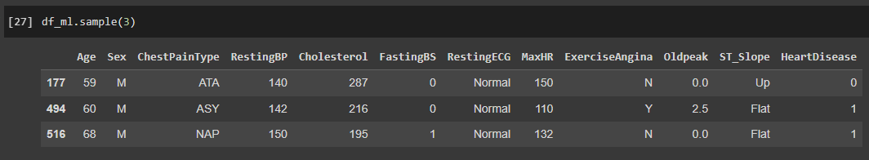
Sampling The Data

Slide 5
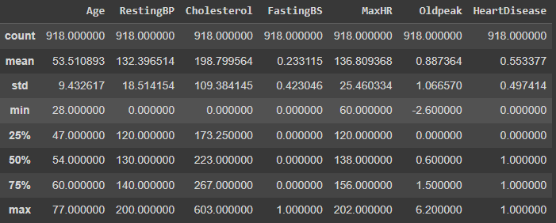
Data Summary

Slide 6
Data Background
The data that was made available contains various features of patient health. Some of the key factors of people who are at risk of heart disease are tabulated such as age, gender, and cholesterol level. While some of the data is not obviously correlated the models that will be presented shortly will be able to combine these distinct features and predict the likely-hood of a patient developing heart disease.

Slide 7
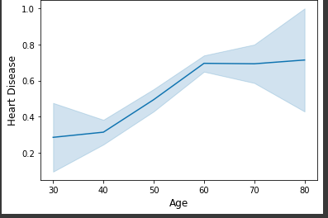
Increase of Heart Disease with Age

Slide 8
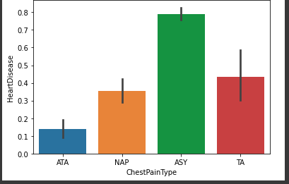
Higher percentage of heart disease among asymptomatic patients

Slide 9
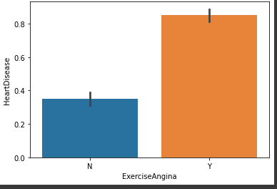
Rates of Exercise Angina

Slide 10
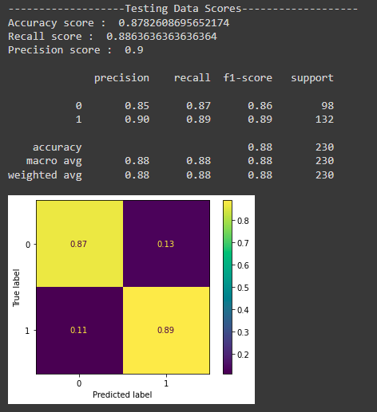
Final Model

Slide 11
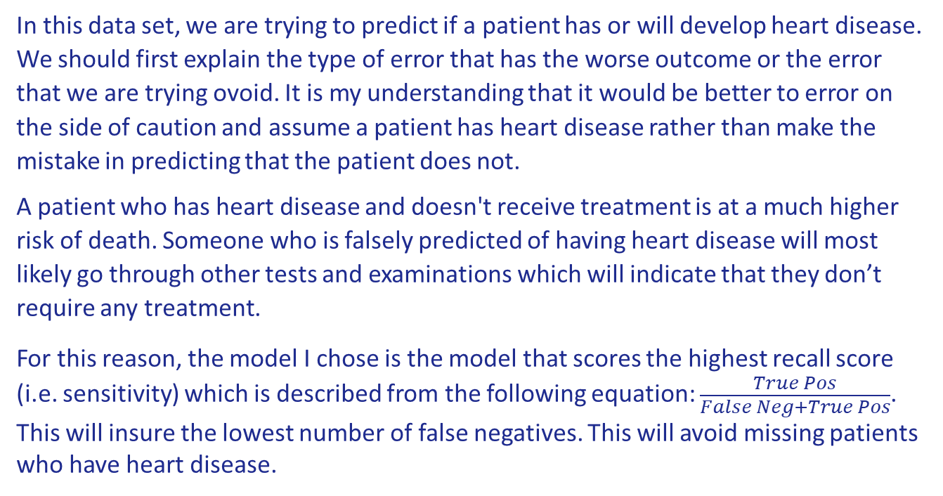
SUMMARY
In this data set, we are trying to predict if a patient has or will develop heart disease. We should first explain the type of error that has the worse outcome or the error that we are trying ovoid. It is my understanding that it would be better to error on the side of caution and assume a patient has heart disease rather than make the mistake in predicting that the patient does not.
A patient who has heart disease and doesn't receive treatment is at a much higher risk of death. Someone who is falsely predicted of having heart disease will most likely go through other tests and examinations which will indicate that they don’t require any treatment.
For this reason, the model I chose is the model that scores the highest recall score (i.e. sensitivity) which is described from the following equation: $\frac{True Pos}{False Neg+True Pos}$. This will insure the lowest number of false negatives. This will avoid missing patients who have heart disease.

Slide 12
THANK YOU
William Borenstein​
Email : zevy613@gmail.com

