Slide 1
COMP702 · 2nd Assessment
LuxLLM-Agent Decision Trace + Action Verification (DTAV)
Ze Wang · 201868809 · Supervisor: Dr Meng Fang Lux AI Season 3
ETHICAL CATEGORY: A0
No human/animal-derived data or human participants. University of Liverpool ethical guidance followed.
Notes:
Introduce yourself, the project and the supervisor. State that the project uses no human participants or human/animal-derived data and follows University ethical guidance.
[Sources]
- User-provided COMP702 CA2 assessment instructions.
- paper/main.tex — Ethics Statement.
[/Sources]

Slide 2
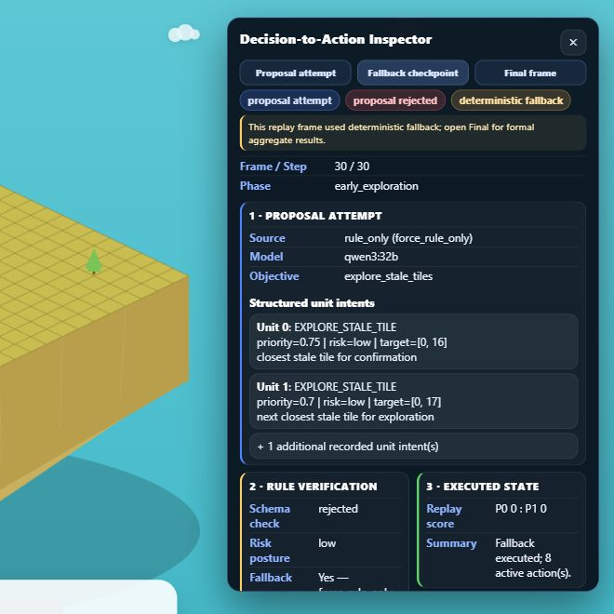
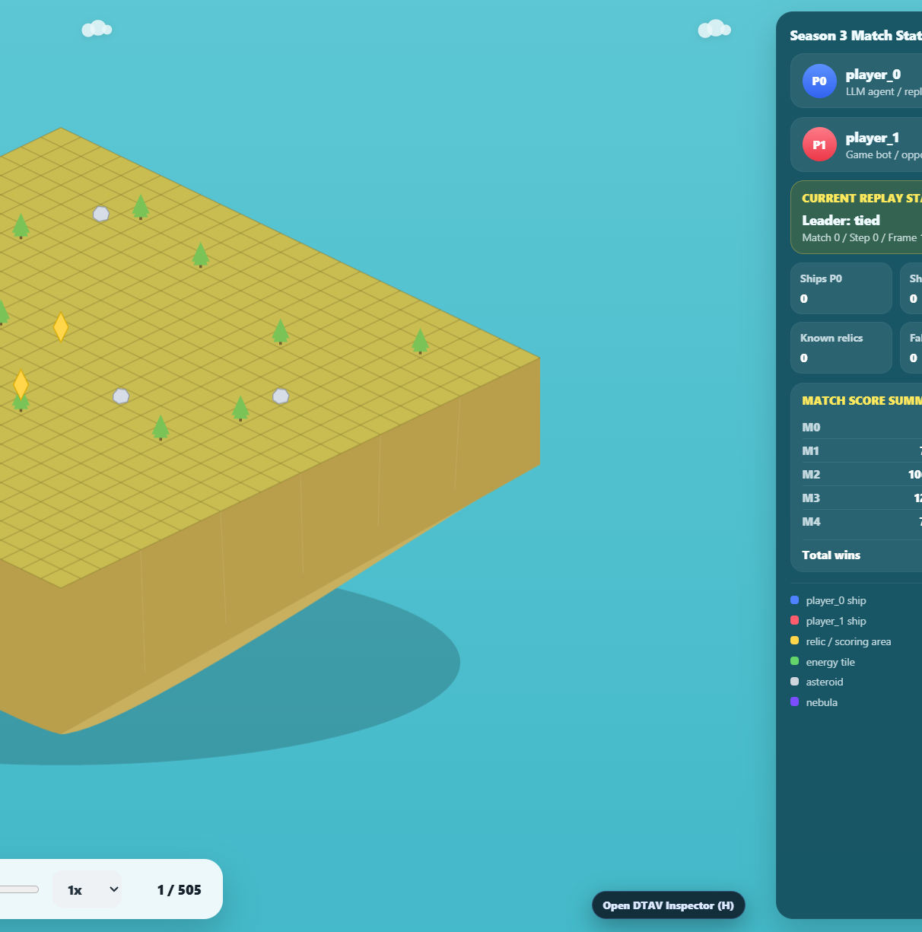
Inspect decisions—not only outcomes
THE INSPECTION GAP
A fluent LLM proposal may be invalid, stale, unsafe or replaced. Win/loss alone cannot show which path produced the executed action. RESEARCH QUESTION How effectively can directly prompted LLMs decide in Lux AI Season 3, and how can DTAV address the observed limitations?
2
Notes:
Explain why outcome-only evaluation is insufficient. State the revised research question and frame DTAV as the project-specific method, not an established general term.
[Sources]
- docs/research_scope_20260814.md.
- Latest user-provided Player View screenshot, 2026-08-18.
[/Sources]

Slide 3
The framework keeps execution control outside the LLM
01 · SUMMARISE
02 · VERIFY
03 · TRACE & INSPECT
Observation → bounded state
Score, phase, units, energy, map memory and candidate targets form a compact prompt.
Proposal → verified intent
Parse, schema-check, normalise, cache or replace; then apply deterministic risk checks.
Legal action → linked evidence
Build a valid Lux action and log provenance, interventions, latency, score and replay linkage.
3
Notes:
Explain the three stages as one controlled pipeline.
Emphasise that the LLM proposes structured intent but does not directly send arbitrary environment actions.
[Sources]
- docs/technical/system_architecture.md.
- src/agent/agent.py.
- src/agent/llm_decider.py.
[/Sources]

Slide 4
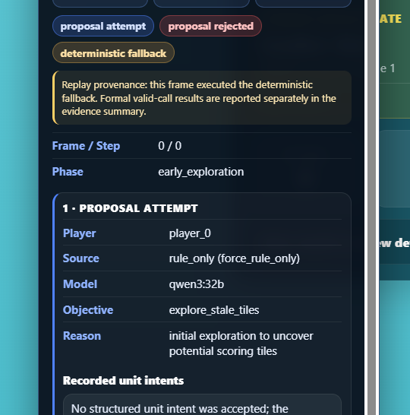
Viewer: proposal → verify → execute
REPLAY-GROUNDED INSPECTION
1 · PROPOSAL Source, model, objective and unit intents. 2 · VERIFY Schema result, risk posture and fallback reason. 3 · EXECUTE Replay score and action summary show what actually reached the environment.
4
Notes:
Switch to the live Viewer after this slide. Demonstrate Proposal attempt, Fallback checkpoint and Final frame, then explain that the panel is an operational audit record rather than hidden chain-of-thought.
[Sources]
- docs/viewers/s3_isometric_battle_viewer_v09n12d_trace_overlay.html.
- Latest user-provided DTAV Inspector screenshot, 2026-08-18.
[/Sources]

Slide 5
Three code boundaries make the agent inspectable
01 · STATE
02 · DECIDE
03 · EXECUTE
state_summarizer.py
Reduces raw observations and memory to stable strategic features.
llm_decider.py
Requests structured intents; parses, validates and normalises responses.
agent.py
Applies cache, verifier, risk filter and fallback before legal actions.
5
Notes:
Show the three files in the development environment after this slide.
Use one short code example from each boundary; do not browse every source file.
[Sources]
- src/agent/state_summarizer.py.
- src/agent/llm_decider.py.
- src/agent/agent.py.
[/Sources]

Slide 6
A matched comparison favours DTAV under the tested setup
FINAL CONTROLLED COMPARISON
Qwen3-32B; 50 matched seeds; roles swapped; 100 matches per method. Same compact observation, temperature, prompt budget, call schedule and minimum legal-action adapter.
48%
63%
+15 pp
DIRECT PROMPT 48 wins / 100 matches
DTAV 63 wins / 100 matches
MATCHED EFFECT 95% CI +6 to +25; p = .0059
6
Notes:
Explain the matched design before interpreting outcomes. Direct prompt won 48 of 100 matches; DTAV won 63 of 100. In the paired comparison, DTAV had a 15 percentage-point advantage, 95% CI 6 to 25 points, McNemar p=.0059.
[Sources]
- reports/direct_prompt_vs_dtav_comparison.json.
- reports/direct_prompt_vs_dtav_trace_analysis.json.
[/Sources]

Slide 7
DTAV improves usable decisions while keeping the path inspectable
ANSWER TO THE RESEARCH QUESTION
Under the recorded configuration, DTAV improved structured-call usability and strategy continuity while retaining a complete operational audit path from proposal through verification to executed action and replay state.
86.1 → 99.9%
95.5 → 5.6%
100%
POST-CHECK VALIDITY Direct prompt → DTAV
RULE-FALLBACK STEPS Direct prompt → DTAV
TRACE + REPLAY LINKAGE both conditions; bounded conclusion
7
Notes:
Answer the research question directly. DTAV improved post-check validity from 86.1% to 99.9% and reduced rule-fallback steps from 95.5% to 5.6%, while both conditions retained complete trace and replay linkage. State that this is a bounded comparison of method bundles under one recorded configuration.
[Sources]
- reports/direct_prompt_vs_dtav_trace_analysis.json.
- docs/dissertation/chapter_7_discussion_conclusion.md.
[/Sources]

