Slide 1
COMP702 · 2nd Assessment
LuxLLM-Agent Decision Trace + Rule Verification
Ze Wang · 201868809 · Supervisor: Dr Meng Fang Lux AI Season 3
ETHICAL CATEGORY: A0
No human/animal-derived data or human participants. University of Liverpool ethical guidance followed.
Notes:
Introduce yourself, the project and the supervisor.
State that the project uses no human participants or human/animal-derived data and follows University ethical guidance.
[Sources]
- User-provided COMP702 CA2 assessment instructions.
- paper/main.tex — Ethics Statement.
[/Sources]

Slide 2
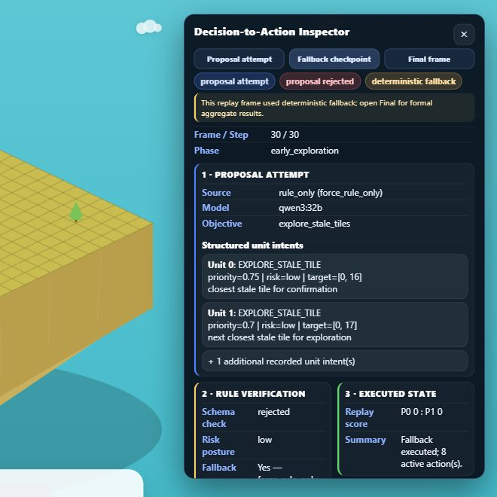
Inspect decisions—not only outcomes
THE INSPECTION GAP
A fluent LLM proposal may be invalid, stale, unsafe or replaced. Win/loss alone cannot show which path produced the executed action. RESEARCH QUESTION How can structured decision tracing and rule-based action verification support inspection and evaluation in Lux AI Season 3?
2
Notes:
Explain why win/loss is insufficient for inspecting a hybrid LLM agent.
State the research question and the boundary: this project evaluates inspectability, not a general model leaderboard.
[Sources]
- docs/technical/system_architecture.md.
- Current local Viewer screenshot captured 2026-08-14.
[/Sources]

Slide 3
The framework keeps execution control outside the LLM
01 · SUMMARISE
02 · VERIFY
03 · TRACE & INSPECT
Observation → bounded state
Score, phase, units, energy, map memory and candidate targets form a compact prompt.
Proposal → verified intent
Parse, schema-check, normalise, cache or replace; then apply deterministic risk checks.
Legal action → linked evidence
Build a valid Lux action and log provenance, interventions, latency, score and replay linkage.
3
Notes:
Explain the three stages as one controlled pipeline.
Emphasise that the LLM proposes structured intent but does not directly send arbitrary environment actions.
[Sources]
- docs/technical/system_architecture.md.
- src/agent/agent.py.
- src/agent/llm_decider.py.
[/Sources]

Slide 4
Viewer: proposal → verify → execute
REPLAY-GROUNDED INSPECTION
1 · PROPOSAL Source, model, objective and unit intents. 2 · VERIFY Schema result, risk posture and fallback reason. 3 · EXECUTE Replay score and action summary show what actually reached the environment.
4
Notes:
Switch to the live Viewer after this slide and demonstrate Proposal attempt, Fallback checkpoint and Final.
Point out that the screenshot reports the proposal, verifier decision and executed state separately.
[Sources]
- Current local Viewer screenshot captured 2026-08-14.
- docs/viewers/s3_isometric_battle_viewer_v09n12d_trace_overlay.html.
[/Sources]

Slide 5
Three code boundaries make the agent inspectable
01 · STATE
02 · DECIDE
03 · EXECUTE
state_summarizer.py
Reduces raw observations and memory to stable strategic features.
llm_decider.py
Requests structured intents; parses, validates and normalises responses.
agent.py
Applies cache, verifier, risk filter and fallback before legal actions.
5
Notes:
Show the three files in the development environment after this slide.
Use one short code example from each boundary; do not browse every source file.
[Sources]
- src/agent/state_summarizer.py.
- src/agent/llm_decider.py.
- src/agent/agent.py.
[/Sources]

Slide 6
300 controlled matches produced complete framework evidence
EVIDENCE DESIGN
Primary: Qwen and DeepSeek each play 100 matched-seed, role-swapped matches against the same rule opponent. Supplementary: 100 direct Qwen-versus-DeepSeek matches under the same framework.
300 / 300
9,267 / 9,267
54 : 46
MATCHES completed; 312,908 trace records
FRESH LLM CALLS valid after recorded checks
DIRECT DUAL-LLM 100 matches; seed-level p = .503
6
Notes:
Explain the primary and supplementary experiment designs before interpreting outcomes.
State that all 9,267 fresh calls were valid after recorded checks; this includes 520 primary Qwen normalisations and 571 dual-run normalisations.
Treat the 54:46 result as supplementary and non-significant at seed level.
[Sources]
- reports/final_trace_evaluation.json.
- reports/dual_llm_trace_evaluation.json.
- reports/verifier_intervention_audit.json.
- reports/dual_llm_verifier_audit.json.
[/Sources]

Slide 7
Tracing and verification make the action path auditable
ANSWER TO THE RESEARCH QUESTION
LuxLLM-Agent links each strategic proposal to deterministic checks and the action that reached Lux. It reveals how decisions were accepted, normalised, cached or replaced—not only whether the agent won.
312,908
28,401
BOUNDED
TRACE RECORDS complete across 300 matches
RISK-FILTER STEPS changed across all studies
INTERPRETATION operational evidence—not causal reasoning or a general ranking
7
Notes:
Answer the research question directly: tracing provides provenance, verification constrains execution, and the Viewer connects both to replay evidence.
State the limitations: operational traces are not a complete causal explanation; evidence comes from one game and two local 32B models.
[Sources]
- reports/final_trace_evaluation.json.
- reports/dual_llm_trace_evaluation.json.
- docs/dissertation/chapter_7_discussion_conclusion.md.
[/Sources]

