Slide 1
Household Power Consumption Forecast
Eric Li, Jessie Chen, Karen Xie, Vanessa Li

Slide 2
Agenda
Problem Statement
Data Property
Proposed Approaches
1
3
5
2
4
6
Data Overview and Assumptions
Data Preprocessing
Result and Future Work

Slide 3
Data Overview & Problem Statement
DATA DESCRIPTION
- Observations of power consumption within the household.
- Collected every minute gathered in a house located in Sceaux (7km of Paris, France) between December 2006 and November 2010 (47 months).
PROBLEM STATEMENT
1. Predict the total active power consumed by the household (global_active_power)
2. Predict the active energy for kitchen, laundry and climate control systems (sub_metering_1, sub_metering_2, sub_metering_3) according to their relationships between active power

Slide 4
Data Overview & Assumptions
Multivariate Time Series
global_active_power: The total active power consumed by the household (kilowatts).
global_reactive_power: The total reactive power consumed by the household (kilowatts).
voltage: Average voltage (volts).
global_intensity: Average current intensity (amps).
sub_metering_1: Active energy for kitchen (watt-hours of active energy).
sub_metering_2: Active energy for laundry (watt-hours of active energy).
sub_metering_3: Active energy for climate control systems (watt-hours of active energy).
*Active power is the real power consumed by the household.
* sub_metering_remainder = (global_active_power * 1000 / 60) - (sub_metering_1 + sub_metering_2 + sub_metering_3)

Slide 5
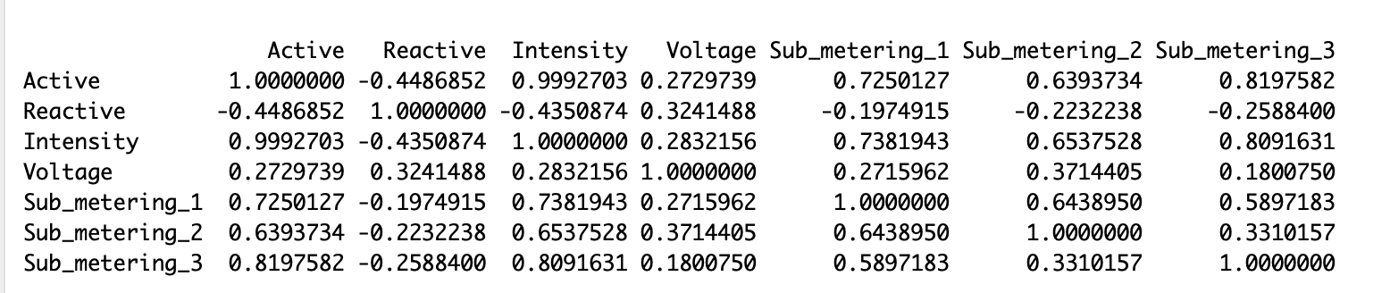
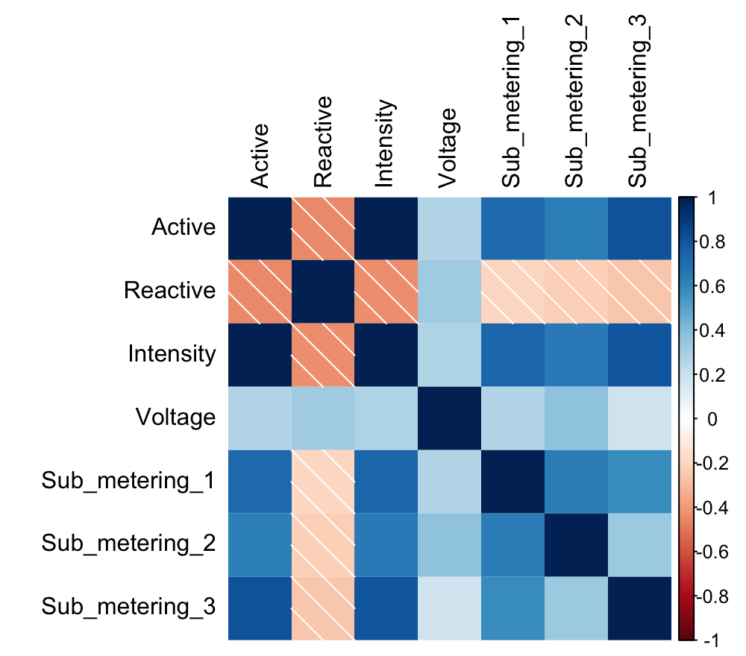
Data Property - Correlation

Slide 6
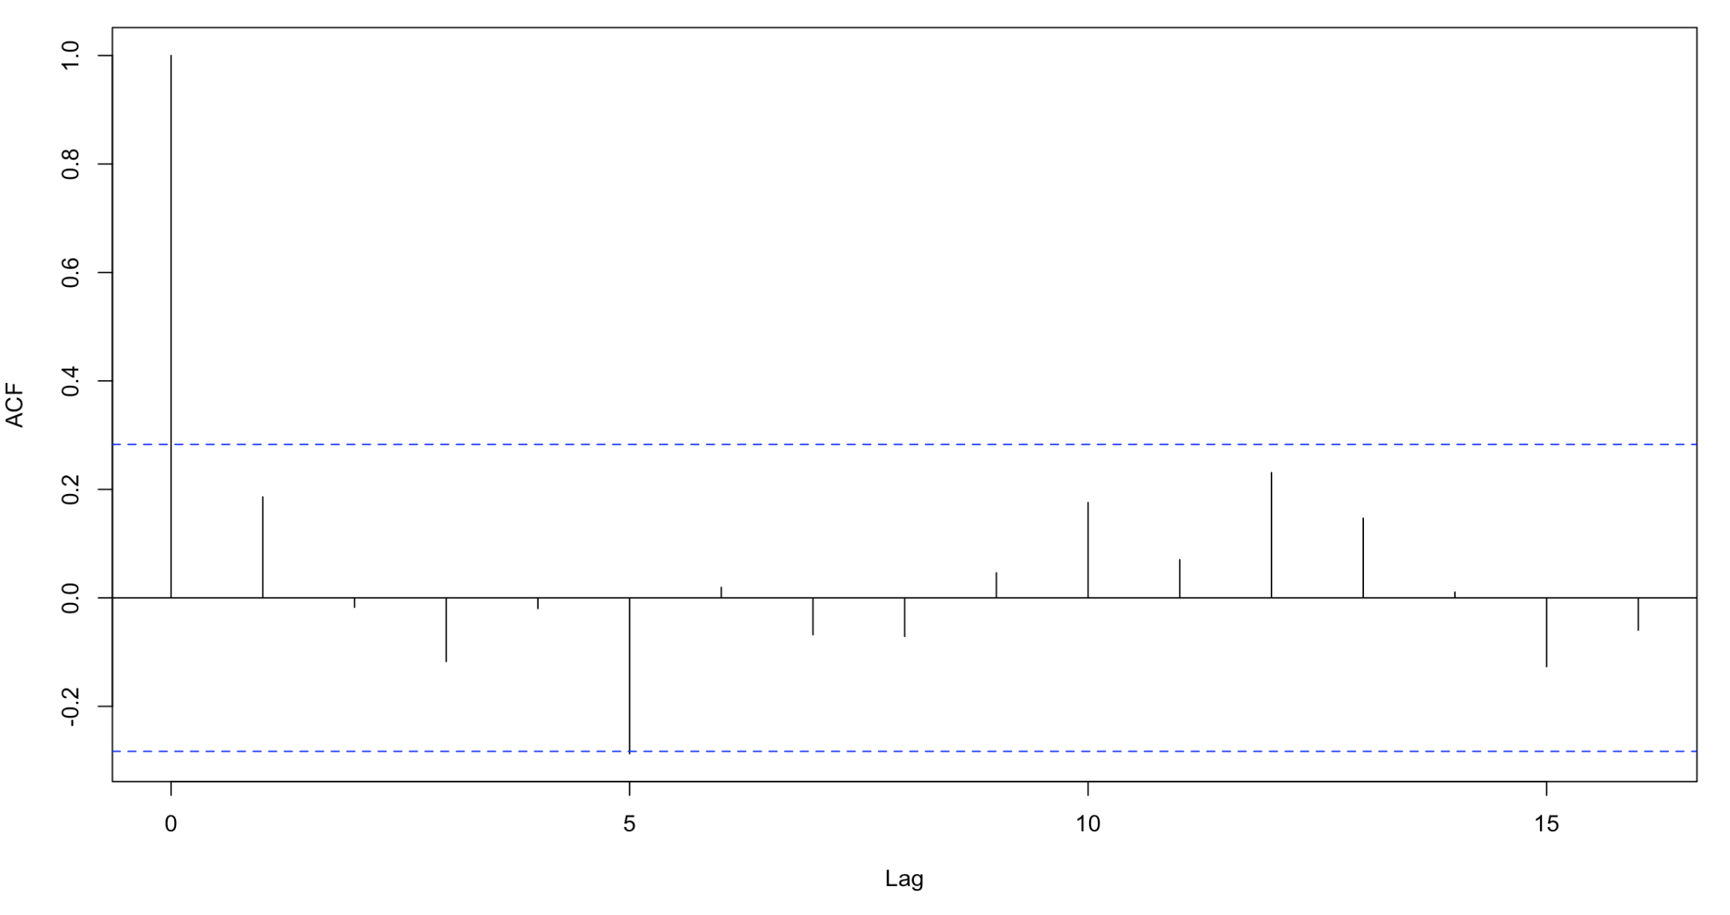
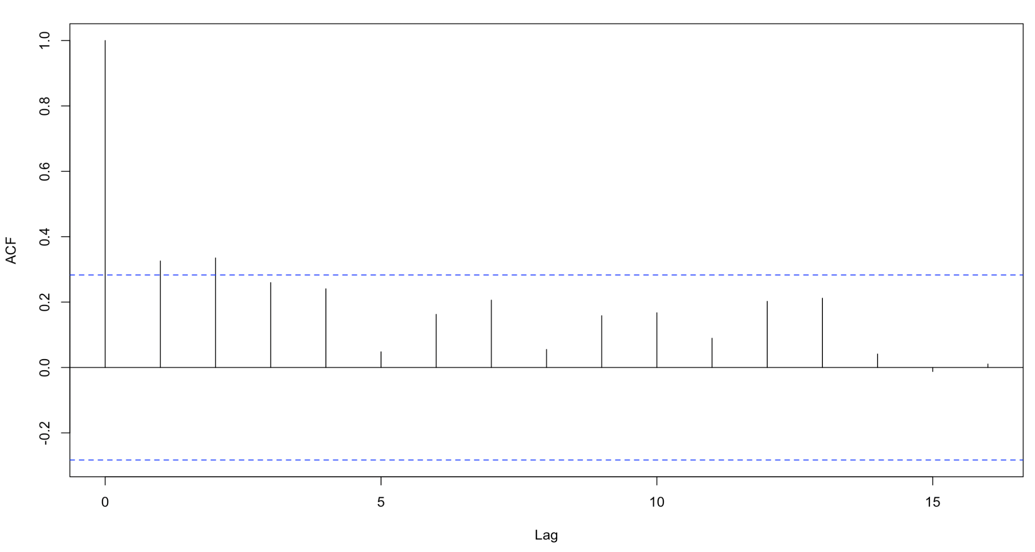
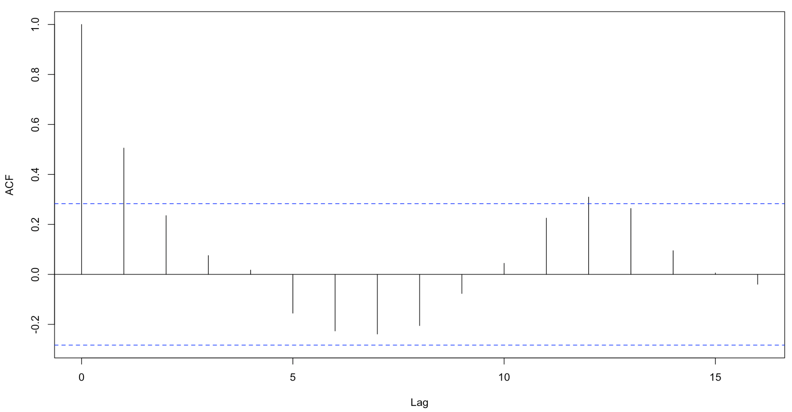
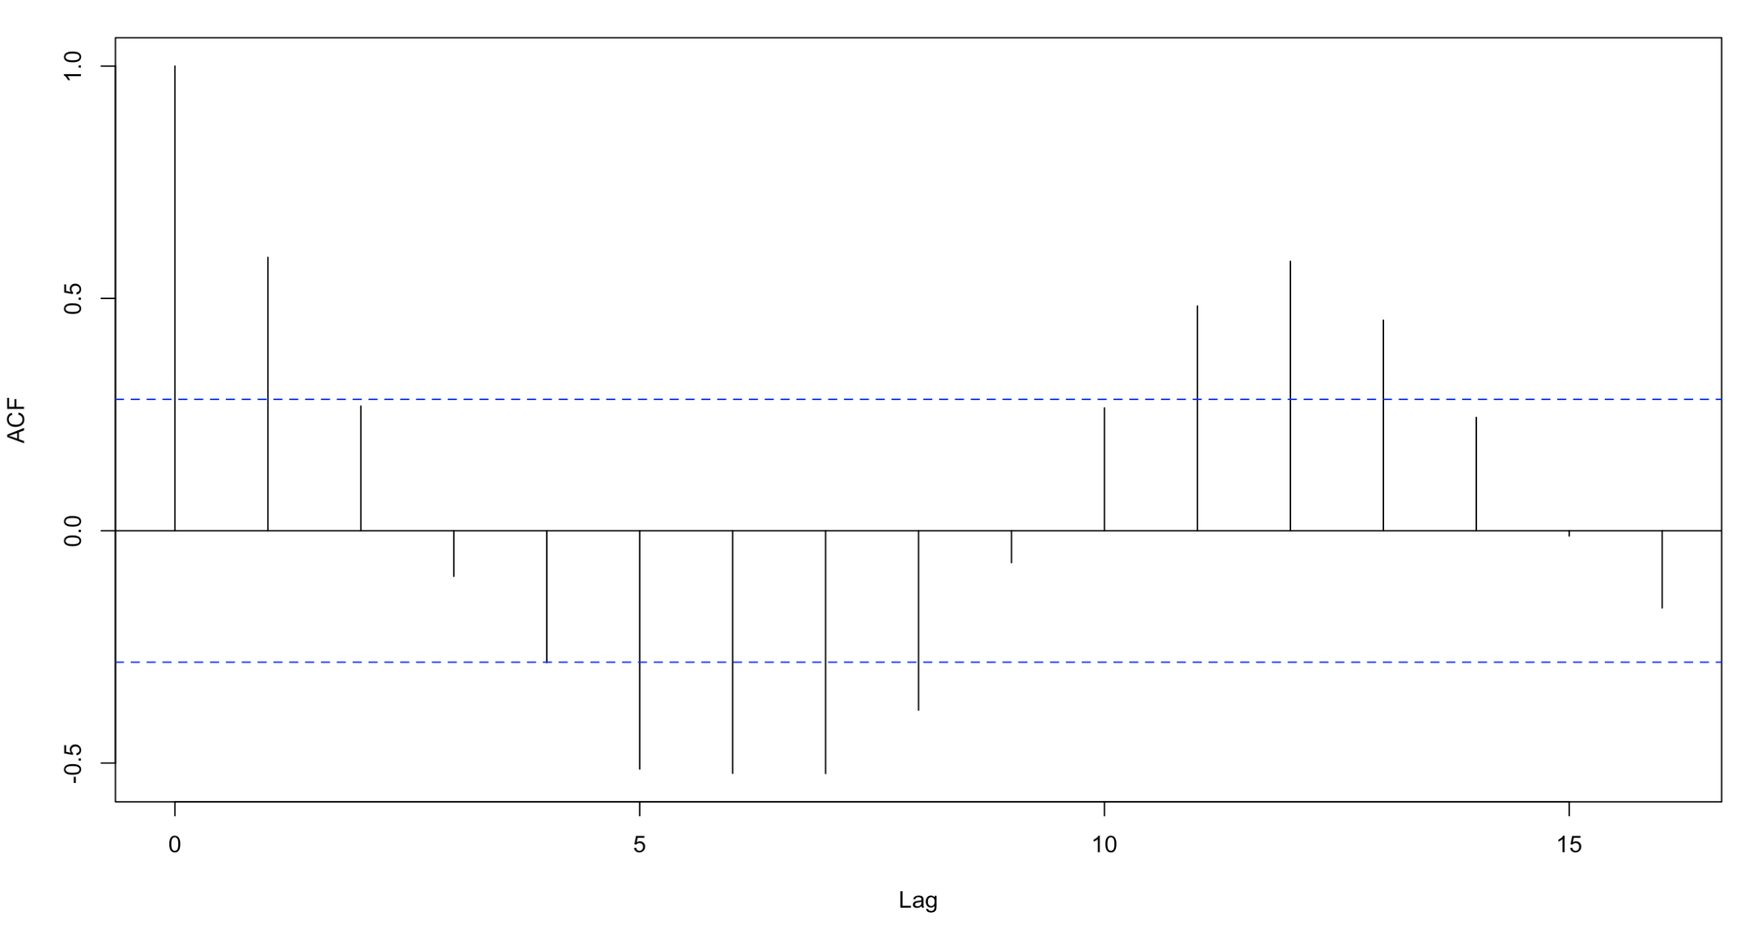
Data Property - Stationarity
Sub_metering_1
Sub_metering_2
Sub_metering_3
Global_Active_Power

Slide 7
Data Property - Stationarity
Attributes | Qualitative | KPSS Test | ADF Test
Sub_metering_1 | Yes | Yes | Yes
Sub_metering_2 | No | No | No
Sub_metering_3 | No | Yes | No
Global Active Power | No | Yes | Yes
Global Reactive Power | No | Yes | Yes
Global Intensity | No | Yes | Yes
Voltage | Yes | Yes | No

Slide 8
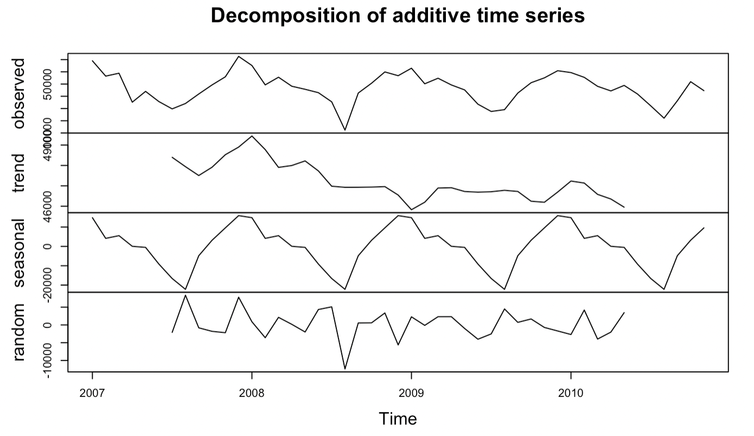
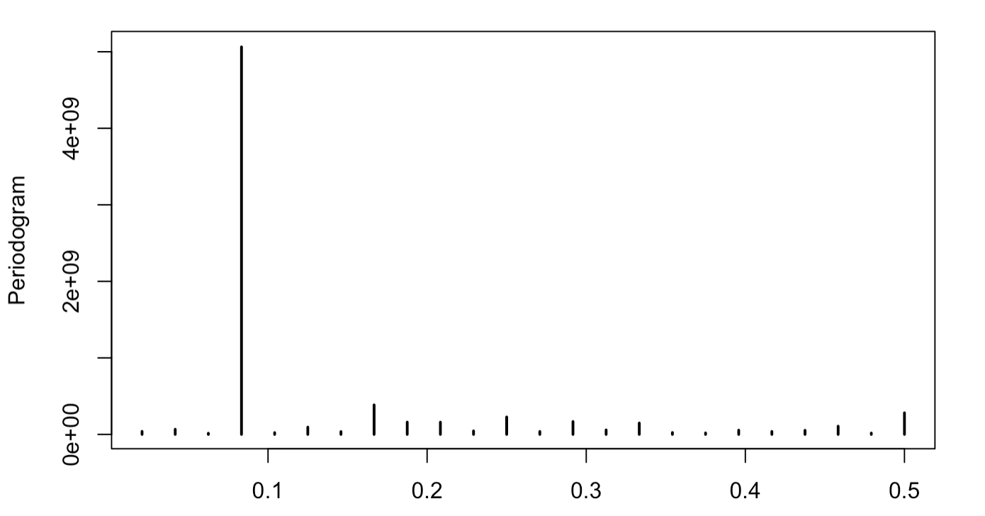
Data Property - Seasonality
Decreasing
Trend
Global Active Power
Yearly
Seasonality

Slide 9
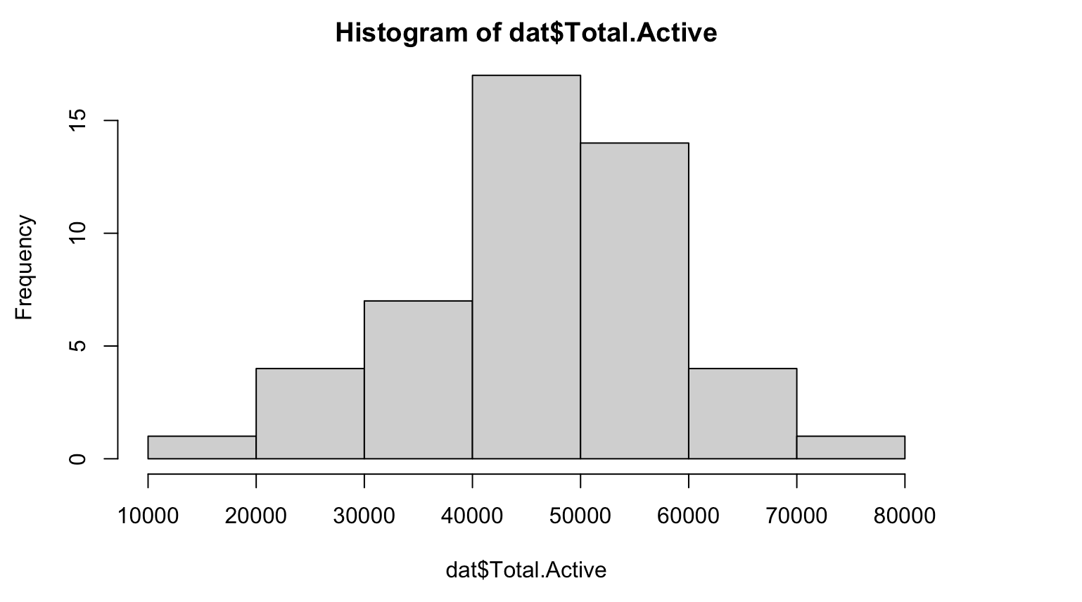
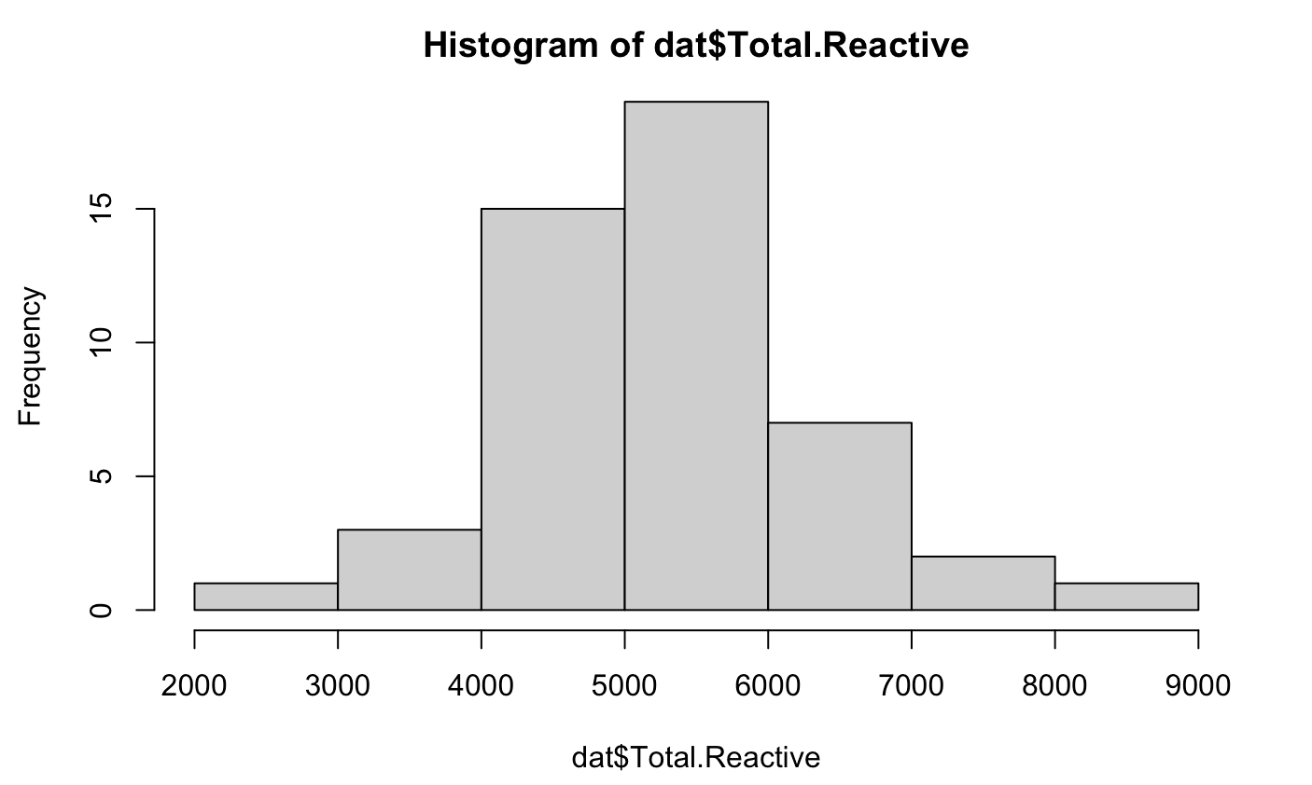
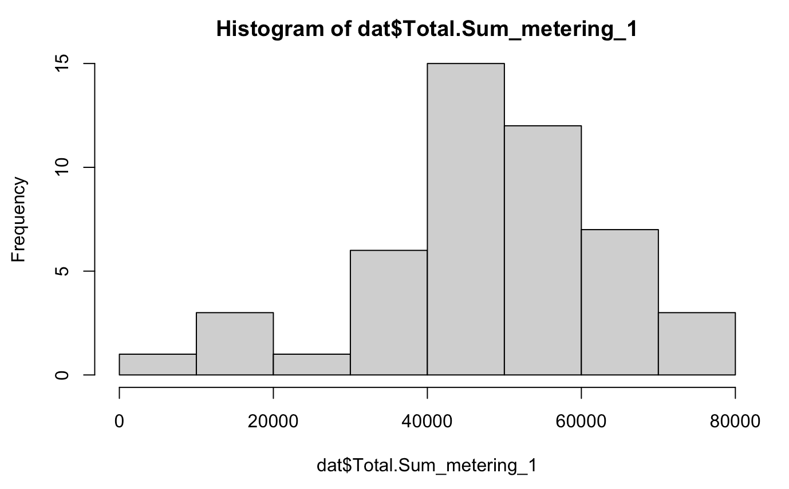
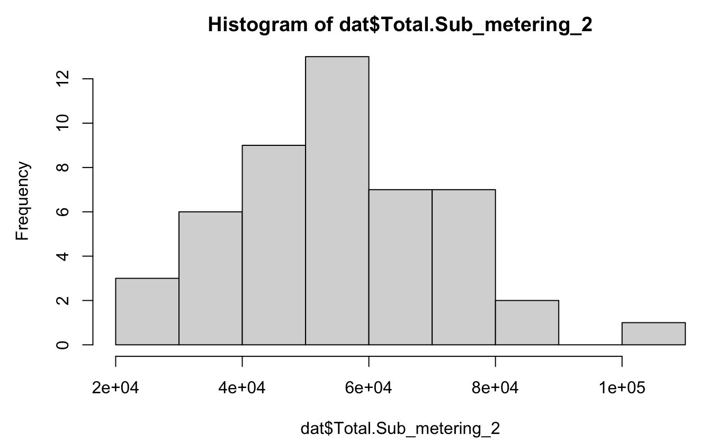
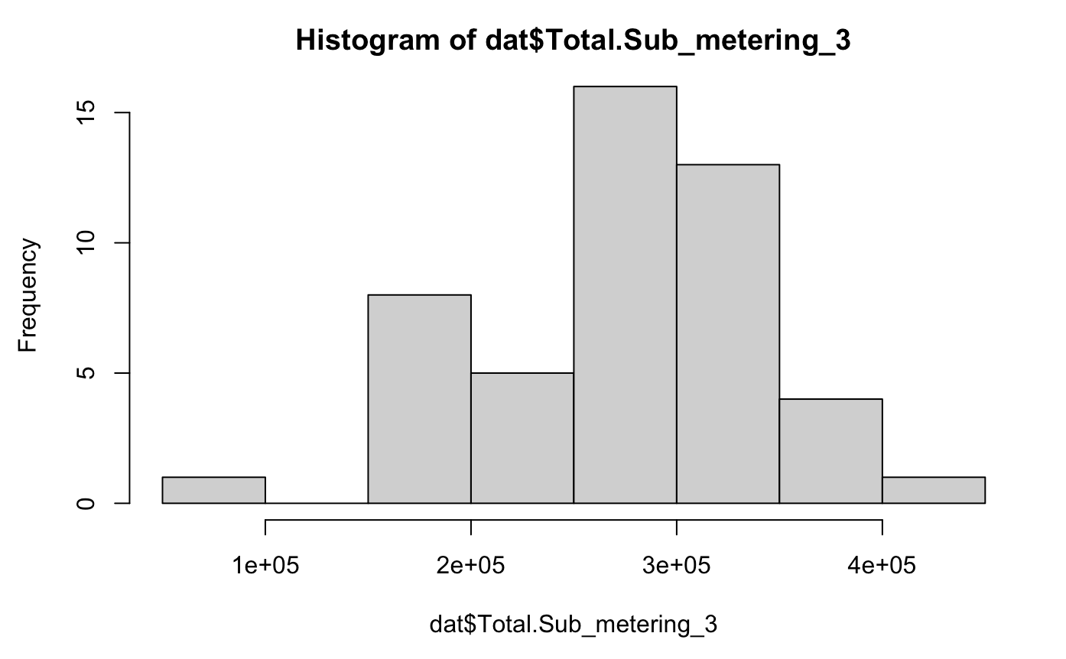
Data Property - Distribution

Slide 10
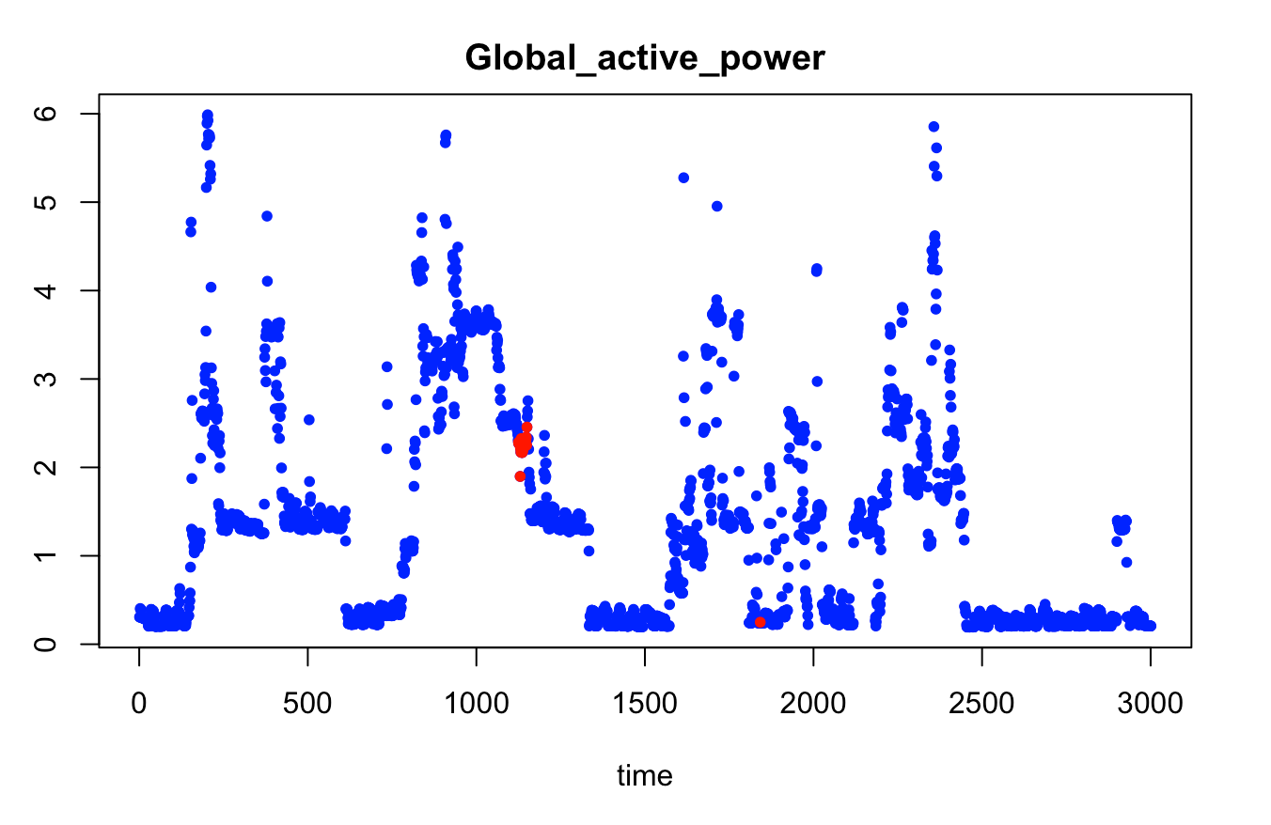
Data Preprocessing
Aggregation: Group by year and month to get monthly data
Differencing: Sub_metering_2
Heteroscedasticity: None
Feature Selection: Drop Intensity and Voltage
Train Test Split: 2007-2009 for train, 2010 for test
Imputation

Slide 11
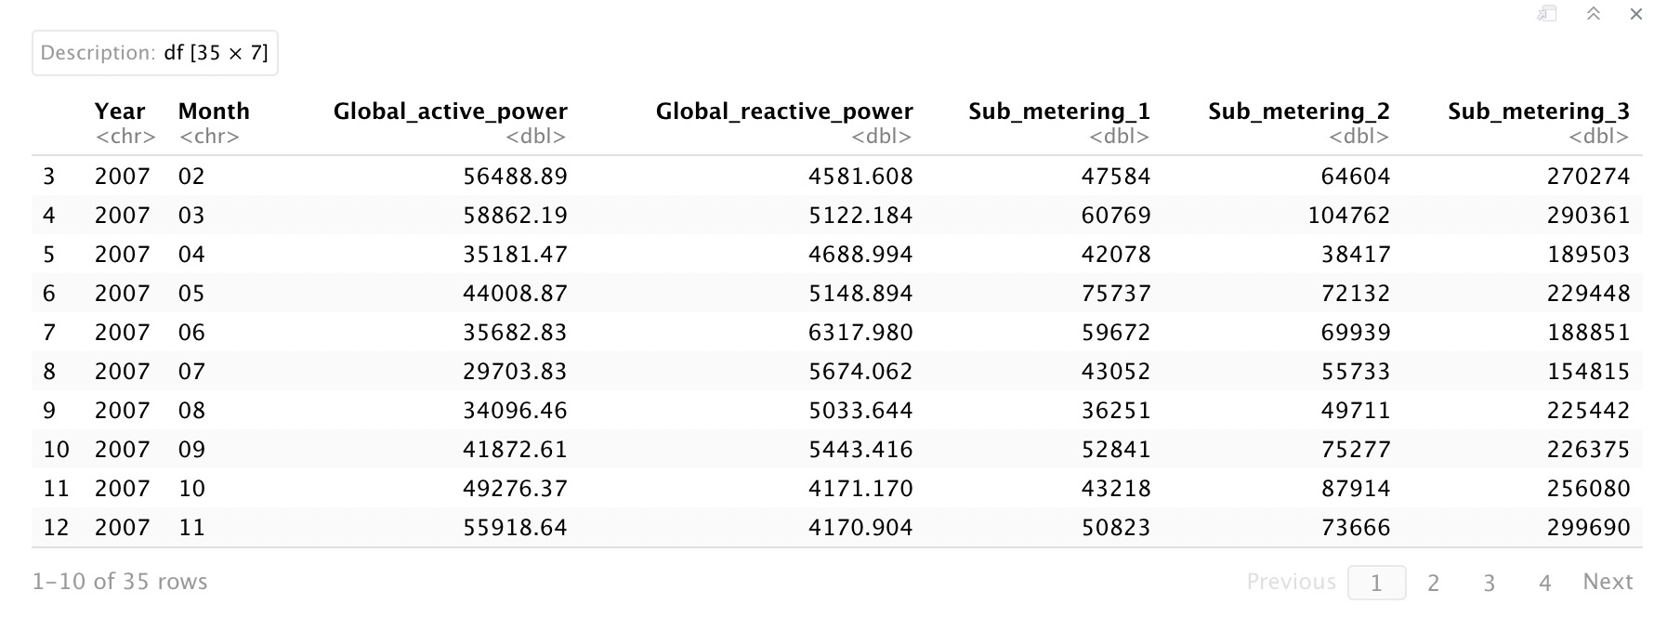
Processed Data

Slide 12
Proposed Models
Active Power
Forecast:
Holt Winters
ARIMA
SARIMA
BSTS
Prophet
Sub_meterings Forecast:
ARIMA (xreg)
BSTS
Prophet
Linear Regression

Slide 13
Model Results – Global Active Power
 | RMSE | sMAPE | AICc | BIC
Holt Winters | 5582.46 | 0.11 | 804.70 | 797.62
BSTS | 16682.27 | 0.29 | - | -
Prophet | 24663.05 | 0.43 | - | -
ARIMA | 11185.66 | 0.19 | 772.26 | 776.26
SARIMA | 6123.26 | 0.13 | 764.27 | 769.32

Slide 14
Model Results – Sub_Metering_1
 | RMSE | sMAPE | AICc | BIC
Prophet with GAP | 11988.81 | 0.25 | - | -
Prophet with GRP | 31181.65 | 0.55 | - | -
Prophet with GAP & GRP | 10966.67 | 0.21 | - | -
Linear Regression with GAP | 15274.85 | 0.90 | 755.23 | 759.90
Linear Regression with GRP | 20375.61 | 1.33 | 794.95 | 799.62
Linear Regression with GAP & GRP | 17843.46 | 1.12 | 753.41 | 759.63
BSTS with GAP | 9420.97 | 0.17 | - | -
BSTS with GRP | 15534.65 | 0.31 | - | -
BSTS with GAP & GRP | 9796.83 | 0.17 | - | -
ARIMA(xreg) with GAP | 12140.73 | 0.28 | 772.24 | 776.24
ARIMA(xreg) with GRP | 17476.06 | 0.34 | 796.92 | 800.92
ARIMA(xreg) with GAP & GRP | 11610.34 | 0.26 | 769.13 | 771.94

Slide 15
Model Results – Sub_Metering_2
 | RMSE | sMAPE | AICc | BIC
Prophet with GAP | 8783.29 | 0.21 | - | -
Prophet with GRP | 40608.43 | 0.61 | - | -
Prophet with GAP & GRP | 8166.66 | 0.15 | - | -
Linear Regression with GAP | 10545.57 | 0.81 | 777.05 | 781.72
Linear Regression with GRP | 13617.29 | 1.31 | 796.89 | 801.56
Linear Regression with GAP & GRP | 11268.79 | 0.88 | 775.34 | 781.56
BSTS with GAP | 9534.59 | 0.23 | - | -
BSTS with GRP | 12831.64 | 0.34 | - | -
BSTS with GAP & GRP | 10532.77 | 0.24 | - | -
ARIMA(xreg) with GAP | 6011.85 | 0.11 | 762.88 | 766.77
ARIMA(xreg) with GRP | 12627.44 | 0.23 | 782.58 | 786.47
ARIMA(xreg) with GAP & GRP | 5777.49 | 0.09 | 761.77 | 765.67

Slide 16
Model Results – Sub_Metering_3
 | RMSE | sMAPE | AICc | BIC
Prophet with GAP | 131811.50 | 0.58 | - | -
Prophet with GRP | 80853.64 | 0.22 | - | -
Prophet with GAP & GRP | 131653.8 | 0.58 | - | -
Linear Regression with GAP | 35317.33 | 0.81 | 817.68 | 822.35
Linear Regression with GRP | 66667.54 | 1.85 | 875.61 | 881.28
Linear Regression with GAP & GRP | 33449.39 | 0.77 | 819.10 | 825.32
BSTS with GAP | 32196.99 | 1.53 | - | -
BSTS with GRP | 30862.39 | 1.51 | - | -
BSTS with GAP & GRP | 32695.31 | 1.52 | - | -
ARIMA(xreg) with GAP | 34732.39 | 0.11 | 816.43 | 819.17
ARIMA(xreg) with GRP | 68745.93 | 0.22 | 894.93 | 899.97
ARIMA(xreg) with GAP & GRP | 36381.66 | 0.11 | 818.59 | 821.32

Slide 17
Future Work
Data Gap
More categories
More household data
Data about GDP, electricity prices, climate
Model Improvement
weekly, quarterly, semi-annually, or yearly
Potential new models

Slide 18
Thank You

Slide 19
References
https://cran.r-project.org/web/packages/bsts/bsts.pdf
https://machinelearningmastery.com/how-to-load-and-explore-household-electricity-usage-data/
https://cran.r-project.org/web/packages/prophet/prophet.pdf
https://archive.ics.uci.edu/ml/datasets/individual+household+electric+power+consumption
https://www.rdocumentation.org/packages/forecast/versions/8.16
https://www.rdocumentation.org/packages/stats/versions/3.6.2

