Slide 1
Build Reactive MicroServices
using
Spring WebFlux/SpringBoot
Dilip

Slide 2
About Me
Dilip
Building Software’s since 2008
Teaching in UDEMY Since 2016

Slide 3
What’s Covered ?
Introduction to Reactive Programming
Advantages of Reactive Programming over traditional programming models
Writing Reactive Programming code using Project Reactor
Introduction Spring WebFlux
Reactive Services using Spring WebFlux
Three Reactive Rest Services using Spring WebFlux
JUnit test cases using JUnit5

Slide 4
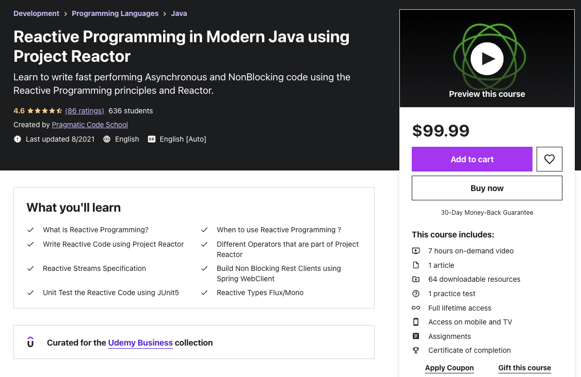

Slide 5
Targeted Audience
Any Developer who is curious to learn about Reactive Programming
Any Developer who is interested in learning Spring WebFlux
Any Developer who is interested in Building Reactive(Non Blocking) APIs

Slide 6
Source Code

Slide 7
Thank You!

Slide 8
Why Reactive Programming ?

Slide 9
Evolution of Programming
Past (10 -15 ) years ago
Current
Monolith Applications
Deployed in Application Server
Does not embrace distributed systems
Microservices Applications
Deployed in Cloud Environments
Embrace Distributed Systems

Slide 10
Expectations of the Application
Response times are expected in milliseconds
No Downtime is expected
Scale up automatically based on the load

Slide 11
Restful API using Spring Boot/MVC
Spring MVC
App
Tomcat
Client
Dispatcher
Servlet
Controller
Service
Dao
Thread pool
DB
API Client
API
External
Service
Concurrency is Thread Per Request model
This style of building APIs are called Blocking APIs
Wont scale for today’s application needs

Slide 12
Restful API using Spring Boot/MVC
DB
Spring MVC App
1
{API}
2
Embedded Server
3
{API}
Latency = Summation of (DB + API + API) response times

Slide 13
Spring MVC Limitations
Thread pool size of Embedded tomcat in Spring MVC’s is 200
Can we increase the thread pool size based on the need ?
Yes, only to a certain limit.
Let’s say you have a use case to support 10000 concurrent users.
Can we create a thread pool of size 10000 Threads ?
No

Slide 14
Thread and its Limitations
Thread is an expensive resource
It can easily take up to 1MB of heap space
More threads means more memory consumption by the thread itself
Less heap space for actually processing the request

Slide 15
Restful API using Spring Boot/MVC
Spring MVC
App
Tomcat
Client
Dispatcher
Servlet
Controller
Service
Dao
Thread pool
DB

Slide 16
Restful API using Spring Boot/MVC
Make these calls in Parallel
DB
Spring MVC App
1
{API}
2
Embedded Server
3
{API}
Latency = Summation of (DB + API + API) response times

Slide 17
Lets explore the asynchrony options in Java
Callbacks
Futures

Slide 18
Callbacks

Slide 19
Callbacks
Asynchronous methods that accept a callback as a parameter and invokes it when the blocking call completes.
Writing code with Callbacks are hard to compose and difficult to read and maintain
Callbackhell

Slide 20
Future

Slide 21
Concurrency APIs in Java
Future
CompletableFuture
Released in Java 5
Write Asynchronous Code
Disadvantages:
No easy way to combine the result from multiple futures
Future.get()
This is a blocking call
Released in Java8
Write Asynchronous code in a functional style
Easy to compose/combine MultipleFutures
Disadvantages:
Future that returns many elements
Eg., CompletableFuture<List<Result> will need to wait for the whole collection to built and readily available
CompletableFuture does not have a handle for infinite values

Slide 22
Drawbacks of Spring MVC
Concurrency is limited in Spring MVC
Blocking code leads to inefficient usage of threads.
Servlet API at the server level is a blocking one

Slide 23
Is there a better option available?
Reactive programming to the rescue

Slide 24
Summary
Does this mean we should stop using Spring MVC?
No
This still works very well for many use cases

Slide 25
What is Reactive Programming ?

Slide 26
What is Reactive Programming ?
Reactive Programming is a new programming paradigm
Asynchronous and non blocking
Data flows as an Event/Message driven stream

Slide 27
Reactive Programming
App
requestForData( )
DB
request(n)
onNext(1)
onNext(2)
.
.
.
onNext(n)
onComplete( )
This is not a blocking call anymore
Calling thread is released to do useful work
Push Based data streams model

Slide 28
What is Reactive Programming ?
Reactive Programming is a new programming paradigm
Asynchronous and non blocking
Data flows as an Event/Message driven stream
Functional Style Code
BackPressure on Data Streams

Slide 29
Backpressure
App
requestForData( )
request(n)
DB
onNext(1)
onNext(2)
.
.
.
onNext(n)
onComplete( )
Overwhelm the app with more data

Slide 30
Backpressure
App
requestForData( )
DB
request(2 )
onNext(1)
onNext(2)
cancel( )
Backpressure

Slide 31
Push-based data flow model
Push-Pull based data flow model

Slide 32
When to use Reactive Programming ?
Use Reactive Programming when there is need to build and support app that can handle high load

Slide 33
Reactive App Architecture
Make these calls in nonblocking style
DB
App
1
{API}
2
Embedded Server
3
{API}
Handle request using non blocking style
Netty is a non blocking Server uses Event Loop Model
Using Project Reactor for writing non blocking code
Spring WebFlux uses the Netty and Project Reactor for building non blocking or reactive APIs

Slide 34
Reactive Streams

Slide 35
Reactive Streams are the foundation for Reactive programming.

Slide 36
Reactive Streams
Reactive Streams Specification is created by engineers from multiple organizations:
Lightbend
Netflix
VmWare (Pivotal)

Slide 37
Reactive Streams Specification
Reactive Streams Specification:
Publisher
Subscriber
Subscription
Processor

Slide 38
Publisher
public interface Publisher<T> {
public void subscribe(Subscriber<? super T> s);
}
1
Publisher represents the DataSource
Database
RemoteService etc.,

Slide 39
Subscriber
public interface Subscriber<T> {
public void onSubscribe(Subscription s);
public void onNext(T t);
public void onError(Throwable t);
public void onComplete();
}
1
2
3
4
App
requestForData( )
DB
onNext(1)
onNext(2)
.
.
.
onNext(n)
onComplete( )

Slide 40
Subscription
public interface Subscription {
public void request(long n);
public void cancel();
}
App
requestForData( )
DB
request(2 )
onNext(1)
onNext(2)
cancel( )
Subscription is the one which connects the app and datasource

Slide 41
Reactive Streams - How it works together ?
Success Scenario
DB
Subscriber
subscribe( this )
1
Publisher
onSubscribe( )
2
Subscription
request( n )
3
onNext( 1 )
4
onNext( 2 )
4.1
.
.
.
onNext( n )
4.n
{API}
onComplete( )
5

Slide 42
Reactive Streams - How it works together ?
Error/Exception Scenario
DB
Subscriber
subscribe( this )
1
Publisher
Subscription
onSubscribe( )
2
request( n )
3
4
{API}
onError( )
Exceptions are treated like the data
The Reactive Stream is dead when an exception is thrown

Slide 43
Processor
public interface Processor<T, R> extends Subscriber<T>, Publisher<R> {
}
Processor extends Subscriber and Publisher
Processor can behave as a Subscriber and Publisher
Not really used this on a day to day basis

Slide 44
Flow API
Release as part of Java 9
This holds the contract for reactive streams
No implementation of the Reactive Streams is available as part of JRE

Slide 45
What is a
Nonblocking or Reactive
RestFul API ?

Slide 46
NonBlocking or Reactive RestFul API
A Non-Blocking or Reactive RestFul API has the behavior of providing end to end non-blocking communication between the client and service
Non-Blocking or Reactive == Not Blocking the thread
Thread involved in handling the httprequest and httpresponse is not blocked at all
Spring WebFlux is a module that’s going to help us in achieving the Non-Blocking or Reactive behavior

Slide 47
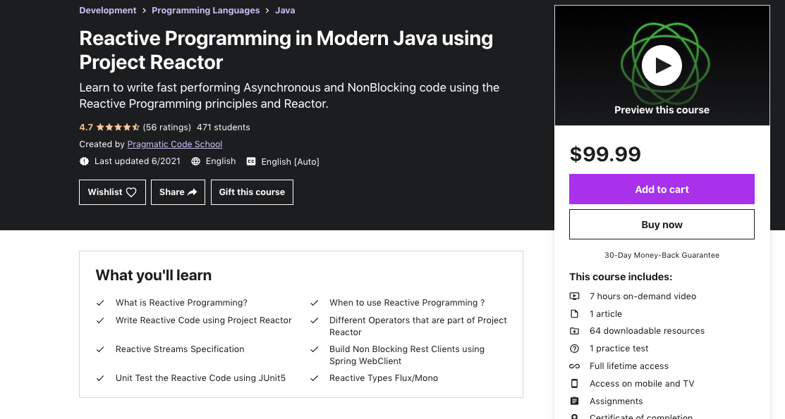
NonBlocking or Reactive API using Spring WebFlux
Spring WebFlux
App
2
Project Reactor
1
Dao
Client
Netty
Controller
Service
APIClient
{API}

Slide 48
Options for
Reactive RestFul API
Using
Spring WebFlux

Slide 49
Setting up the Project
For this
Course

Slide 50
Section Overview

Slide 51
Section Overview
Explore Project Reactor

Slide 52
Spring WebFlux
Spring WebFlux
Annotated Controllers
Functional Endpoints

Slide 53
What are we going to build in this course ?

Slide 54

Movies Application using MicroServices Pattern
Annotated Controller
MoviesInfo Service
Name, cast,
year
Annotated Controller
MoviesService
Functional Endpoints
MoviesReview
Service
Rating, Review

Slide 55
Movies Application using MicroServices Pattern
Annotated Controller
MoviesInfo Service
Annotated Controller
MoviesService
Functional Endpoints
MoviesReview
Service

Slide 56
Streaming Endpoint
Using
Spring Webflux

Slide 57
Streaming Endpoint
Streaming Endpoint is a kind of Endpoint which continuously sends updates to the clients as the new data arrives
This concept is similar to Server Sent Events(SSE)
Easy to implement in Spring WebFlux
Examples : Stock Tickers, Realtime updates of Sports Events

Slide 58
Automated Testing
Using JUnit5

Slide 59
Automated Tests
Automated Tests plays a vital role in delivering quality Software
Two types of Automated Tests:
Integration Tests
Unit Tests

Slide 60
Integration Tests
Integration test is a kind of test which actually test the application end to end
1
2
3
IntegrationTest
Controller
Service
Repository
DB

Slide 61
Unit Tests
Unit test is a kind of test which tests only the class and method of interest and mocks the next layer of the code
Unit Test
Controller
Service
Mock
Repository
DB

Slide 62
Movies Application using MicroServices Pattern
Annotated Controller
MoviesInfo Service
Annotated Controller
MoviesService
Functional Endpoints
MoviesReview
Service

Slide 63
Integration Tests using Embedded MongoDB
In-Memory
Mongo
DB
IntegrationTest
Controller
Service
Repository
DB
testImplementation 'de.flapdoodle.embed:de.flapdoodle.embed.mongo'

Slide 64
Unit Tests
Unit test is a kind of test which tests only the class and method of interest and mocks the next layer of the code
Controller
Service
Repository
DB
Unit Test
Controller
Mock
Mockito

Slide 65
Benefits of Unit Tests
Unit Tests are faster compared to Integration Tests
Unit Tests are handy for performing Bean Validations

Slide 66
Spring WebFlux Test has an annotation named “@WebFlux” test

Slide 67
Using ResponseEntity
In
Spring WebFlux

Slide 68
How Netty Works
with
Spring WebFlux ?

Slide 69
NonBlocking or Reactive API using Spring WebFlux
Spring WebFlux
App
2
1
Dao
Client
Netty
Controller
Service
APIClient
{API}

Slide 70
How does
Netty
handle the request?

Slide 71
Netty (WebFlux’s Default Server)
Spring WebFlux App
Channel
Client
Netty
Channel represents an open connection between the client and server
Request and Response is sent via the channel

Slide 72
Channel
Channel has ChannelHandlers
Accepting the client connection
Reading the data as bytes from the network to a Java Object(Transformation)
Writing the data back to the client
This is all taken care for us by Spring WebFlux
As a developer, we just focus on writing the application related code

Slide 73
Channel and EventLoop
Netty , uses EventLoop model to handle the connections in a nonblocking fashion
An EventLoop is powered by one single thread
NodeJs uses the same pattern.
Node js has just one thread/one eventloop to handle client requests
Number of Eventloops to handle the request is equal to no of cores in your machine
Eventloops are part of the EventLoopGroup

Slide 74
EventLoop
Req1
Req2
Event Queue
Loop

Slide 75
How Channel and EventLoop linked ?
Any time a channel is created it gets assigned to an EventLoop
This EventLoop is responsible for handling the different events that occurs in the lifetime of a channel

Slide 76
Channel Lifecycle
1
ChannelUnregistered
Channel is Created and its not registered with the Eventloop
2
ChannelRegistered
Channel is registered with the Eventloop
3
ChannelActive
Channel is active and its now possible to send and receive the data
4
ChannelInActive
Channel is not connected to the client anymore and ready to be closed
All these Lifecycle changes are treated as events

Slide 77
How Netty handles the request ?
Netty had two EventloopGroups
One to just accept connections
Other one to handle them
Spring WebFlux App
Controller
Service
Dao
Client
Netty
Req1
Thread1
Response
Event Queue
Loop

Slide 78

Netty in Action

Slide 79
Functional Web
In
Spring WebFlux

Slide 80
Functional Web
This is an alternative programming model for building RESTFUL APIs in Spring WebFlux
Functional web module uses the functional programming aspects:
Lambdas
Method References
Functional Interfaces

Slide 81
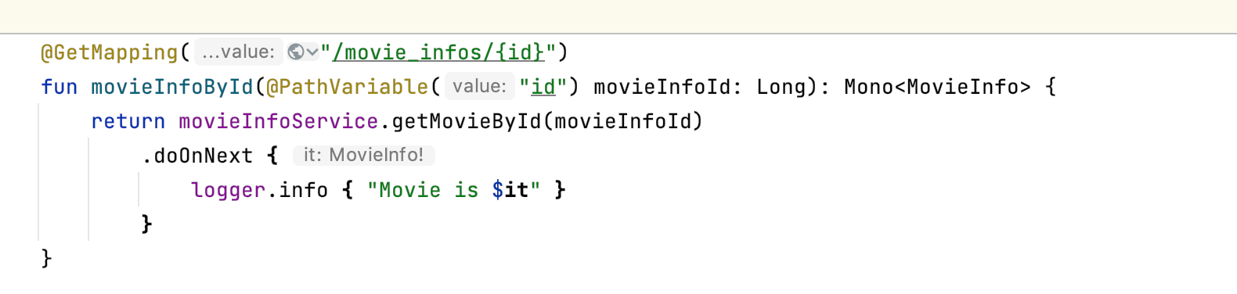
Functional Web
Rest Endpoints are configured
Code to handle the request
is located
Router
Handler

Slide 82
Is there an advantage in building RestFul APIs using Functional Web?

Slide 83
Functional Web
Benefits:
All the RestFul APIs endpoints are configured in one single file
Code is lightweight compared to the Controller alternative
Challenges:
Need to have knowledge about functional programming
Bean Validation is different in Functional Web
Exception handling in Functional Web is different from the Controller approach

Slide 84
Movies Application using MicroServices Pattern
Annotated Controller
MoviesInfo Service
Annotated Controller
MoviesService
Functional Endpoints
MovieReview
Service

Slide 85
Movies Application using MicroServices Pattern
Annotated Controller
MoviesInfo Service
Annotated Controller
MoviesService
Functional Endpoints
MovieReview
Service
WebClient

Slide 86
Webclient

Slide 87
WebClient
It is a reactive non-blocking Rest Client
It uses a functional style API
It allows the application to interact with other services in a non-blocking fashion
Its auto configured in to the application by Spring Boot

Slide 88
Exceptions
in
Service to Service
Communication

Slide 89
Movies Application using MicroServices Pattern
MoviesInfo Service
MoviesService
MovieReview
Service

Slide 90
Http Failures
Http Failure falls in to two categories:
4xx - Client Error
400(Bad Request), 404 (Not Found) and etc.,
5xx - Server Error
500(Internal Server Error), 503 (Service Unavailable) and etc.,

Slide 91
Introduction to Wiremock

Slide 92
Movies Application using MicroServices Pattern
MoviesInfo Service
MoviesService
MovieReview
Service

Slide 93
Movies Application using MicroServices Pattern
Mock MoviesInfo Service
MoviesInfo Service
MoviesService
MoviesReview
Service
Mock
MovieReview
Service
Wiremock to the Rescue

Slide 94
Benefits of WireMock
Easy to test the success scenarios (2xx)
Test the contract
Serialization/Deserialization
Easy to simulate error scenarios
4xx
5xx
SocketTimeout Exceptions and more..,

Slide 95
Why Retry failed HTTP calls ?

Slide 96
Movies Application using MicroServices Pattern
MoviesInfo Service
MoviesService
MovieReview
Service
Intermittent Network Issues
Slow Network
External Service is down

Slide 97
Handle Network Errors
Retrying Failed Calls
Retry the failed call N number of times before giving up
Retry the failed call with a backoff
Retry Specific Exceptions
Retry only 5xx not 4xx exceptions

Slide 98
Server Sent Events (SSE)

Slide 99
Sever Sent Events
Server
(API)
Client
Uber App - Realtime updates of the driver location
Dominos, DoorDash etc.
Data is sent in the form of events
Its Unidirectional once the connection is established between the client and server
Long live client connections

Slide 100
Publish new MovieInfo as a ServerSentEvent(SSE)

Slide 101
Sinks

