Slide 1
Sale Prediction
Zening Li, Qingxu Wang

Slide 2
Research Question
Problem: Merchants need a model to predict future sales in order to prevents import low sales product.
Objective: Using historical sales time-series data from January 2013 to October 2015 to predict November 2015 product sales.
Case: If the game merchants use our model. They will know that although accessories for Playstation 2 have a huge sales volume, they do not need to import them. Out model forecast the result by time series so it will understand the decreasing in sales of the accessories for Playstation 2.
This model can use to forecast not only November 2015 but also future data.

Slide 3
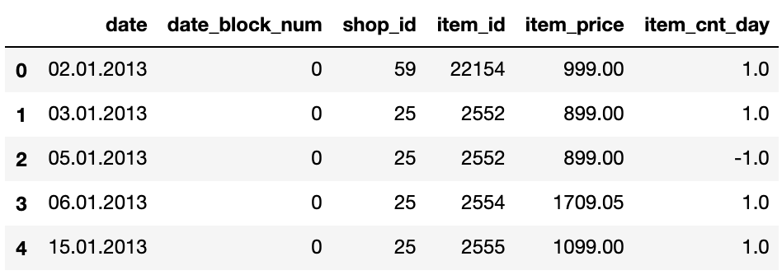
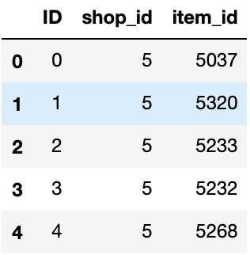
Dataset
https://www.kaggle.com/c/competitive-data-science-predict-future-sales
Daily sales data
Reason: Dataset from Kaggle competition of sales prediction.

Slide 4
Dataset Decription (train file)
date: sales date
date_block_num: The month from 0 to 33 to sale the products
shop_id: unique ID for shops
item_id: unique ID for products
item_price: price of products
item_cnt_day: number of the item sell per day

Slide 5
Dataset Decription (test file)
ID: unique ID for specific shops sell specific products
shop_id: unique ID for shops
item_id: unique ID for products

Slide 6
Data Munging
Drop “date” and “item_price” columns.
Merge train and test file to find the specific sales happen in real.
Drop shop_id and item_id because ID can presents both shop_id and item_id.
For each ID get the total items per each month.
Add zero to the total items for the month which the ID sell nothing to make the data consecutive.
Remove data not being sale for the resent 6 month and the ID is missing.
Interpolate the data

Slide 7
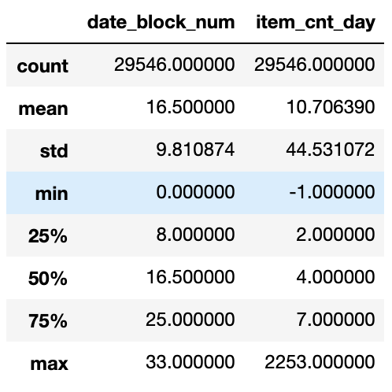
Statistical Summary
The data shrink to 29546 rows, which means there are a lot of missing data and products out of market or never on the market.
The rest of the data is useful to use for our time series mdel.

Slide 8
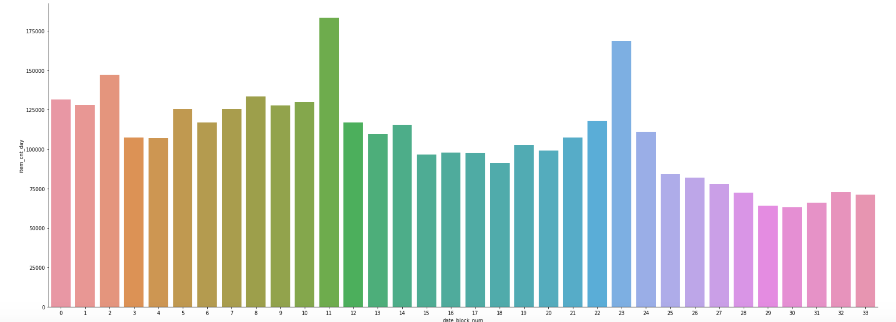
Visualization Before Clean

Slide 9
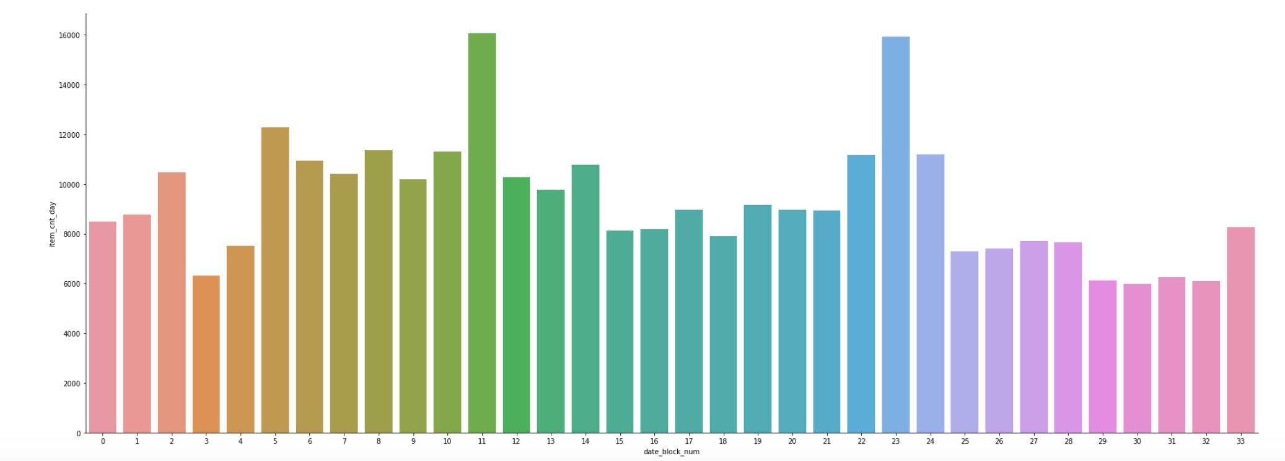
Visualization After Clean

Slide 10
Visualization
Month 11 and month 23 sales more than other month
Shapes are basically the same.
There are some small differences. For example, before clean items sales on month 32 is more than 31, but after clean month 32 is less than 31. This because some shop_id and item_id does not being record in the test file. From our point of view, it does not sell the product so we considered them as false data.
In the future, we need to figure out does the “price” column useful in the mode.

Slide 11
Model
We use ARIMA to do the time series model.

