Slide 1
Sale Prediction
Zening Li, Qingxu Wang

Slide 2
Research QuestionS：
Problem: Merchants need a model to predict future sales in order to manage production and purchases to minimize loss and maximize profit.
Objective: Using historical sales time-series data from January 2013 to October 2015 to predict November 2015 product sales for each type of product and in a specific store.
Case: If the game merchants use our model. They will know that although accessories for Playstation 2 have a huge sales volume for the year, however, they do not need to import them because it is not going to be sold many in the future. Our model forecasts the result by time series so it will understand the decreasing in sales of the accessories for Playstation 2.
This model can use to forecast not only November 2015 but also future data.

Slide 3
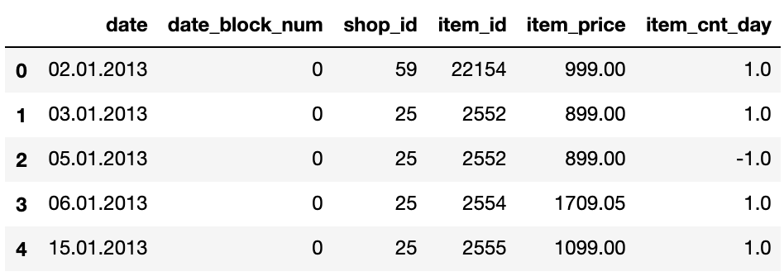
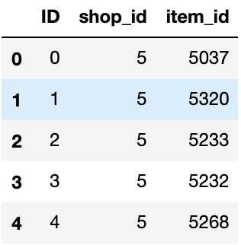
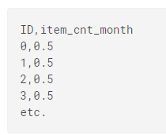
Dataset
https://www.kaggle.com/c/competitive-data-science-predict-future-sales
Dataset was collected and uploaded to Kaggle to let people practice.
This is train dataframe: This is test dataframe: This is sample submission:

Slide 4
Dataset Decription (train file)
date: sales date
date_block_num: The month from 0 to 33, for example 0 means Jan, 2013
shop_id: unique ID for shops
item_id: unique ID for products
item_price: price of products at the day
item_cnt_day: number of items sold on that day

Slide 5
Dataset Decription (test file)
ID: unique ID for specific shop and specific product
shop_id: unique ID for shops, the same with that in train file
item_id: unique ID for products, the same with that in train file

Slide 6
Data Munging
Create price and count dataset
For count dataset
Drop “date” and “item price” columns
Make the dataset into matrix form. All the loss information we put zero in it.
Merge the “test.csv” file by “item_id” and “shop_id”.
Drop useless columns: “ID”, “date_block_num”, “item_id”, “shop_id”
Same procedure on price dataset
Merge two dataset together when doing modeling

Slide 7
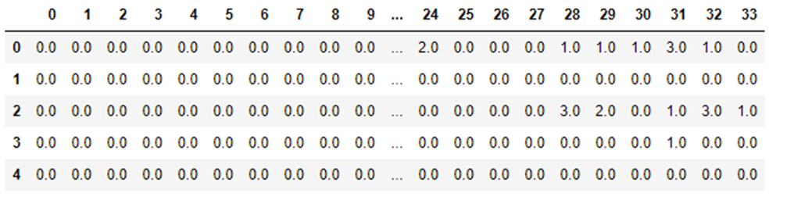
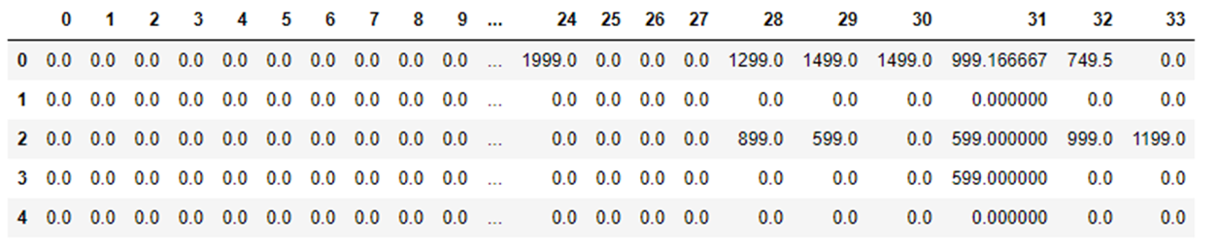
Count dataframe and PRICE DATAFRAME (Feature engineering)

Slide 8
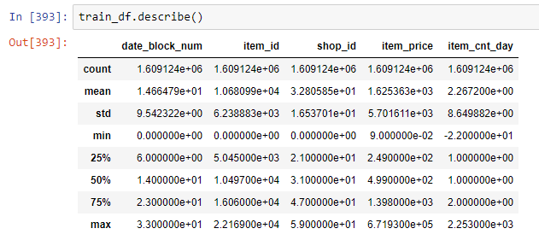
Statistical Summary
Mainly focus on item-price and item_cnt_day, we can see there are more than a million lines of data, prices for products varies from really cheap to more than 600000 per item! (In Ruble, so around 1000 dollars).
Minimum item_cnt_day can be negative, we explain them as returns. 25% to 75% fall into 1 and 2, most items are sold one or two per day, fair enough.

Slide 9
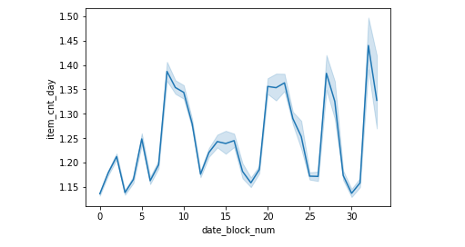
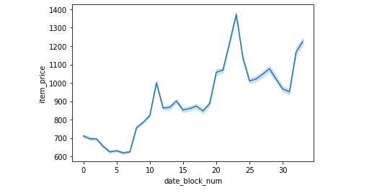
Visualization
Item count
Item price

Slide 10
Results from Visualization
As we can see, the trend is the higher the price is the lower the sales amount is, vice versa.
(This means sales amount is highly associated with price, we first tried to predict amount without using price factor, and fall very behind in the competition, after seeing the plot we decided to use LSTM method which takes price into account.
Another thing we found is that the trend of Russian goods prices are raising, it is shown in pictures, hope their salaries follow the expenditures!

Slide 11
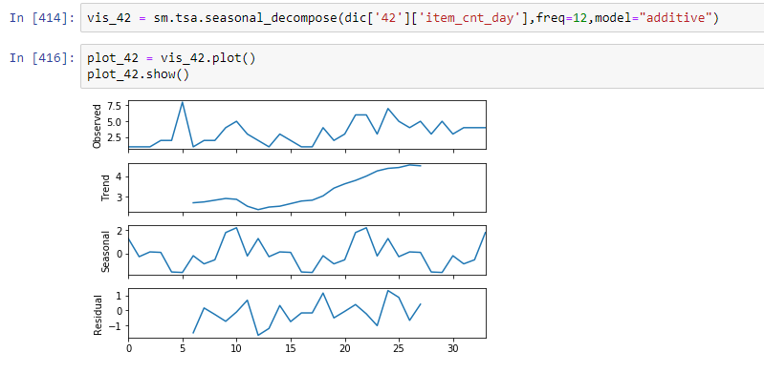
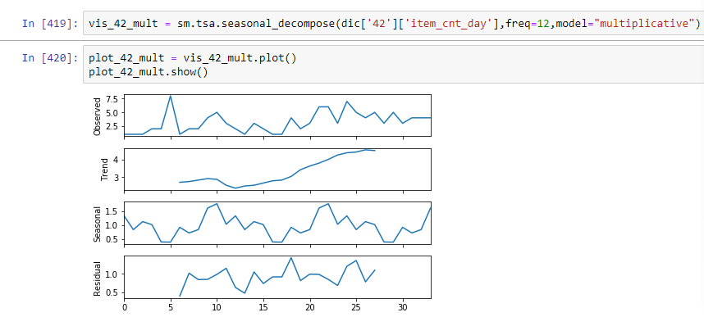
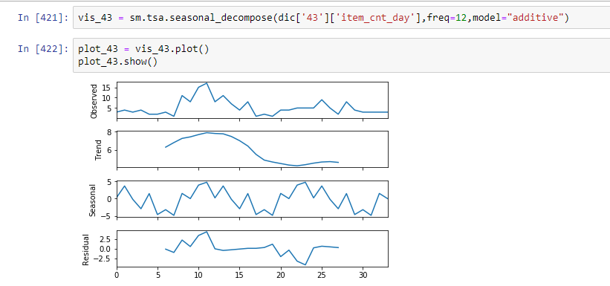
VisualizatioN Time series decomposition:
Accracy was not so good using Arima, we are not using it to compete then.

Slide 12
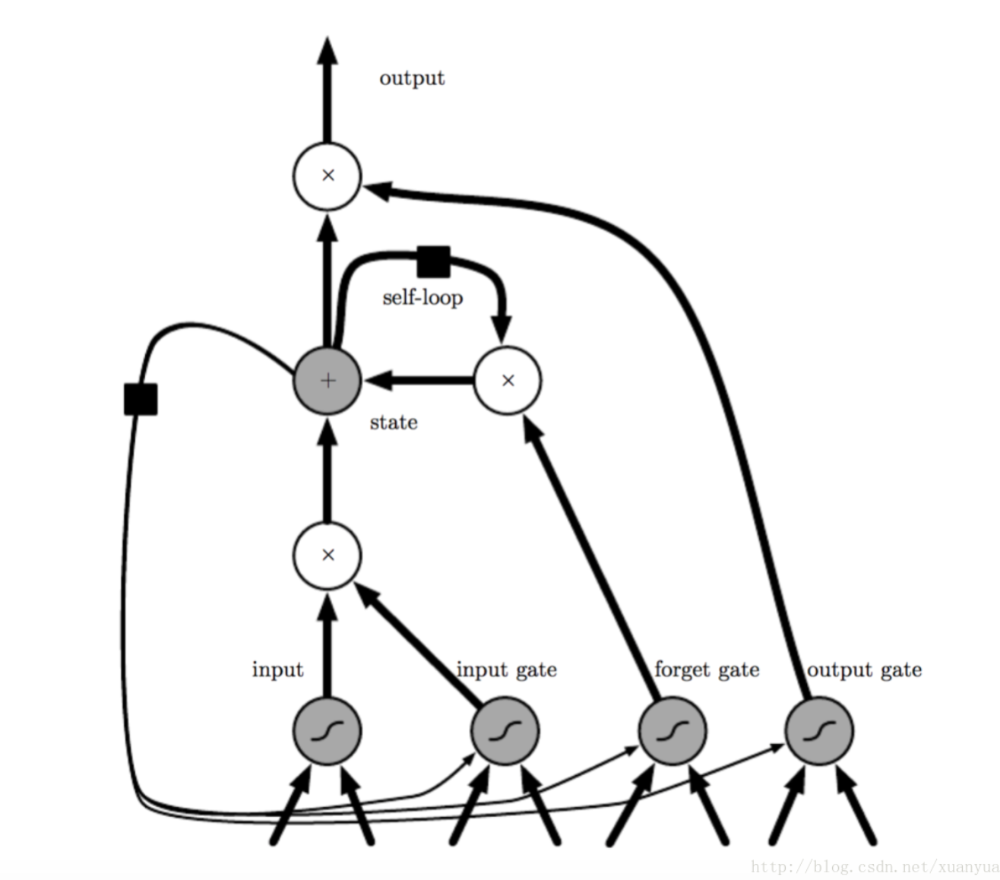
Model
We use LSTM from keras.
LSTM refers to Long short-term memory:
It is an artificial recurrent neural network (RNN) architecture used in the field of deep learning.
It can not only process single data points, but also entire sequences of data.
A common LSTM unit is composed of a cell, an input gate, an output gate and a forget gate.
Information from Wikipedia: https://en.wikipedia.org/wiki/Long_short-term_memory
Figure Information from https://blog.csdn.net/xuanyuansen/article/details/61913886

Slide 13
MODEL
Our independent variables are item_cnt_month and item_price, using LSTM doesn’t need serious hypothesis test, it can process missing values itself, assigning all of them to one, it knows how to process those data.
After fitting the model, we can use the model to predict future item_cnt, it uses some inner processes to convert price data to relate to item counts and finally helps predicting future item counts.
Basic time series can only predict future values given one column of data, however LSTM can use more than one column, it gives better prediction basically.

Slide 14
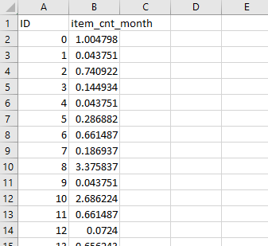
RESULts of the model
RMSE = 5.227 for the whole training data, for this test we used the first 33 month data to predict the 34th month, where we have the data( because we don’t have the 35th month data, it can only be tested after submission).
Now we can happily submit our prediction csv file, the file looks like:

Slide 15
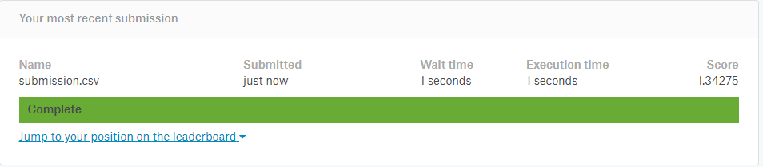

Submission:
The score is not too good, however, we improved a great deal! (though for our first version, there might be something wrong in data cleaning).
Thank you!
Reference: https://www.kaggle.com/nicapotato/multivar-lstm-ts-regression-keras

