Slide 1
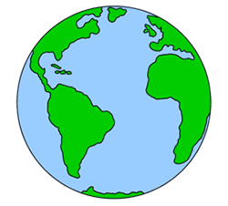
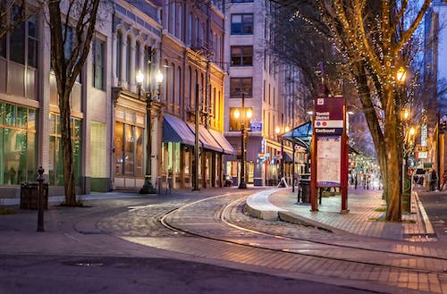
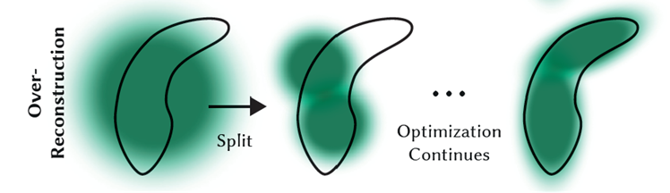
Text Description
Generation of curved world representation
Multidiffusion
Planar latent features
Global camera Pose
Rasterization with local camera pose
3D Gaussian Splatting with Triplane

