Slide 1
Massive Parallel Programing
With Java & CUDA

Slide 2
Course Contents
Day One. GPGPU
Introduction to GPU programming.
Basic Architecture.
GPUs programming model. MAP-REDUCE
Programming flow in GPUs.
Java & CUDA.
MAP operations.
Exercises: vector addition , matrix addition and multiplication.
Day Two. GPU memories
GPU Memory types and uses.
Registers.
Global memory.
Shared Memory.
Other types.
Improving MAP Operations.
REDUCE Operations.
Exercises: matrix multiplication and Max Reduce.
Day Three. Performance & Optimization
Memory Bound vs. Computationally Bound Algorithms.
Memory Access.
Coalescent access
Avoiding Shared memory bank conflicts.
Thread Divergence in a warp.
Loop unrolling and other easy improvements.
Improving REDUCE operations.
“Rules of thumb”.
Exercises: Advanced Max reduce and simulated annealing
Day Four. Tools
CUDA LIBRARIES AND TOOLS
Day Five. The Road Forward
Growing into the Multi-GPU

Slide 3
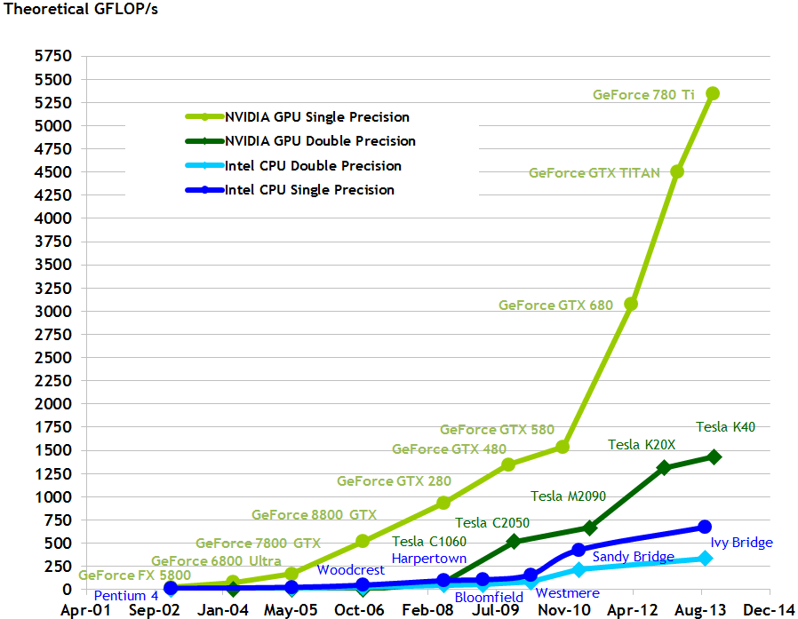
Why GPUs…

Slide 4
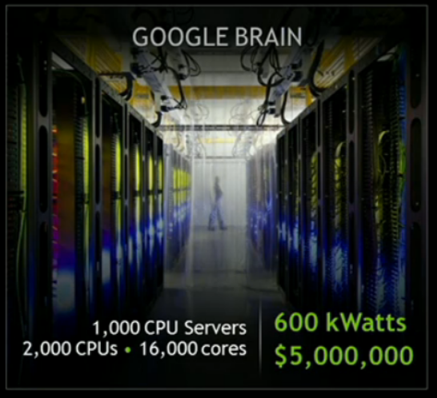
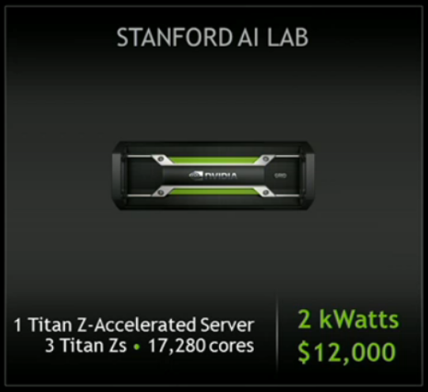
Same algorithm in Deep Neutral Networks
300X cheaper in energy cost
417X cheaper hardware
http://www.gputechconf.com/attendees/keynotes-replay

Slide 5
Nvidia Pascal. The new arhitecture.
Before:
NVIDIA Quadro (Maxwell)
CUDA cores
RAM memory DDR3 | 6 Gb
Memory Bandwith | 320 Gb/sec
Now:
NVIDIA K10 (Kepler) | P100
CUDA cores
RAM memory DDR5 | 8/16 GB
Memory Bandwith | 320 GB/sec

Slide 6
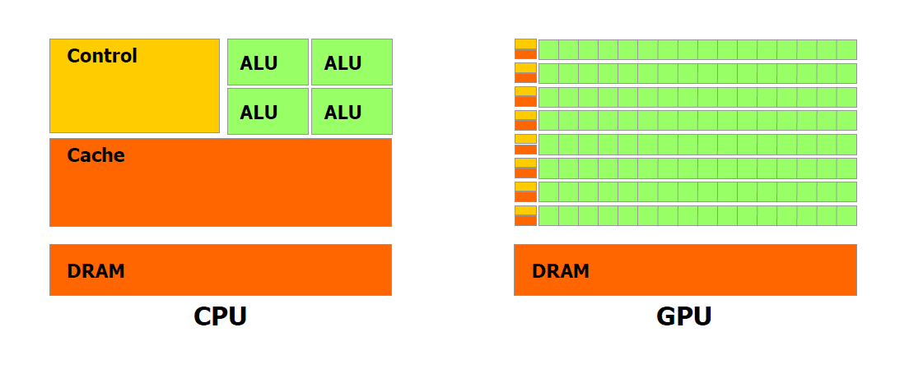
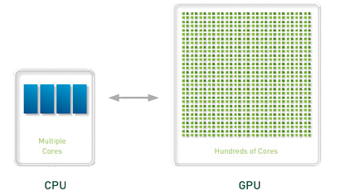
Basic Architecture. CPU vs GPU
The GPU has a lot of area for Arithmetic, but less cache and less control-prediction.
By the way, from now on:
HOST = CPU
DEVICE = GPU

Slide 7
Advantages of GPUs vs CPUs
Thousands of cores.
Easy programming model, minimum thread management required.
Faster Access to Memory. (several times faster)
Memory Access latency can be “hidden”.
…But parallel programming of any kind is tough.
We will use the “MAP-REDUCE” paradigm to design our algorithms.
MAP operations are easy.
For most REDUCE operations Nvidia provides great libraries ☺
For the time being only real options are OpenCL and CUDA, and the distinction is not that important…

Slide 8
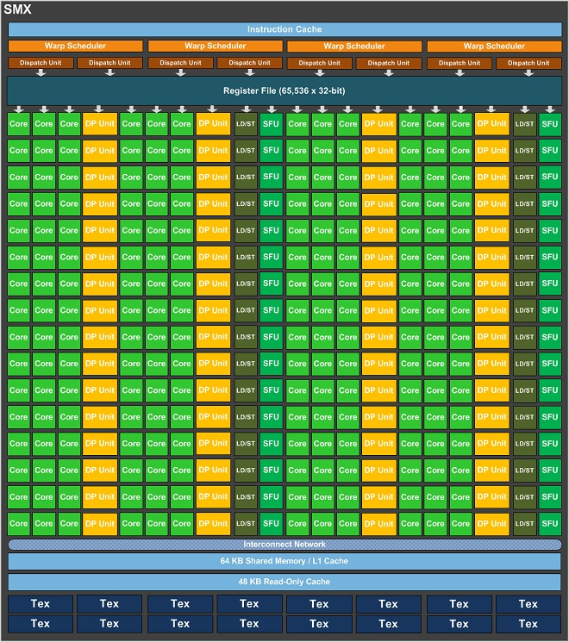
A bit more about hardware. The SMx
SM/SMX: Stream Multiprocessor
Architecture 1.x (GT200) each SM has 8 SP.
Architecture 2.0 y 2.1 (Fermi), each SM 16 SP.
Architecture 6.x (Pascal) each SMX has a wooping 128 SP.
SMs handle the “thread blocks”.
SP: Stream Processor.
Each SP executes a “thread”.
SFU: Special Functions Unit.
Each SM can store and handle many “Blocks”, during execution it switch between them to hide the latency of the memory operations. The switching is done without any additional cost, “zero scheduling overhead”.

Slide 9


CUDA Hardware. Parallelism Granularity
The two levels of hardware will give us two levels of parallelism:
- SMx will run one or more Blocks of threads.
- SP will run one or more Threads.
SMX: Streaming Multiprocessor
SP: Streaming Processor
Important: We will always have way more blocks and threads than SMx and SPs.
One of the best things of Gpus is their ability to use many parallel processes and switch between them at runtime. It is called “zero overhead scheduling”

Slide 10
NVIDIA CUDA
It is a extension of C, few keywords are needed.
Although proprietary in nature it is free, the compiler is based on LLVM.
There are bindings for Python, Fortan, Java, Ruby, .NET, etc…
Alternatives:
OpenCL: Open version, slower improvement of the language. It needs some more lines of code but translation from CUDA is almost automatic*.
CloseToMetal/Stream SDK. ATI/AMD, abandoned for OpenCL…
DirectCompute Microsoft, Microsoft seems to integrate with CUDA with C++ AMP. Compiler directive
Intel has released the Intel Xeon Phi coprocessor, based on x86 arch. Problem is it doesn´t bring a programming model on its own… you can use OpenMP, Pthreads.
Open ACC. Compiler directive based (ike OpenMP) using pragmas.
For the time being only real options are OpenCL and CUDA, and the distinction is not that important…

Slide 11
Flow in a CUDA/OpenCL program
“Host” = CPU
“Device” = GPU
Secuential code
Memory reserve in GPU
Memory reserved
Memory copy CPU to GPU
Memory copy Received
Kernel execution
Kernel launch
Memory copy received
Memory copy CPU to GPU
Free GPU memory
Memory deallocated

Slide 12
CUDA Threads & Blocks. Parallelism Granularity
In GPUs we have two levels of parallelism:
- Blocks. Group of threads that go to the same SMx.
- Threads. Each thread will be executed in one streaming processor.
We can “visualize” threads and blocks spatially.
The GRID is the set of all blocks, each block has a set of threads.
Each thread has one 3D id within its block.
Each block has one 3D id within its grid.
Combining the Thread id and the Block id we have the GLOBAL thread identification.
Block 0
Thread 0
Thread 1
Thread 2
Thread n
…

Slide 13
SMX. Block handling
At a certain time a SMX will be handling one or more thread blocks.
Every SP will execute one or more of those threads.
Block 0
Block 27
Block 55
Thread 0
Thread 0
Thread 1
Thread 2
Thread n
Thread 0
Thread 1
Thread 1
Thread 2
Thread n
Thread 2
Thread n
…
…
…
Thread 0
Thread 33
The best part?... we don’t have to worry about the management of blocks and threads! The GPU will do that for us and in the most optimal way!!

Slide 14
Grid and Block Configurations
GRID LEVEL:
gridDim.x, gridDim.y, gridDim.z gives us the number of blocks in each dimension
blockIdx.x, blockIdx.y, blockIdx.z gives us the block ID in each dimension.
Máximum of 65 536 x 65 536 blocks per grid.
That means almost 4 300 million blocks!!!
BLOCK LEVEL:
blockDim.x, blockDim.y, blockDim.z gives us the number of threads in each dimension
threadIdx.x, threadIdx.y, threadIdx.z identifies the thread in each block.
Máximum 1024 threads per Block.
WE CAN USE MORE THAN FOUR TRILLION THREADS BEFORE NEEDING TO REASSIGN WORK !!!!

Slide 15
Grid and Block Configurations
blockIdx.x
blockIdx.y
Block 0,0,0
blockIdx.z
Thread 0,0,0
Thread 1,0,0
Thread 2,0,0
Thread n,0,0
…
blockDim.y
Thread 0,1,0
Thread 1,1,0
Thread 2,1,0
Thread n,1,0
…
blockDim.x
threadIdx.x
threadIdx.y
threadIdx.z
Thread 2,1,7
This way we will have a unique identification for every block and every thread

Slide 16
First Example. MAP Operations
A MAP operation takes one or more inputs to produce separate outputs. Common MAP operations are map (simple type), scatter, gather, stencil and transpose (Some authors would disagree).
Any algorithm made with exclusively MAP operations is considered “embarrassingly parallel”, extremely easy to program with speedups in GPUs that can reach 1000x.

Slide 17
Vector Addition. Sequential Code
1 | void vectoradd_serial( float *output, float *inputA, float *inputB, int size){
2 | for( int i=0; i< size; i++){ // a loop of size iterations.
3 | output[i] = inputA[i] + inputB[i];
4 | }
5 | }
Notice the loop, that is the first and easiest type of paralelization, we get rid of the loops.

Slide 18
Vector Addition (Pure MAP)
It’s a simple MAP operation where each thread takes one value from each input vector to produce one value in the output vector.
0
7
2
8
44
15
6
…
3
…
2
11
4
0
2
1
7
8
…
5
9
tid 4
tid 0
tid 1
tid 0
tid blockDim.x
v
tid 0
tid 1
tid 2
tid 3
…
…
Block 0
Block 1
Block gridDim.x -1
11
11
2
10
45
22
14
…
8
11

Slide 19
Vector Addition (Pure MAP)
So… how do we calculate the block and grid dimensions?
11
11
2
10
45
22
14
…
11
size
First we fix the number of threads per block… we will choose proper number for performance optimization (more on that on Day 3).
Threads per block = 256
Then we adjust the number of blocks to span the whole vector size!
Blocks per grid = minimum multiple of 256 greater than size
tid 4
tid 0
tid 1
tid 0
tid blockDim.x
v
tid 0
tid 1
tid 2
tid 3
…
…
Block 0
Block 1
Block gridDim.x -1

Slide 20
Vector Addition. Device Code
1
2 | __global__ void add( float* output, float* inputA, float* inputB, int size){
3 | int gid = blockIdx.x * blockDim.x + threadIdx.x; //calc. thread index
4 | if( gid < size) output[gid] = inputA[gid] + inputB[gid];
5 | }
No loop!, we just need to identify the thread with its global index.
Personally I like to call it gid, from global id
gid = block ID x number of threads per block + thread ID inside the block
In GPU programming we never create the threads according to the number of processors, we don’t care how many processors we have, we may never know it.
Instead we create the threads we NEED for the data!!!!

Slide 21
Vector Addition. Host Code (1)
STEP 1: ALLOCATE DEVICE(GPU) MEMORY
54 | CUdeviceptr deviceInputA = new CUdeviceptr();
55 | cuMemAlloc(deviceInputA, numElements * Sizeof.FLOAT);
56
57 | CUdeviceptr deviceInputB = new CUdeviceptr();
58 | cuMemAlloc(deviceInputB, numElements * Sizeof.FLOAT);
59
60 | CUdeviceptr deviceOutput = new CUdeviceptr();
61 | cuMemAlloc(deviceOutput, numElements * Sizeof.FLOAT);
CUdeviceptr creates a pointer in the device memory.
cuMemAlloc assigns memory to that pointer.

Slide 22
Vector Addition. Host Code (2)
STEP 2: COPY DATA TO THE DEVICE
64 | …
65 | cuMemcpyHtoD(deviceInputA, Pointer.to(hostInputA), numElements * Sizeof.FLOAT);
66 | cuMemcpyHtoD(deviceInputB, Pointer.to(hostInputB), numElements * Sizeof.FLOAT);
67 | …
cuMemcpyHtoD copies the data from host to the device
cuMemcpyDtoH copies the data from device to host

Slide 23
Vector Addition. Host Code(3)
STEP 3: Set up Kernel parameters, pointer to device data
69 | …
70 | Pointer kernelParameters = Pointer.to(Pointer.to(new int[]{numElements}),
71 | Pointer.to(deviceInputA), Pointer.to(deviceInputB), Pointer.to(deviceOutput));
73
74 | int blockSizeX = 256; //will always fix this part
75 | int gridSizeX = (int) Math.ceil((double)numElements/blockSizeX); //IMPORTANT
76 | …
We will always (well 99% of the time) launch as many threads as data elements in the MAP function. To do this we will ALWAYS fix the size of the blocks, but we will generate as many blocks as we need.

Slide 24
Vector Addition. Host Code(4)
STEP 4: Launching Kernel
79 | …
80 | cuLaunchKernel( function ,
71 | gridSizeX, 1, 1, //the 3D dimension of the thread grid
73 | blockSizeX, 1, 1, // the 3D dimension of the thread blocks
74 | 0, null, //I’ll explain this line later…
75 | kernelParameters, null);
76 | cuCtxSynchronize(); //very important in JCUDA…we need to synchronize!!!
77 | …

Slide 25
Vector Addition. Host Code (5)
STEP 5: COPY SOLUTION DATA TO THE HOST
91 | …
92 | cuMemcpyDtoH(Pointer.to(hostOutput), deviceOutput, numElements * Sizeof.FLOAT);
93 | …
cuMemcpyHtoD copies the data from host to the device
cuMemcpyDtoH copies the data from device to host

Slide 26
Vector Addition. Host Code (6)
98 | …
99 | cuMemFree(deviceInputA);
100 | cuMemFree(deviceInputB);
101 | cuMemFree(deviceOutput);
102 | …
Unfortunately we don’t have garbage collection in CUDA so we need to deallocate manually

Slide 27
Vector Addition. Compilation
We compile the *.cu files as PTX which is a kind of assembler for gpus…
C:\workspace\vectoraddition>nvcc –ptx vectoradd.cu –o vectoradd.ptx
We compile the java files as usual…
C:\workspace\vectoraddition>javac –cp.;jcuda-0.5.0.jar jcvectoradd.java
And then we run it…
C:\workspace\vectoraddition>java –cp.;jcuda-0.5.0.jar jcvectoradd

Slide 28
About Parallelism Granularity
In general blocks correspond roughly to Streaming Multiprocessors (SMx) and threads to streaming processors(SP).
…BUT unlike traditional parallel programming we will create MANY more blocks than SMx and many many more threads than SP… that will give us a huge advantage in GPU programming!!!!

Slide 29
Our second program in CUDA. Another MAP
Matrix addition. An O(n^2) problem.
Every thread will compute one element in the result matrix.
1 | public void matrixadd_serial( int size, float[] inputA, float[] inputB, float[] output){
2 | for( int col=0; col< size; col++){ // a loop of size iterations.
3 | for( int row=0; row< size; row++){ // another loop of size iterations.
4 | output[col + row*size] = inputA[col + row*size] + inputB[col +row*size];
5 | }
6 | }
7 | }

Slide 30
CUDA is GPU independent!
CUDA program grid
The execution will depend on what gpu we have available.
We cannot predict the order of block execution.
Block 0
Block 1
Block 2
Block 3
Block 4
Block 5
Block 6
Block 7
Block 8
Block 9
Block 10
Block 11
GPU with 2 SMX
GPU with 6 SMX
Block 0
Block 1
Block 0
Block 1
Block 2
Block 3
Block 4
Block 5
Block 2
Block 3
Block 6
Block 7
Block 8
Block 9
Block 10
Block 11
Block 4
Block 5
Block 6
Block 7
Block 8
Block 9
Block 10
Block 11

Slide 31
Sincronization.
In GPUs we have two levels of parallelism blocks and threads.
We can establish synchronization barriers inside blocks .
CAREFULL, DO NOT INCLUDE __SYNCTHREADS() INSIDE VARIABLE LOOPS OR INSIDE IF-ELSE STRUCTURES.!!!!!!!
To synchronize between blocks we use different kernels!!!
The end of a kernel is a natural synchronization barrier.
Overhead costs for launching each kernel is practically zero, we can divide our algorithm in as many kernels as we want/need.
Memory remains intact between kernel launches!!!*
__syncthreads()
*Actually that depends on the memory type.

Slide 32
Flow in a CUDA/OpenCL program II
“Host” = CPU
“Device” = GPU
Secuential code
Memory reserve in GPU
Memory reserved
Memory copy CPU to GPU
Memory copy Received
Kernel 1 launch
Kernel 1 execution
Kernel 2 launch
Kernel 2 execution
Kernel 3 launch
Kernel 3 execution
Memory copy received
Memory copy CPU to GPU
Free GPU memory
Memory deallocated

Slide 33
Flow in a CUDA program III. Streams
Stream 2
“Host” = CPU
Stream 1
Stream 0
Secuential code
Memory reserve in GPU
Memory reserved
Memory copy CPU to GPU
Memory copy Received
Kernel 1 launch
Kernel 1 execution
Kernel 2 launch
Kernel 2 execution
Kernel 3 launch
Kernel 3 execution
Memory copy received
Memory copy CPU to GPU
Free GPU memory
Memory deallocated

Slide 34
Flow program III.b Streams
Allows asynchronous execution and latency hiding for big transfers between host and devices.
Each Stream has it’s own “context”.
Well designed streams allow to extract better performance from one or more GPUs.
Not every problem fits stream usage.
We wont see streams anymore in this phase…
By default we will operate in Stream 0

Slide 35
Calling function from inside a kernel.
We can create device functions that can only be called from device code.
In C we could actually mark them as both host and device, in that case the compiler will generate a host version and a device version.
Each thread will call the device functions with its own data, the grid and block ids are available to the function.
__device__ int myFunction(…){ }

Slide 36
Warps…...
A warp is the execution unit in a SMx…
Currently a warp has 32 threads in nvidia gpus.
Many warps are executed at the same time in Kepler’s SMx…
Warp size is not a part of CUDA specification, we should NOT program for a specific warp size as it may change in the future.
We will see how warps affect performance in class 3.
We will always use multiples of warp size for block sizes.

Slide 37
Few advices about performance
Advancing a little day Three of the course…
Try to lunch as many threads as possible, ideally having many blocks per SMx…
We want Block size to be multiple of warp size (32 threads).
Usually 128 or 256 threads per block works very well…

Slide 38
Last program. Version 1
Matrix Multiplication. Is an O(n^3)
Each thread will calculate one element of the result matrix.
1 | public void matrixmul_serial( int size, float[] inputA, float[] inputB, float[] output){
2 | for( int col=0; col< size; col++){ // a loop of size iterations.
3 | for( int row=0; row< size; row++){ // another loop of size iterations.
4 | for( int k=0; k< size; k++){ //yet another loop of size iterations.
5 | output[col + row*size] += inputA[col + k*size] * inputB[k +row*size];
6 | }
7 | }
8 | }
9 | }

Slide 39
References
About CUDA C
CUDA by Example. Jason Sanders, Edward Kandrot. beginners, great examples.
Udacity course. Fantastic material, biased towards image applications.
Programming Massively Parallel Processors. Wen-Mei, David B. Kirk beginners.
CUDA Computing Gems(I & II). Compiled by Wen-Mei. Advanced, best papers in GPU computing, some are tough to follow articles, provides mostly pseudocode.
CUDA programming. Shane Cook. Medium-Advanced. Great for developers.
Sean Baxter’s website http://www.modergpu.com is fantastic, advanced users.
Documentation available in http://developer.nvidia.com/nvidia-gpu-computing-documentation
CUDA Getting started
CUDA C Programming Guide. Nvidia
CUDA Best Practices Guide. Nvidia very good one!
CUDA Occupancy calculator.xls…. We’ll talk a little about this

