Slide 1
Automatic License Number Plate Recognition
Developed a system to detect and recognize the number plate web application as Major Project
By
Bibek Bhattarai
Dipesh Gautam
Ajit Baniya

Slide 2
Introduction
The primary objective of this project is to develop a robust Automatic License Plate Recognition System (ALPR) using computer vision techniques.
Through this project, we aim to explore fundamental concepts in image processing, pattern recognition, and machine learning.
This project will help to achieve accurate and real-time detection of license plates under various environmental conditions and scenarios.

Slide 3
Problem Statement
The traffic control and management system have undergone significant development in the past decade but it still exhibits shortcomings, particularly in leveraging modern technology.
The current approach employed by the Nepal Traffic Police for detecting number plates relies on a manual process, necessitating substantial human resources.
The outcomes have not met expectations relative to the resources invested, given the arduous nature of the vehicle tracking process.

Slide 4
Objectives
To develop the system to identify and recognize the vehicle number plate.

Slide 5
Literature Review
This system challenges in traditional tracking methods include false positives.(Vehicle Tracking using CNNs (S. Shruthi, 2011))
ANPR involves preprocessing, plate extraction, segmentation, and recognition.(A. Jain and J. Kundargi, 2015)
SVMs applied to handle variations in Nepali number plates.(A. Pant, P. Gyawali, S. Acharya)
YOLO used for real-time object detection in ANPR. (L. Rayson et al.)
Automated localization, normalization, segmentation, and SVM-based classification. (A. Pant, P. Gyawali, S. Acharya)
Devnagari License Plate Detection, Classification and Recognition using Deep Learning. (Pankaj Raj Dawadi, 2021)

Slide 6
Required Tools
To develop our system, the following tools will be used accordingly:
Python - For implementing the Automatic License Number Plate Recognition
Fast Api - For the development of a robust backend
NumPy - For numerical computing in Python
TensorFlow - For constructing and training deep neural networks
OpenCV - For processing image and video data from cameras or sensors

Slide 7
YOLOv8 - For real time object detection in computer vision applications.

Slide 8
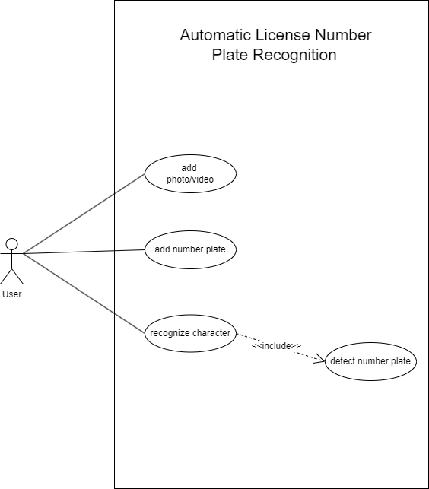
Use Case Diagram

Slide 9
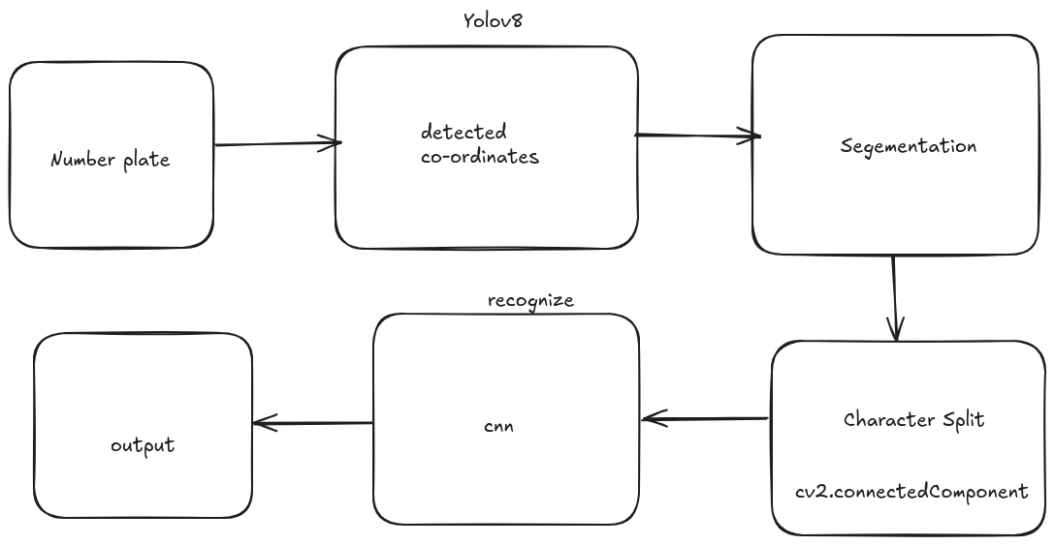
ALNPR Architecture

Slide 10
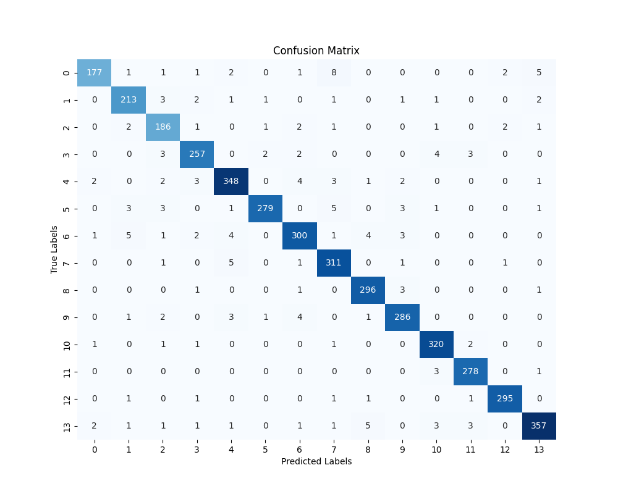
Confusion Matrix

Slide 11
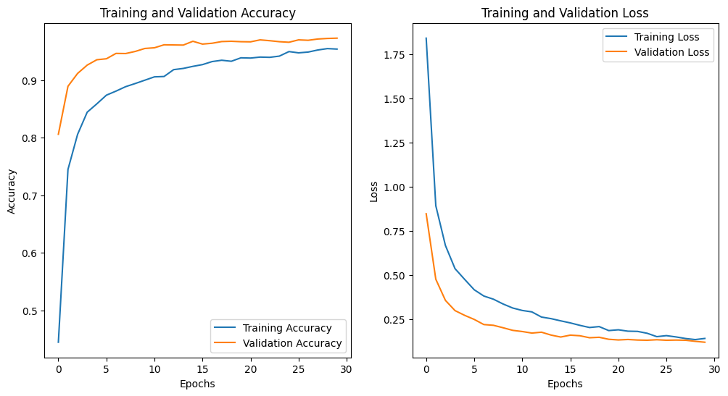
Accuracy and Loss

Slide 12
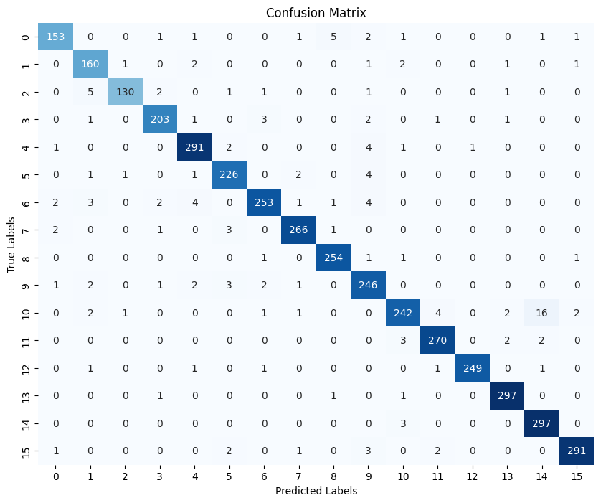
Confusion Matrix with Dropout Layer

Slide 13
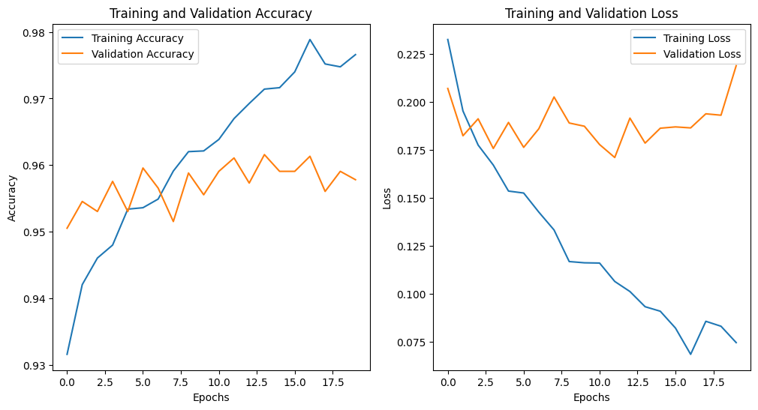
Loss and Accuracy with Dropout Layer

Slide 14
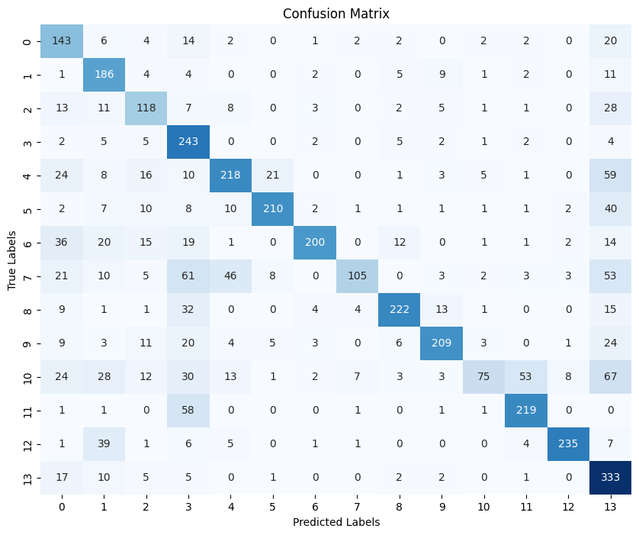
Confusion Matrix with Sgd Optimizer

Slide 15
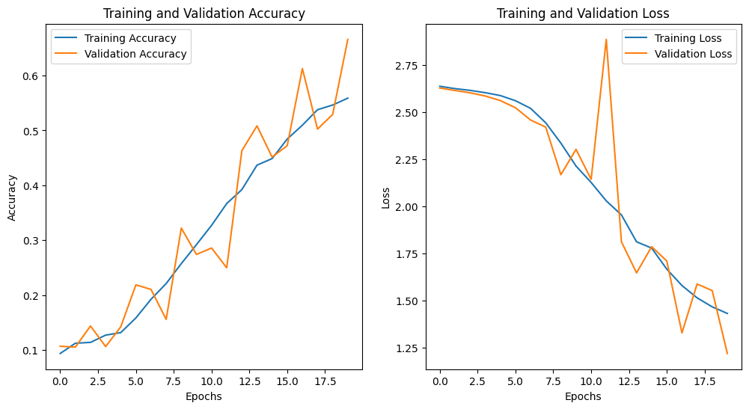
Accuracy and Loss with Sgd Optimizer

Slide 16
Bibliography
S. Shruthi, "Vehicle Tracking using Convolutional Neural Network," World Congress on Engineering, London, 2011.
A. Jain and J. Kundargi, "Automatic Number Plate Recognition Using Artificial Neural Network," International Research Journal of Engineering and Technology (IRJET), vol. 2, 2015.
A. Pant, P. Gyawali, and S. Acharya, "Automatic Number Plate Recognition with Support Vector Machines," Kathmandu.

Slide 17
L. Rayson, L. Zanlorensi, G. Goncalves, E. Todt, W. Schwartz and D. Menotti, "An Efficient and Layout-Independent Automatic License Plate Recognition System Based on the YOLO Detector," Department of Informatics, Federal University of Paran´a, Curitiba, Brazil.
P. R. Dawadi, B. K. Bal, and M. Pokharel, "Devnagari License Plate Detection, Classification and Recognition using Deep Learning," Kathmandu, 2021.

Slide 18
Thank You
Any Queries?

