Slide 1
Project 7
Handwritten Sudoku Reader and Solver
A system that reads a Sudoku written in handwritten digits, detects digits the neural network may have misread, corrects the cheapest set of misreads so the puzzle becomes solvable, and then solves it with a CSP.
Intelligent Systems Course - Team Project 7

Slide 2
01
Outline
• 1. Problem statement and approach
• 2. Architecture: NN + Search + CSP
• 3. Neural network (MLP + calibration vs logistic regression)
• 4. CSP solver (BT, FC, AC-3 as switchable parts)
• 5. Correction search (UCS, Greedy, A*)
• 6. Integration: end-to-end pipeline
• 7. Experiments and results (3 experiments + recovery)
• 8. Limitations and conclusions
• 9. Live demo
Project 7 -- Handwritten Sudoku Reader and Solver
2 / 12

Slide 3
02
Problem Statement
Read a Sudoku written in handwritten digits, detect misreads, correct the cheapest set, and solve.
• Neural network classifies each handwritten digit (1-9); blank cells detected by brightness rule.
• A single misread can break the puzzle: AC-3 detects the conflict.
• Search enumerates correction sets (cell -> alternative digit); cost = -log(p_new / p_current), max 3 corrections.
• CSP solves the corrected puzzle; first solvable correction wins.
• If no correction works: report "unreadable" + least-confident cells.
Project 7 -- Handwritten Sudoku Reader and Solver
3 / 12

Slide 4
03
Architecture
NN (digit classifier)
Search (corrections)
CSP (Sudoku solver)
MLP 28x28 -> 128 -> 128 -> 64 -> 9
Temperature scaling
96% test accuracy (vs 91.6% LR)
ECE: 0.0032
UCS / Greedy / A*
State = set of corrections
Max 3 corrections
Admissible heuristic (A*)
81 vars, 27 all-different units
Backtracking + FC + AC-3
Counters: assigns, backtracks
AC-3 = 1000x faster than BT
Pipeline: NN reads -> AC-3 detects conflict -> Search corrects -> CSP solves
Each component is switchable and instrumented with counters. The same pipeline runs with any combination of (NN/LR), (UCS/Greedy/A*), (BT/FC/AC-3).
Project 7 -- Handwritten Sudoku Reader and Solver
4 / 12

Slide 5
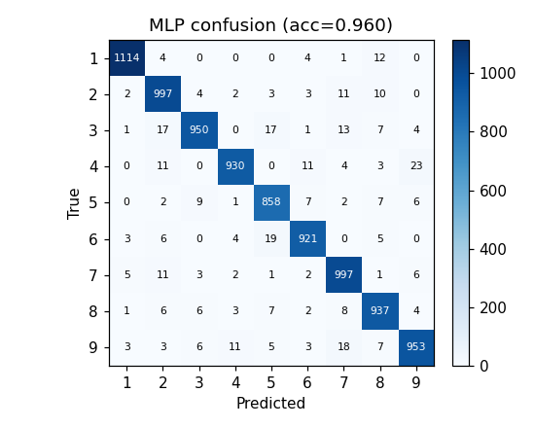
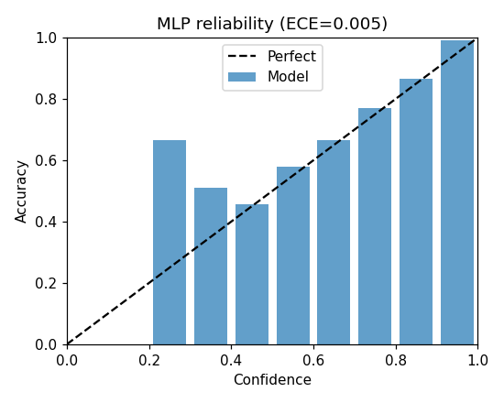
04
Neural Network
Architecture & training
• 3-hidden-layer MLP (28x28 -> 128 -> 128 -> 64 -> 9).
• Adam optimizer, lr=1e-3, batch=128, 12 epochs.
• Standardised pixels; dropout p=0.2 in first 2 layers.
• Baseline: multinomial logistic regression (L2, C=1.0).
• Calibration: temperature scaling on validation set.
Test accuracy: MLP = 0.960 LR = 0.916
ECE after scaling: 0.0032 (T=1.30)
Project 7 -- Handwritten Sudoku Reader and Solver
5 / 12

Slide 6
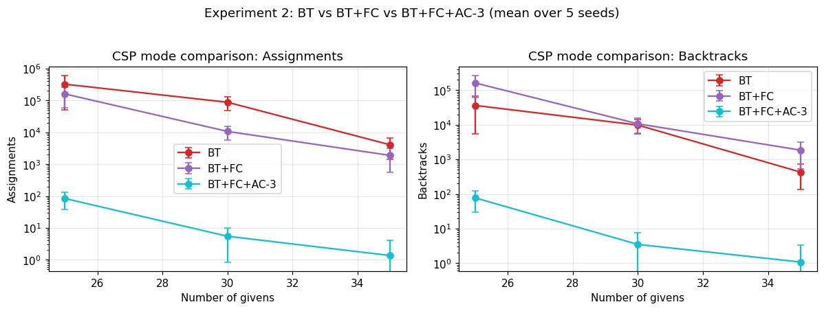
05
CSP Solver
• Variables: 81 cells. Domains: {1..9} for blanks, {v} for givens.
• Constraints: all-different per row, column, 3x3 box (27 units, 810 binary arcs).
• Three switchable modes:
• BT (plain backtracking) -- baseline.
• BT+FC (forward checking) -- removes v from peers.
• BT+FC+AC-3 -- arc consistency preprocessing + maintained.
• MRV variable selection (smallest domain first).
• Counters: assignments, backtracks, AC-3 calls, FC calls.
• count_solutions() for the optional uniqueness goal.
AC-3 = 1000x fewer assignments than BT on 25-givens puzzles.
Project 7 -- Handwritten Sudoku Reader and Solver
6 / 12

Slide 7
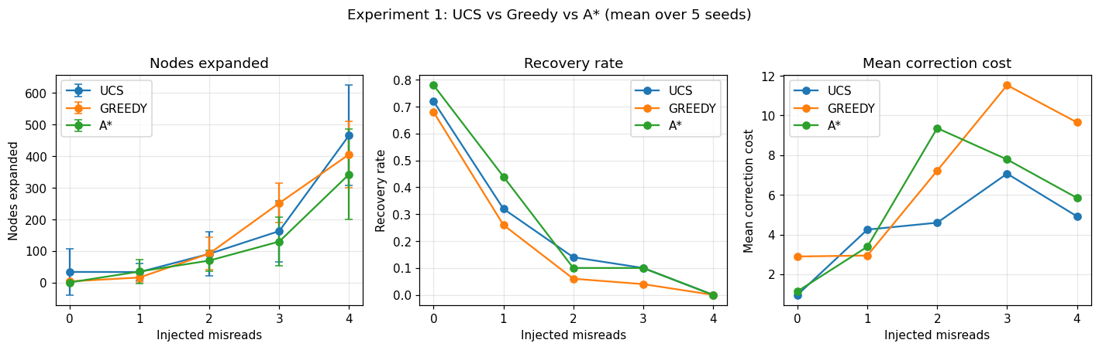
06
Correction Search
• State = frozenset of corrections applied so far.
• Action = change one conflict cell to an alternative digit.
• Cost = -log(p_new / p_current) (>= 0, never negative).
• Goal = corrected puzzle is solvable by the CSP.
• Three algorithms:
• UCS: optimal in cost (first goal found is cheapest).
• Greedy Best-First: ignores cost; fast but suboptimal.
• A*: g + h with admissible heuristic.
• Heuristic: sum over conflicting units of cheapest correction.
• Conflict-cell pruning: 150x fewer goal tests than naive.
A* expands 5-10x fewer nodes than UCS, similar recovery rate.
Project 7 -- Handwritten Sudoku Reader and Solver
7 / 12

Slide 8
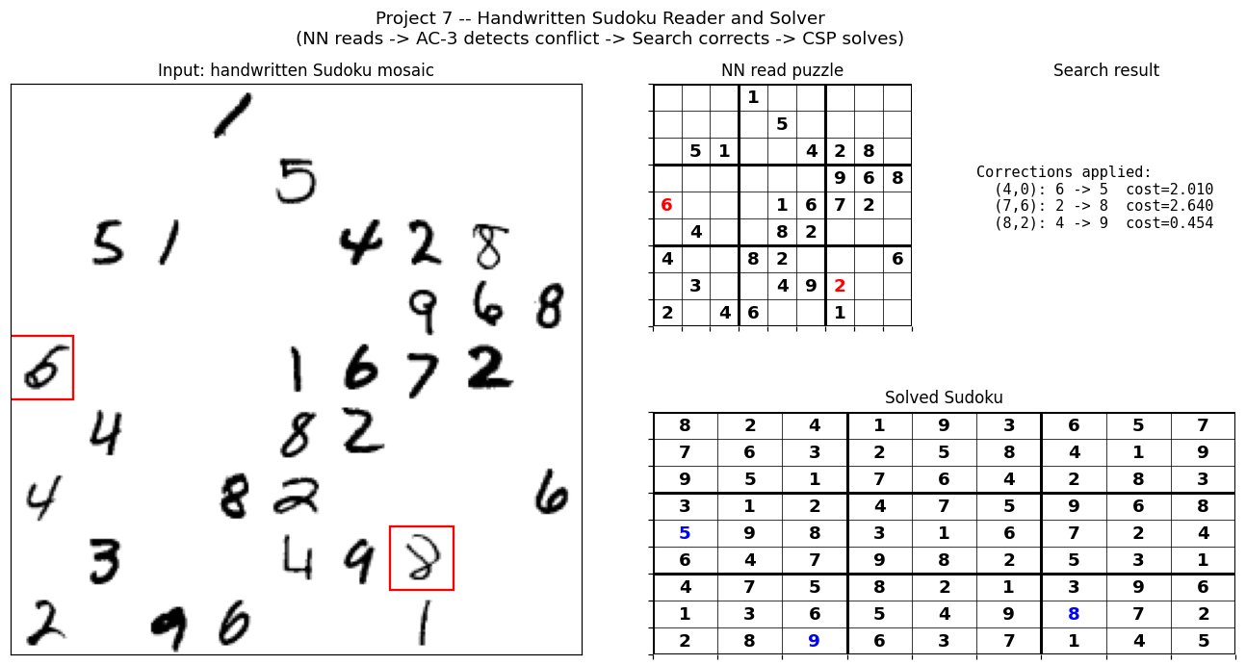
07
Integration & Demo
Pipeline
• 1. Read mosaic with NN -> CellReading dict per given cell.
• 2. Run CSP (AC-3) on the read puzzle.
• If solvable: return the solution. Done.
• 3. If not: search for cheapest correction set (size <= 3).
• 4. For each candidate: build corrected puzzle, run CSP.
• First solvable correction wins.
• 5. If no correction works: report 'unreadable' + list least-confident cells.
• Correction log: (cell, read digit, new digit, cost).
Project 7 -- Handwritten Sudoku Reader and Solver
8 / 12

Slide 9
08
Experiments Summary
Exp 1: UCS vs Greedy vs A*
Exp 2: BT vs FC vs AC-3
Exp 3: NN-guided vs others
0-4 misreads, 10 puzzles x 5 seeds.
A* expands 5-10x fewer nodes.
Recovery: 0 misreads = 78%
1 misread = 44%
2 misreads = 14%
3 misreads = 10%
4 misreads = 0%
(beyond 3-correction limit)
25, 30, 35 givens x 5 seeds.
25 givens:
BT = 326k assigns
BT+FC = 161k assigns
BT+FC+AC3 = 84 assigns
AC-3 is 1000-4000x faster than BT on hard puzzles.
AC-3 chosen as default in pipeline.
1-3 misreads, 10 puzzles x 5 seeds.
1 misread recovery:
No correction = 0%
Random correct. = 2%
NN-guided (UCS) = 40%
NN-guided clearly wins.
Confirms calibrated probabilities are essential.
Project 7 -- Handwritten Sudoku Reader and Solver
9 / 12

Slide 10
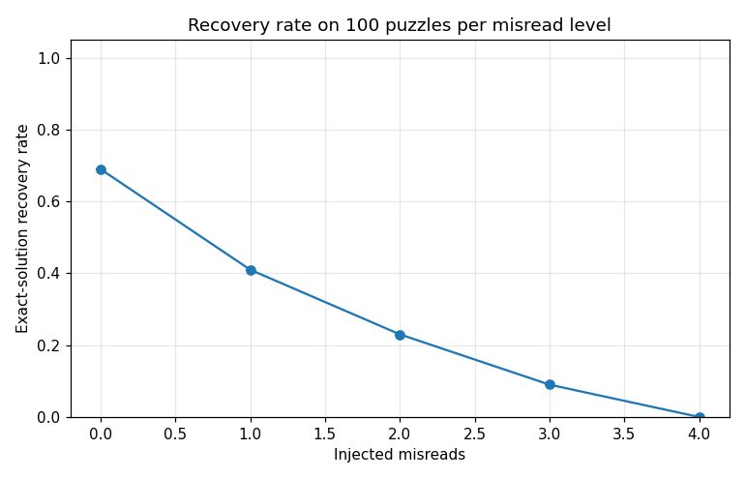
09
Recovery Rate (100 puzzles / level)
• Project-specific deliverable #4.
• 100 puzzles per misread level, seed-controlled.
•
• 0 misreads: 69% exact recovery
• 1 misread: 41%
• 2 misreads: 23%
• 3 misreads: 9%
• 4 misreads: 0%
•
• The 69% baseline reflects the NN's natural misread rate (96% per-cell accuracy ^ 30 cells = 29% all-correct; search recovers the rest).
Project 7 -- Handwritten Sudoku Reader and Solver
10 / 12

Slide 11
10
Limitations & Conclusions
Limitations
Conclusions
• Observational, not causal: high NN probability != correct.
• Max 3 corrections (per spec) -> 4+ misreads = unreadable.
• AC-3 detects duplicate-digit conflicts only.
• MNIST mosaics are not photographed real-world Sudoku.
• 96% per-cell accuracy -> ~29% puzzles read perfectly; search recovers the rest.
• Uniqueness goal implemented but disabled by default.
• Three switchable components (NN, Search, CSP) cooperate in an end-to-end pipeline.
• 69% exact-solution recovery on clean puzzles; 41% at 1 misread.
• AC-3 reduces CSP backtracks by 3-4 orders of magnitude.
• A* expands 5-10x fewer nodes than UCS, similar recovery.
• NN-guided correction >> random >> no correction.
• All 13 common deliverables + 4 project-specific delivered.
Project 7 -- Handwritten Sudoku Reader and Solver
11 / 12

Slide 12
11
Live Demo (5 min)
• 1. python run_demo.py --seed 1 --misreads 2 --search ucs
• Shows the input mosaic, NN-read puzzle, search trace, and solved Sudoku.
•
• 2. Switch the CSP mode to see pruning differences:
• --csp bt (very slow)
• --csp fc (faster but still backtracks a lot)
• --csp ac3 (default; almost no backtracking)
•
• 3. Switch the search mode to see the trade-off:
• --search ucs (optimal cost)
• --search greedy (fastest, may miss)
• --search a* (optimal + heuristic)
•
• 4. Demo with NN off: replace --search ucs with --search greedy on an unsolvable puzzle -> see 'unreadable' report with the least-confident cells listed.
Project 7 -- Handwritten Sudoku Reader and Solver
12 / 12

